Slide 1
Personality
Anoosha Rehan, Lecturer, FAST NUCES CFD

Slide 2
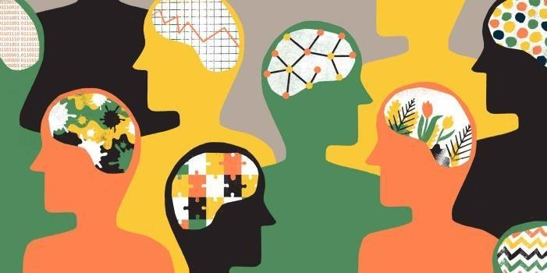
Definition of Personality
A person’s pattern of thinking, feeling and acting.
Personality refers to the characteristic patterns of thinking, feeling, and behaving (Cacioppo & Freberg, 2013).
An individual’s unique and relatively stable patterns of behaviors, thoughts, and feelings (Baron & Misra, 2014).

Slide 3
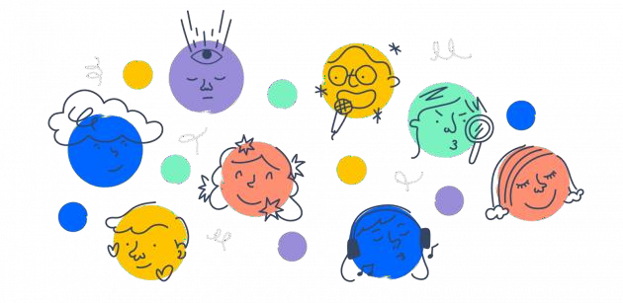
Definition of Personality
Personality is the pattern of enduring characteristics that produce consistency and individuality in a given person. Personality encompasses the behaviors that make each of us unique and that differentiate us from others. Personality also leads us to act consistently in different situations and over extended periods of time.

Slide 4
Types of Personalities
Type A
Type B
Ambitious
Easily angered
Stress prone
Highly competitive
Workaholics
Feel time pressure
More prone to heart disease & hypertension
Health neglect
Relaxed
Calm and composed
Less stressed
Easygoing
Don’t face much health problems
Single-tasking
Time flexibility
Patient
Health conscious

Slide 5
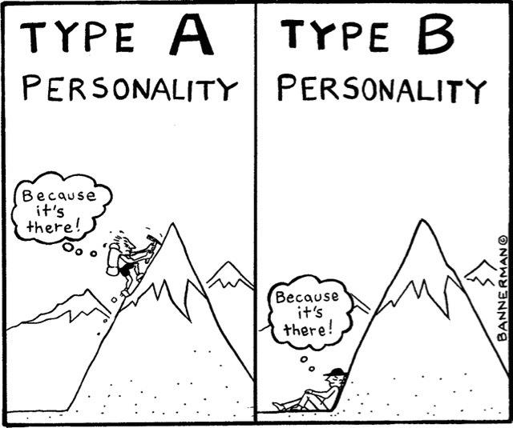
Types of Personalities
Type A
Type B
Work hard
Play hard to win
Impatient (get destructive)
Dominating
As hardworking as type A but they don’t mind losing
Play for entertainment
Flexible (get productive)
Emotional & Expressive

Slide 6
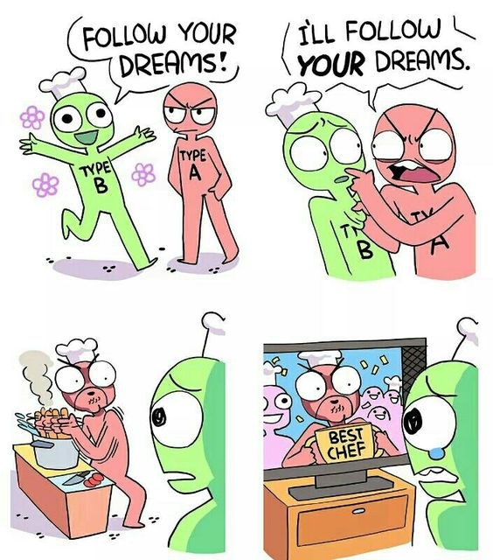

Slide 7
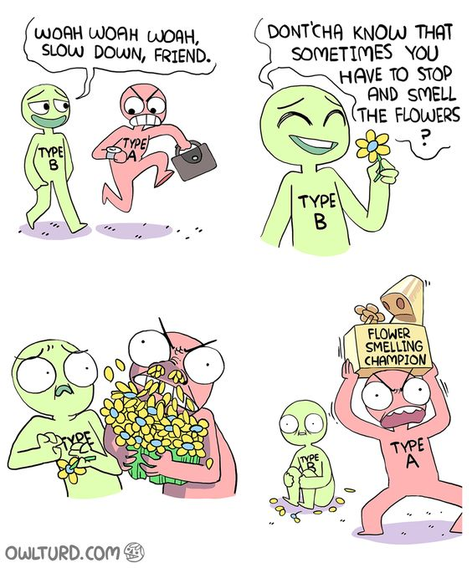

Slide 8
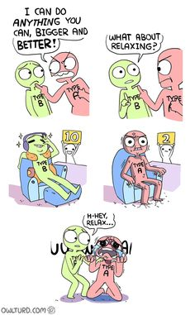

Slide 9
Would you rather:
a) Finish all your tasks perfectly, even if it means staying up late,
OR
b) Get a good night's sleep and risk not finishing everything but feeling well-rested for the next day?

Slide 10
Would you rather:
a) Lead a team project, taking charge and making decisions,
OR
b) Work collaboratively on a team, contributing your ideas but letting others lead?

Slide 11
Would you rather:
a) Have a highly structured daily routine with planned activities,
OR
b) Have a flexible schedule, adapting to spontaneous plans and opportunities?

Slide 12
Would you rather:
a) Win a competition, even if it means intense preparation and sacrifice,
OR
b) Enjoy the experience of participating in the competition, regardless of the outcome?

Slide 13
Would you rather:
a) Multitask and juggle multiple responsibilities simultaneously, aiming to accomplish as much as possible in a short amount of time,
OR
b) Focus on completing one task at a time, giving each task your full attention and concentration, even if it means taking longer to finish?

Slide 14
Assessment of Personality
Personality assessment involves the techniques for systematically gathering information about a person in order to understand and predict behavior.
Goal of personality assessment is to obtain reliable, valid measures of individual differences that will permit the accurate prediction of behavior.
There are main 2 types of tests to assess personality:
Projective Tests
Non-Projective Tests

Slide 15
Assessment of Personality
Projective Test
A projective personality test is where the subject is given an ambiguous stimulus and is asked to respond spontaneously.
Stimulus consists of words, pictures or inkblots with no clear answer. The test-takers are asked to respond with their thoughts, feelings, or interpretations.
These responses are believed to reveal unconscious aspects of the individual's personality.
The responses in projective tests are open-ended and can vary widely among individuals.

Slide 16
Assessment of Personality
The ambiguous stimulus allows test takers to project their own needs, dreams, feelings into their response. The observer’s responses to the stimulus are then used to infer information about the observer’s personality.
All projective tests are based on the projective hypothesis which states that the individual's response to an ambiguous stimulus represents a projection of his or her own inner, often unconscious, feelings and needs.

Slide 17
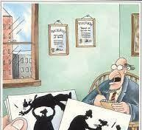
Assessment of Personality
Projective tests are the indirect method of personality assessment based on psychoanalytic assumptions:
Personality is mostly unconscious.
People are unaware of contents of unconscious.

Slide 18
Assessment of Personality
The 2 most frequently used projective tests are:
Rorschach Inkblot Test
Thematic Apperception Test (TAT)
Rorschach Inkblot Test:
The most widely used projective test.
A set of ten inkblots designed to identify people’s feelings when they are asked to interpret what they see in the inkblots.
In this test, Reactions to inkblots are employed to classify personality types.

Slide 19
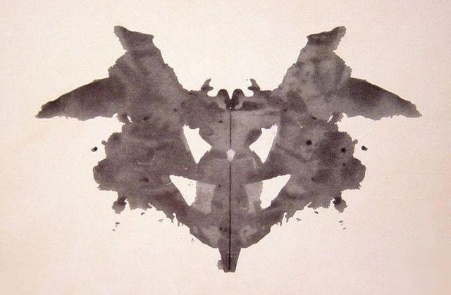
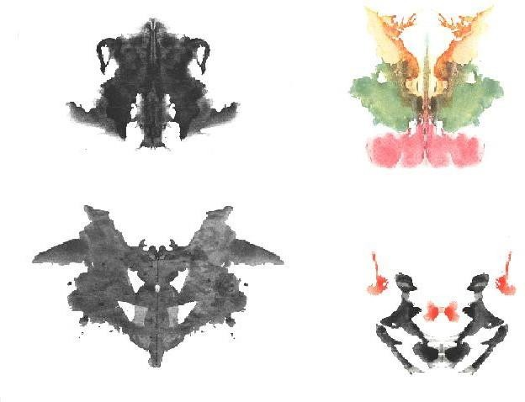
Assessment of Personality

Slide 20
Assessment of Personality
Thematic Apperception Test (TAT):
Stories about ambiguous pictures are used to draw inferences about the storyteller’s personality.
Giving the subject a picture that is ambiguous (can have several meanings) and ask them what is occurring.

Slide 21
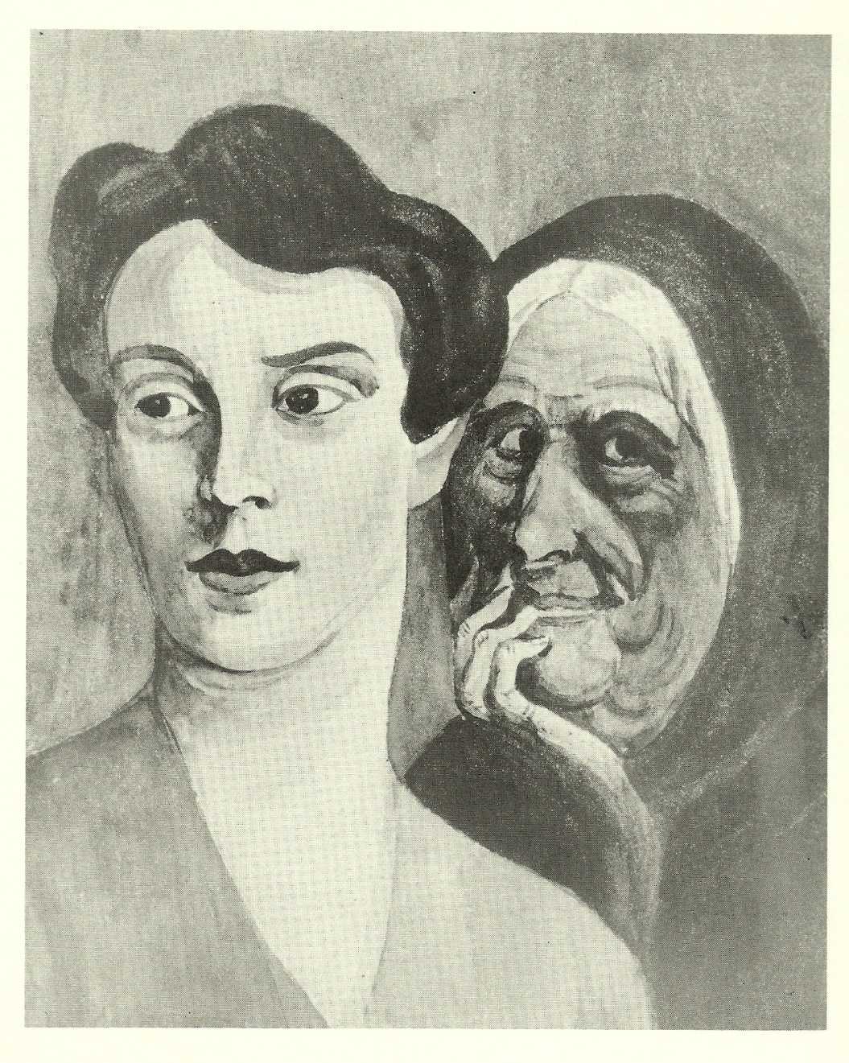
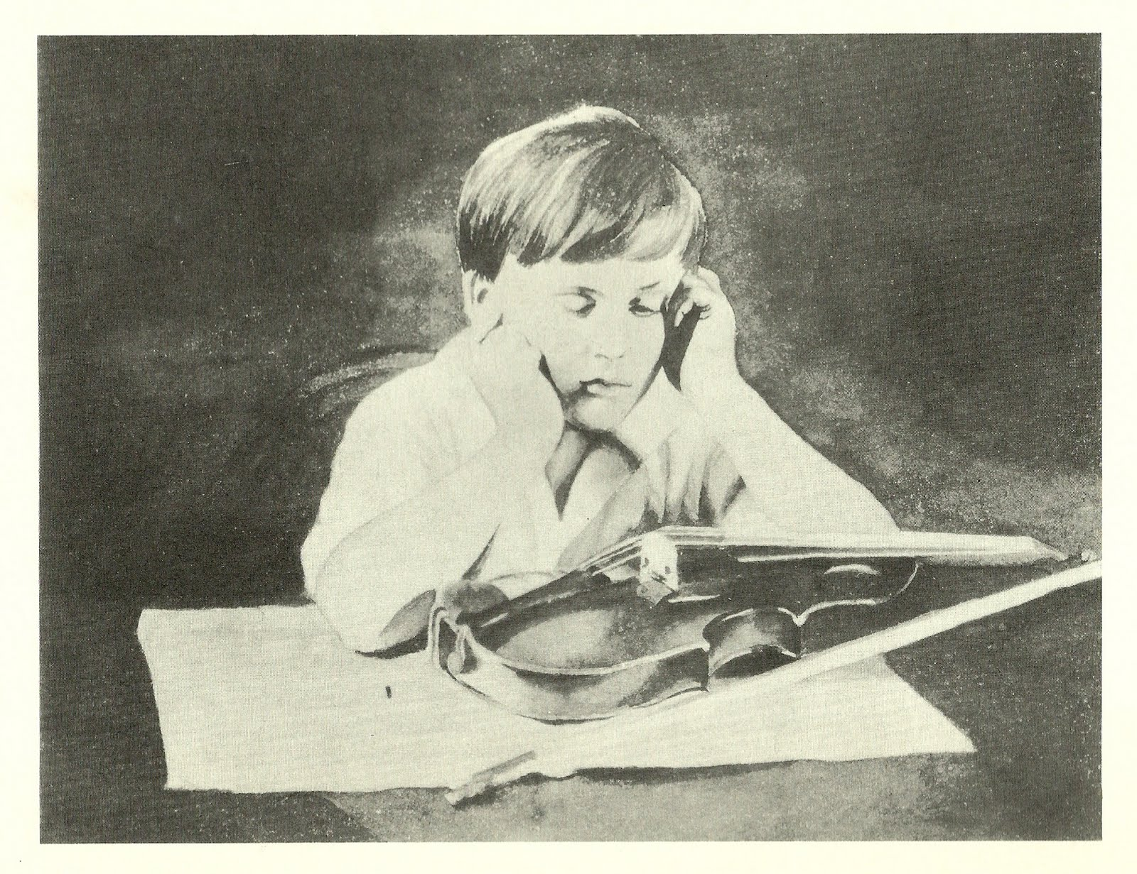
Assessment of Personality

Slide 22
Assessment of Personality
Non-Projective Test
A non-projective personality test also known as objective personality test, presents the test taker with a number of specific items to which he/she is asked to respond, either on paper or on a computer screen.
Non-projective tests present clear, structured questions or statements with specific response options.
These tests aim to measure specific personality traits, behaviors, diagnose psychological disorders, or measure traits like intelligence, aptitude, or vocational interests.
The responses in non-projective tests are typically selected from predefined options (e.g., multiple-choice, Likert scale). They provide quantifiable data and are less open to interpretation.

Slide 23
Assessment of Personality
The 2 most frequently used non-projective tests are:
Self-report Inventories (self-report questionnaires)
Interview
i. Self-report Inventories:
These measures ask people about a sample range of their behaviors.
These reports are used to infer the presence of particular personality characteristics.

Slide 24
Assessment of Personality
Examples of objective personality tests are:
MMPI (Minnesota Multiphasic Personality Inventory)
16 PF (the Sixteen Personality Factor Questionnaire)
MMPI:
The most commonly used self-report measure is the Minnesota Multiphasic Personality Inventory (MMPI-2), designed to differentiate people with specific sorts of psychological difficulties from normal individuals.

Slide 25
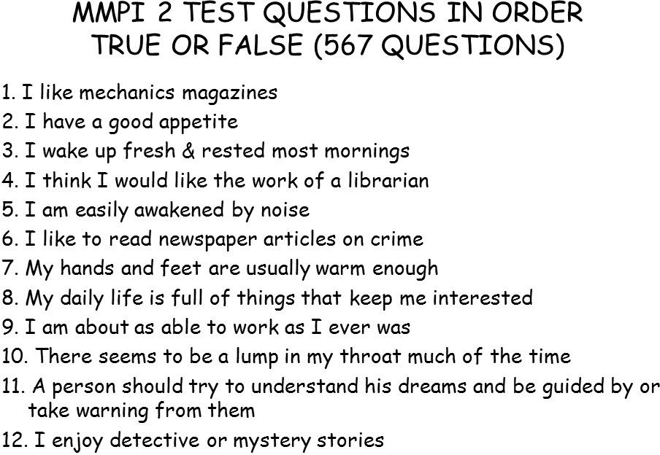
Assessment of Personality

Slide 26
Assessment of Personality
ii. Interview:
This measure asks the person about his/herself. Information that reveals personality. It obtains information that reveals personality.
Examples of interviews are:
Face-face Interview,
Online Interview,
Telephonic Interview

Slide 27
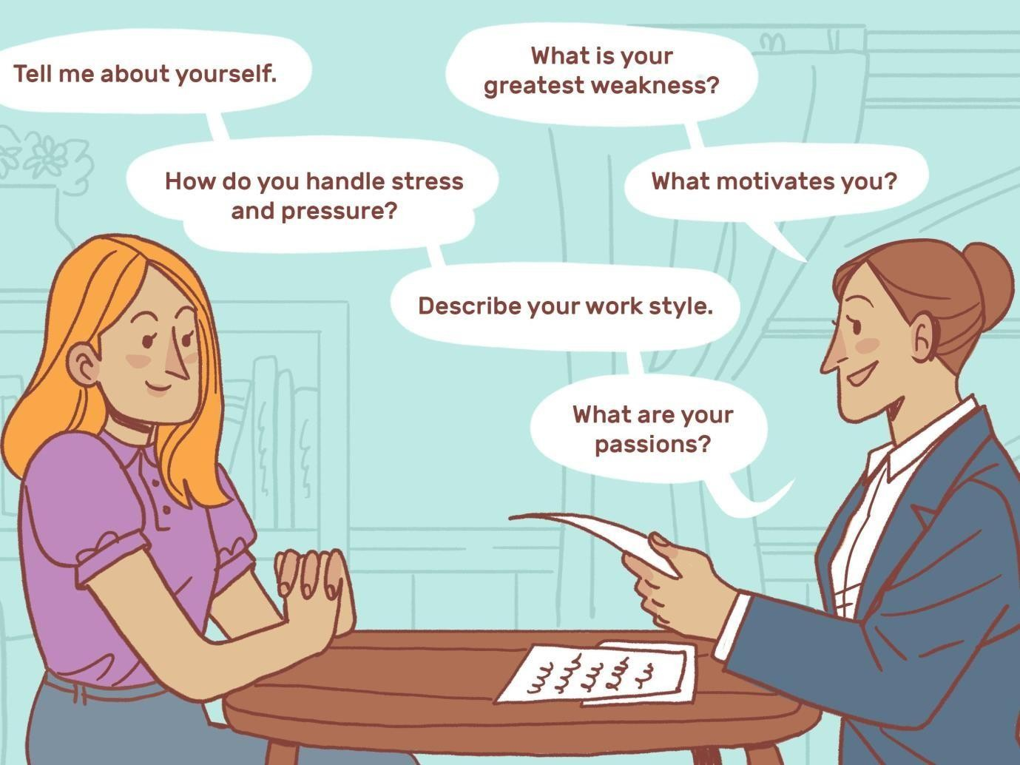

Slide 28
Thank you!

