Slide 1
Taming the Garbage Collector – how the worst enemy of the programmers change into the best friend
Beata Zalewa

Slide 2


ABOUT
In professional life Microsoft Certified Trainer, administrator, developer, freelancer, sometimes a miracle-worker and magician.
From the beginning of career associated with Microsoft technologies.
Private life in numbers: 1 husband, 1 daughter, 1 cat and 2 dogs. My hobbies are detective stories and photography.
Email: info@zalnet.pl (INFO@ZALNET.PL)
Skype: beata.zalewa
Facebook: https://web.facebook.com/beata.zalewa

Slide 3
AGENDA
Managed and unmanaged resources vs Garbage Collector
Garbage Collection
.NET Memory Management
BenchmarkDotNet package
Working with LINQ
MemoryDiagnoser
Memory Leaks
Roslyn-based heap allocation analyzer

Slide 4
STEP I
Managed and unmanaged resources vs Garbage Collector

Slide 5
MANAGED RESOURCES
Managed Resources are those that are pure .NET code.
They are managed by the runtime and are under its direct control. e.g. int, long, double, string, struct or class.
While programming in the managed environment, you allocate memory on the managed heap using the new operator:
var obj = new ClassName();
When your work is done, then the garbage collector (GC) reclaims that memory.

Slide 6
UNMANAGED RESOURCES
Unmanaged Resources are those that are not under direct control of runtime:
- Database Connections
File
File streams
- COM objects
- etc.

Slide 7
GARBAGE COLLECTOR
Garbage Collector is responsible for freeing memory which is no longer required.
GC knows only about Managed Resources.
At some undeterministic point in time, the GC will come along and clean up all the memory and resources associated with a managed object.

Slide 8
WHO’LL TAKE CARE OF UNMANAGED RESOURCES??
Finalizer and IDisposable
If your class wraps any unmanaged resource, then you should have a Finalizer and implement IDisposable.
IDisposable interface has a method Dispose(), used to clean unmanaged resources explicitly (you explicitly call this method for cleaning).
Finalizer is also used to clean all unmanaged resources, but not explicitly, so you write the code of cleaning but you do not explicitly call this method. It will be called by GC.
Finalizer is basically a safegaurd if you forget to do cleaning explicitly via IDisposable.
Since both IDisposable and Finalizer serve the same purpose of cleaning unmanaged resources, better we keep core cleaning logic in a single place.

Slide 9
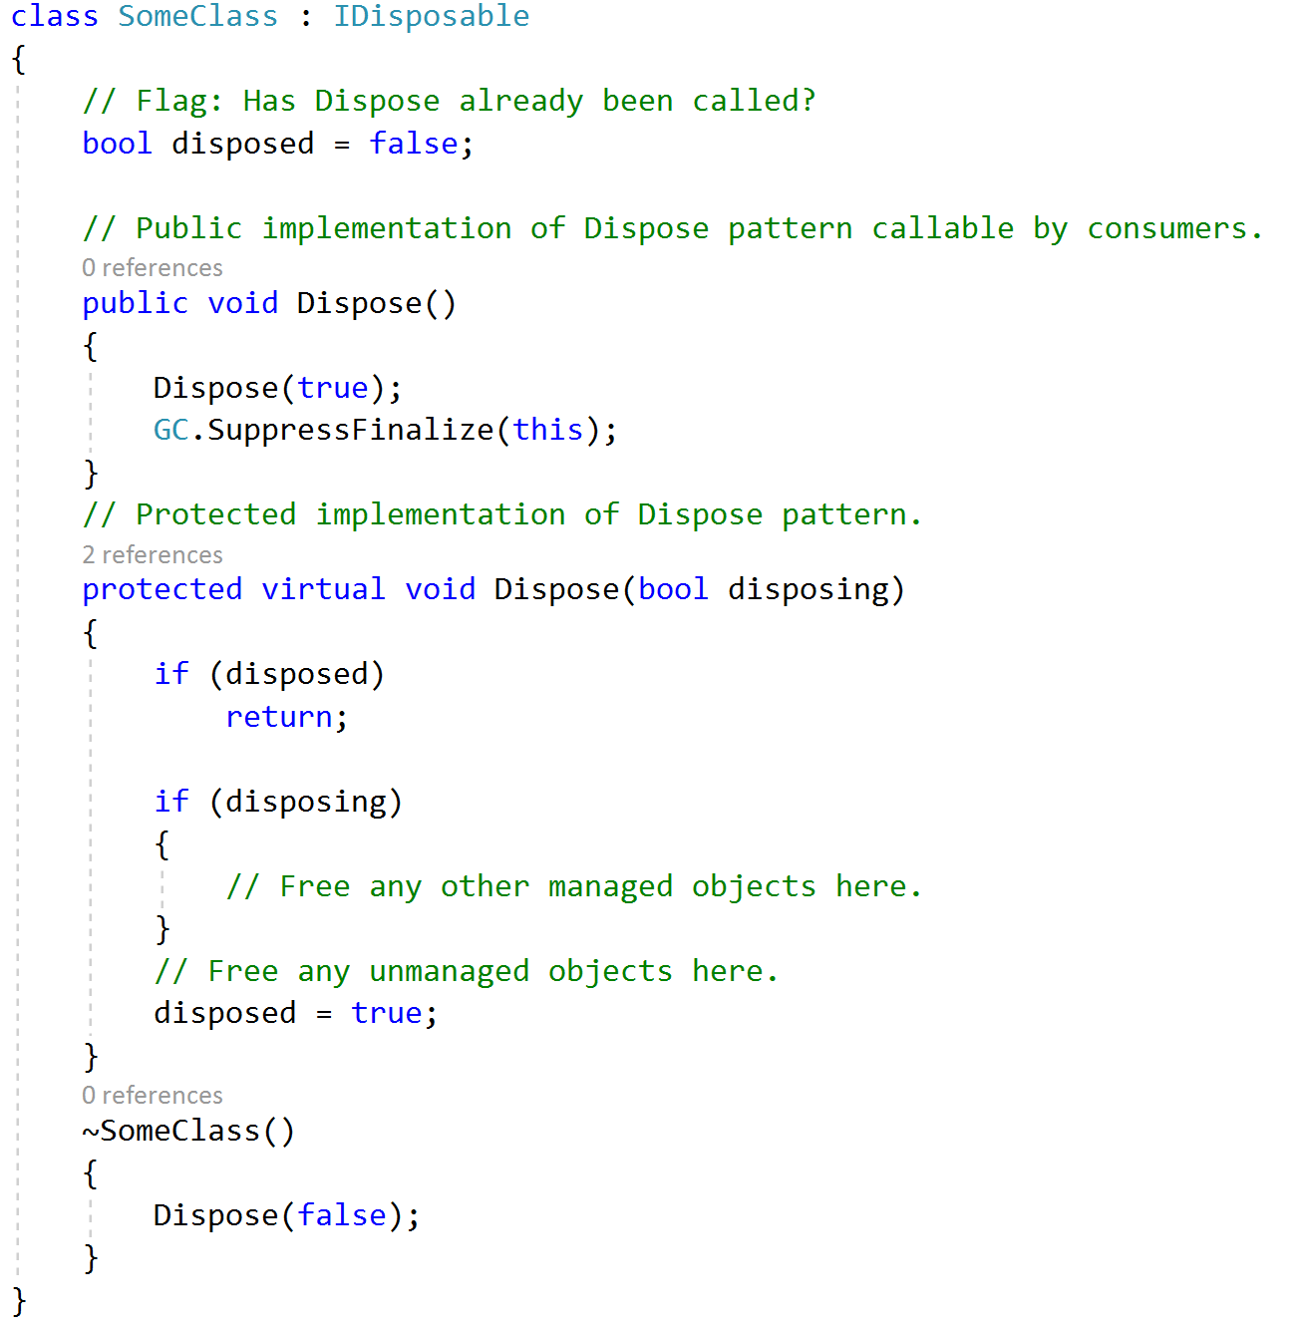
IDISPOSABLE INTERFACE

Slide 10
DEMO
Garbage Collection Demo

Slide 11
STEP II
Garbage Collection

Slide 12
HOW GARBAGE COLLECTOR WORKS?
The purpose of the garbage collector is to discover objects on the managed heap that are no longer reachable and to reclaim the memory occupied by these objects.
Once an object is discovered to be no longer reachable, the garbage collector checks to see if the object has a finalizer.
If the object doesn’t have a finalizer, it is marked for collection and its memory is reclaimed by the garbage collector.

Slide 13
HOW GARBAGE COLLECTOR WORKS?
If an object has a finalizer, it will not be marked for garbage collection, but instead be marked for finalization.
It will not get garbage collected during the current pass of the garbage collector.
Instead, its finalizer will be run at some point after garbage collection finishes. It will then be eligible for collection during the next pass of the garbage collector.
Reclaiming memory for objects with finalizers therefore requires at least two passes of the garbage collector.

Slide 14
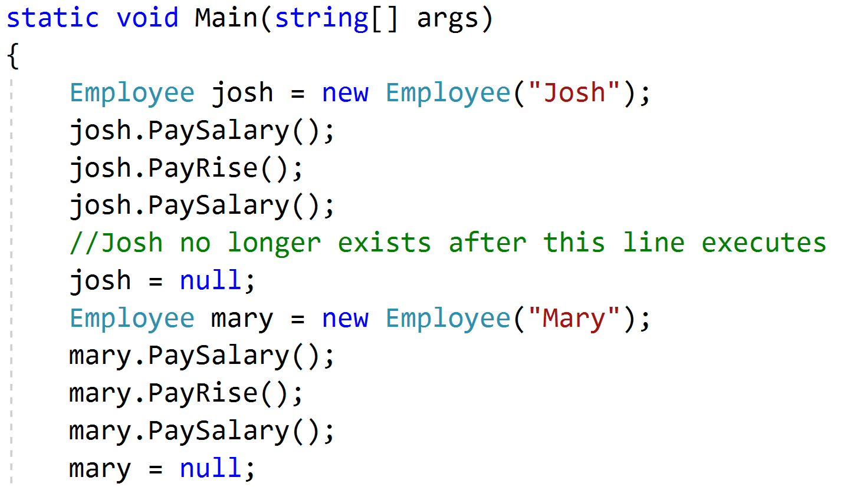
OBJECTS WITH FINALIZERS
In general an object can be garbage collected when it is no longer referenced by any other object or reference-typed variable.
For example, the object named „Josh” is no longer referenced in the code below when the josh variable is set to null.

Slide 15
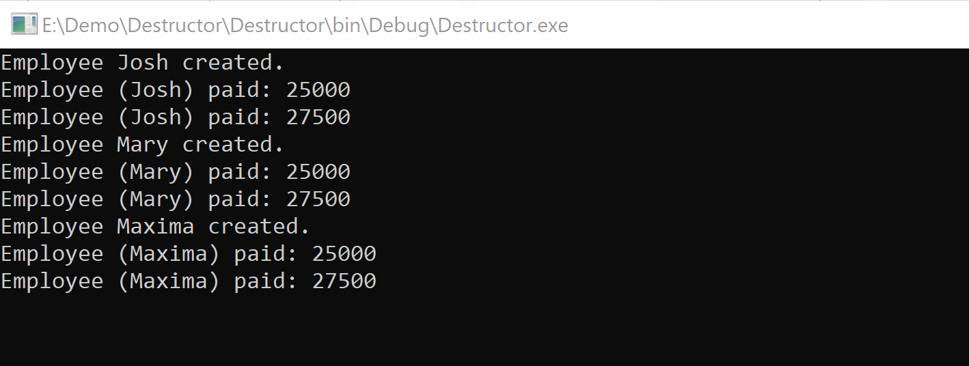
OBJECTS WITH FINALIZERS
In practice, the situation can be different:

Slide 16
DEMO
Destructor

Slide 17
GENERATIONS
Referenced-typed objects in an application have different lifetimes.
The application will use some objects as long as the application is running. Others are referenced only during execution of a single method.
If the garbage collector always examined every object whenever it did a garbage collection pass, it would spend a lot of time reexamining longer-living objects that can’t yet be garbage collected.
The garbage collector can perform more efficiently by looking at only a subset of all objects during each pass. It does this by grouping objects into generations.

Slide 18
GENERATIONS
Generations:
Generation 0 – Objects that have been created since the last GC pass (newest objects)
Generation 1 – Objects that have survived one pass of the GC
Generation 2 – All other objects (oldest objects)
The garbage collector examines and collect objects in generation 0, moving to higher generations only if it needs additional memory.
Objects are promoted to the next generation only if a GC pass is done on the generation in which they are located.

Slide 19
GENERATIONS
When the garbage collector performs a GC pass, it looks only at objects in generation 0, releasing memory for any that are no longer reachable.
In this way, the garbage collector is more efficient, because it is only looking at a portion of the managed heap.
If the garbage collector has collected Gen 0, but the application requires more memory, the garbage collector can then garbage collect generation 1.
If the application still requires memory after collecting generation 1, it can move on to generation 2.
This scheme relies on the fact that if an object survives one GC pass, it likely has a longer lifetime and will survive future passes.

Slide 20
GENERATIONS
Objects are only promoted to the next generation if the generation that they are currently located in is examined and collected during a garbage collection pass.
This means:
Since the GC always examines Gen 0 during any GC pass, Gen 0 objects that survive a garbage collection are always promoted to Gen 1.
Objects in Gen 1 are only promoted to Gen 2 if Gen 1 is examined and collected during a GC pass and the object survives.
The GC will very often do only a Gen 0 pass during collection.
When the GC only examines and collects Gen 0, Gen 1 objects are not examined and therefore not promoted to Gen 2.

Slide 21
LARGE OBJECTS ARE ALLOCATED ON THE LARGE OBJECT HEAP
The managed heap is the area in memory where reference-typed objects are allocated.
When you create a new object, a portion of the managed heap is allocated for the object.
In reality, objects are stored on either the Small Object Heap (SOH) or the Large Object Heap (LOH).
Objects that are larger than 85,000 bytes are allocated on the LOH. All other objects are allocated on the SOH.
This improves the performance of the garbage collector (GC), since it typically collects objects in Generation 0 (newest), only moving to older generations if necessary.

Slide 22
LARGE OBJECTS ARE ALLOCATED ON THE LARGE OBJECT HEAP
Other differences between the two heaps:
The SOH is generational–objects belong to generation 0, 1 or 2.
The LOH is not sub-divided into generations.
After the LOH is garbage collected, the heap is not compacted. This results in the memory becoming fragmented and requires maintaining a linked list of free blocks. (The SOH is compacted after every collection).
Allocation on the LOH can be slower than the SOH, due to the fragmentation.

Slide 23
FORCING A GARBAGE COLLECTION
The garbage collector (GC) normally runs automatically, doing a garbage collection pass when necessary (when there is memory pressure and you are allocating memory for some new object).
You typically just let the garbage collector run automatically, never explicitly asking it to do garbage collection.
For testing purposes, however, you might want to force garbage collection to happen at a particular time. You can do this by calling the GC.Collect method.
Calling Collect will force a collection across all generations. You can also specify the highest generation to collect as follows:
GC.Collect() – Collect generations 0, 1, 2
GC.Collect(0) – Collect generation 0 only
GC.Collect(1) – Collect generations 0, 1

Slide 24
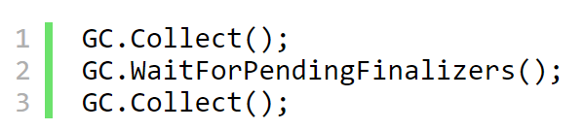
FORCING A GARBAGE COLLECTION
Objects with finalizers will not be collected when you call Collect, but rather placed on the finalization queue.
If you want to also release memory for these objects, you need to wait until their finalizers are called and then do another garbage collection pass.

Slide 25
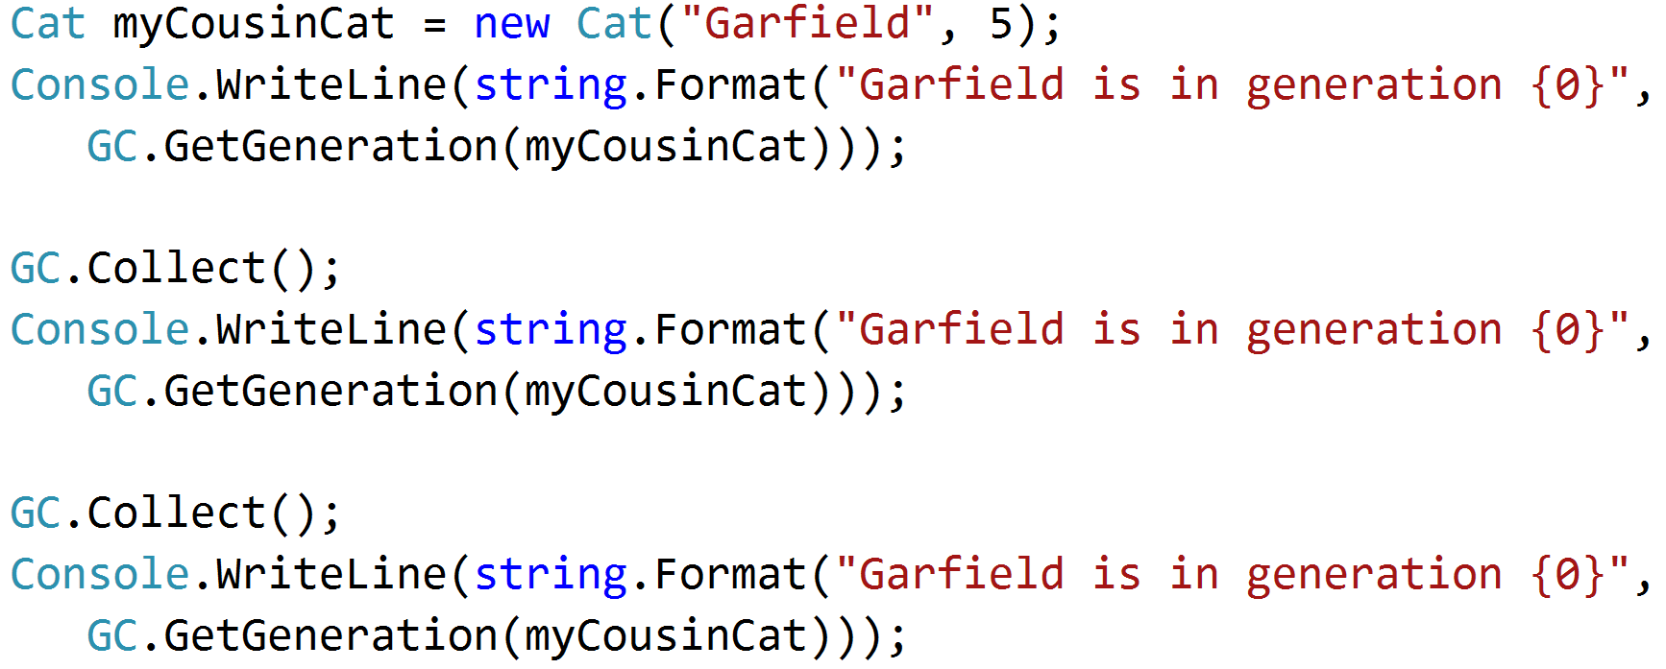
FORCING A GARBAGE COLLECTION
The garbage collector (GC) groups objects into generations to avoid having to examine and collect all objects in memory whenever a garbage collection is done.
For debugging purposes, it’s sometimes useful to know which generation an object currently belongs to. You can get this information using the GC.GetGeneration method.

Slide 26
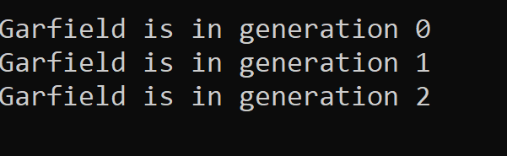
FORCING A GARBAGE COLLECTION
In the example above, the “Garfield” Cat object starts out in generation 0.
After we do the first garbage collection, it’s promoted to generation 1 and after the 2nd collection, it’s promoted to generation 2.

Slide 27
FINALIZERS ARE CALLED WHEN AN APPLICATION SHUTS DOWN
A finalizer is an override of the System.Object.Finalize method that you implement using the destructor syntax.
The finalizer is called automatically by the garbage collector, before it releases memory for the object.
Finalizers are also called when an application shuts down.
Before the application shuts down, the finalizers of any objects that still exist on the managed heap are called.
This is only true if the application shuts down in a controlled manner. If the application crashes, the finalizers will not be called.

Slide 28
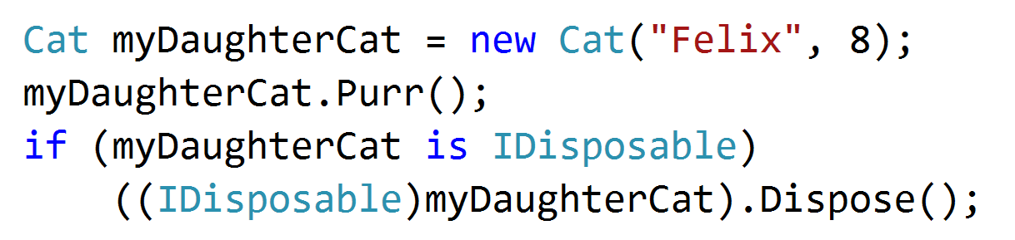
CHECKING TO SEE IF OBJECTS ARE DISPOSABLE
If a type implements the IDisposable interface, you should always call the Dispose method on an instance of the class when you are done using it. The presence of IDisposable indicates that the class has some resources that can be released prior to garbage collection.
One pattern for checking if an object implements the IDisposable interface.

Slide 29
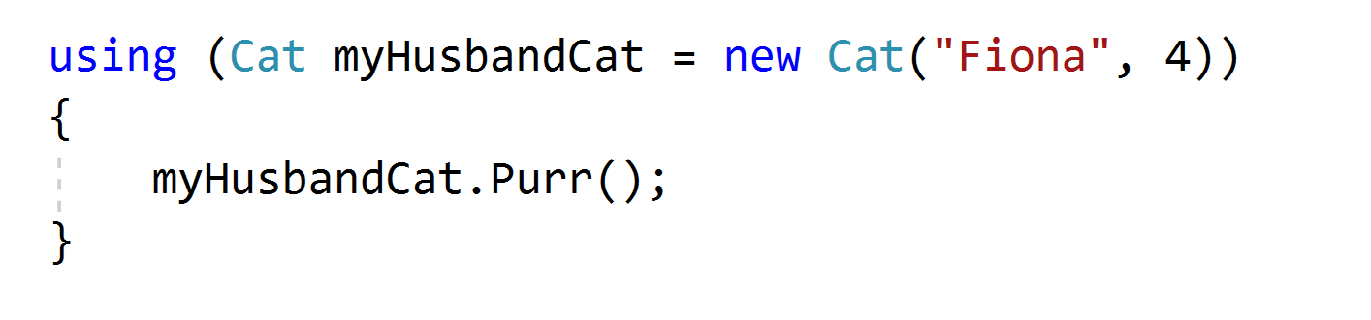
CHECKING TO SEE IF OBJECTS ARE DISPOSABLE
You can also use the using statement to automatically call Dispose on an object when you’re done using it.
In this case class must implement IDisposable interface.

Slide 30
DEMO
Cats Demo

Slide 31
STEP III
.NET Memory Management

Slide 32
BASIC LEVEL OF MEMORY MANAGEMENT
To perform efficient memory manipulation in performance critical system, we need to have a good understanding of memory management.

Slide 33
NET MEMORY PERFORMANCE COUNTERS UPDATED WHEN GARBAGE COLLECTOR RUNS
The .NET CLR Memory performance counters can be used to track memory usage for CLR-based (.NET) applications.
The counters, however, are only updated when the garbage collector runs. This means that if you’re watching one of the counters, you won’t necessarily see it update immediately after your application allocates some memory.
If you are doing some debugging or profiling related to memory management, you can force garbage collection at the point where you want to measure memory usage.
You do this using the GC.Collect method. GC.Collect should not typically be called explicitly in production code.

Slide 34
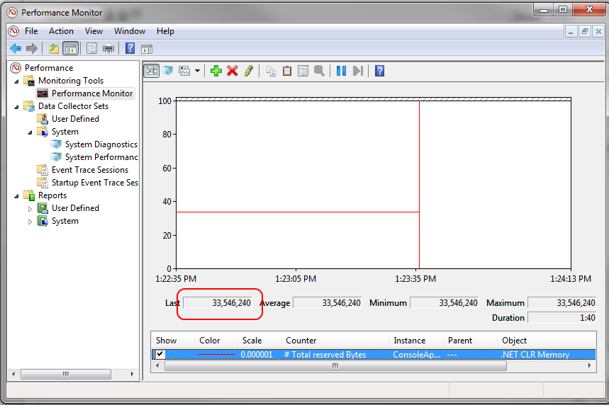
LOOKING AT .NET MEMORY USAGE USING PERFORMANCE COUNTERS
Provide numeric performance information about the system
Located in different areas in the system – disk, .NET, networking, OS objects
Available on-demand using built-in tools like perfmon and typeperf
You can write your own

Slide 35
LOOKING AT .NET MEMORY USAGE USING PERFORMANCE COUNTERS
As you create new objects in .NET, the garbage collector allocates memory for the objects on the heap. As memory is allocated, the process consumes some of its available virtual memory. (In practice, a 32-bit process can allocate at most around 1.5GB of its 2GB maximum).
You can keep track of (roughly) how much memory on the managed heap that your application has allocated by using performance counters.

Slide 36
EVENT TRACING FOR WINDOWS
High-speed logging framework supporting more than 100K structured messages per second
▸ .NET, drivers, services, third party components
▸ Can be turned on on-demand while running
▸ Very small overhead

Slide 37
LOOKING AT .NET MEMORY USAGE USING PERFORMANCE COUNTERS
To track memory usage:
Start Performance Monitor.
Start your application.
Click the “+” icon to add a counter.
Expand the .NET CLR Memory section.
Select the # Total Reserved Bytes counter and select your application.
Click the Add button and then click OK.
You’ll now see a graph indicating total number of bytes of memory that your application has reserved. The Last field will show you the most recent value.

Slide 38
DEMO
Get TotalMemory indicates how much memory you’ve allocated

Slide 39
STEP IV
BenchmarkDotNet package

Slide 40
COMMON PROGRAMMING CHALLENGE
A common programming challenge is how to manage complexity around code performance – a small change might have a large impact on application performance.
Sometimes you want to be able to perform micro-benchmarks against your code before and after and see really small changes, and know right away if you’ve made things better or worse.
BenchmarkDotNet helps in this situation.

Slide 41
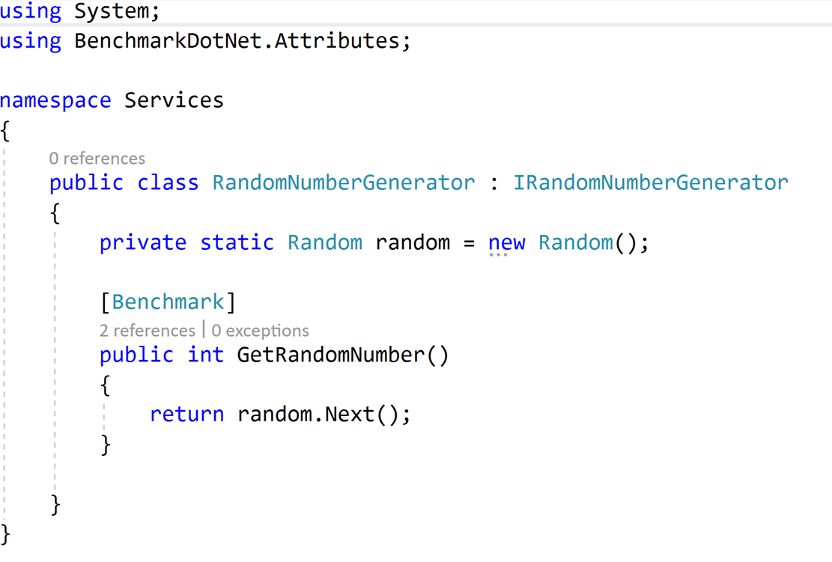
HOW TO START?
Project with installed BenchmarkDotNet package and class witch Benchmark attribute:

Slide 42
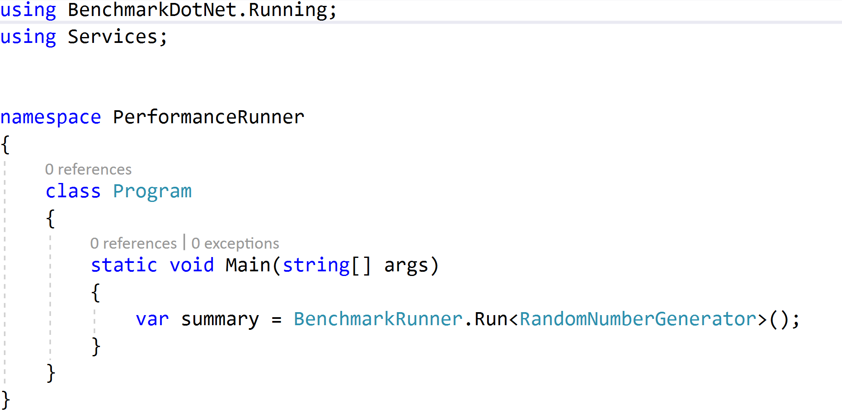
HOW TO START?
Call the BenchmarkRunner method:

Slide 43
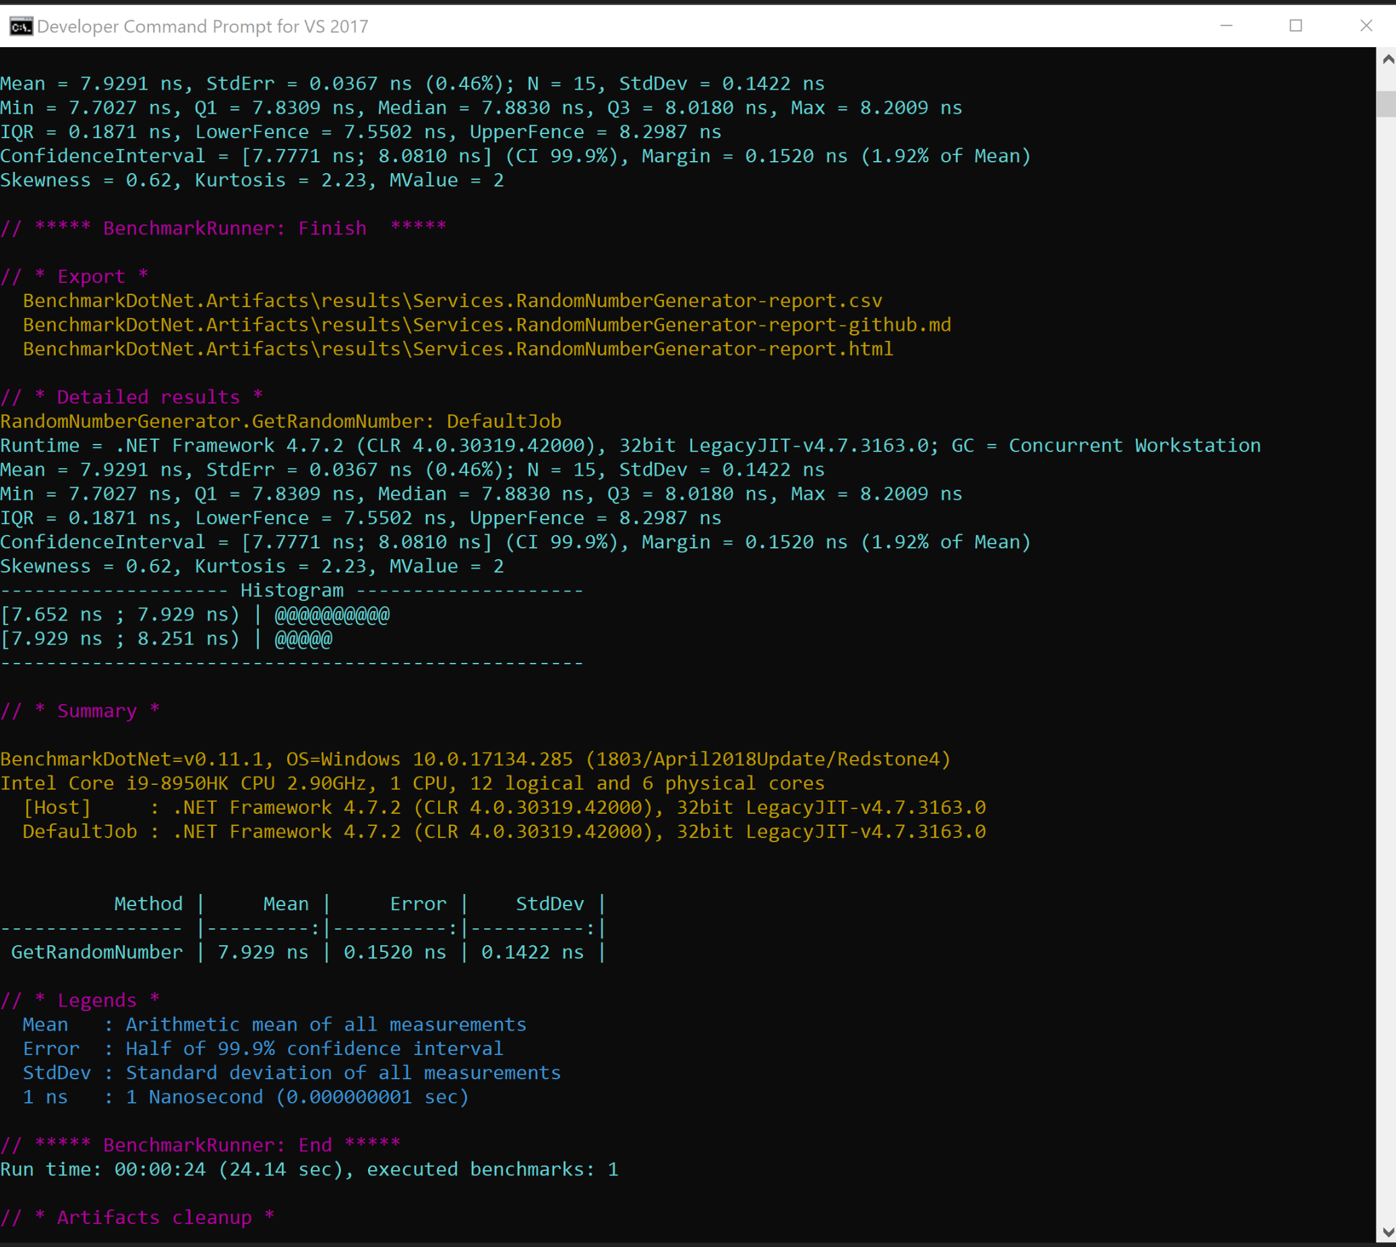
RESULTS

Slide 44
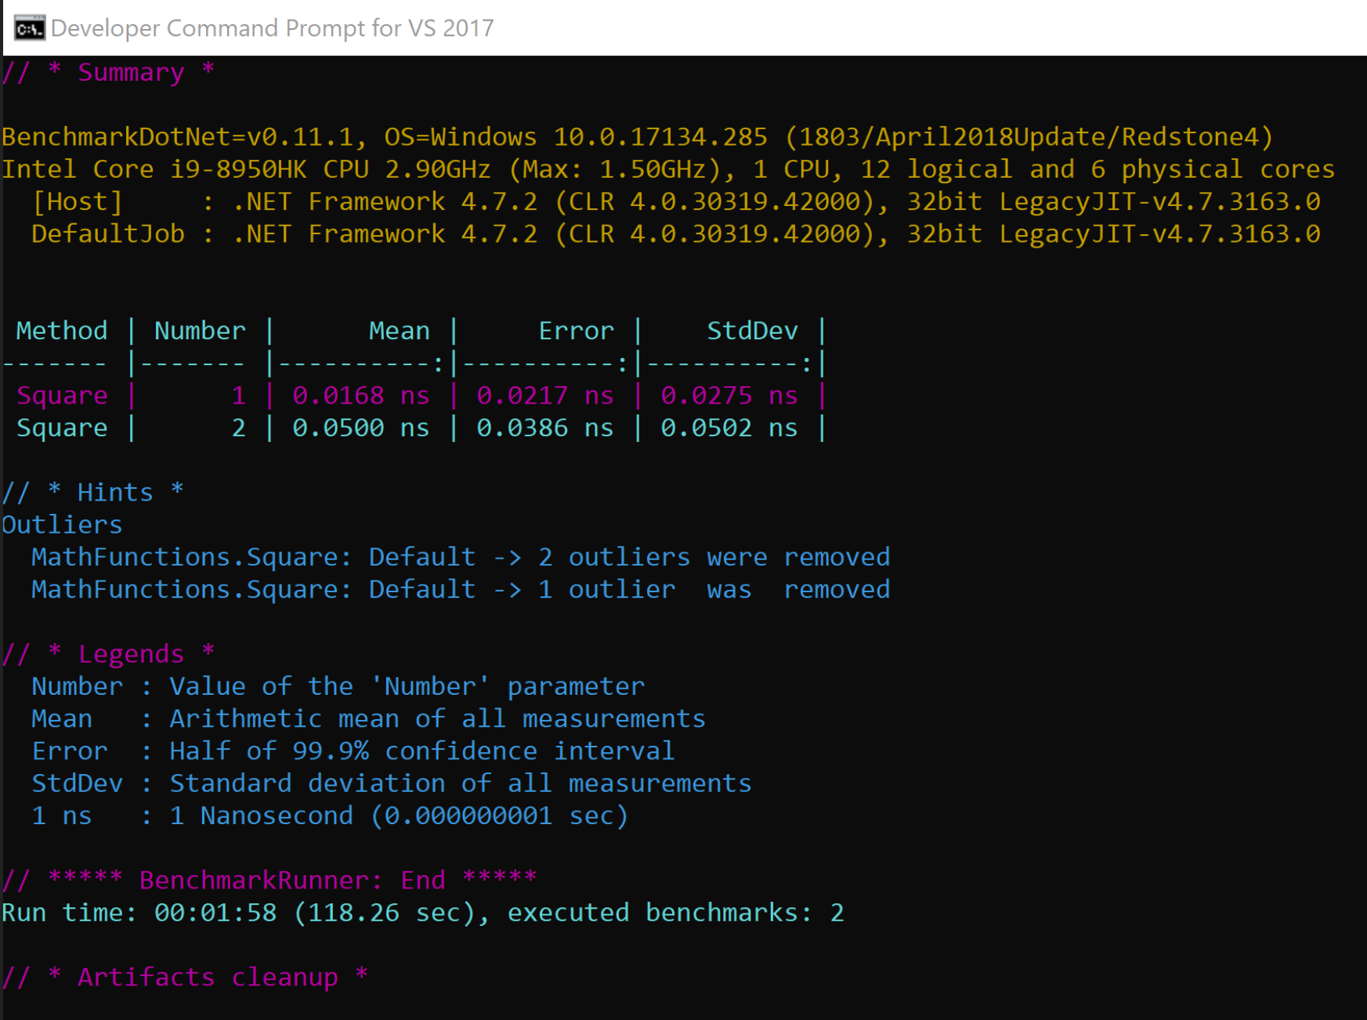
RESULTS

Slide 45
DEMO
Benchmark Demo

Slide 46
STEP V
Working with LINQ

Slide 47
LINQ
Language-Integrated Query (LINQ) is the name for a set of technologies based on the integration of query capabilities directly into the C# language.
Traditionally, queries against data are expressed as simple strings without type checking at compile time or IntelliSense support. Furthermore, you have to learn a different query language for each type of data source: SQL databases, XML documents, various Web services, and so on.
With LINQ, a query is a first-class language construct, just like classes, methods, events.

Slide 48
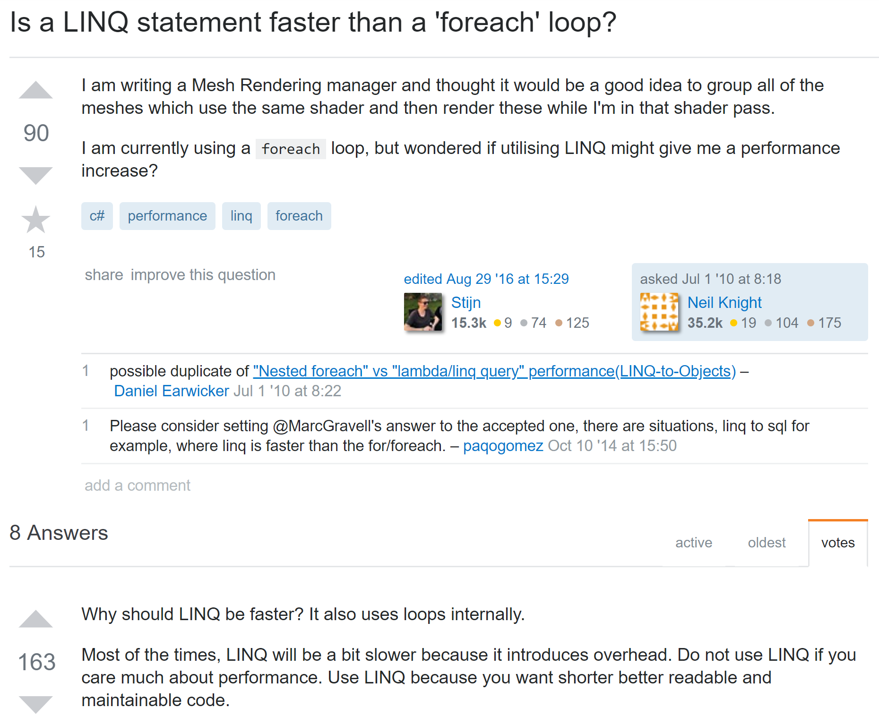
WHICH WAY IS FASTER?

Slide 49
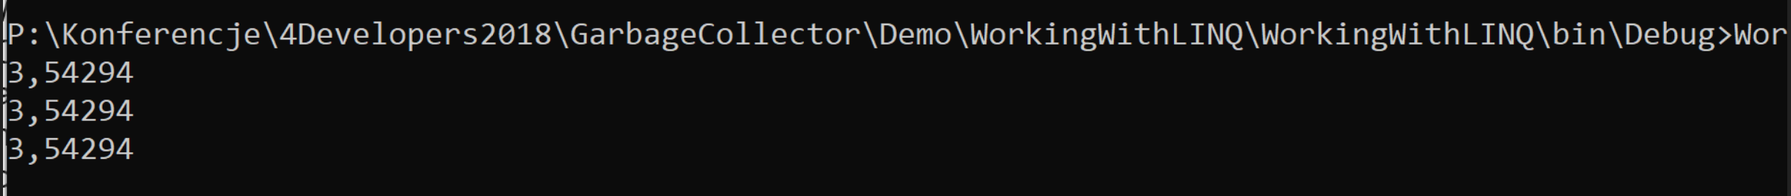
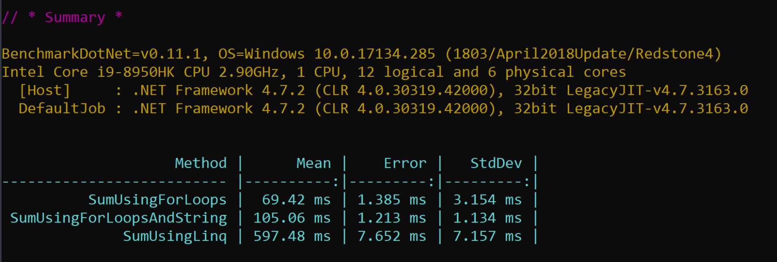
HOW TO CHECK IT?
Compare 3 different queries with the same end result:

Slide 50
DEMO
Working with LINQ

Slide 51
STEP VI
MemoryDiagnoser

Slide 52
MEMORY DIAGNOSER
MemoryDiagnoser is one of its features that allows measuring the number of allocated bytes and garbage collection frequency.
Before the 0.10.1 version of BenchmarkDotNet the MemoryDiagnoser was part of BenchmarkDotNet.Diagnostics.Windows package. Internally it was using Event Tracing for Windows (ETW), which had following implications:
It was not cross-platform (Windows only).
It was as accurate as ETW allowed us it to be. We were using the GCAllocationTick event which is raised “Each time approximately 100 KB is allocated”. Which means that if 199 KB was allocated we would know only about the first 100 KB.

Slide 53
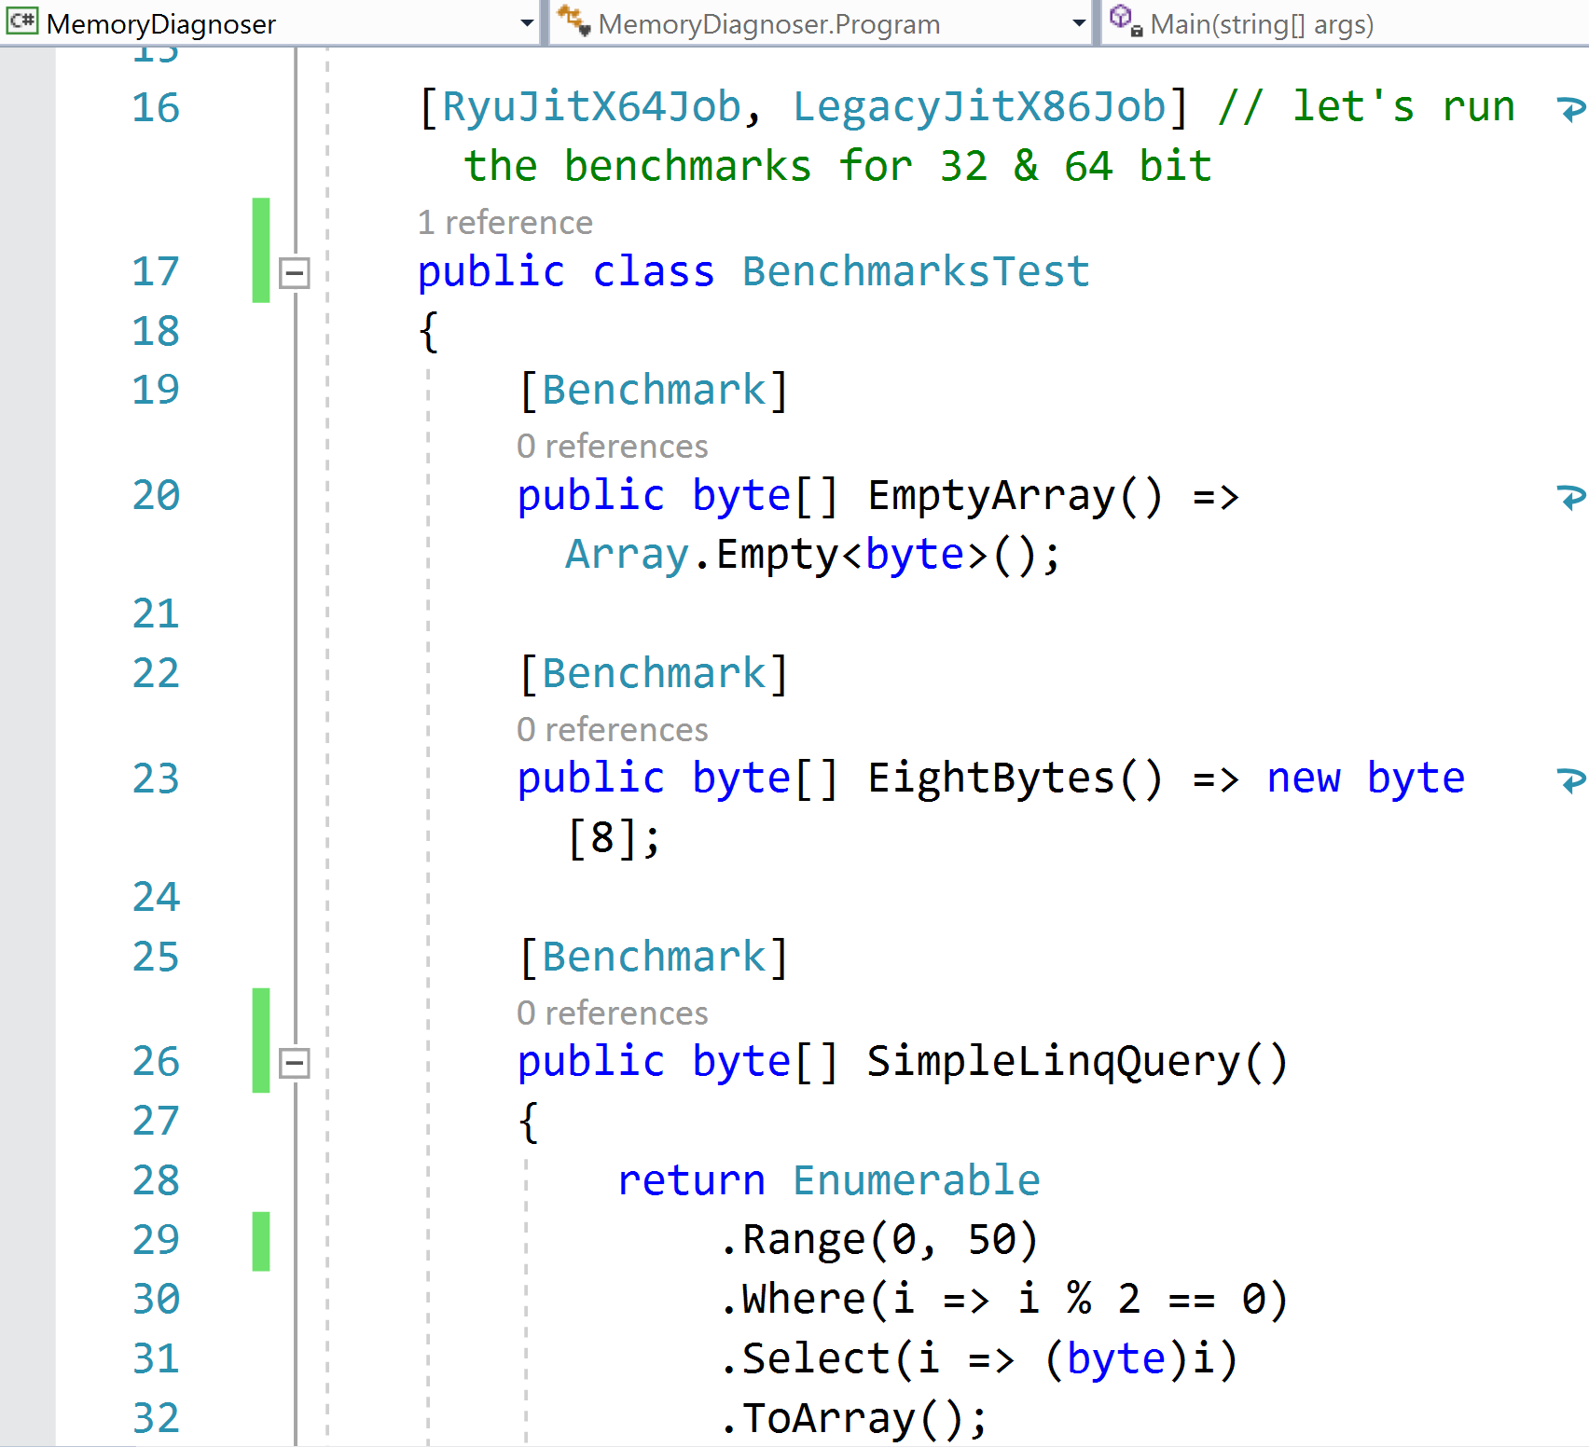
MEMORY DIAGNOSER
Class with Benchmark attribute:
Email: info@zalnet.pl www.zalnet.pl

Slide 54
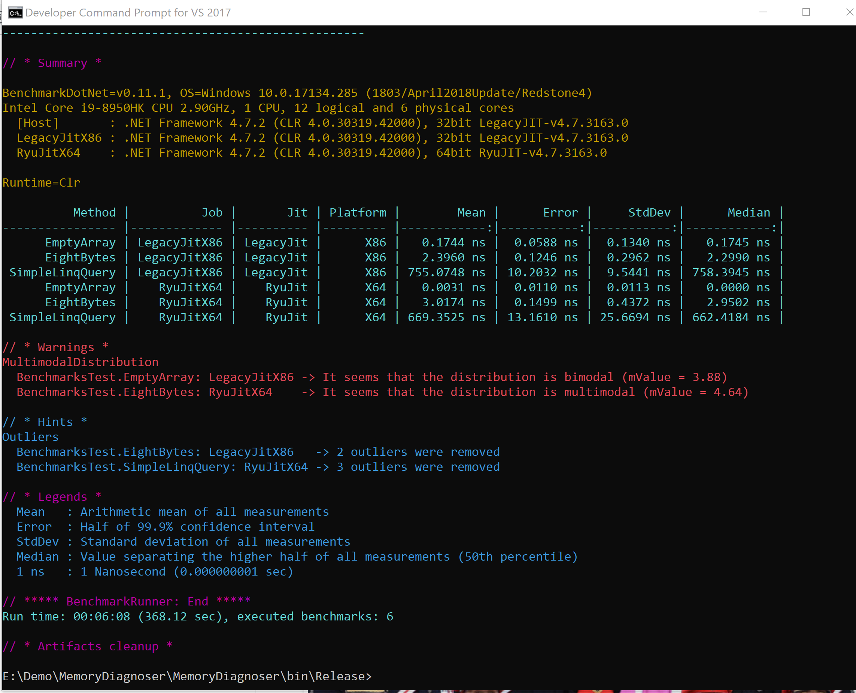
MEMORY DIAGNOSER
Email: info@zalnet.pl www.zalnet.pl

Slide 55
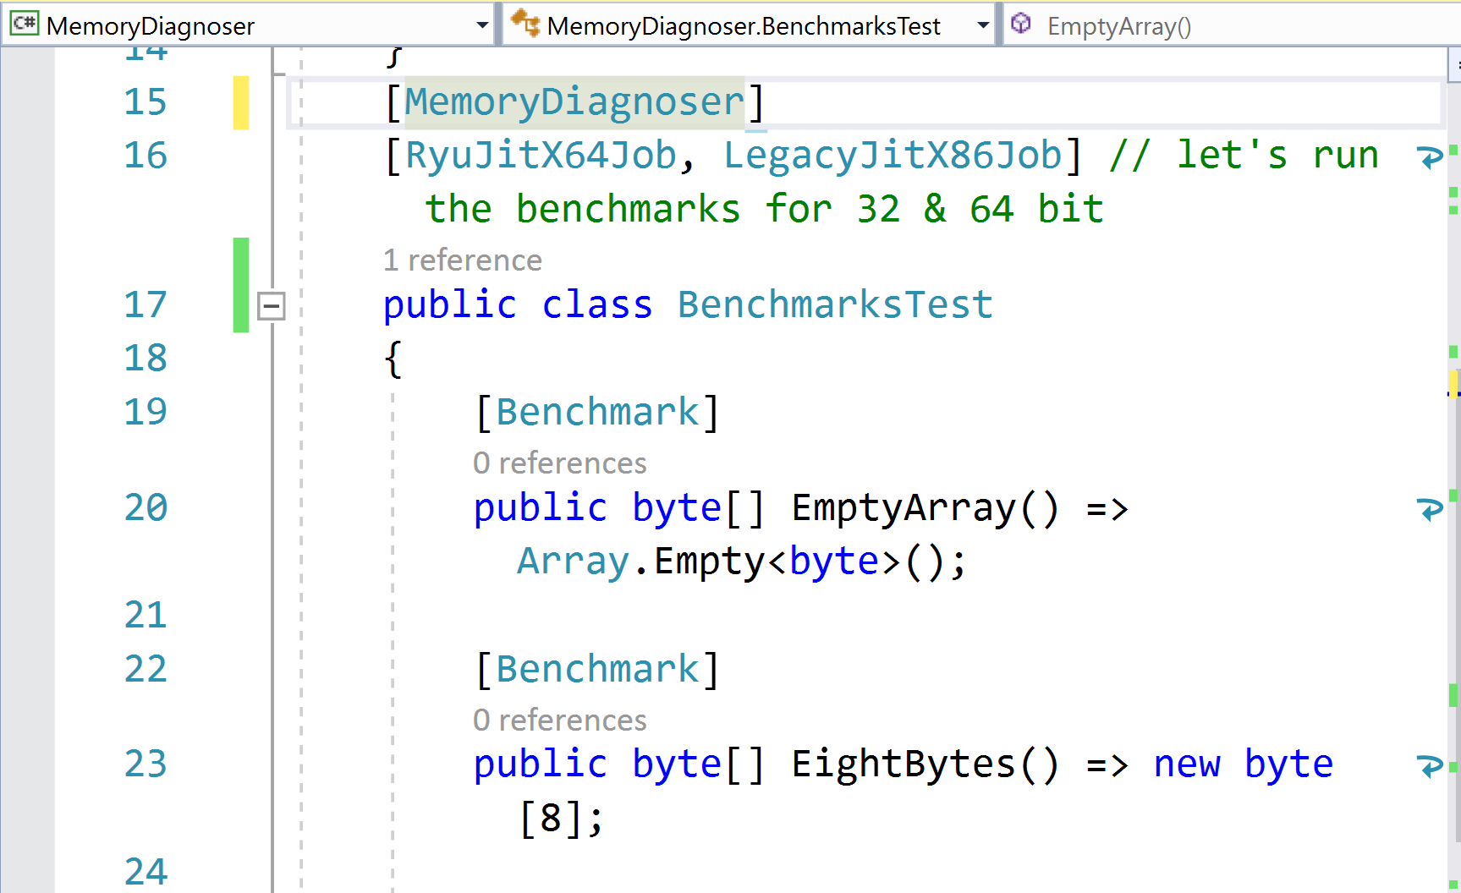
MEMORY DIAGNOSER
Add the MemoryDiagnoser attribute to the class :
Email: info@zalnet.pl www.zalnet.pl

Slide 56
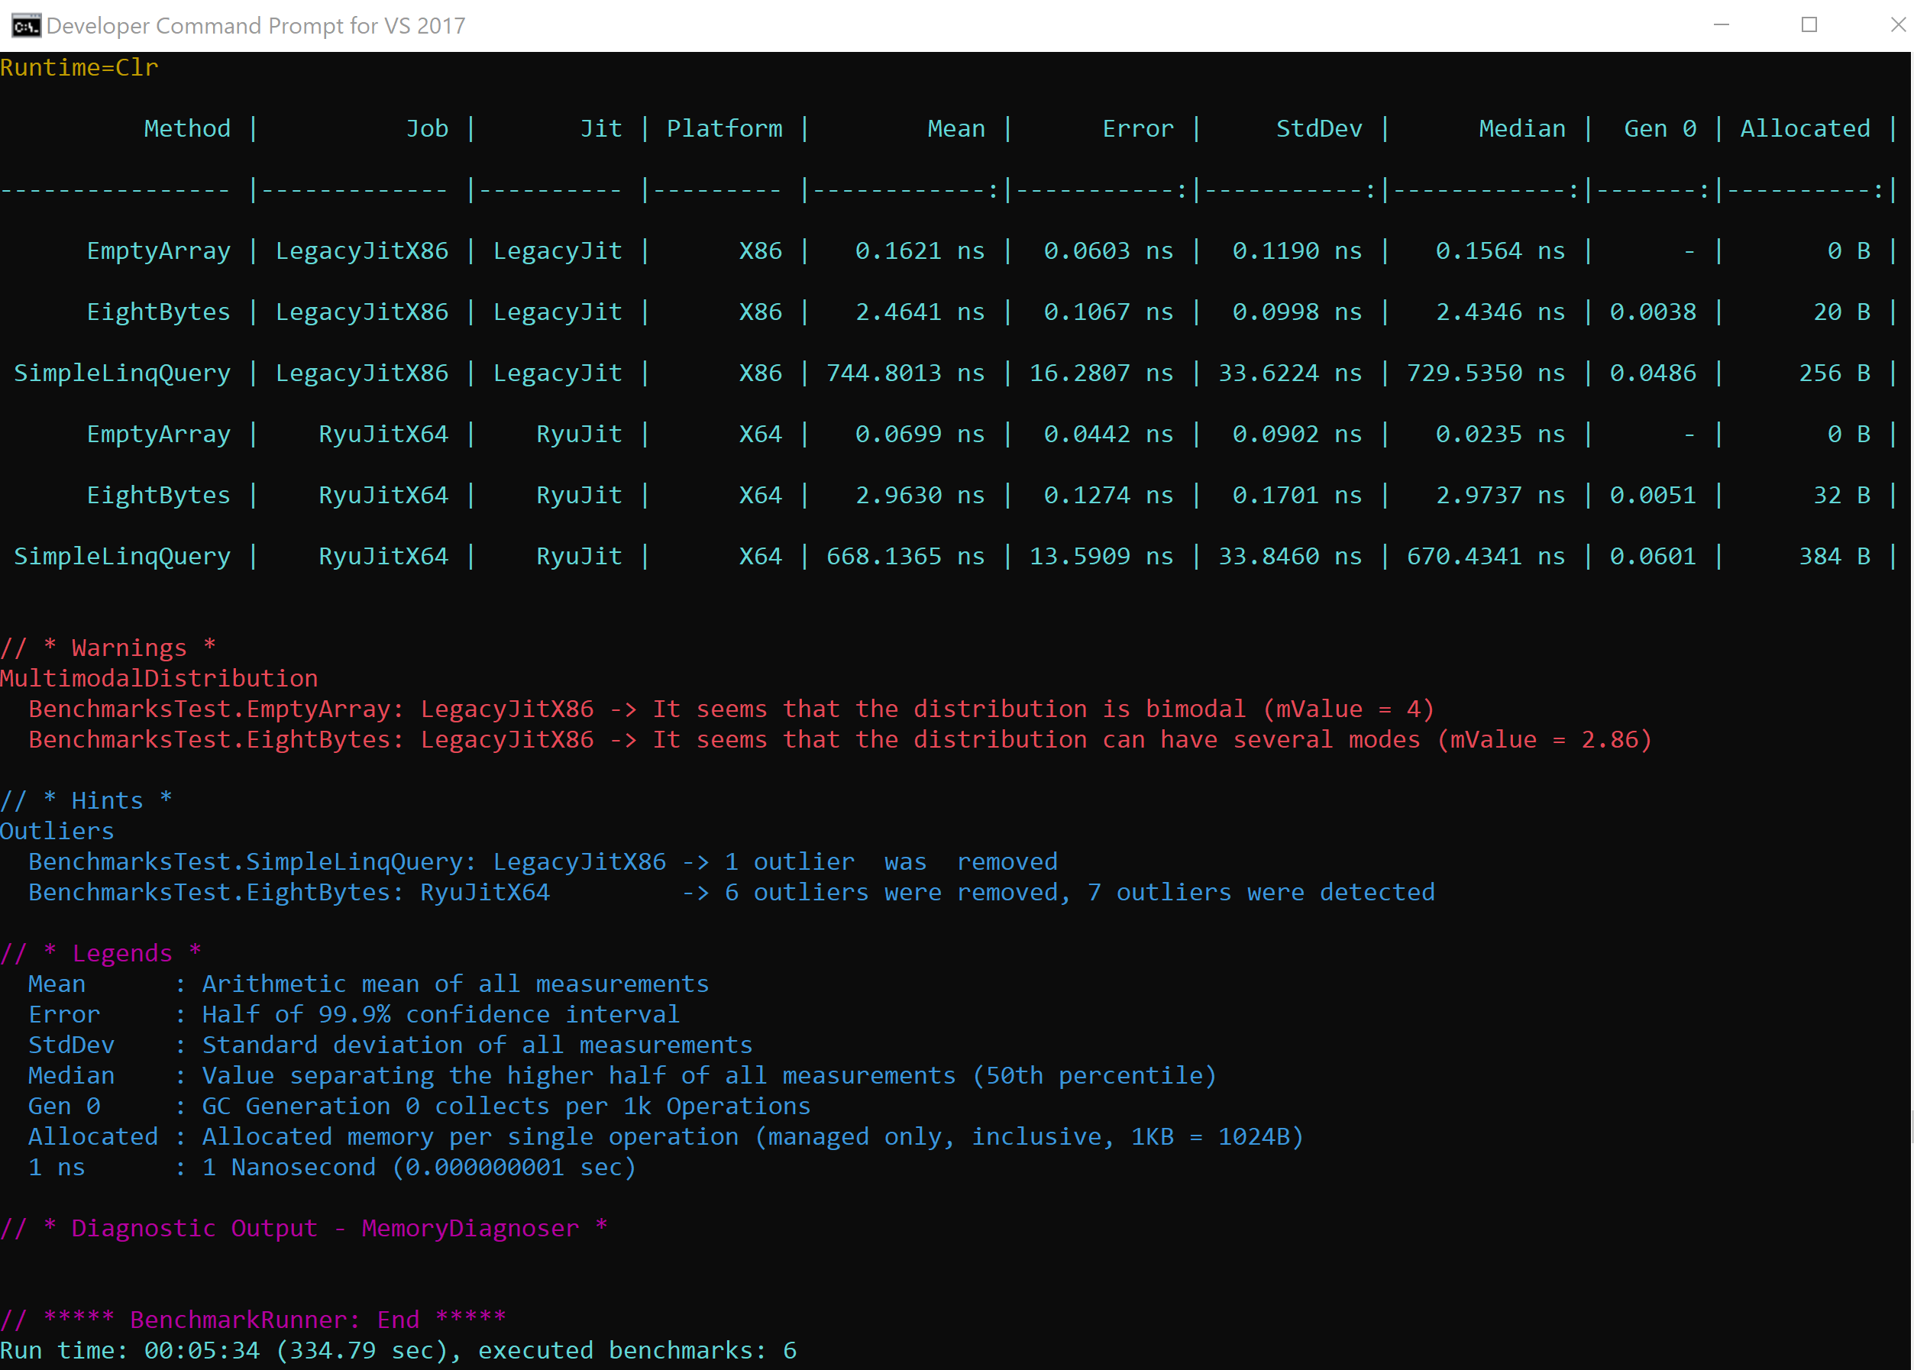
MEMORY DIAGNOSER
Email: info@zalnet.pl www.zalnet.pl

Slide 57
DEMO
MemoryDiagnoser
Email: info@zalnet.pl www.zalnet.pl

Slide 58
STEP VII
Memory Leaks

Slide 59
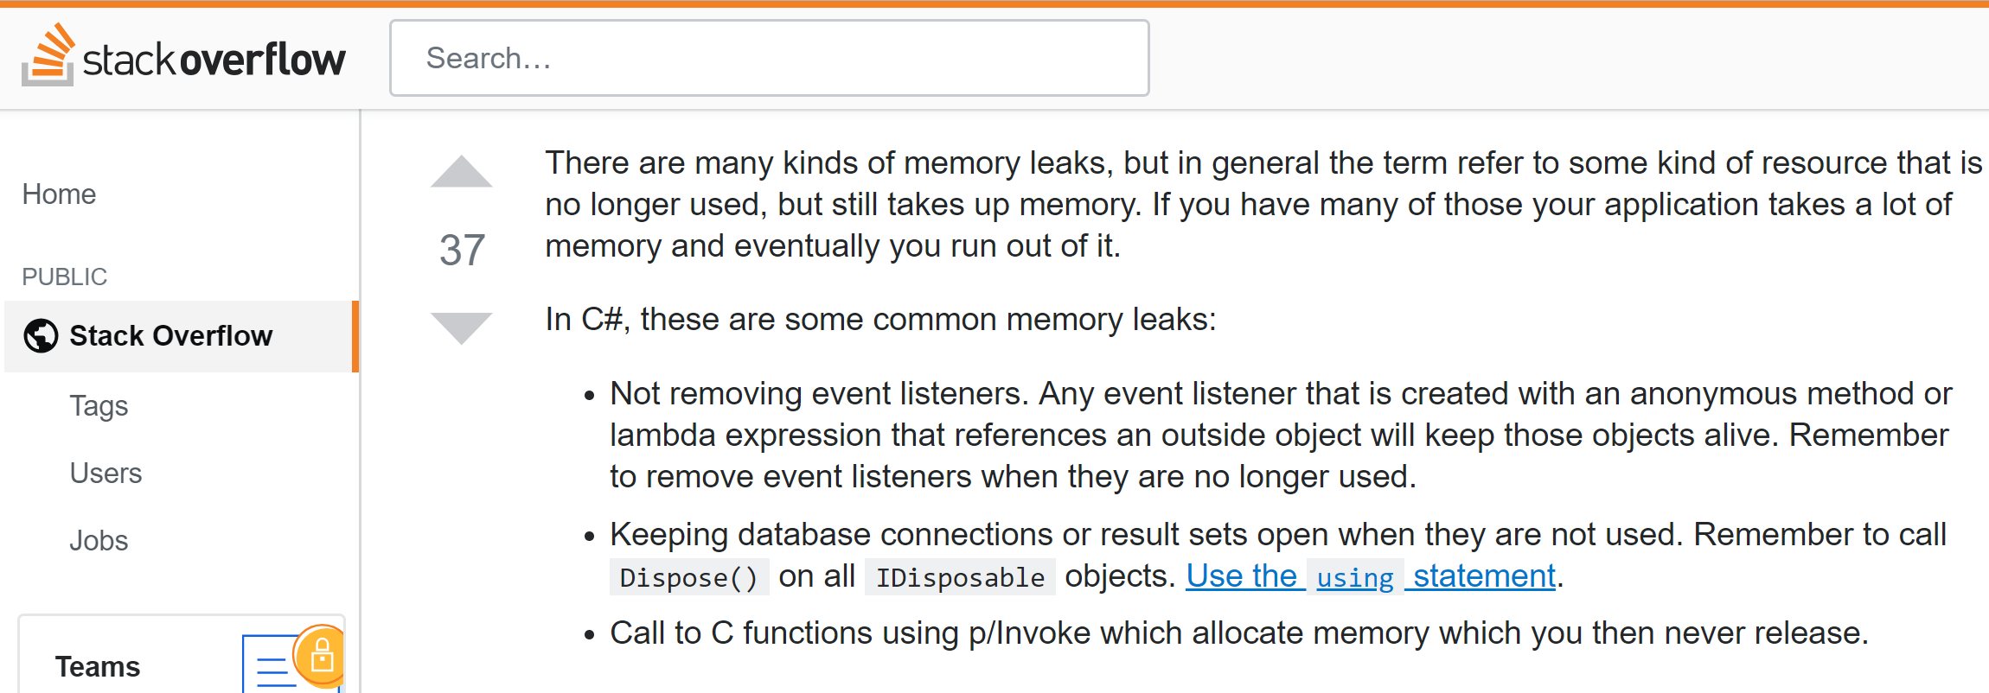
WHAT IS MEMORY LEAK?

Slide 60
DEMO
Issues with Memory Leaks

Slide 61
STEP VIII
Roslyn-based heap allocation analyzer

Slide 62
CLR HEAP ALLOCATION ANALYZER
Roslyn based C# heap allocation diagnostic analyzer.
It can detect most heap allocations including explicit allocations, value type to reference type (boxing), closure captures (a.k.a Display Classes) and can tell you why the closure is being captured. Implicit delegate creation and implicit allocations done by the compiler for params, etc.
It can also run as part of your build and flag as warnings. It is, however, most demonstrative in its code-assist form in the IDE.
It can be downloaded from Visual Studio MarketPlace.
https://github.com/mjsabby/RoslynClrHeapAllocationAnalyzer for the source.

Slide 63
DEMO
Heap Analyzer

Slide 64
Q & A
Email: info@zalnet.pl
Demos after conference:
https://github.com/bzalewa/ConferenceGdansk
Thanks for coming ☺

