Slide 1
Parameter sniffing in stored procedures - how to recognize and correct undesirable issues
Beata Zalewa

Slide 2


ABOUT
In professional life Microsoft Certified Trainer, administrator, developer, freelancer, sometimes a miracle-worker and magician.
From the beginning of career associated with Microsoft technologies.
Private life in numbers: 1 husband, 1 daughter, 1 cat and 2 dogs. My hobbies are detective stories and photography.
Email: info@zalnet.pl
Skype: beata.zalewa
Facebook: https://web.facebook.com/beata.zalewa

Slide 3
AGENDA
Parameter sniffing isn’t always a bad thing
Parameter Sniffing issues
Possible workarounds to overcome Parameter Sniffing
Conclusions

Slide 4
STEP I
Parameter sniffing isn’t always a bad thing

Slide 5
Parameter sniffing
Most of the time it’s good.
It means SQL Server is caching and reusing query plans to make your queries run faster.

Slide 6
DEMO 1
Parameter Sniffing demo

Slide 7
STEP II
Parameter Sniffing issues

Slide 8
Parameter sniffing issues
Parameter sniffing only becomes a problem when the cached plan isn’t anywhere close to being the optimal plan for given input parameters.

Slide 9
Main issue
SQL Server compiles the stored procedures using (sniffing) the parameters send the first time the procedure is compiled and put it in plan cache.
After that every time the procedure executed again, SQL Server retrieves the execution plan from the cache and uses it (unless there is a reason for recompilation).
The potential problem arises when the first time the stored procedure is executed, the set of parameters generate an acceptable plan for that set of parameters, but very bad for other more common sets of parameters.

Slide 10
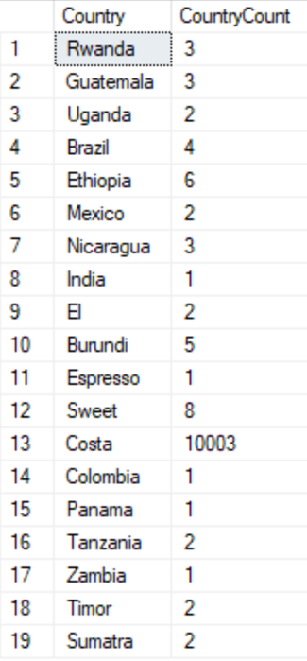
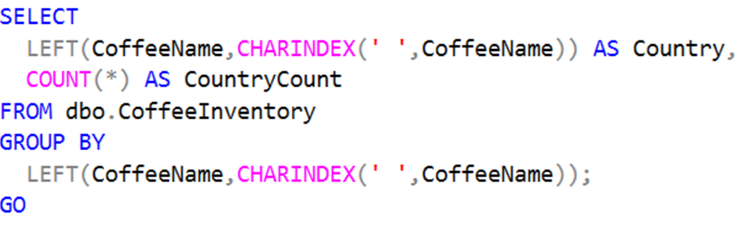
Main issue
Notes:
"Costa Rica" has more than 10,000 rows in this table, while all other country names are in the single digits.
This means that when we executed our stored procedure for the first time, SQL Server generated an execution plan that used a table scan because it thought this would be the most efficient way to retrieve 10,003 of the 10,052 rows.
This table scan query plan is only optimal for Costa Rica . Passing in any other country name into the stored procedure would return only a handful of records, making it more efficient for SQL Server to use our nonclustered index.
However, since the Costa Rica plan was the first one to run, and therefore is the one that got added to the query plan cache, all other executions ended up using the same table scan execution plan.
After clearing our cached execution plan using DBCC FREEPROCCACHE, we executed our stored procedure again but with 'Ethiopia' as our parameter. SQL Server determined that a plan with an index seek is optimal to retrieve only 6 of the 10,052 rows in the table. It then cached that Index Seek plan, which is why the second time around the 'Costa Rica' parameter received the execution plan with Index Seek.

Slide 11
DEMO 2
Parameter sniffing example

Slide 12
STEP III
POSSIBLE WORKAROUNDS TO OVERCOME PARAMETER SNIFFING

Slide 13
HOW DO I PREVENT PARAMETER SNIFFING?
Create SQL Server Stored Procedures using the WITH RECOMPILE Option
Use the SQL Server Hint OPTION (RECOMPILE)
Use the SQL Server Hint OPTION (OPTIMIZE FOR)
Use IF– ELSE
Disable Parameter Sniffing for a Specific SQL Server Query
Disable SQL Server Parameter Sniffing at the Instance Level

Slide 14
WORKAROUND 1
Create SQL Server Stored Procedures using the WITH RECOMPILE Option
This is the simplest solution, but not one of the best.
If the problem is a single query inside the stored procedure code then performing a recompilation of the entire procedure is not the best approach.
We should correct the problematic query.
Recompilation will increase CPU load and in heavy concurrent systems it could be as problematic as the issue we are trying to solve.
Notes:
If the problem is that the optimizer uses a plan compiled with parameters that are no longer suitable then a recompilation will create a new plan with the new parameters right? This is the simplest solution, but not one of the best. If the problem is a single query inside the stored procedure code then performing a recompilation of the entire procedure is not the best approach. We should correct the problematic query.
Furthermore, recompilation will increase CPU load and in heavy concurrent systems it could be as problematic as the issue we are trying to solve.

Slide 15
DEMO 3
SP WITH RECOMPILE Option example

Slide 16
WORKAROUND 2
Use the SQL Server Hint OPTION (RECOMPILE)
Recompiling the whole stored procedure is not the best choice.
We can take advantage of the hint RECOMPILE to recompile the awkward query alone.

Slide 17
DEMO 4
Option (RECOMPILE) example

Slide 18
WORKAROUND 3
Use the SQL Server Hint OPTION (OPTIMIZE FOR)
This hint will allow us to set a parameter value to use as a reference for optimization
We can use this hint when we know for sure which parameter values the procedure will use to execute.
But if you are using SQL Server 2008 or above then OPTIMIZE FOR UNKNOWN will bring some light.
It won’t produce the best plan, the resulting plan will be something in between.
So to use this hint you must consider how often the stored procedure is being executed with a wrong plan and how much it impacts production environment having a long running query.

Slide 19
DEMO 5
Option (OPTIMIZE FOR) example

Slide 20
WORKAROUND 4
Use IF - ELSE
This option needs more work.
How do you determine what the IF condition should be?
What happens more data is added to the table over time and the distribution of data changes?
But will give you the best performance if you want your plans to be cached and be optimal for the data getting passed in.

Slide 21
DEMO 6
Use IF – ELSE example

Slide 22
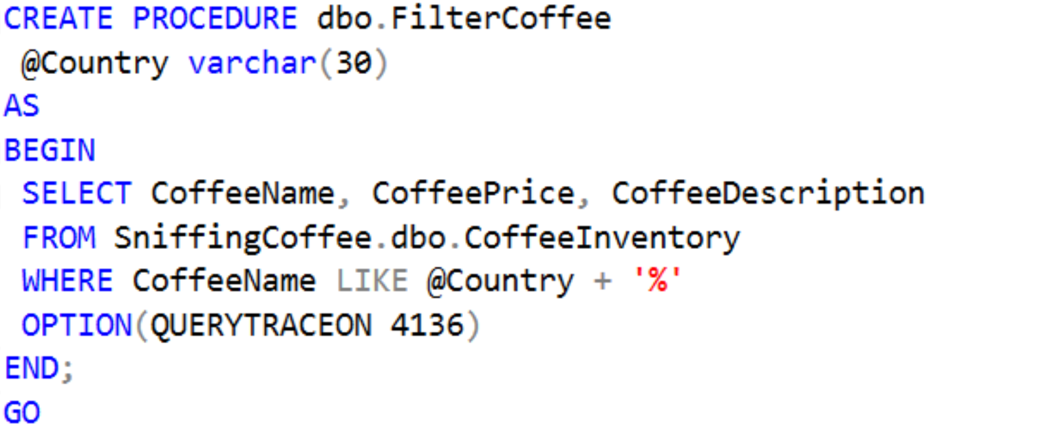
WORKAROUND 5
Disable Parameter Sniffing for a Specific SQL Server Query
Query can use a trace flag as a hint to change the behaviour of the query optimizer.
The way to do this is by adding the QUERYTRACEON hint to the OPTION clause.
Trace flag 4136 disables parameter sniffing.

Slide 23
WORKAROUND 6
Disable Parameter Sniffing for a Specific SQL Server Query
Maybe this is the worst choice you can make.
Parameter sniffing is not a bad thing and is very useful in most cases to get the best plan.
But if you want, starting the instance with trace flag 4136 set will disable parameter sniffing.
You can read more about this and the patch level required to use this flag on this KB article: SQL Server 2008 R2 Cumulative Update 2, SQL Server 2008 SP1 Cumulative Update 7 and SQL Server 2005 SP3 Cumulative Update 9 introduce trace flag 4136 that can be used to disable the "parameter sniffing" process.
Before using this method try to use the previous method.

Slide 24
STEP IV
Conclusions

Slide 25
CONCLUSIONS
Parameter sniffing is only bad when your data values are unevenly distributed and cached query plans are not optimal for all values.
SQL Server caches the query plan that is generated from the first run of a query/stored procedure with whatever parameter values were used during that first run.
Using the RECOMPILE hint is a good solution when your queries aren’t getting ran often or aren’t staying in the the query cache most of the time anyway.
The OPTIMIZE FOR hint is good to use when you can specify a value that will generate a query plan that is efficient for most parameter values and are OK with taking a hit for a sub-optimal plan on infrequently queried values.
Using complex logic (like IF/ELSE) will give you ultimate flexibility and performance, but will also be the worst for long term maintenance.

Slide 26
SOURCES
Microsoft documentation
https://hackernoon.com
https://www.mssqltips.com

Slide 27
Q & A
Email: info@zalnet.pl
Demos after conference:
https://github.com/bzalewa/ExpertSummit2018
Thanks for coming ☺

