Slide 1

Workshop preparing to an exam 70-761
Beata Zalewa

Slide 2

About
In professional life consultant, Microsoft Certified Trainer, administrator, developer, freelancer, sometimes a miracle-worker and magician.
From the beginning of career associated with Microsoft technologies.
Private life in numbers: 1 husband, 1 daughter, 1 cat and 2 dogs. My hobbies are detective stories and photography.
Email: info@zalnet.pl
Skype: beata.zalewa
WWW: https://blog.zalnet.pl

Slide 3
Agenda
Manage data with Transact-SQL
WORKSHOP 1
1: Create Transact-SQL SELECT queries
Understanding the foundations of T-SQL
Understanding logical query processing
Getting started with the SELECT statement
Filtering data with predicates
Sorting data
Filtering data with TOP and OFFSET-FETCH
Combining sets with set operators
2: Query multiple tables by using joins
Cross joins
Inner joins
Outer joins
Queries with composite joins and NULLs in join columns
Multi-join queries

Slide 4
Agenda
WORKSHOP 2
3: Implement functions and aggregate data
Type conversion functions
Date and time functions
Character functions
CASE expressions and related functions
System functions
Arithmetic operators and aggregate functions
Search arguments
Function determinism
4: Modify data
Inserting data
Updating data
Deleting data
Merging data
Using the OUTPUT option
Impact of structural changes on data

Slide 5
Agenda
Query data with advanced Transact-SQL components
WORKSHOP 3
1: Query data by using subqueries and APPLY
Subqueries
The APPLY operator
2: Query data by using table expressions
Table expressions described
Table expressions or temporary tables?
Derived tables
Common table expressions
Views and inline table-valued functions

Slide 6
Agenda
WORKSHOP 4
3: Group and pivot data by using queries
Writing grouped queries
Pivoting and Unpivoting Data
Using Window Functions
4: Query temporal data and non-relational data
System-versioned temporal tables
Query and output XML data
Query and output JSON data

Slide 7
Agenda
Program databases by using Transact-SQL
WORKSHOP 5
1: Create database programmability objects by using Transact-SQL
Views
User-defined functions
Stored procedures
WORKSHOP 6
2: Implement error handling and transactions
Understanding transactions
Error handling with TRY-CATCH
3: Implement data types and NULLs
Working with data types
Handling NULLs

Slide 8
Manage data with Transact-SQL
1: Create Transact-SQL SELECT queries
Understanding the foundations of T-SQL
Understanding logical query processing
Getting started with the SELECT statement
Filtering data with predicates
Sorting data
Filtering data with TOP and OFFSET-FETCH
Combining sets with set operators
2: Query multiple tables by using joins
Cross joins
Inner joins
Outer joins
Queries with composite joins and NULLs in join columns
Multi-join queries

Slide 9
What is Transact-SQL?
Structured Query Language (SQL)
Developed by IBM in 1970s
Adopted as a standard by ANSI and ISO standards bodies
Widely used in industry
Microsoft’s implementation is Transact-SQL
Referred to as T-SQL
Query language for SQL Server and Azure SQL Database
SQL is declarative, not procedural
Describe what you want, don’t specify steps

Slide 10
Manage data with Transact-SQL
Transact-SQL (T-SQL) is the main language used to manage and manipulate data in Microsoft SQL Server and Azure SQL Database.
If you work with any of the Microsoft SQL products—as a developer, DBA, BI professional, data analyst, data scientist, or in any other capacity—you need to know your T-SQL.
Manage data covers the elements of the SELECT statement, how to combine data from multiple tables with set operators and joins, use of built-in functions, and how to modify data.

Slide 11
1. Create Transact-SQL SELECT Queries
Skill 1.1: Create Transact-SQL SELECT queries
To write correct and robust T-SQL code, it’s important to first understand the roots of the language, as well as a concept called logical query processing.
You also need to understand the structure of the SELECT statement and how to use its clauses to perform data manipulation tasks like filtering and sorting.
You often need to combine data from different sources, and one of the ways to achieve this in T-SQL is using set operators.

Slide 12
1. Create Transact-SQL SELECT Queries
Understanding the foundations of T-SQL
Understanding logical query processing
Getting started with the SELECT statement
Filtering data with predicates
Sorting data
Filtering data with TOP and OFFSET-FETCH
Combining sets with set operators

Slide 13
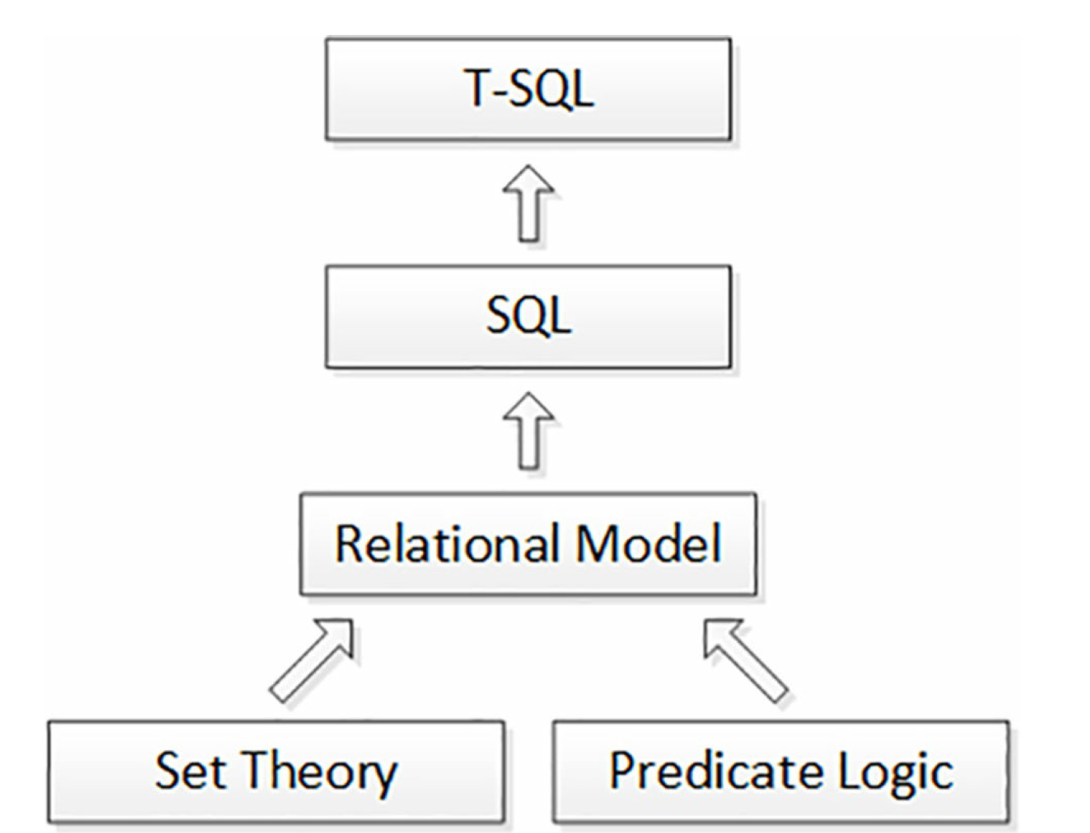
Understanding the foundations of T-SQL

Slide 14
Understanding the foundations of T-SQL
T-SQL is a dialect of standard SQL.
SQL is a standard of both the International Organization for Standards (ISO) and the American National Standards Institute (ANSI).
The two standards for SQL are basically the same.
The SQL standard keeps evolving with time. Following is a list of the major revisions of the standard so far:
- SQL-86
- SQL-89
- SQL-92
- SQL:1999
- SQL:2003
- SQL:2006
- SQL:2008
- SQL:2011

Slide 15
Standards in T-SQL
T-SQL supports multiple functions that convert a source expression to a target type.
Among them are the CAST and CONVERT functions.
The former is standard and the latter isn’t.
The nonstandard CONVERT function has a style argument that CAST doesn’t support.
Because CAST is standard, you should consider it your default choice for conversions.
You should consider using CONVERT only when you need to rely on the style argument.

Slide 16
Standards in T-SQL
According to standard SQL, you should terminate your statements with a semicolon.
The T-SQL documentation specifies that not terminating all statements with a semicolon is a deprecated feature, but TSQL currently doesn’t enforce this for all statements, rather only in cases where there would otherwise be ambiguity of code elements.
For example, a statement preceding the WITH clause of a common table expression (CTE) has to be terminated because this clause can also be used to define a table hint in the preceding statement.
As another example, the MERGE statement has to be terminated due to possible ambiguity of the MERGE keyword.
You should still follow the standard and terminate all of your statements even where it is currently not required.

Slide 17
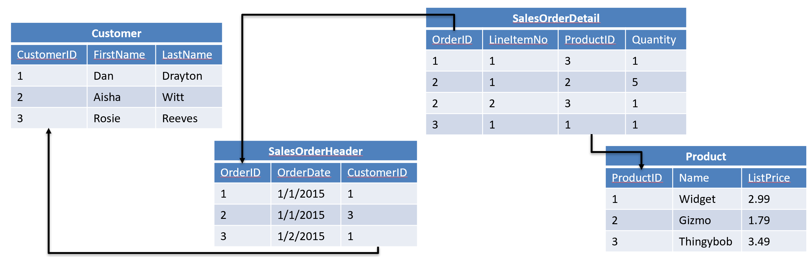
Relational Databases
Entities are represented as relations (tables), in which their attributes are represented as domains (columns)
Most relational databases are normalized, with relationships defined between tables through primary and foreign keys

Slide 18
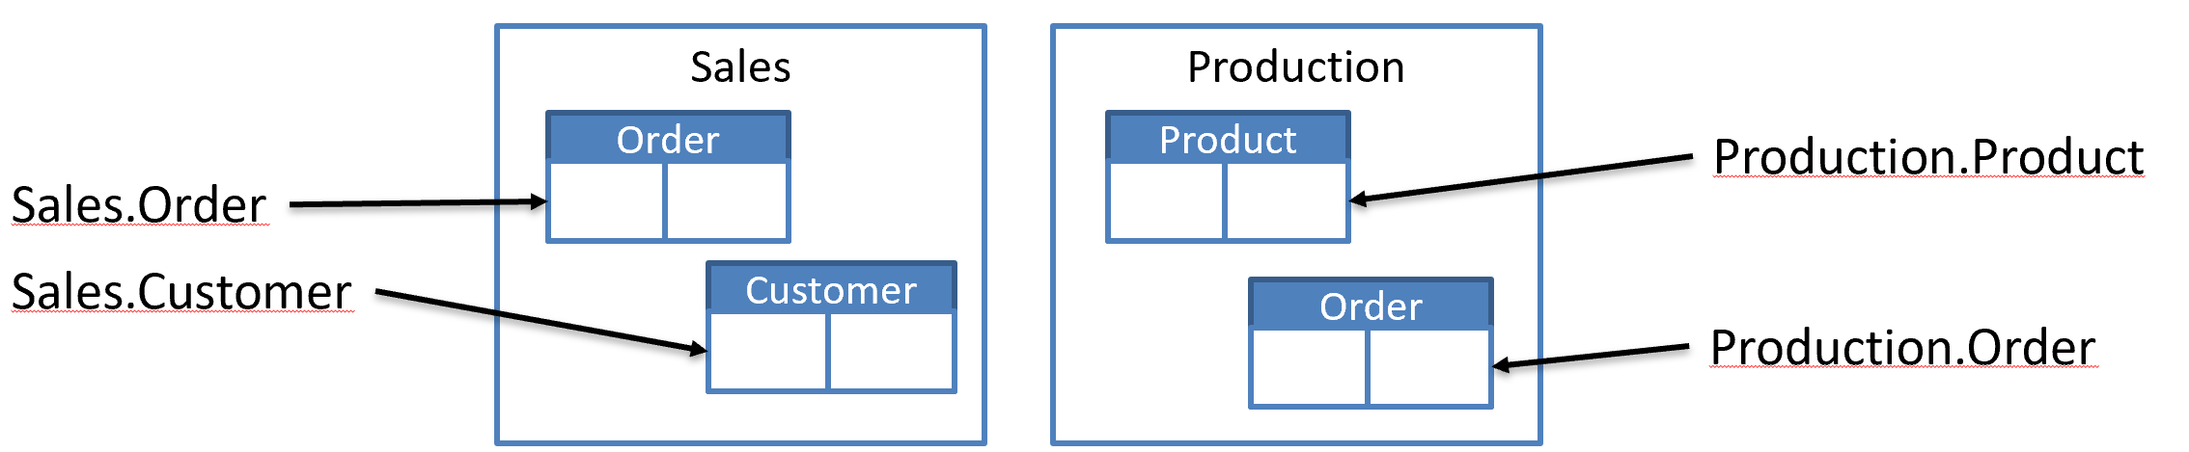
Schemas and Object Names
Schemas are namespaces for database objects
Fully-qualified names:
[server_name.][database_name.][schema_name.]object_name
Within database context, best practice is to include schema name:
schema_name.object_name

Slide 19
Using T-SQL in a relational way
A relation has a heading and a body.
The heading is a set of attributes and the body is a set of tuples.
A set is supposed to be considered as a whole.
In T-SQL is that you’re supposed to write queries that interact with the tables as a whole.
You should try to avoid using iterative constructs like cursors and loops that iterate through the rows one at a time.
You should also try to avoid thinking in iterative terms because this kind of thinking is what leads to iterative solutions.

Slide 20
Using T-SQL in a relational way
A set has no duplicates.
In other words, it has unique members.
T-SQL doesn’t always enforce this rule.
For example, you can create a table without a key.
In such a case, you are allowed to have duplicate rows in the table.
To follow relational theory, you need to enforce uniqueness in your tables.
For example, you can enforce uniqueness in your tables by using a primary key, or a unique constraint.
Even when the table doesn’t allow duplicate rows, a query against the table still return duplicate rows in its result.

Slide 21
Removing Duplicates
SELECT ALL
Default behavior includes duplicate
SELECT DISTINCT
Removes duplicates
Color
Blue
Red
Yellow
Blue
Yellow
Black
SELECT Color
FROM Production.Product;
Color
Blue
Red
Yellow
Black
SELECT DISTINCT Color
FROM Production.Product;

Slide 22
Using T-SQL in a relational way
DEMO
(Skill 1.1.sql)

Slide 23
Understanding logical query processing
T-SQL has both logical and physical sides to it.
The logical side is the conceptual interpretation of the query that explains what the correct result of the query is.
The physical side is the processing of the query by the database engine.
Physical processing must produce the result defined by logical query processing.
To achieve this goal, the database engine can apply optimization.
Optimization can rearrange steps from logical query processing or remove steps altogether, but only as long as the result remains the one defined by logical query processing.

Slide 24
Understanding logical query processing
T-SQL, being based on standard SQL, is a declarative English-like language.
In this language, declarative means you define what you want, as opposed to imperative languages that define also how to achieve what you want.
Standard SQL describes the logical interpretation of the declarative request (the “what” part), but it’s the database engine’s responsibility to figure out how to physically process the request (the “how” part).

Slide 25
Understanding logical query processing
It is important not to draw any performance-related conclusions from what you are reviewing about logical query processing.
That’s because logical query processing only defines the correctness of the query.
When addressing performance aspects of the query, you need to understand how optimization works.
Optimization can be quite different from logical query processing because it’s allowed to change things as long as the result achieved is the one defined by logical query processing.

Slide 26
Understanding logical query processing
The main statement used to retrieve data in T-SQL is the SELECT statement. Following are the main query clauses specified in the order that you are supposed to type them (known as "keyed-in order"):
1. SELECT
2. FROM
3. WHERE
4. GROUP BY
5. HAVING
6. ORDER BY
The logical query processing order, which is the conceptual interpretation order, is different. It starts with the FROM clause. Here is the logical query processing order of the six main query clauses:
1. FROM
2. WHERE
3. GROUP BY
4. HAVING
5. SELECT
6. ORDER BY

Slide 27
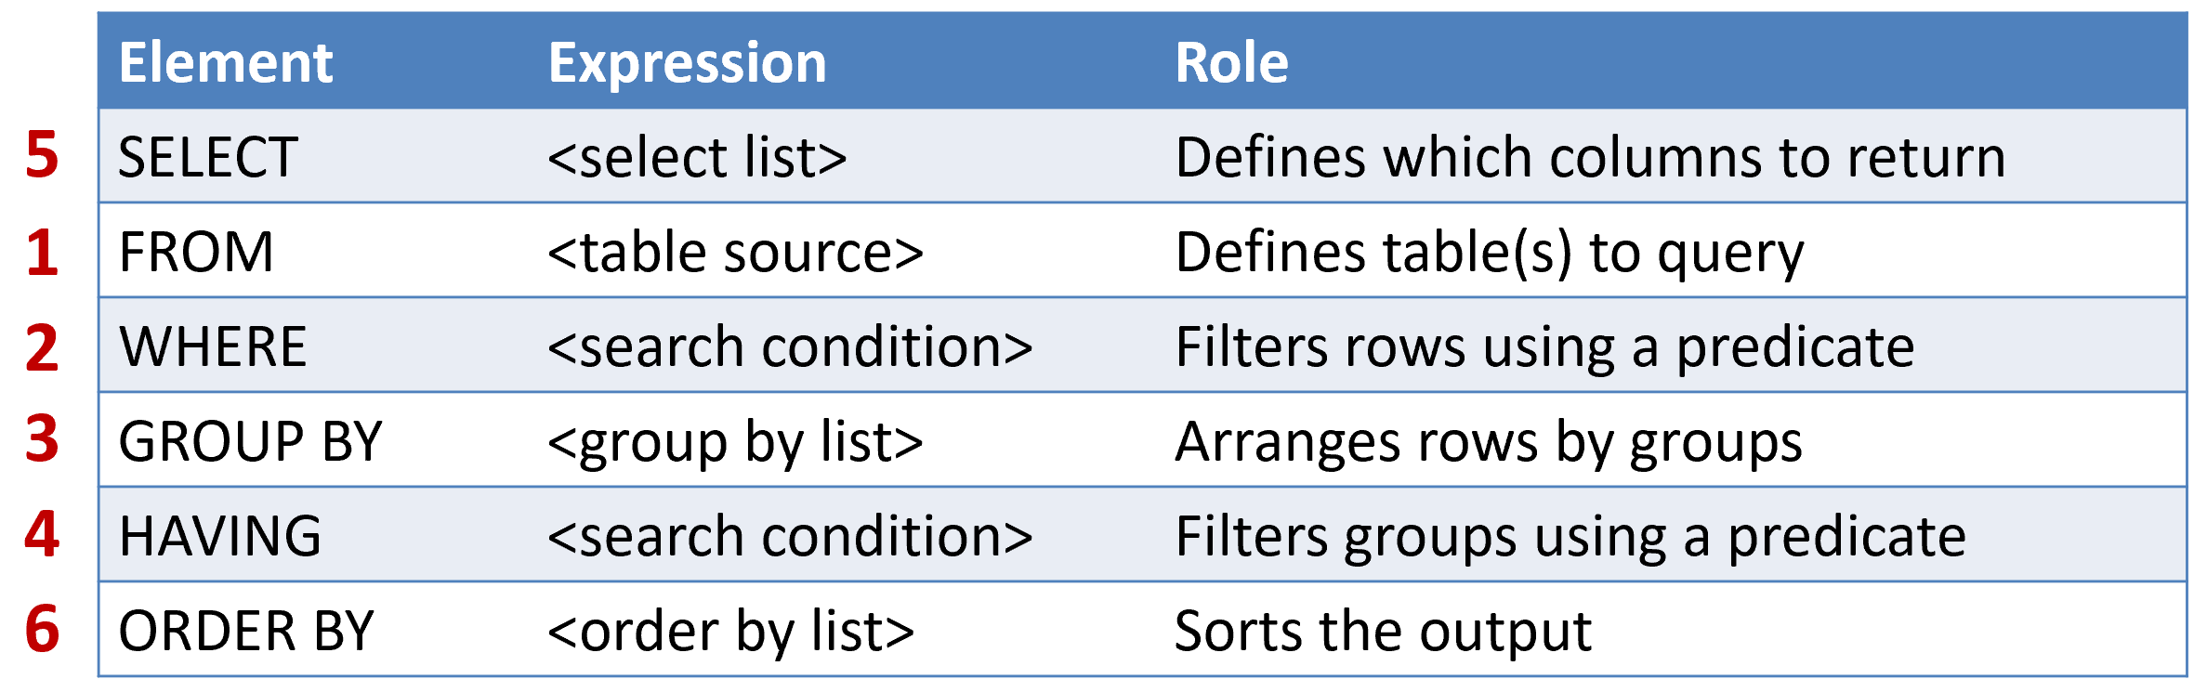
Understanding logical query processing
SELECT OrderDate, COUNT(OrderID)
FROM Sales.SalesOrder
WHERE Stas = 'Shipped'
GROUP BY OrderDate
HAVING COUNT(OrderID) > 1
ORDER BY OrderDate DESC;

Slide 28
Using T-SQL in a relational way
DEMO
(Skill 1.1.sql)

Slide 29
Getting started with the SELECT statement
SELECT * FROM Production.Product;
All columns
Specific columns
Expressions and Aliases
SELECT Name, ListPrice
FROM Production.Product;
SELECT Name AS Product, ListPrice * 0.9 AS SalePrice
FROM Production.Product;

Slide 30
Getting started with the SELECT statement
SELECT * FROM Production.Product;
All columns
Specific columns
Expressions and Aliases
SELECT Name, ListPrice
FROM Production.Product;
SELECT Name AS Product, ListPrice * 0.9 AS SalePrice
FROM Production.Product;

Slide 31
Getting started with the SELECT statement
DEMO
(Skill 1.1.sql)

Slide 32
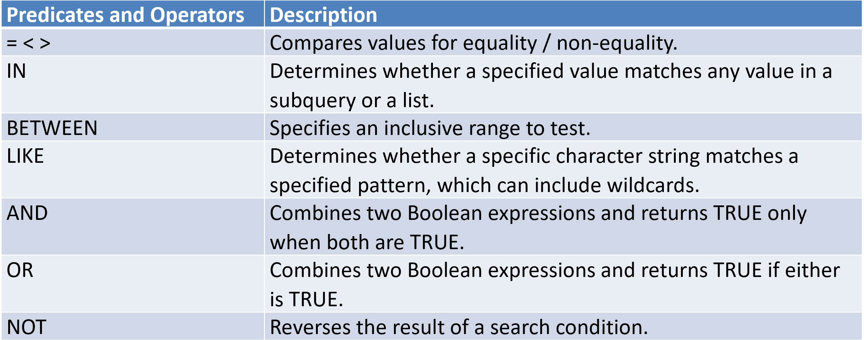
Filtering data with predicates
Filtering data is one of the most fundamental aspects of T-SQL querying.
Almost every query that you write involves some form of filtering.Specify predicates in the WHERE clause.

Slide 33
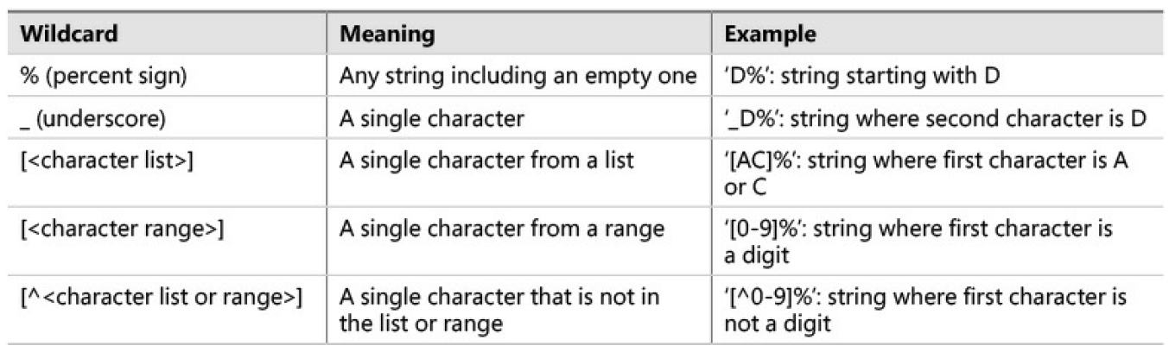
Filtering character data
The LIKE predicate supports wildcards that you can use in your patterns.
Available wildcards, their meaning, and an example
demonstrating their use.

Slide 34
Getting started with the SELECT statement
DEMO
(Skill 1.1.sql)

Slide 35
Sorting data
Use ORDER BY to sort results by one or more columns
Aliases created in SELECT clause are visible to ORDER BY
You can order by columns in the source that are not included in the SELECT clause
You can specify ASC or DESC (ASC is the default)
SELECT ProductCategory AS Category, ProductName
FROM Production.Product
ORDER BY Category, Price DESC;

Slide 36
Sorting data
DEMO
(Skill 1.1.sql)

Slide 37
Filtering data with TOP and OFFSET-FETCH
TOP allows you to limit the number or percentage of rows returned by a query
Works with ORDER BY clause to limit rows by sort order
Added to SELECT clause:
SELECT TOP (N) | TOP (N) Percent
With percent, number of rows rounded up
SELECT TOP (N) WITH TIES
Retrieve duplicates where applicable (nondeterministic)
SELECT TOP 10 ProductName, ListPrice
FROM Production.Product ORDER BY ListPrice DESC;

Slide 38
Paging Through Results
OFFSET-FETCH is an extension to the ORDER BY clause:
Allows filtering a requested range of rows
Dependent on ORDER BY clause
Provides a mechanism for paging through results
Specify number of rows to skip, number of rows to retrieve:
ORDER BY <order_by_list>
OFFSET <offset_value> ROW(S)
FETCH FIRST|NEXT <fetch_value> ROW(S) ONLY

Slide 39
Filtering data with TOP and OFFSET-FETCH
DEMO
(Skill 1.1.sql)

Slide 40
Combining sets with set operators
Set operators operate on two result sets of queries, comparing complete rows between the results. Depending on the result of the comparison and the operator used, the operator determines whether to return the row or not.
TSQL supports the operators: UNION, UNION ALL, INTERSECT, and EXCEPT.
The general form of code using these operators is as follows:
<query 1>
<operator>
<query 2>
[ORDER BY <order_by_list>];

Slide 41
What are UNION Queries?
UNION returns a result set of distinct rows combined from all statements
UNION removes duplicates during query processing (affects performance)
UNION ALL retains duplicates during query processing
-- only distinct rows from both queries are returned
SELECT countryregion, city FROM HR.Employees
UNION
SELECT countryregion, city FROM Sales.Customers;

Slide 42
UNION Guidelines
Column aliases
Must be expressed in first query
Number of columns
Must be the same
Data types
Must be compatible for implicit conversion (or converted explicitly)

Slide 43
What are INTERSECT Queries?
INTERSECT returns only distinct rows that appear in both result sets
-- only rows that exist in both queries will be returned
SELECT countryregion, city FROM HR.Employees
INTERSECT
SELECT countryregion, city FROM Sales.Customers;

Slide 44
What are EXCEPT Queries?
EXCEPT returns only distinct rows that appear in the first set but not the second
Order in which sets are specified matters
-- only rows from Employees will be returned
SELECT countryregion, city FROM HR.Employees
EXCEPT
SELECT countryregion, city FROM Sales.Customers;

Slide 45
Combining sets with set operators
DEMO
(Skill 1.1.sql)

Slide 46
2. Query multiple tables by using joins
Cross joins
Inner joins
Outer joins
Queries with composite joins and NULLs in join columns
Multi-join queries

Slide 47
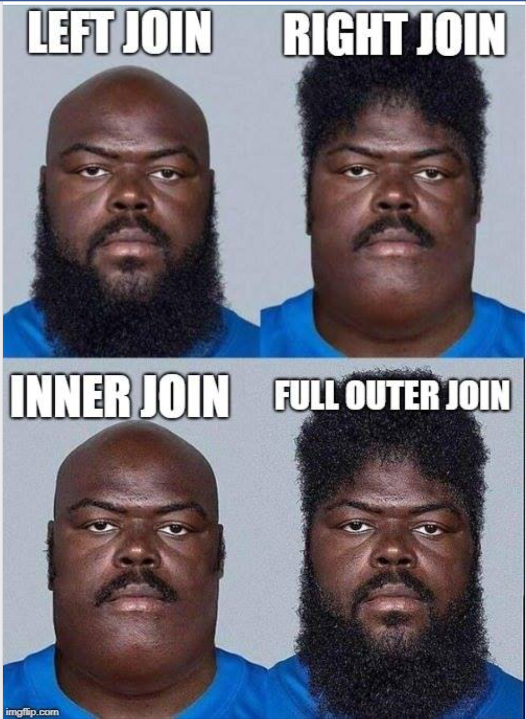
2. Query multiple tables by using joins

Slide 48
Join Concepts
Combine rows from multiple tables by specifying matching criteria
Usually based on primary key – foreign key relationships
For example, return rows that combine data from the Employee and SalesOrder tables by matching the Employee.EmployeeID primary key to the SalesOrder.EmployeeID foreign key
It helps to think of the tables as sets in a Venn diagram
Sales orders that were taken by employees
Employee
SalesOrder

Slide 49
Cross Joins
Combine each row from first table with each row from second table
All possible combinations output
Logical foundation for inner and outer joins
Inner join starts with Cartesian product, adds filter
Outer join takes Cartesian output, filtered, adds back non-matching rows (with NULL placeholders)
Due to Cartesian product output, not typically a desired form of join
Some useful exceptions:
Table of numbers, generating data for testing
Employee
EmployeeID | FirstName
1 | Dan
2 | Aisha
Product
ProductID | Name
1 | Widget
2 | Gizmo
SELECT emp.FirstName, prd.Name
FROM HR.Employee AS emp
CROSS JOIN Production.Product AS prd;
Result
FirstName | Name
Dan | Widget
Dan | Gizmo
Aisha | Widget
Aisha | Gizmo

Slide 50
Cross Joins
DEMO
(Skill 1.2.sql)

Slide 51
Join Syntax
ANSI SQL-92
Tables joined by JOIN operator in FROM Clause
Preferred syntax
ANSI SQL-89
Tables joined by commas in FROM Clause
Not recommended: Accidental Cartesian products!
SELECT ...
FROM Table1 JOIN Table2
ON <on_predicate>;
SELECT ...
FROM Table1, Table2
WHERE <where_predicate>;

Slide 52
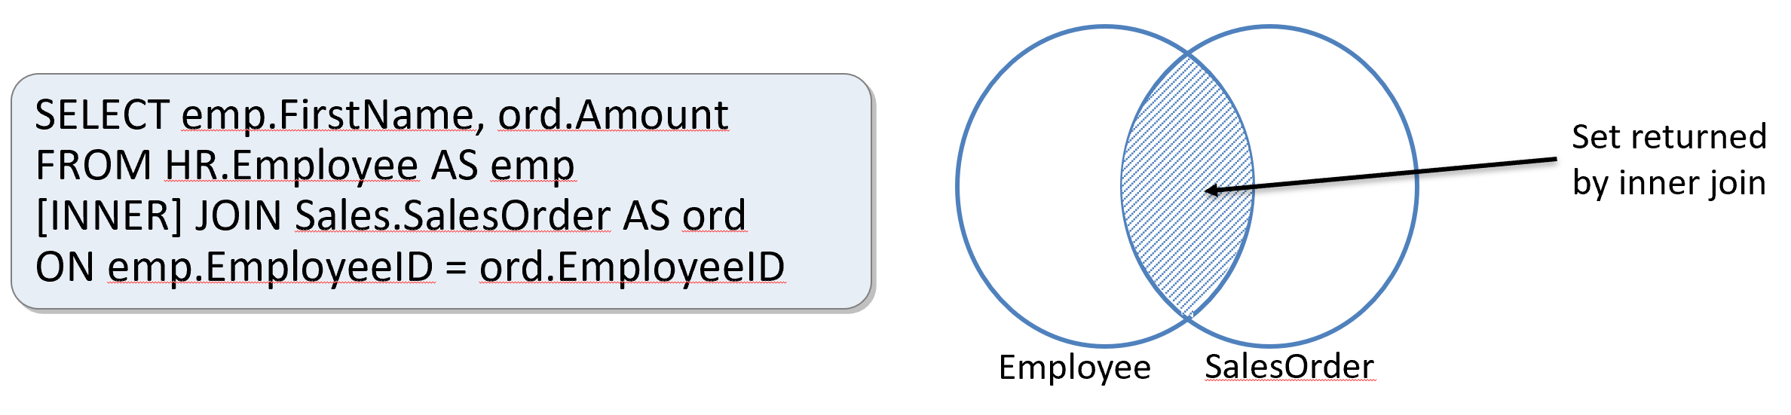
Inner Joins
Return only rows where a match is found in both input tables
Match rows based on attributes supplied in predicate
If join predicate operator is =, also known as equi-join

Slide 53
Inner Joins
Returns only rows where a match is found in both input tables
Matches rows based on attributes supplied in predicate
ON clause in SQL-92 syntax (preferred)
WHERE clause in SQL-89 syntax
Why filter in ON clause?
Logical separation between filtering for purposes of join and filtering results in WHERE
Typically no difference to query optimizer
If join predicate operator is =, also known as equi-join

Slide 54
Inner Joins
DEMO
(Skill 1.2.sql)

Slide 55
Outer Joins
Return all rows from one table and any matching rows from second table
One table’s rows are “preserved”
Designated with LEFT, RIGHT, FULL keyword
All rows from preserved table output to result set
Matches from other table retrieved
Additional rows added to results for non-matched rows
NULLs added in places where attributes do not match
Example: Return all employees and for those who have taken orders, return the order amount. Employees without matching orders will display NULL for order amount.
SELECT ep.FirstName, ord.Amount
FROM HR.Employee AS emp
LEFT [OUTER] JOIN Sales.SalesOrder AS ord
ON emp.EmployeeID = ord.EmployeeID;
Set returned by left outer join
Employee
SalesOrder

Slide 56
Outer Joins
DEMO
(Skill 1.2.sql)

Slide 57
Queries with composite joins and NULLs in join columns
Some joins can be a bit tricky to handle, for instance when the join columns can have NULLs, or when you have multiple join columns—what’s known as a composite join.

Slide 58
Self Joins
Employee
EmployeeID | FirstName | ManagerID
1 | Dan | NULL
2 | Aisha | 1
3 | Rosie | 1
4 | Naomi | 3
Compare rows in same table to each other
Create two instances of same table in FROM clause
At least one alias required
Example: Return all employees and the name of the employee’s manager
SELECT emp.FirstName AS Employee,
man.FirstName AS Manager
FROM HR.Employee AS emp
LEFT JOIN HR.Employee AS man
ON emp.ManagerID = man.EmployeeID;
Result
Employee | Manager
Dan | NULL
Aisha | Dan
Rosie | Dan
Naomi | Rosie

Slide 59
Working with NULLs NULL Values
NULL represents a missing or unknown value
ANSI behaviour for NULL values:
The result of any expression containing a NULL value is NULL
2 + NULL = NULL
'MyString: ' + NULL = NULL
Equality comparisons always return false for NULL values
NULL = NULL returns false
NULL IS NULL returns true

Slide 60
Working with NULLs NULL Functions
ISNULL(column/variable, value)
Returns value if the column or variable is NULL
NULLIF(column/variable, value)
Returns NULL if the column or variable is value
COALESCE (column/variable1, column/variable2,…)
Returns the value of the first non-NULL column or variable in the list

Slide 61
Queries with composite joins and NULLs in join columns
DEMO
(Skill 1.2.sql)

Slide 62
Multi-join queries
A join in T-SQL takes place conceptually between two tables at a time.
A multi-join query evaluates the joins conceptually from left to right.
So the result of one join is used as the left input to the next join.
Multi join queries that mix different join types are very common in
practice and therefore there’s a high likelihood that questions about
those will show up in the exam.
Make sure that you understand the pitfalls in mixing join types, especially when an outer join is subsequently followed by an inner join, which discards the outer rows that were produced by the outer join

Slide 63
Multi-join queries
DEMO
(Skill 1.2.sql)

Slide 64
Resources
Used resources: Exam Ref 70-761 Querying Data w - Itzik Ben-Gan https://github.com/nakicam/70-761
Notes:
Css3 js html + pg sample _ 2 html 5 plus linux w js

Slide 65
Q & A
Email: info@zalnet.pl
Skype: beata.zalewa
Blog: https://blog.zalnet.pl
Demo:
https://github.com/bzalewa/WarsztatyDoEgzaminu70761Lublin
https://github.com/SamanthaDSpivey/Querying-Transact-SQL
Thank you for your precious time☺

