Slide 1
ID:
Password:
Log in
Forgot password?
Notes:
Log in page – Only the administrators are allowed to log in and set the task and task force to complete the task.
None of the other members are allowed, as there will be a risk of other member tampering the database and allocate the man power in unnecessary means.
Ask for the ID and Password to log in to the website.

Slide 2
Recent updates
Admin: Bob Jims
Dashboard
New recent updates will be shown in this web page
Member
Task
Task status
Notes:
Shows all the recent update data

Slide 3
Project Member
Admin: Bob Jims
Field:
ID:
Add
delete
Dashboard
Name:
Email ID:
edit
Member
ID | Name | Email ID | Field
45645 | Bob Jims | Jims@aber.com | Project leader
74444 | Rob Katy | Katy@aber.com | Programmer
45555 | Jute Ron | Ron@aber.com | Programmer
Task
Task status
Notes:
Member page allows the admin to add staff and delete staff.
The admin can use this page if the admin wants to add more staff in the team.
Or else if the team members resigned or has been sent to different place and can no longer work for the project then the admin can delete the staff members form the data base using the this webpage.

Slide 4
Project Member
Admin: Bob Jims
Field: Programmer
ID: 74444
Add
delete
Dashboard
Name:
Email ID:
Edit
Member
ID | First Name | Last Name | Field
74444 | Rob | Katy | Programmer
Task
Task status
Notes:
To delete employee the admin can use the field, ID, First name or Last name and use the search button to search the user.
It search through the database and shows the user
now admin can choose the name from result and use the delete option to delete the name from the database.

Slide 5
Task
Admin: Bob Jims
Dashboard
Task: Start on web page development
Member
Task Member:
Start Date:
Task
Task status:
Completion date:
Task status
add
Task description
Notes:
Task allows the admin to add task in the database that needs to be perform to complete the project.
Task(text box)– add task that needs to be performed for the project completion.
Task member (drop down list)-adds the task members that needs to work on it.
Start date (calendar)– time the task needs to be started
Completion date (calendar)– when the task needs to be complete in.
Task status
Add option allows admin to add the task on the data base.
The green box is the description for the task details

Slide 6
Task
Admin: Bob Jims
Dashboard
Task: Start on web page development
Member
Task Member:
Start Date:
Bob Jims (Programmer)
Rob Katy (Programmer)
Bob Jims (Project Leader)
Shell Sea (Designer)
Woods Hut (Tester)
Completion date:
Task
Task status:
Task status
add
Notes:
Task member – is a drop down list field so the admin can choose who he should assign the project to.

Slide 7
Task
Admin: Bob Jims
Dashboard
Task: Start on web page development
Member
Task Member: Bob Jims (Programmer)
Start Date:
Task
Task Member:
Completion date:
Bob Jims (Programmer)
Rob Katy (Programmer)
Bob Jims (Project Leader)
Shell Sea (Designer)
Woods Hut (Tester)
Task status:
Task status
add
Rob Katy Programmer has been assigned to Start on Programming GUI for mobile application.
Jute Ron Programmer has been assigned to Start on Programming GUI
for mobile application.
Notes:
“+” allows admin to add multiple task member for the specified task.

Slide 8
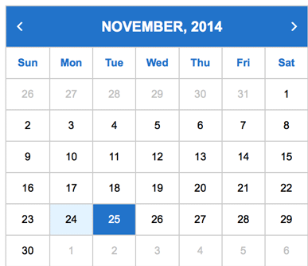
Task
Admin: Bob Jims
Dashboard
Task: Start on web page development
Member
Task Member: Bob Jims (Programmer)
Start Date:
Task
Task Member: Rob Katy (Programmer)
Completion date:
Task status:
Task status
add

Slide 9
Task status
Admin: Bob Jims
Dashboard
Task | Start Date | Completion Date | Stauts
programming the application login. | 2/10/2014 | 2/11/2014 | Ongoing
Designing the login webpage for website | 10/10/2014 | 16/11/2014 | ongoing
Email
Member
Task
Task status
Notes:
Task status shows all the task that is added by the admins to complete the project

