Slide 1


FeedApp
Design Document
Group 5
Beate Skogvik
Rita Haveland Borlaug
Sunniva Storetvedt Lothe

Slide 2
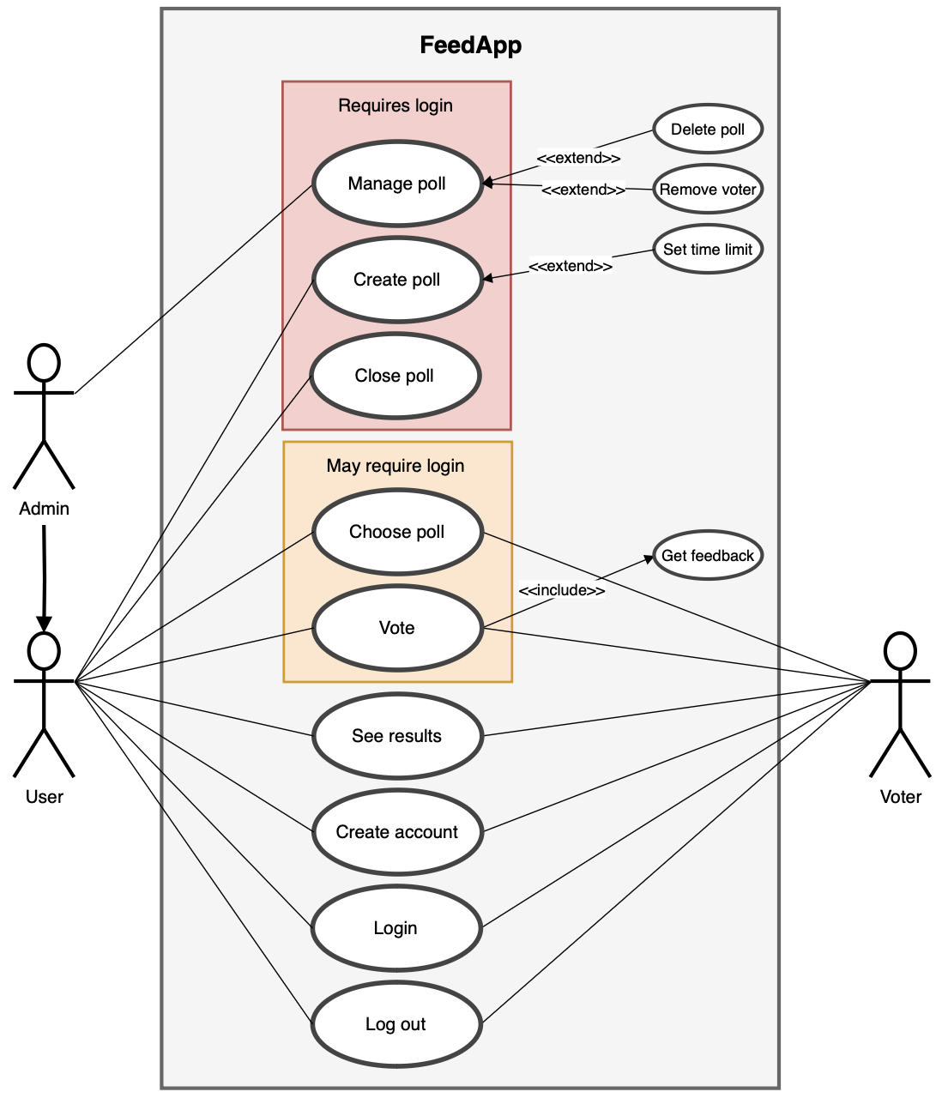
Use case diagram

Slide 3

Domain model

Slide 4



Created tables

Slide 5
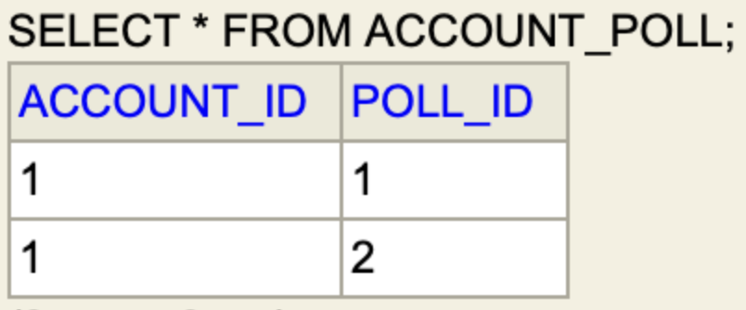
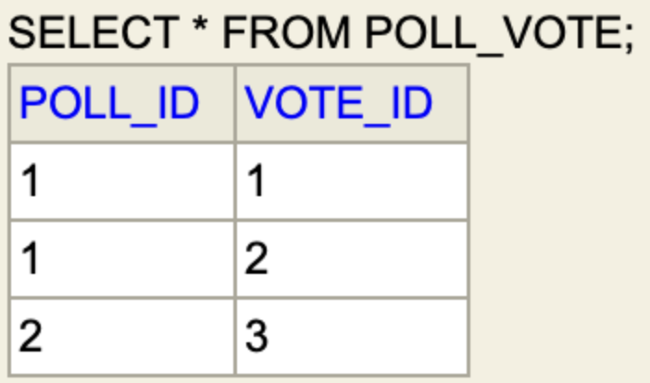
Created tables

Slide 6
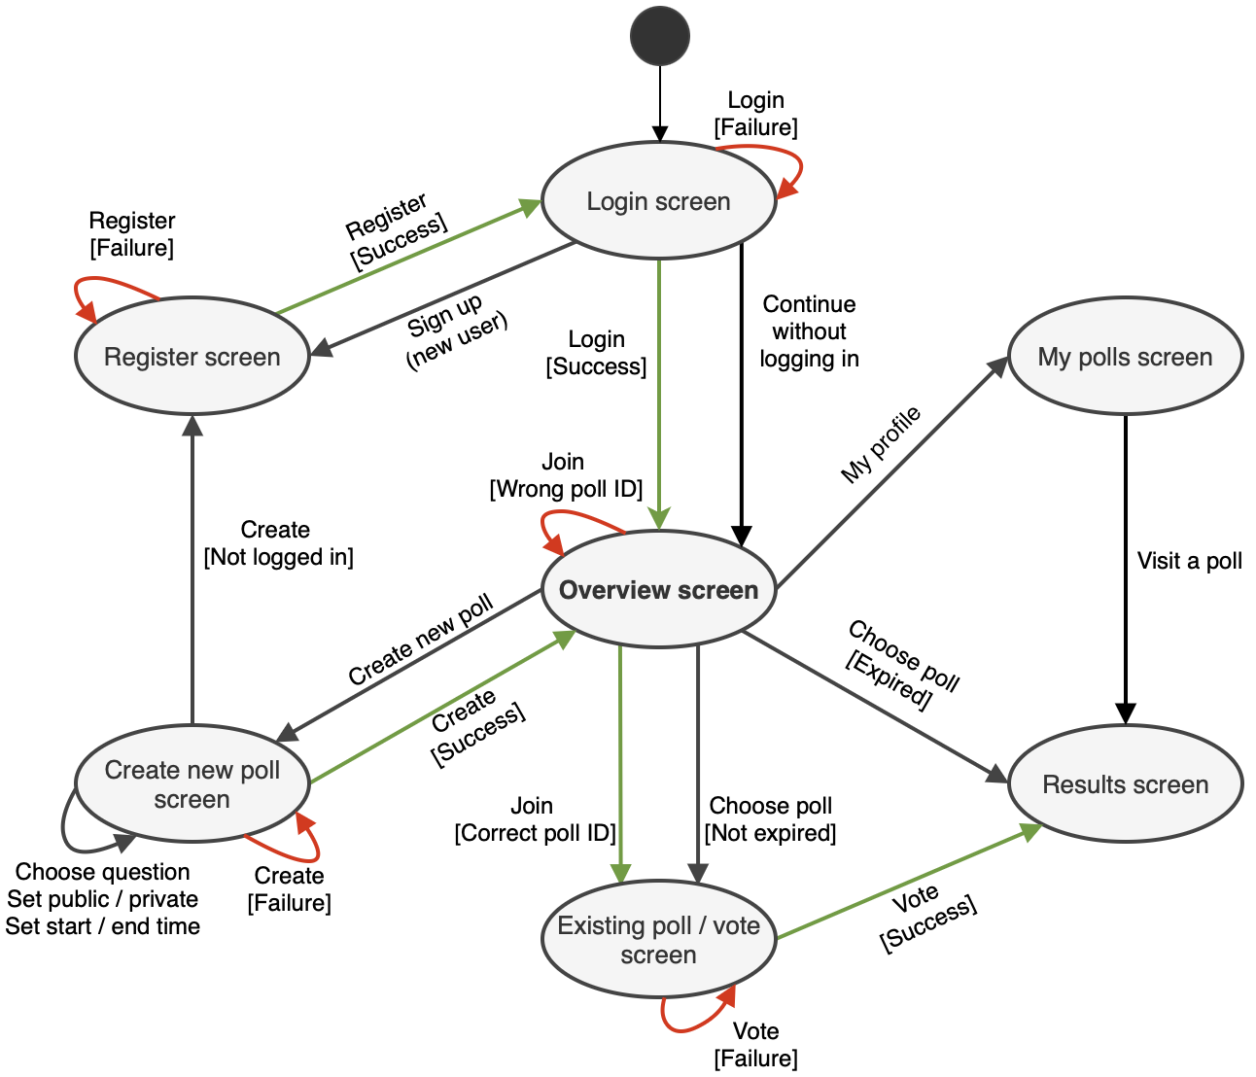
Application flow diagram

Slide 7
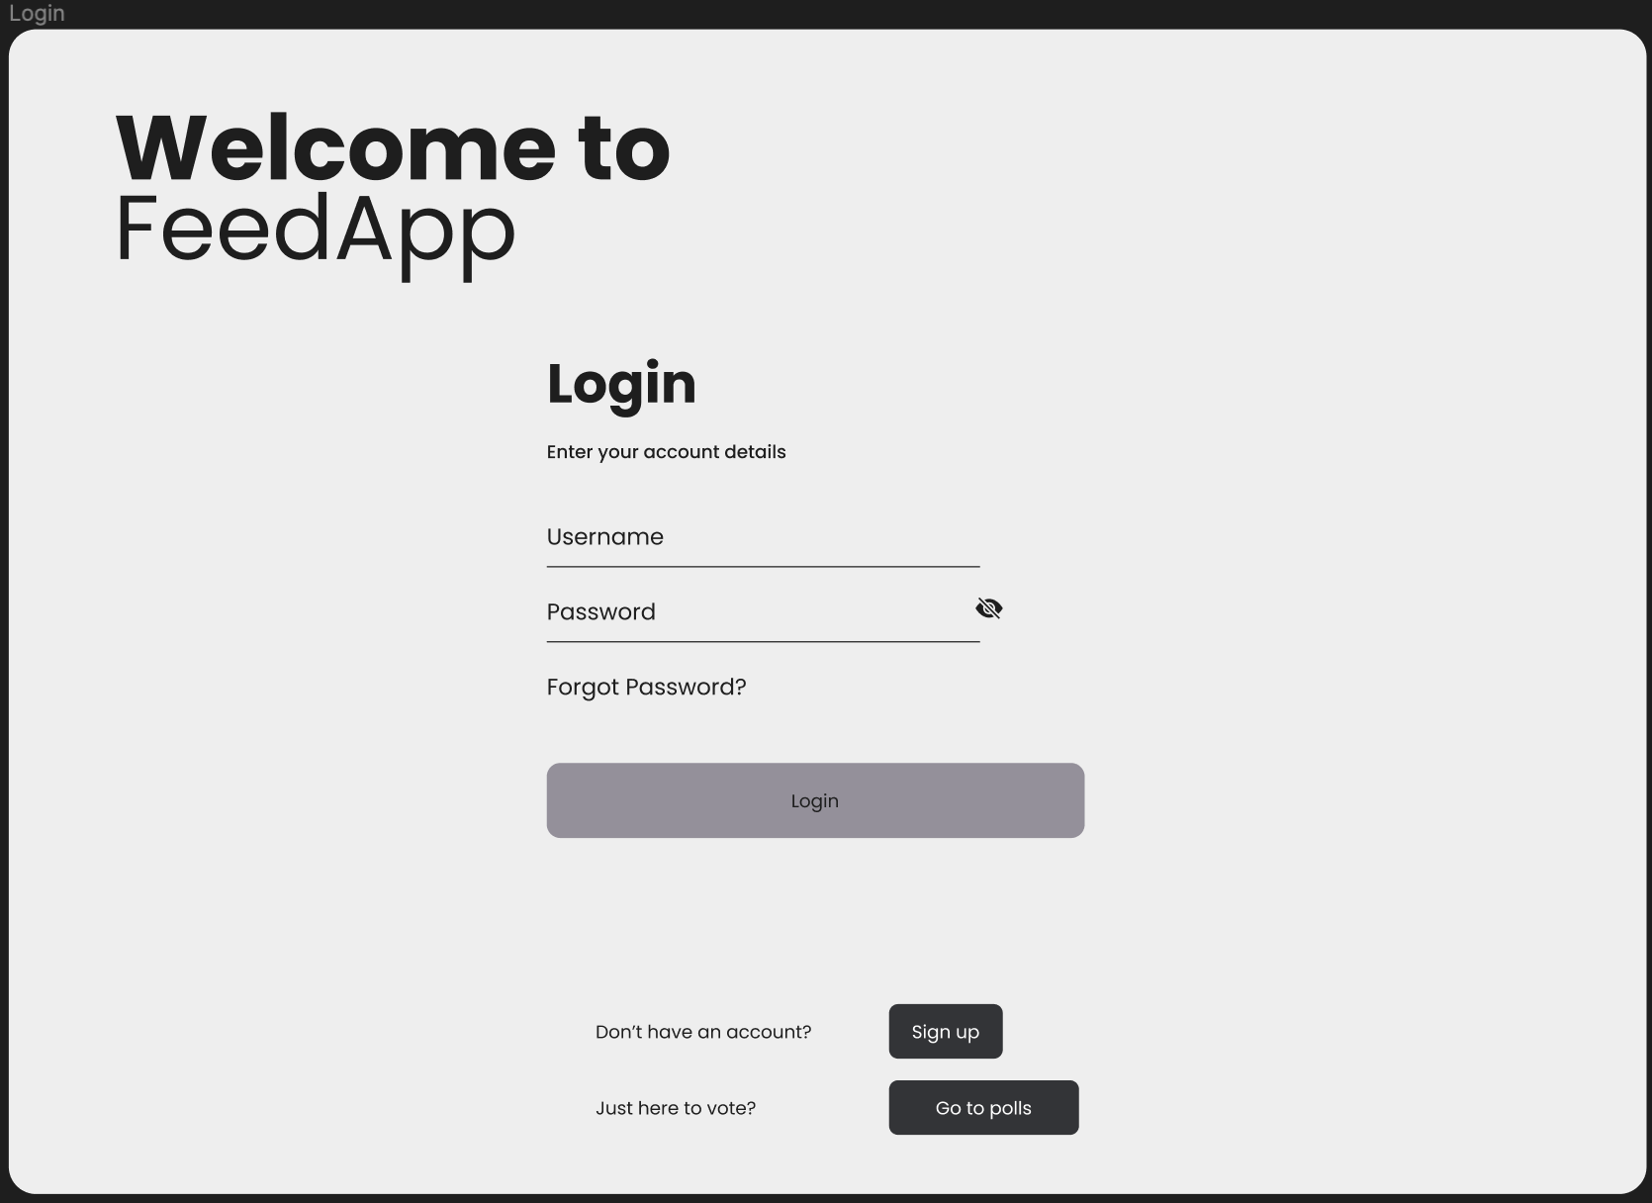
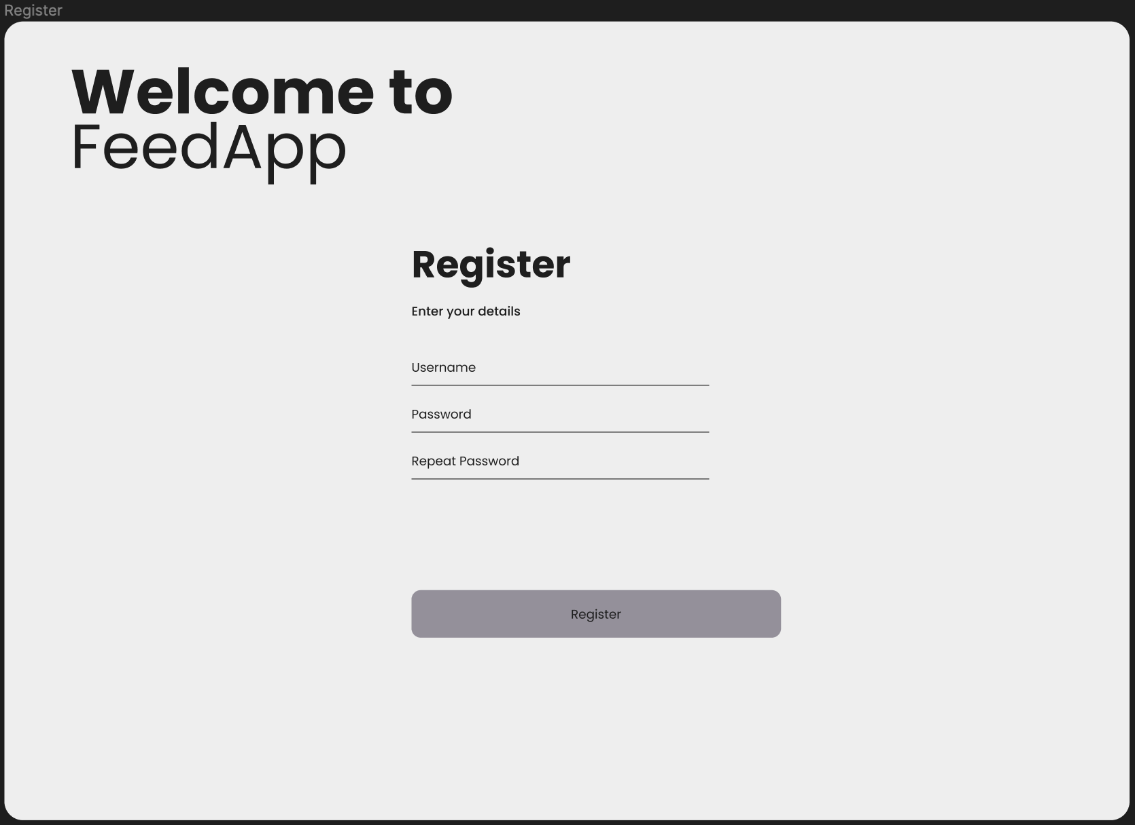
Mock-up user screens

Slide 8
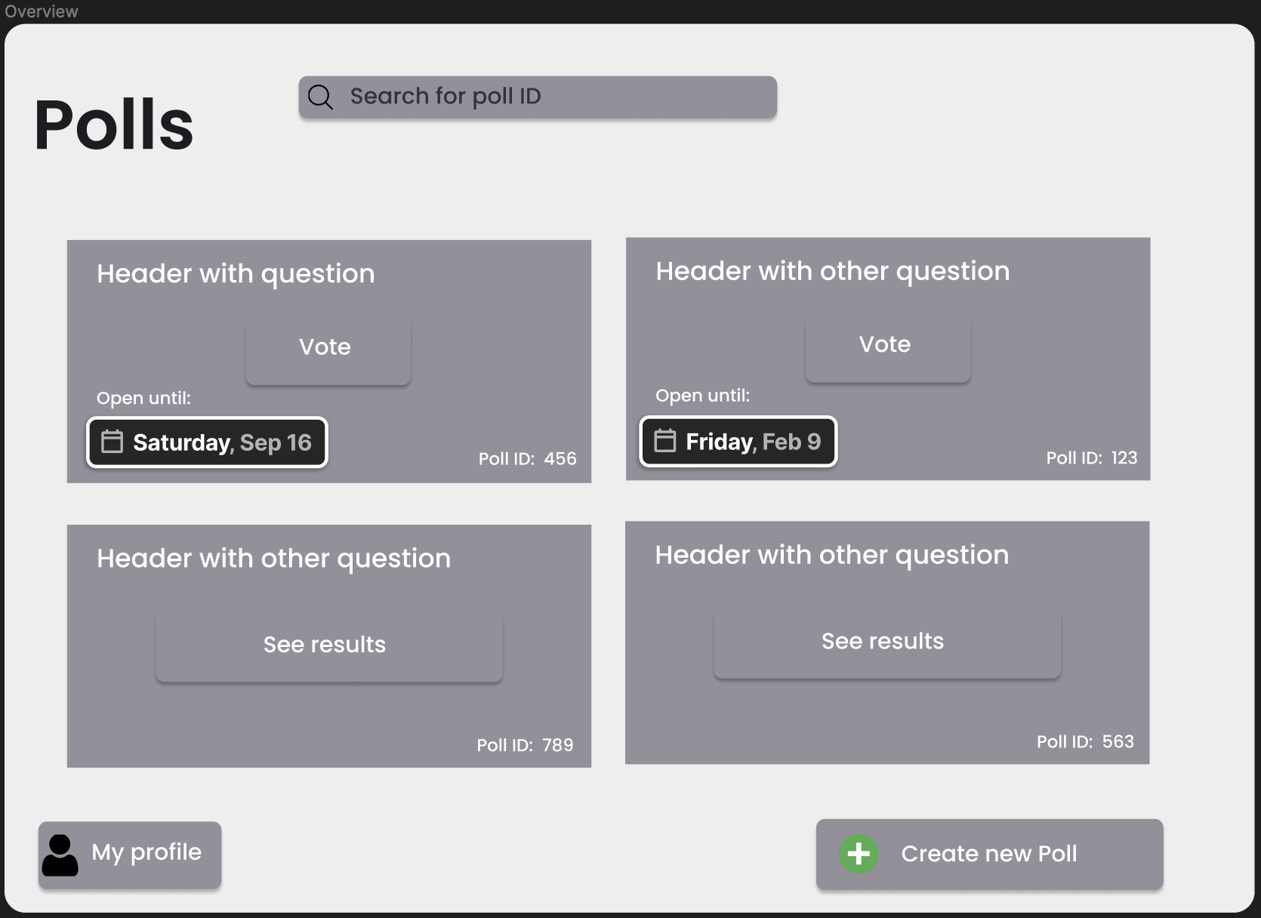
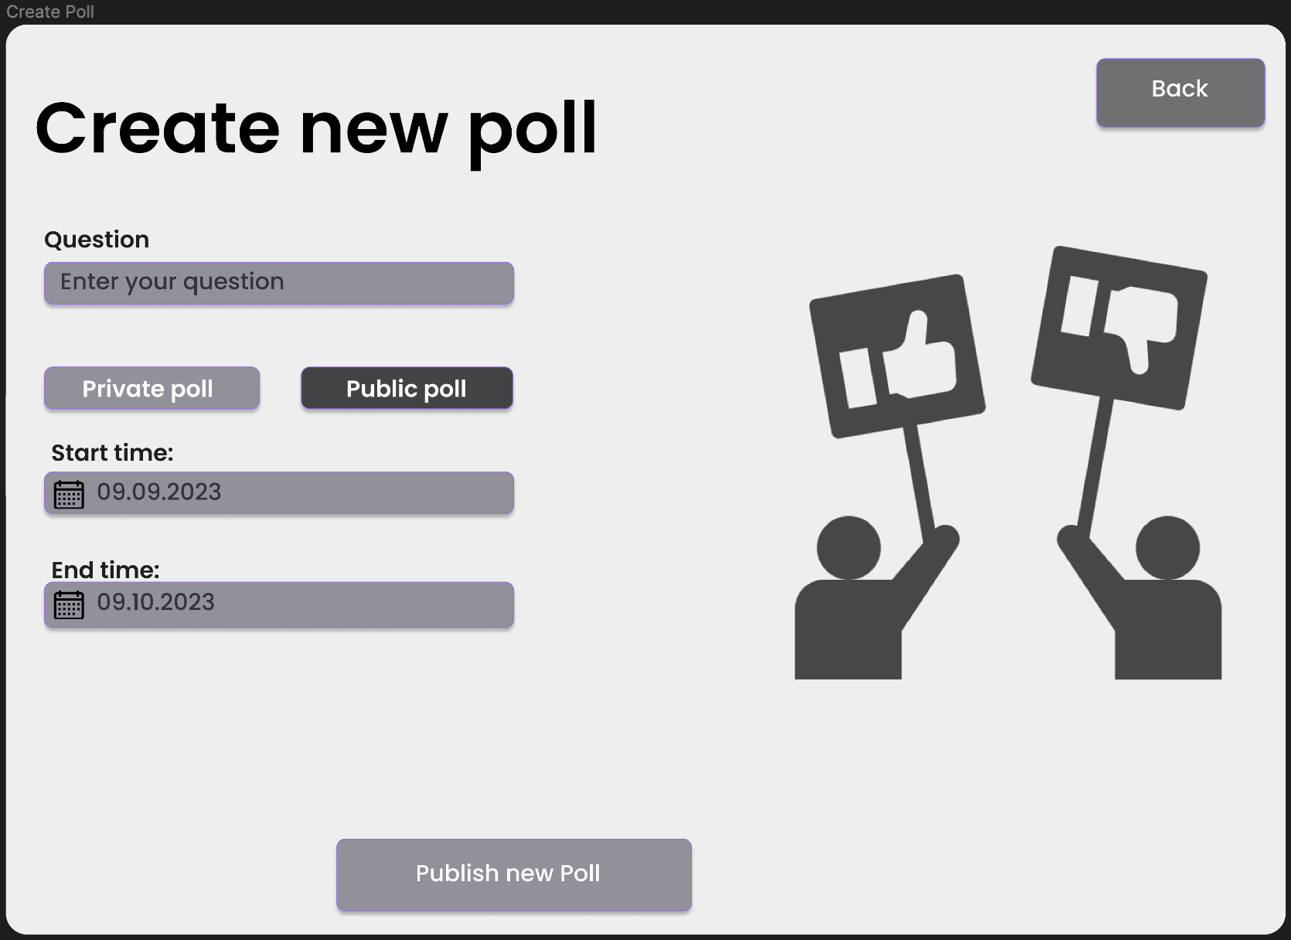
Mock-up user screens

Slide 9
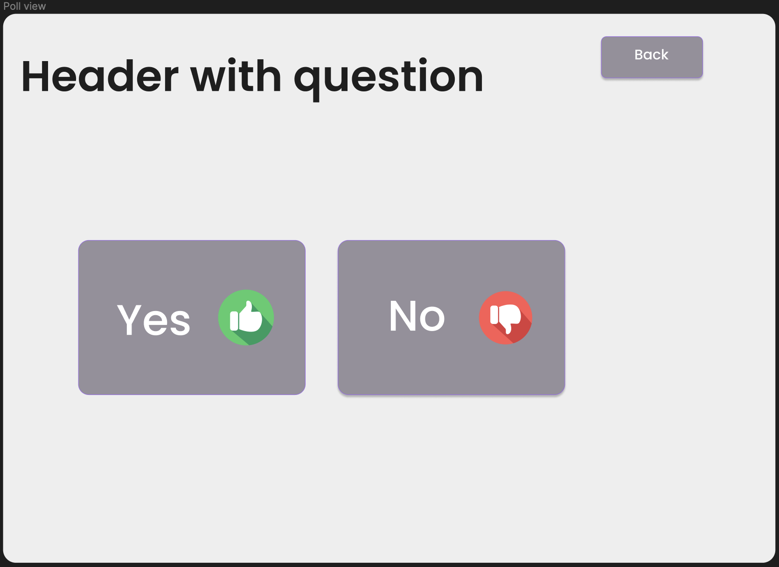
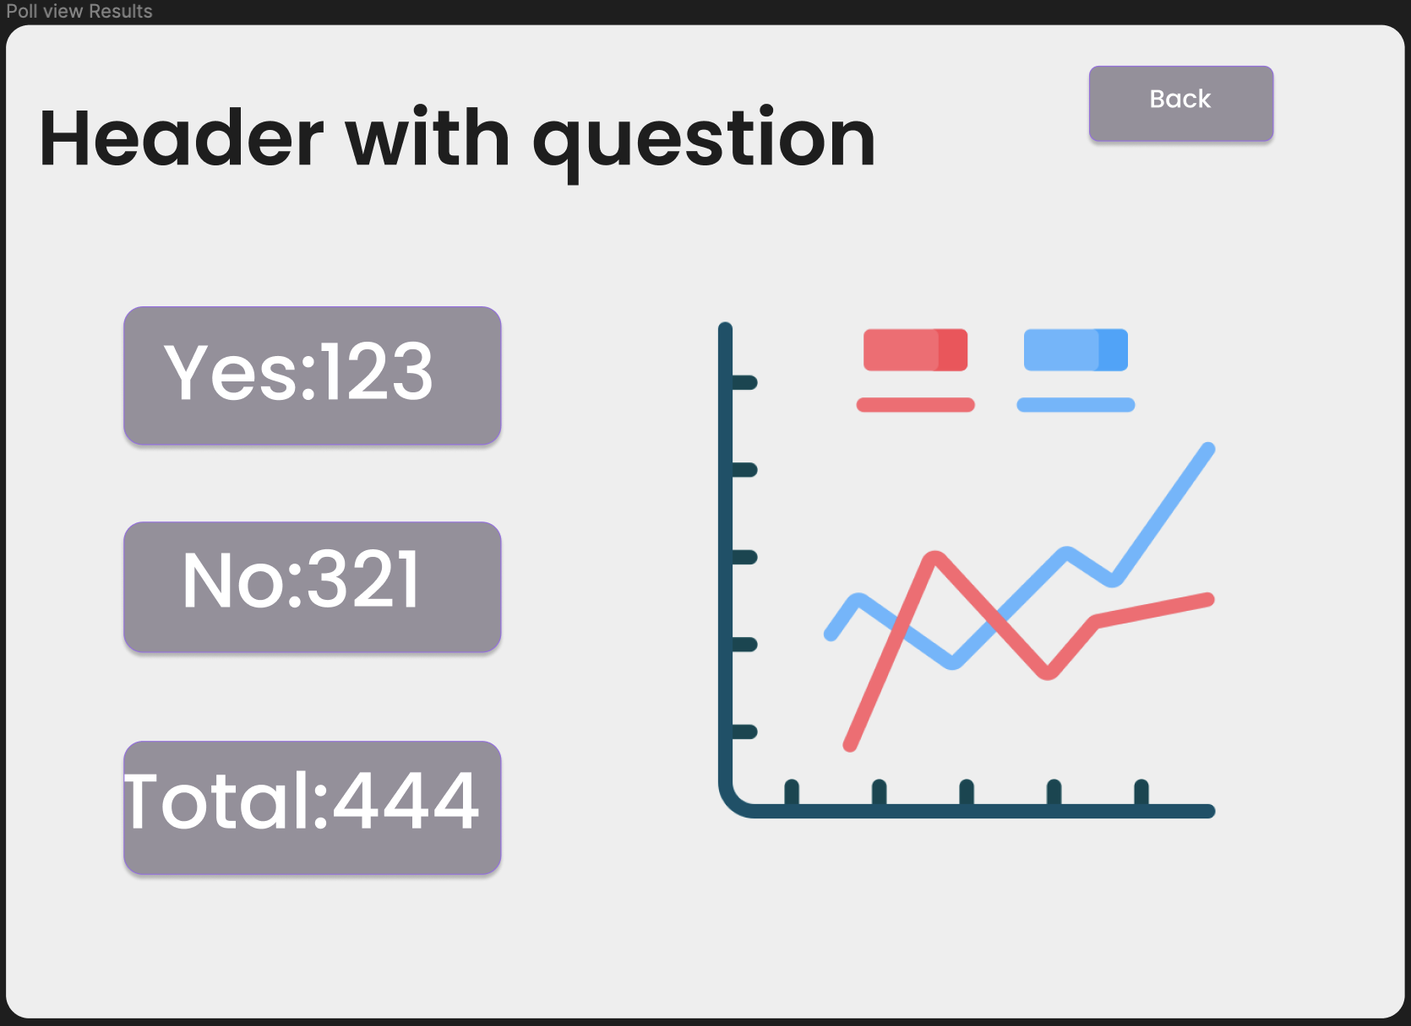
Mock-up user screens

Slide 10
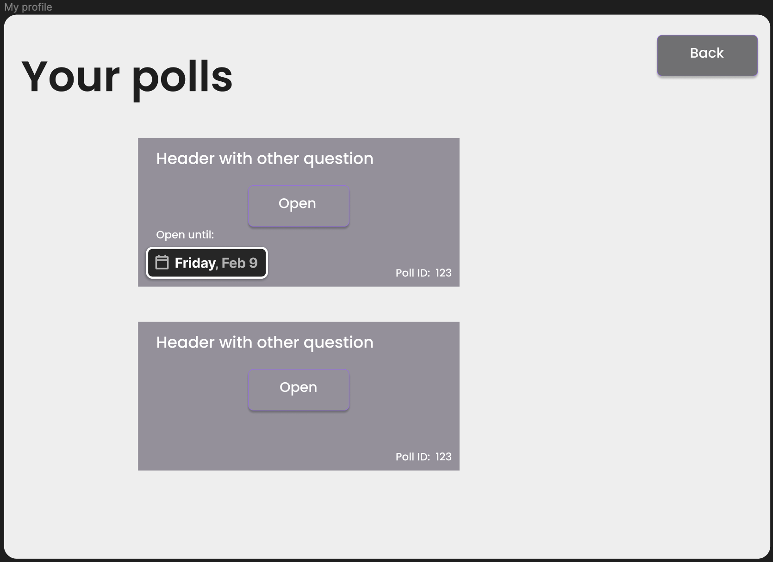
Mock-up user screens

Slide 11
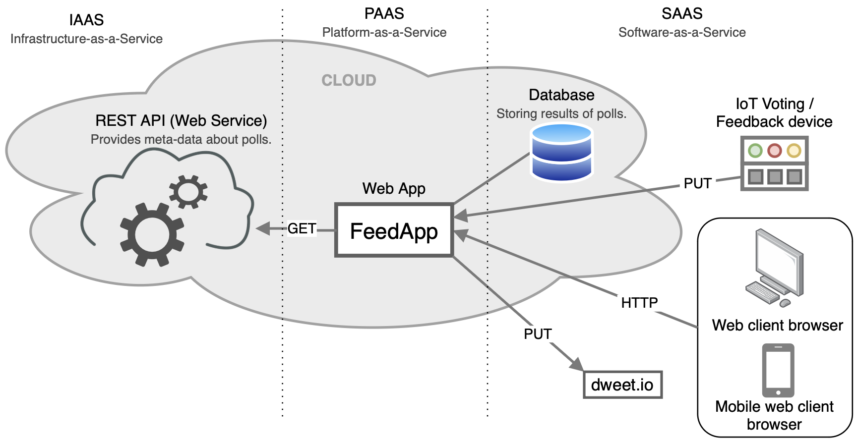
System-specific architectural diagram

