Slide 1


FeedApp
Design Document
Group 5
Beate Skogvik
Rita Haveland Borlaug
Sunniva Storetvedt Lothe

Slide 2
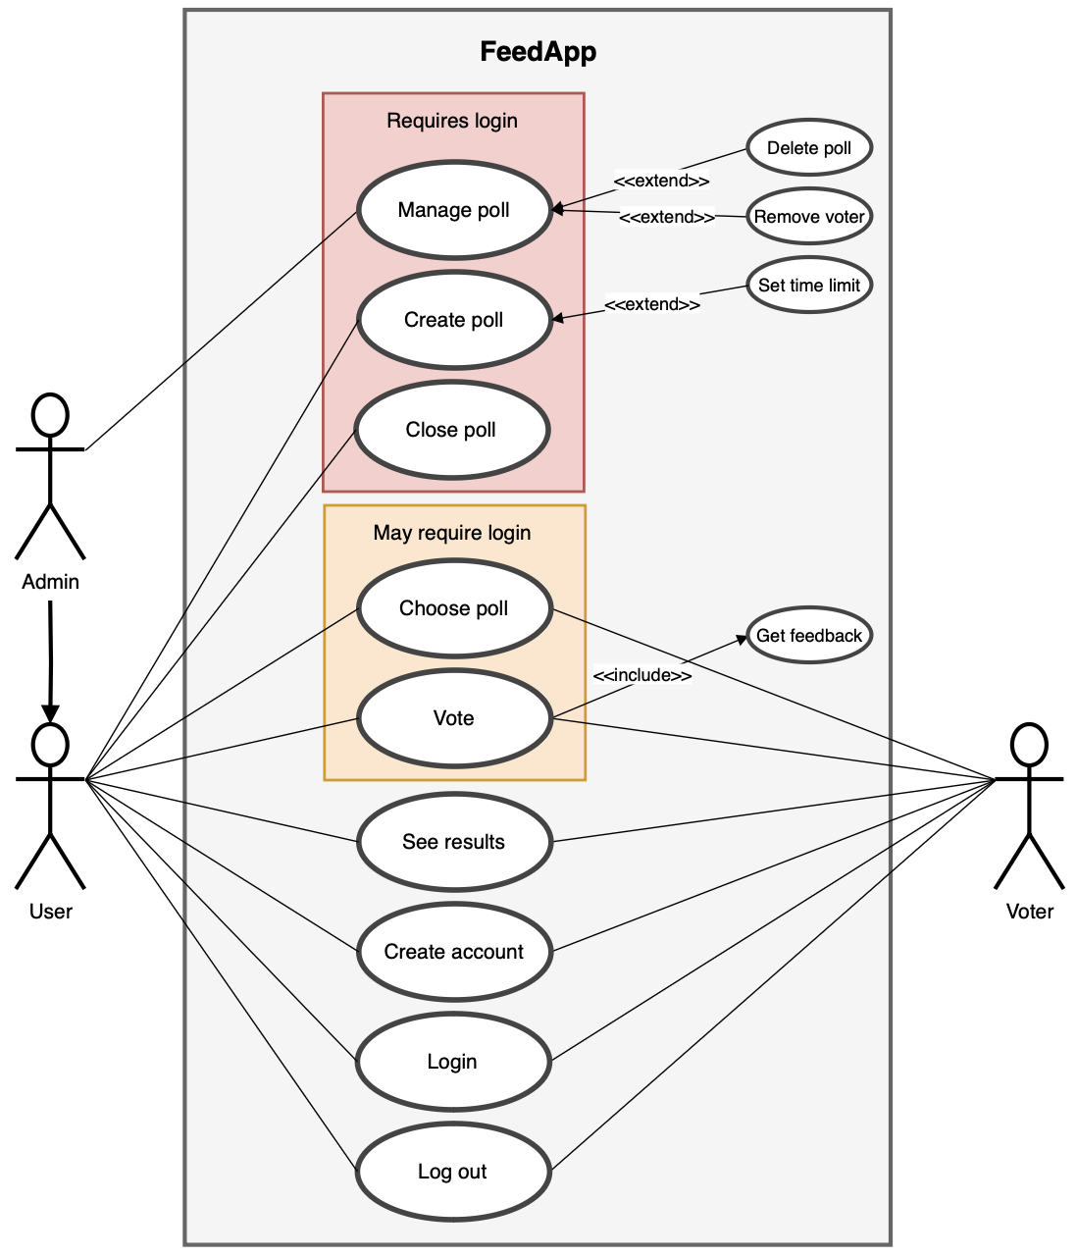
Use case diagram

Slide 3
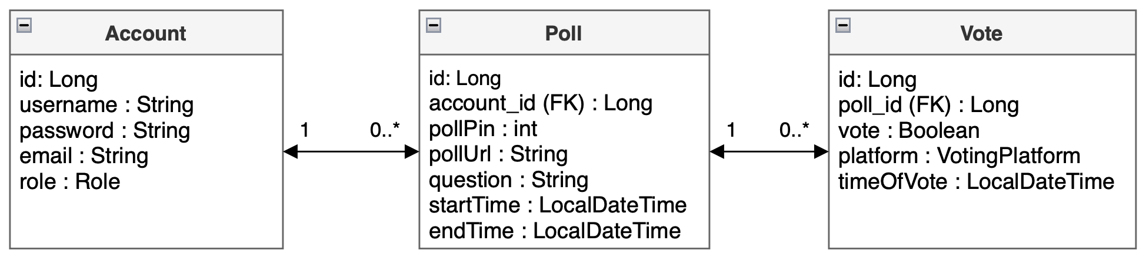
Domain model

Slide 4
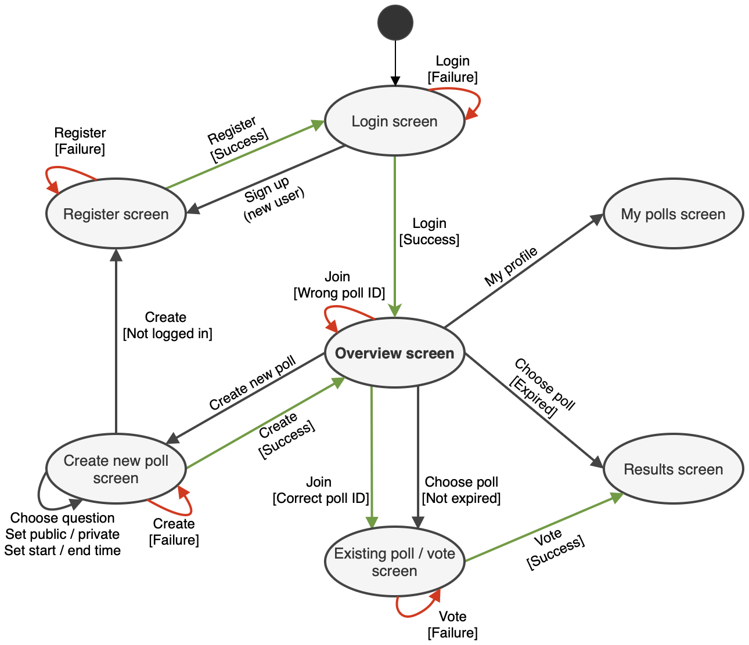
Application flow diagram

Slide 5
Mock-up user screens

Slide 6
Mock-up user screens

Slide 7
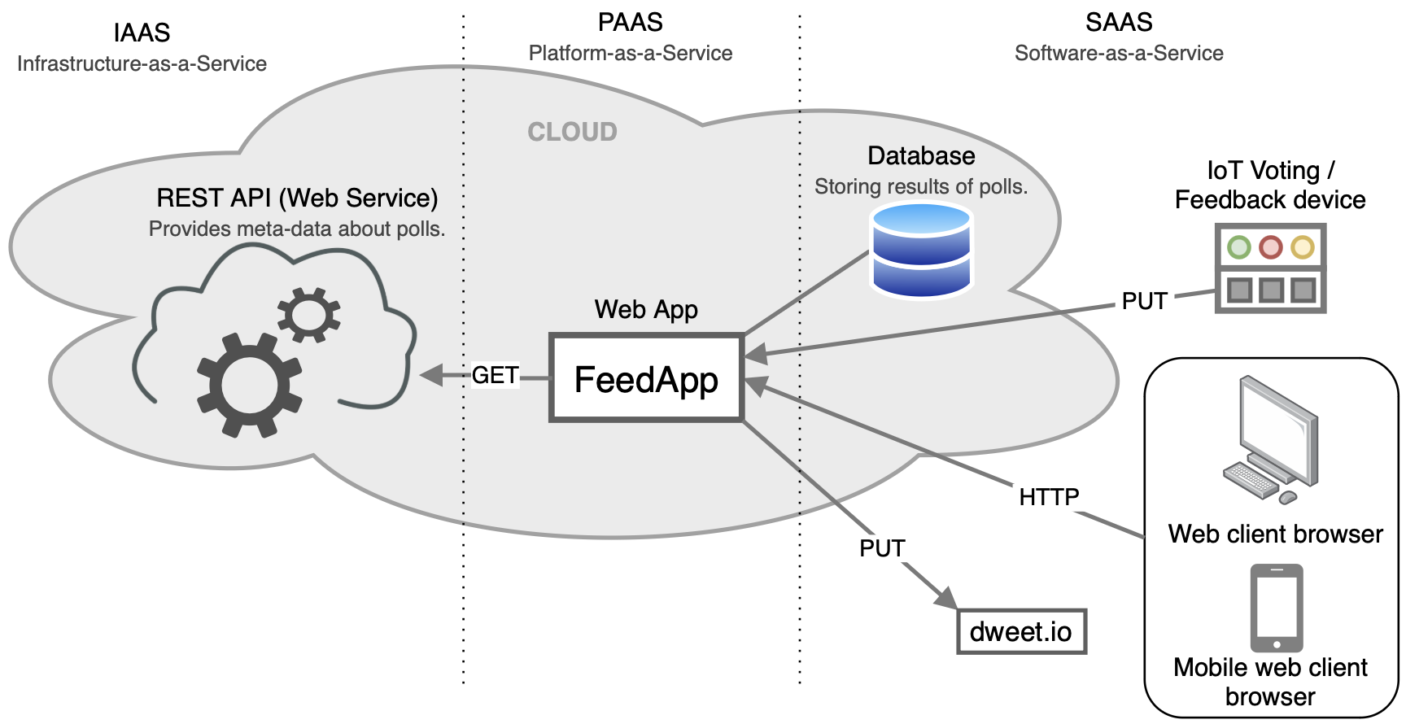
System-specific architectural diagram

