Slide 1


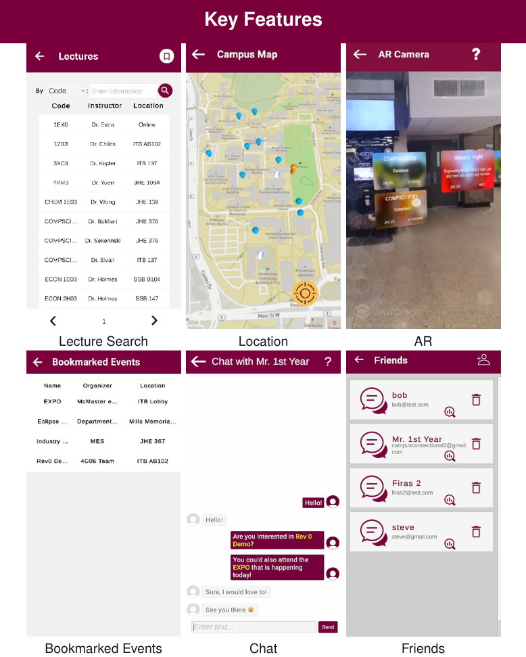
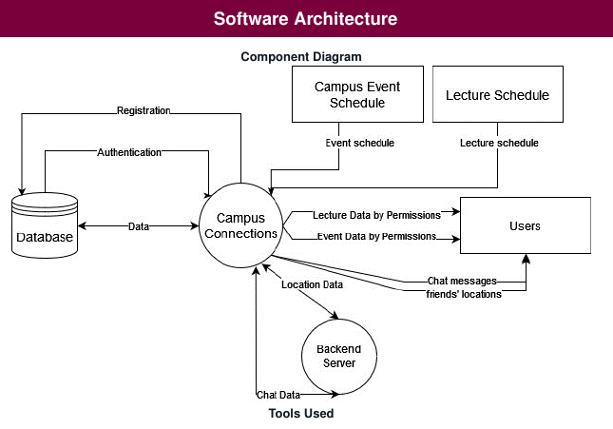







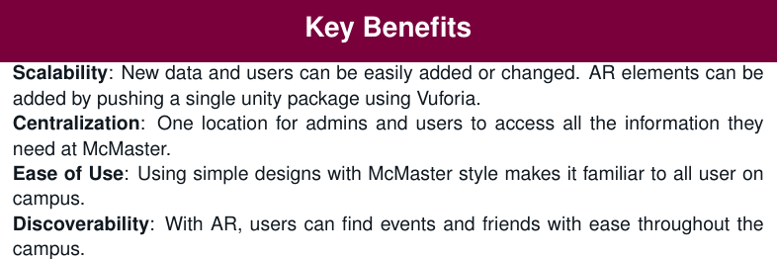
Acknowledgements
To Dr. Irene Yuan, supervisor of this project and for all her help in designing and improving the usability of the application.

