Slide 1
Design Patterns

Slide 2
What is a design pattern?
A design pattern is a general reusable solution to a commonly occurring problem within a given context -- a formalised best practice
Gained popularity after the book “ Design Patterns: Elements of Reusable Object-Oriented Software” by “Gang of four” (GOF)
DPs are NOT: data structures, algorithms, domain-specific system architectures, programming language features
MUST be studied in a language's context
Object-oriented design patterns typically show relationships and interactions between classes or objects, without specifying the final application classes or objects that are involved

Slide 3

Two Principles
Program to an interface not an implementation
In Python we think about interfaces all the time
Duck typing - suitability is determined based on method and properties
If it quacks and can show feathers, it is a duck
Polymorphism

Slide 4
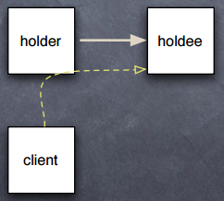
Two Principles
Favour object composition over inheritance
In Python, hold or wrap
Inherit only when it’s really convenient
Exposes everything
Hold: Object O has subobject S as an attribute
Use self.S.method or O.S.method
Simple, direct, immediate

Slide 5
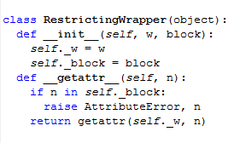
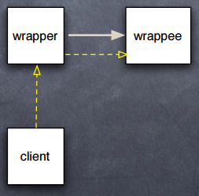
Two Principles
Favour object composition over inheritance
Wrap = Hold + delegate

Slide 6
Classification of Design Patterns
Creational - deal with object creation mechanisms, trying to create objects in a manner suitable to the situation
Structural - deal with mutual composition of classes or objects, ease the design by identifying a simple way to realize relationships between entities
Behavioural - deal with how classes or objects interact and distribute responsibilities among them

Slide 7
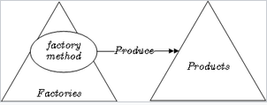
Factory
A subroutine that returns a "new" object may be referred to as a "factory", as in factory method or factory function
An object housing a factory method can also be referred to as factory

Slide 8
Factory
Using factories instead of constructors or prototypes allows one to use polymorphism for object creation -- python inherently supports this. Classes are callable and you can pass them as arguments
The consuming code need not be tied to specific classes/objects
In Python, factory is semantically equivalent to constructor – it generalizes the constructor. Any interface that supports constructor

Slide 9
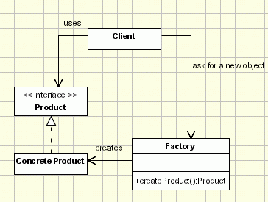
Factory method pattern
factory method pattern uses factory methods to deal with the problem of creating objects without having to specify the exact class of the object that will be created

Slide 10
Factory method pattern
Usually, you have to choose which subclass to instantiate
You do this job in a dedicated factory method
Need to register the classes
Example factory.py

Slide 11
Abstract Factory Method
Provides a way to encapsulate a group of individual factories that have a common theme without specifying their concrete classes
Client code programs to the abstract factory and product interfaces, doesn’t have to worry about the concrete classes and implementation details

Slide 12
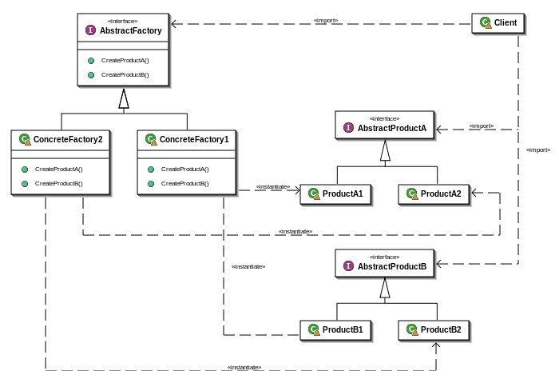
Abstract Factory Method
Example abstract_factory.py

Slide 13

Singleton
We want only one instance to exist
Sub-classing is a problem to Singleton
Other approaches: import module, create only one instance ☺

Slide 14
Dependency Injection
Objects are created “outside”
Good way of implementing loose coupling
Inherent to Python
Makes unit testing flexible and easy

Slide 15
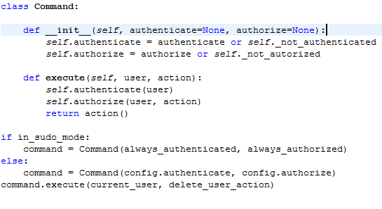
Dependency Injection

Slide 16
Other creational patterns
Builder
Object Pool
Prototype
Lazy Initialisation

Slide 17
Adapter
Client code C requires a protocol P1
Supplier code S provides different protocol P2 (with a superset of P1's functionality)
Adapter code A "sneaks in the middle": A implements P1 by means of appropriate calls to S
A is a supplier (produces protocol P1) to C, A is also a client (consumes protocol P2) "inside“
Can be implemented at class level (subclassing/using Mixin classes) or object level (Wrap)
E.g. socket._fileobject: from sockets to file-like objects (w/much code for buffering)
Python, often _callables_ are adapted too via decorators, functools etc.

Slide 18
Facade
Interpose a simpler "Facade" object/class exposing a controlled subset of functionality
Client code calls into the Facade only
Facade implements its simpler functionality via calls into the rich, complex subsystem
Clients gain simplicity

Slide 19
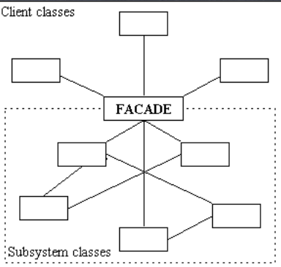
Facade

Slide 20
Other structural patterns
Decorator - Add functionality without inheritance, already integrated into the python language
Proxy - Prevent direct access, decouple from access/location

