Slide 1
HTML

Slide 2
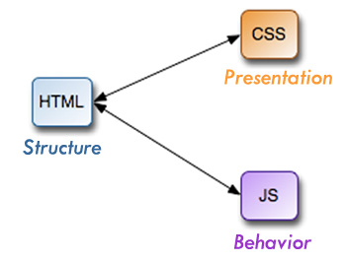
Separation of content and presentation
Separation of content and presentation (or separation of content and style) is a design principle under which visual and design aspects (presentation and style) are separated from the core material and structure (content) of a document.

Slide 3
Same content multiple devices
HTML
Content
CSS
CSS
CSS
CSS
CSS
Presentation
Device
TV
Print
Audio
Mobile
Assistive
Technology

Slide 4
HTML Versions - Who Decides?
HTML5 is specified by the HTML Working Group of theW3C following the W3C process
W3C
The World Wide Web Consortium (W3C) is an international community where Member organizations, a full-time staff, and the public work together to develop Web standards. Led by Web inventorTim Berners-Lee and CEO Jeffrey Jaffe, W3C's mission is to lead the Web to its full potential.

Slide 5
Tim Berners-Lee
The inventor of the World Wide Web.
He made a proposal for an information management system in March 1989,
He implemented the first successful communication between a Hypertext Transfer Protocol (HTTP) client and server via the Internet sometime around mid-November of that same year.

Slide 6
First Website
The first website built was at CERN within the border of France,^{[30]} and was first put online on 6 August 1991:
http://info.cern.ch/hypertext/WWW/TheProject.html

Slide 7
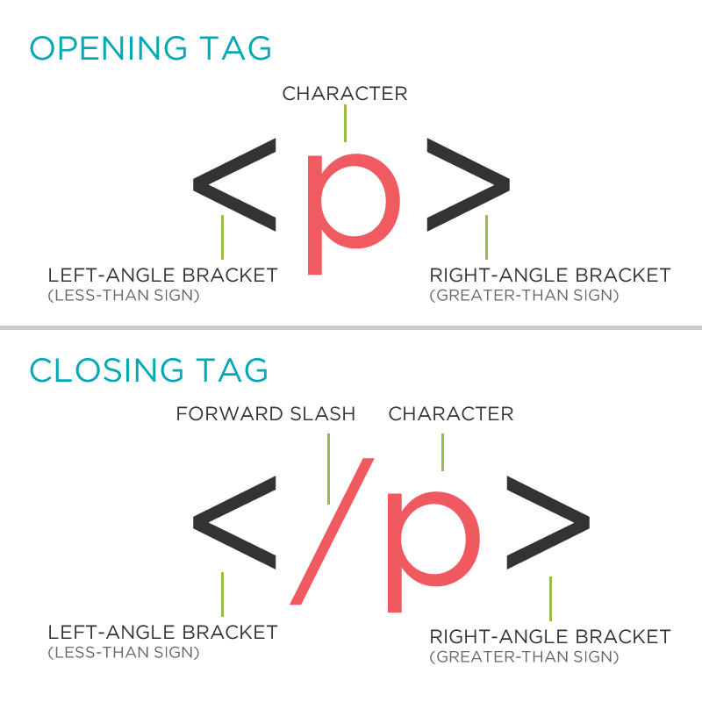
Basic tag

Slide 8
Basic Structure
<!DOCTYPE HTML>
<html>
<head>
<title>Title of the document</title>
</head>
<body>
<p>The content of the document......</p>
</body>
</html>

Slide 9
<!DOCTYPE HTML>
The <!DOCTYPE> declaration must be the very first thing in your HTML document, before the <html> tag.
Instruction to the web browser about what version of HTML the page is written in
HTML5 there is only one
<!DOCTYPE html>

Slide 10
<html></html>
The <html> tag tells the browser that this is an HTML document.
These are the opening tags for your webpage
All markup should be placed inside of these tags

Slide 11
<head><head>
The <head> element can include tags for css, javascript, keywords, here are some:
<title> (this element is required in an HTML document), <style>, <base>, <link>, <meta>, <script>, <noscript>
The elements placed in the head tag are meant for browsers to preprocess before loading the rest of the document

Slide 12
<body></body>
The <body> tag defines the document's body.
The <body> element contains all the contents of an HTML document, such as text, hyperlinks, images, tables, lists, etc.

Slide 13
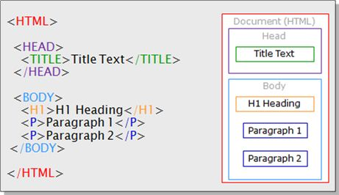
HTML Structure

