Slide 1
Development of a vascularized 3D scaffold for tissue regeneration using plant-derived materials
- Liver tissue regeneration
260344 Ares Brambilla
280549 Andrea Col
260155 Elisa Colombo
259192 Rebecca Maria Di Giacinti
259093 Beatrice Lino
Bioartificial and Biomimetic Structures
Prof S. Farè

Slide 2
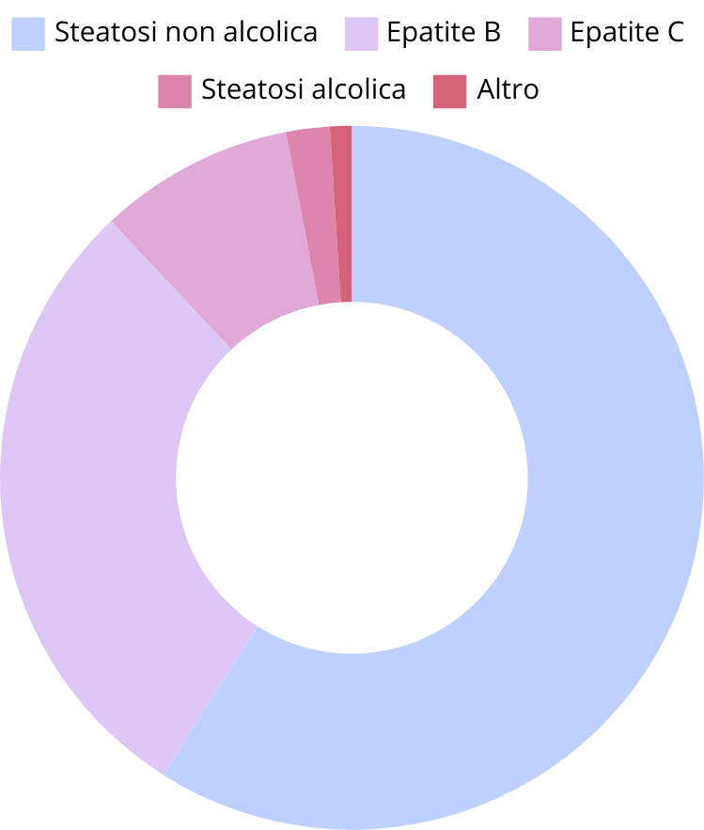


INTRODUCTION
Chronic liver diseases
Liver functions:
Homeostasis
Xenobiotic metabolism
Detoxification
Immune regulation
AMBIENT
2 million deaths worldwide every year

Slide 3
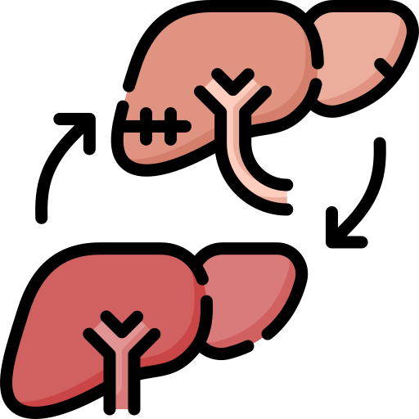

INTRODUCTION - treatments
Orthotopic liver transplantation (OLT)
Gold standard and currently the best known treatment for liver failure. Donor availability and immunosuppressive drugs are the critical points.
Extracorporeal liver support
For patients on the waiting list or in the early stages after transplantation. Limits on movement and volumes, and optimal oxygen supply.
Tissue engineering
Innovative and accessible solution to reduce the mortality rate, without the previous restrictions.
MORPHEUS

Slide 4
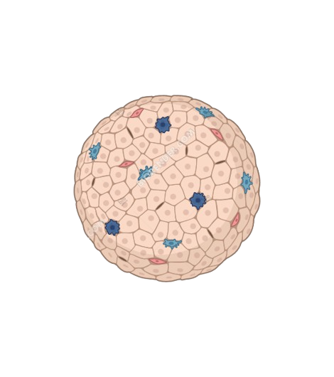
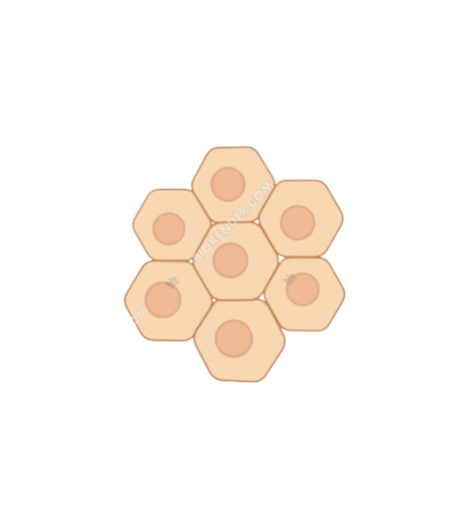

STRUCTURE AND REQUIREMENTS
OBJECTIVE: regeneration of the damaged structural units, the LIVER LOBULES
Anatomical structure:
Geometry
Cell adhesion
Porosity
Mechanical properties
Vascularization
Dense layer of connective tissue that follows the branches of blood vessels and bile ducts, delimiting the structural units called liver lobules, in which blood flows from the center to the periphery.
Degradability

Slide 5
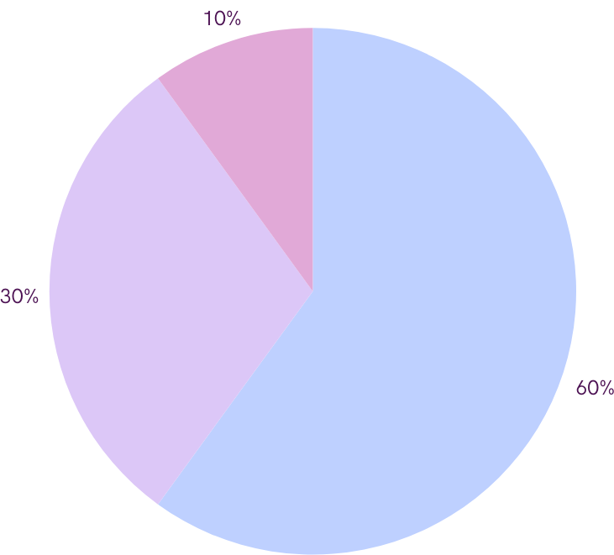
MATERIALS
Alginate
Algae-derived
Non-toxic
Non-immunogenic
Biodegradable
Chemically modified with Norbornene

Slide 6
MATERIALS
Gelatin
Collagen-derived
Biocompatible
Non-cytotoxic and low immunogenicity
Improves printing performance
Excellent workability
Low cost
Chemically modified with Tetrazine
Gel_Tz + Alg_Nb
BIO-ORTHOGONAL CLICK REACTION
SCAFFOLD CROSSLINKING

Slide 7
MATERIALS
Soy peptide powder SPP
Product of SP proteolysis
Excellent biocompatibility and cytocompatibility
Improved printability of the bioink
Promotes cell adhesion and proliferation
Promotes angiogenesis
The BIOINK was made with cells of the endothelial line HUVEC

Slide 8
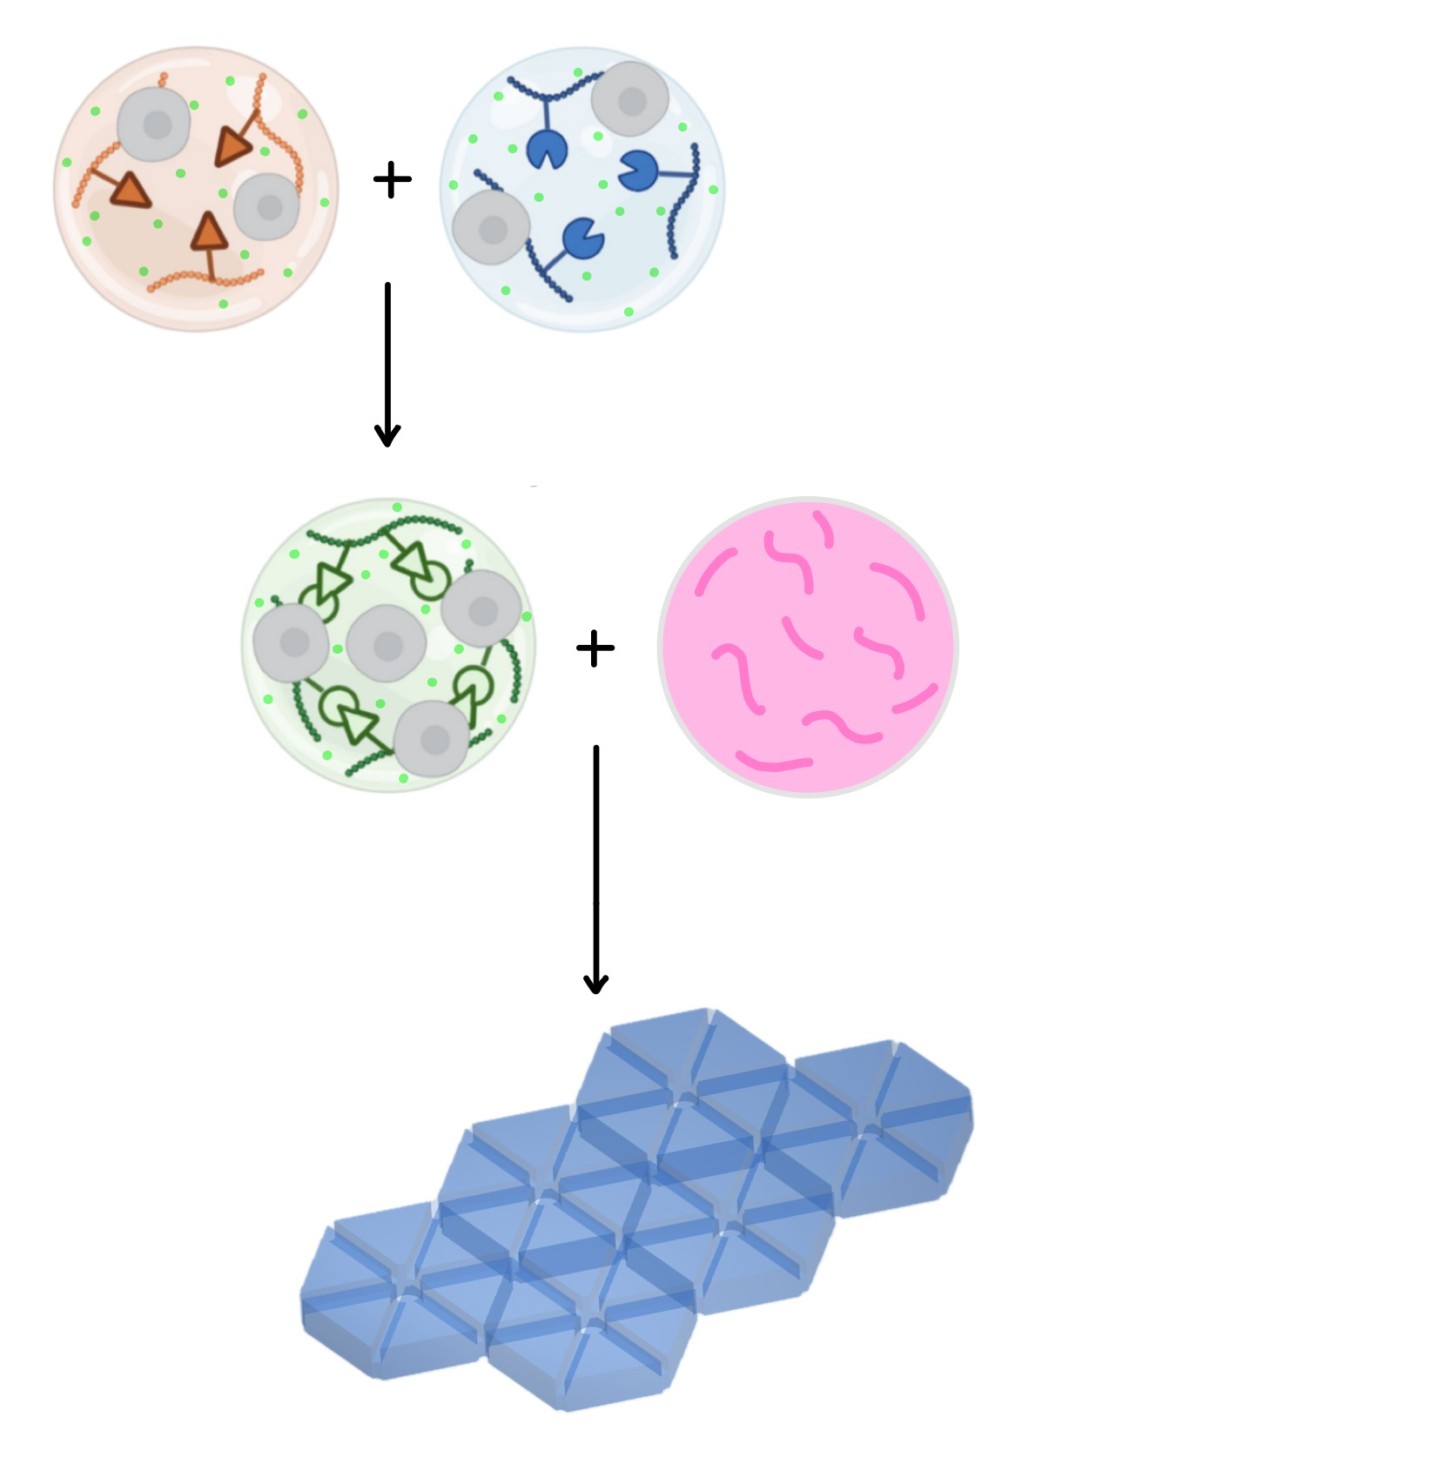
FABRICATION METHOD
Materials: | Bioink of Alg_Nb + Gel_Tz + SPP+ cells, PEG 600-1000
Printing technique: | Piston-driven extrusion-based
Shape of the structural unit: | Hexagon
Ø of the circumscribed circle: | 2 mm
Unit height: | 1 mm
Ø of the central channel: | 250 μm
L of the transverse channels: | 150 μm
Height of the transverse channels: | 0.5 mm
Final patch dimensions (L x W x H): | 3.4 cm x 4 cm x 0.5 cm
Alg_Nb + SPP + cells
Gel_Tz + SPP+ cells
PEG 600-1000
 | Melting point (°C) | Freezing point (°C)
PEG 600 -1000 (1:1) | 34.1° ± 1° | 26.7°±1°
AMBIENT
 | Cartridge T (°C) | Print bed T (°C)
BIOINK | 32° | 25°
PEG 600 -1000 (1:1) | 35°
SCAFFOLD

Slide 9
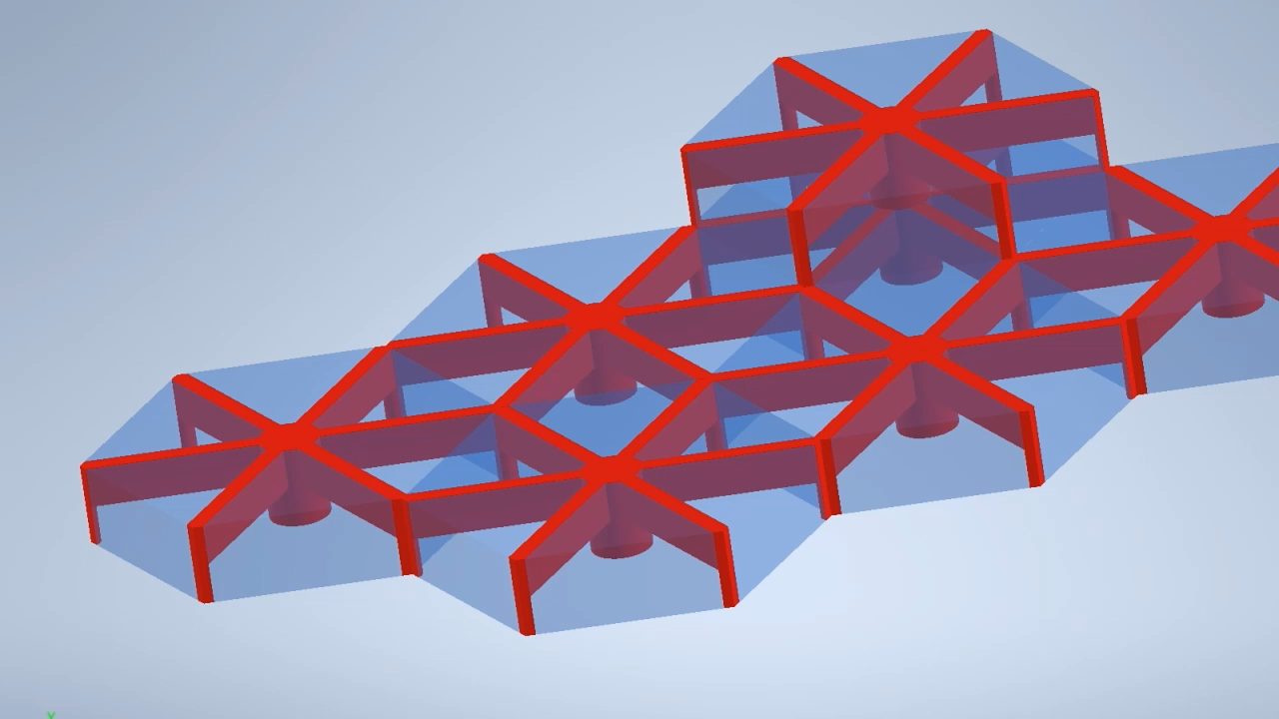
PRINTING GOAL
AMBIENT

Slide 10
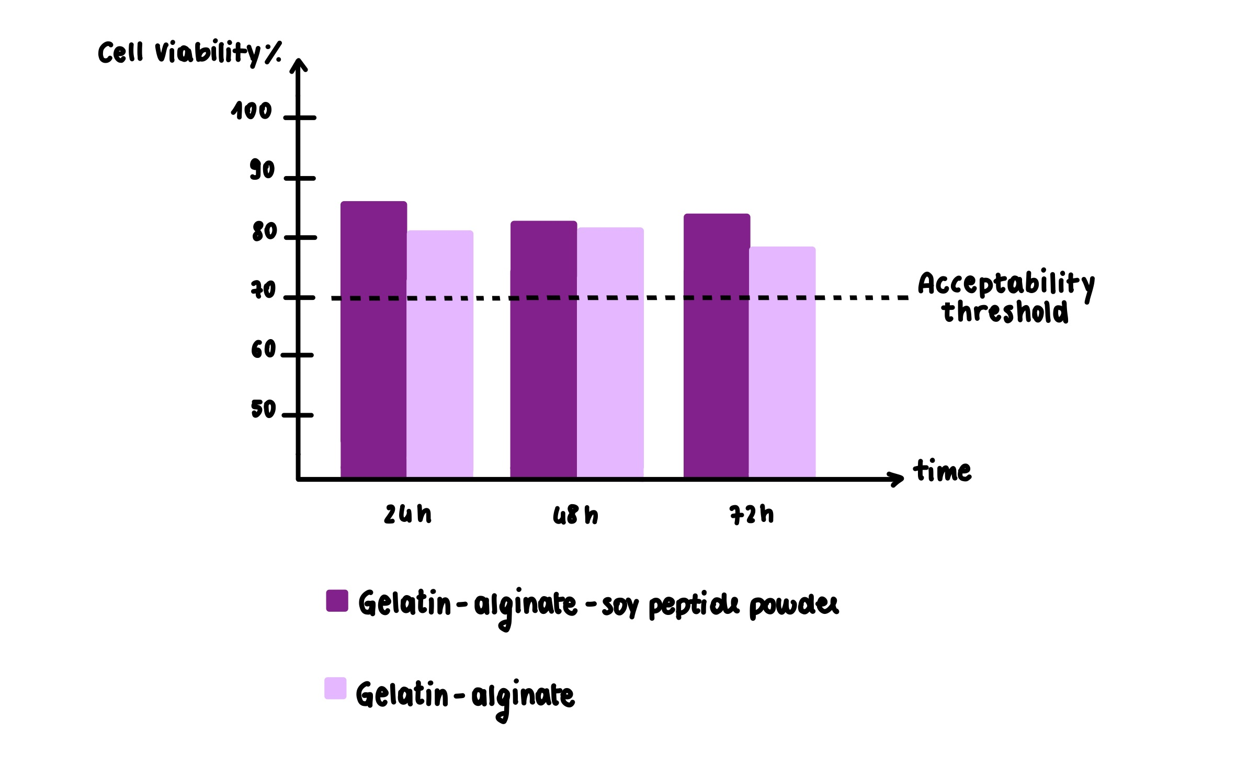
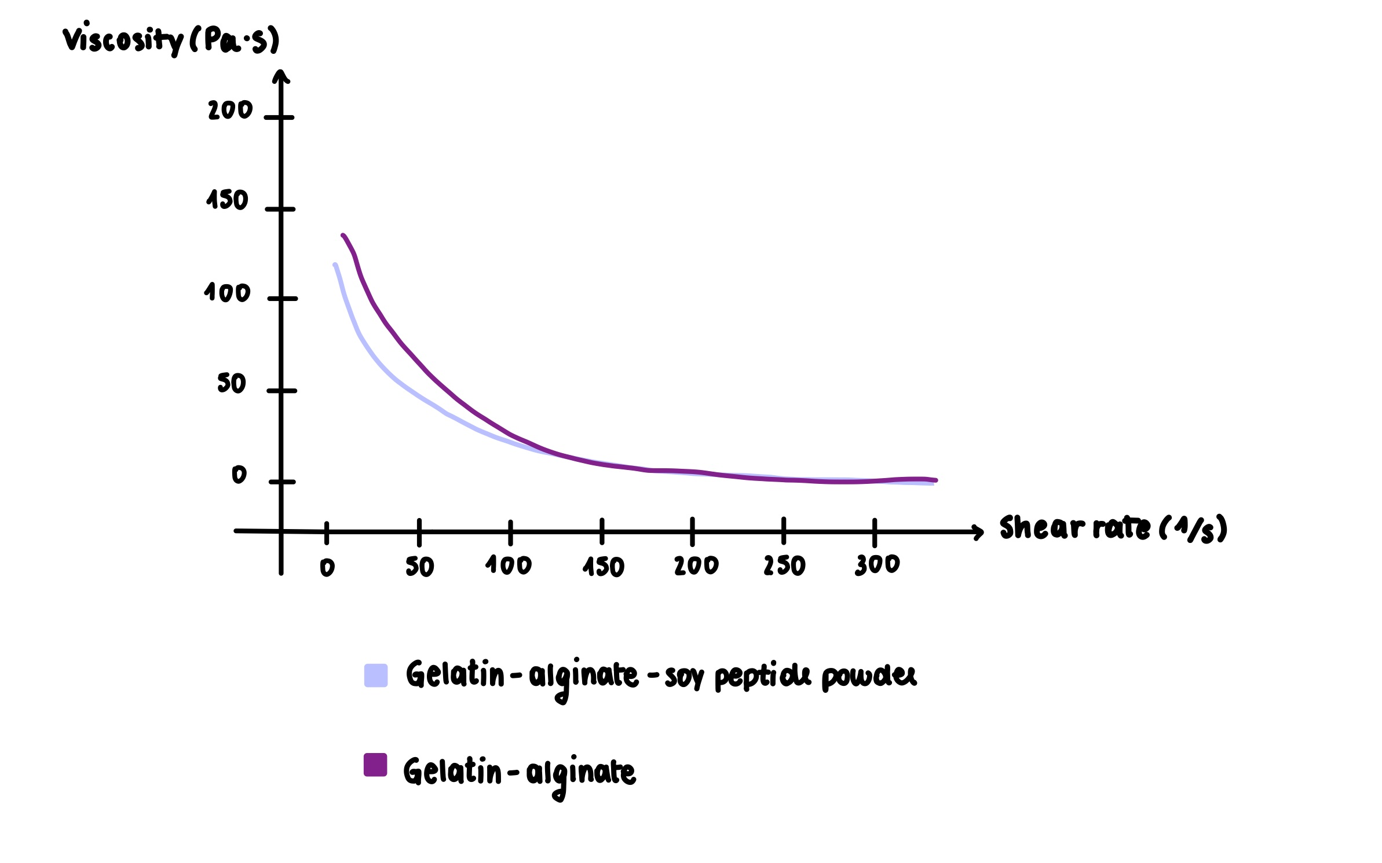
PRE-PRINTING CHARACTERIZATION
Indirect cytotoxicity test:
Rheological test with shear rate ramp:
MORPHEUS

Slide 11
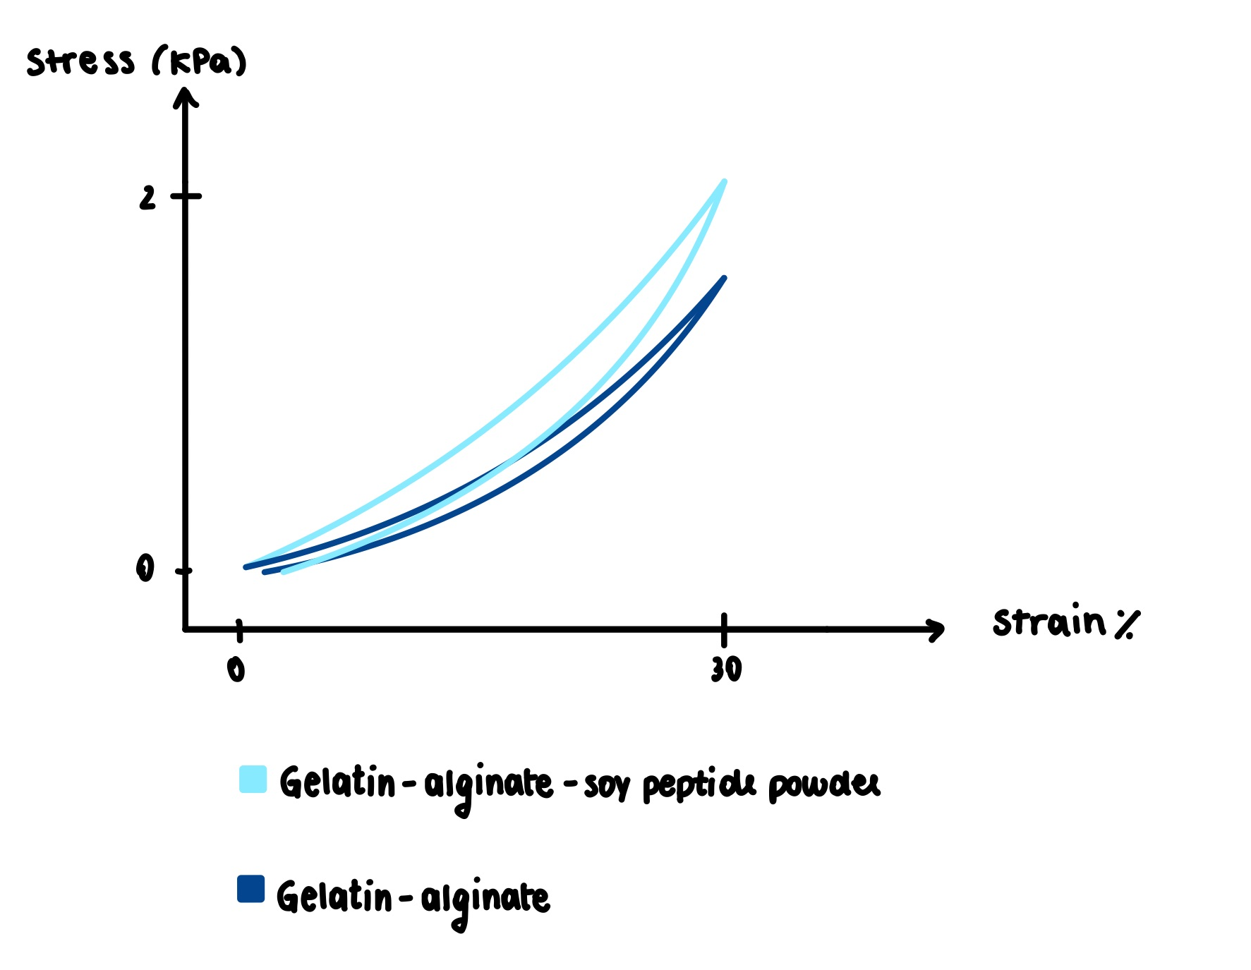
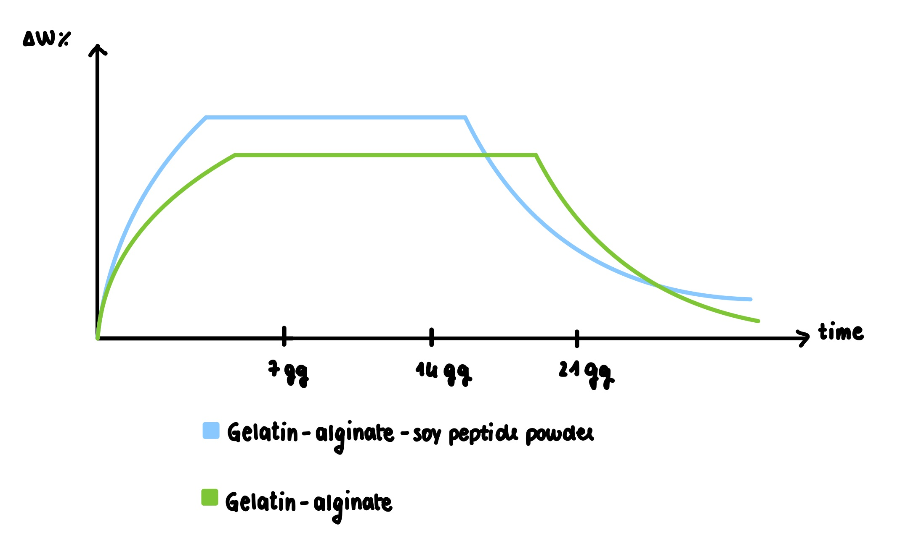
POST-PRINTING CHARACTERIZATION
Degradation test:
Compression mechanical test:
MORPHEUS
AMBIENT

Slide 12
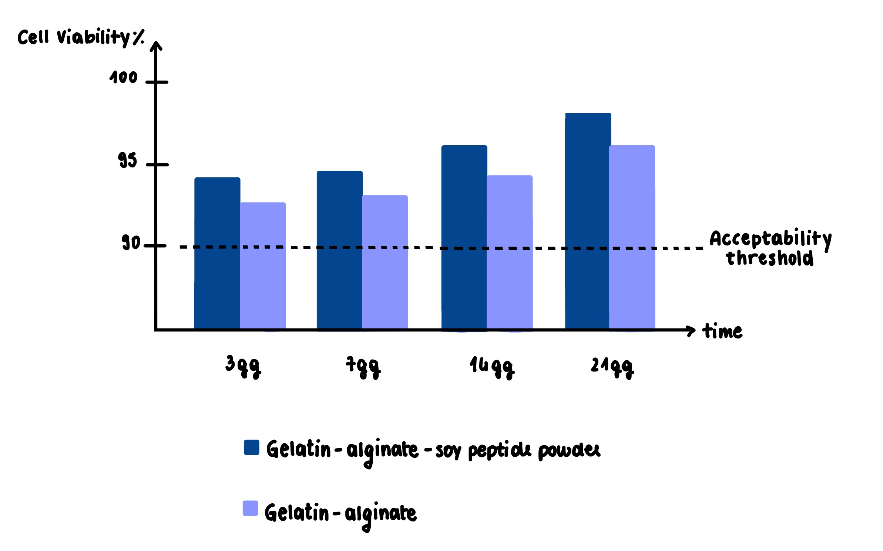
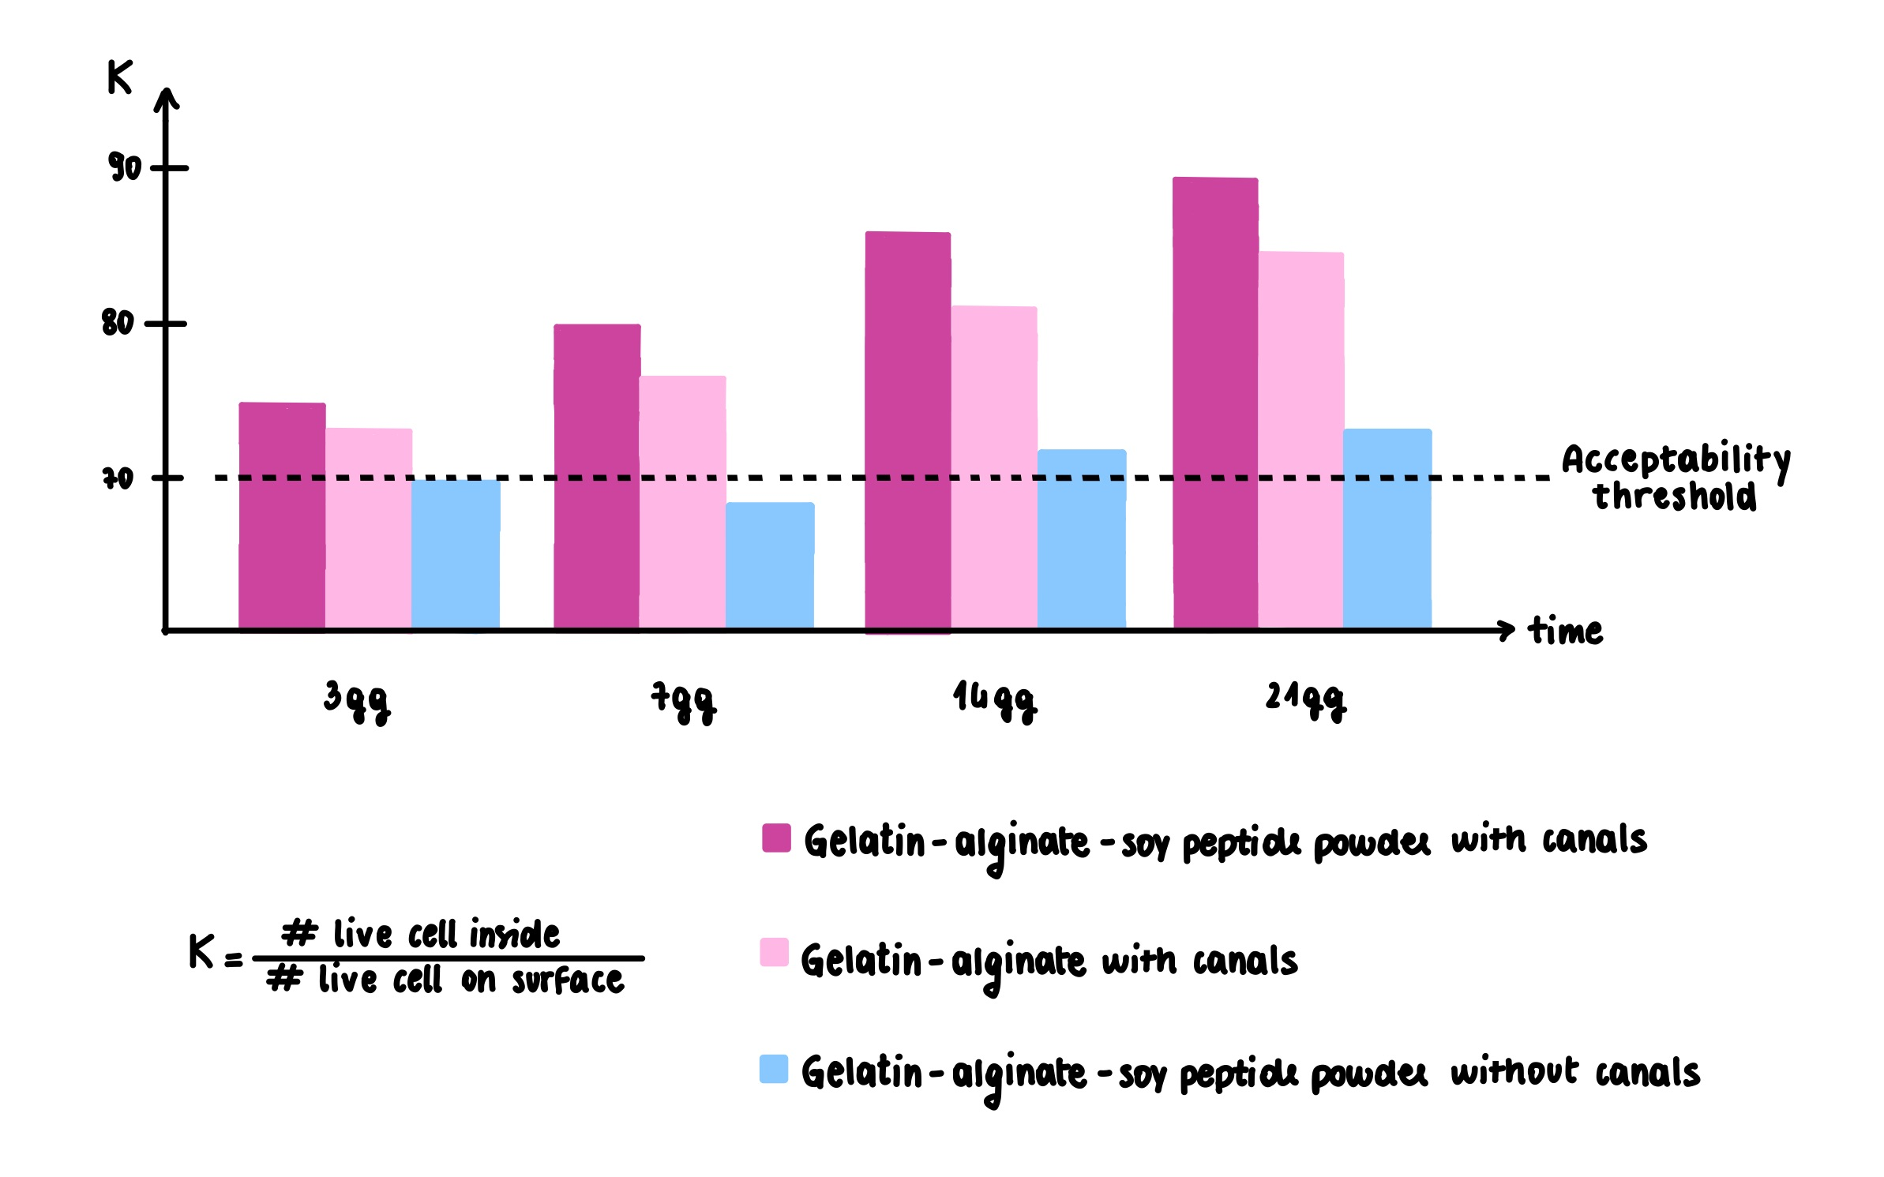
POST-PRINTING CHARACTERIZATION
Indirect cytotoxicity test :
Cell viability ratio between the inside and outside of the scaffold:

Slide 13
CONCLUSIONS AND FUTURE DEVELOPMENTS
parameters | today | goal
Ø of the circumference: | 2 mm | 1mm
Ø of the longitudinal channel: | 250 μm | 150 μm
L of the transverse channels: | 150 μm | 50 μm
Geometry
Cell adhesion
Porosity
In addition:
Test new samples, varying different parameters in both design and production.
Run tests with autologous liver cells.
Run in vivo tests.
Verify production costs and times.
Mechanical properties
Vascularization
Degradability
Notes:
Future developments: improve the printing characteristics of the material to obtain smaller and more precise channels (?)
In vivo tests and characterization
Test different sacrificial materials for printing

Slide 14
REFERENCES
Vazirzadeh, Masoud et al. “Natural Scaffolds Used for Liver Regeneration: A Narrative Update.” Stem cell reviews and reports vol. 18,7 (2022): 2262-2278. doi:10.1007/s12015-022-10362-8
Lacombe, Jerome et al. “Plant-Based Scaffolds Modify Cellular Response to Drug and Radiation Exposure Compared to Standard Cell Culture Models.” Frontiers in bioengineering and biotechnology vol. 8 932. 7 Aug. 2020, doi:10.3389/fbioe.2020.00932
Harris, Ashlee F et al. “The Emerging Role of Decellularized Plant-Based Scaffolds as a New Biomaterial.” International journal of molecular sciences vol. 22,22 12347. 16 Nov. 2021, doi:10.3390/ijms222212347
Limaye, Apurva et al. “Plant-Derived Zein as an Alternative to Animal-Derived Gelatin for Use as a Tissue Engineering Scaffold.” Advanced nanobiomed research vol. 4,3 (2024): 2300104. doi:10.1002/anbr.202300104
Jian, Honglei et al. “In vitro construction of liver organoids with biomimetic lobule structure by a multicellular 3D bioprinting strategy.” Cell proliferation vol. 56,5 (2023): e13465. doi:10.1111/cpr.13465
Hosseini, Vahid et al. “Current progress in hepatic tissue regeneration by tissue engineering.” Journal of translational medicine vol. 17,1 383. 21 Nov. 2019, doi:10.1186/s12967-019-02137-6
Kulig, Katherine M, and Joseph P Vacanti. “Hepatic tissue engineering.” Transplant immunology vol. 12,3-4 (2004): 303-10. doi:10.1016/j.trim.2003.12.005
Vasudevan, Ashwini et al. “Evolution of Electrospinning in Liver Tissue Engineering.” Biomimetics (Basel, Switzerland) vol. 7,4 149. 30 Sep. 2022, doi:10.3390/biomimetics7040149
Heydari, Zahra et al. “Tissue Engineering in Liver Regenerative Medicine: Insights into Novel Translational Technologies.” Cells vol. 9,2 304. 27 Jan. 2020, doi:10.3390/cells9020304
Mazza, Giuseppe et al. “Liver tissue engineering: From implantable tissue to whole organ engineering.” Hepatology communications vol. 2,2 131-141. 21 Dec. 2017, doi:10.1002/hep4.1136
AMBIENT

Slide 15
REFERENCES
Agarwal, Tarun et al. “Liver Tissue Engineering: Challenges and Opportunities.” ACS biomaterials science & engineering vol. 5,9 (2019): 4167-4182. doi:10.1021/acsbiomaterials.9b00745
Bhatt S, Supriya et al. “Scaffold-mediated liver regeneration: A comprehensive exploration of current advances.” Journal of tissue engineering vol. 15 20417314241286092. 13 Oct. 2024, doi:10.1177/20417314241286092
Mirdamadi, Elnaz Sadat et al. “Liver Tissue Engineering as an Emerging Alternative for Liver Disease Treatment.” Tissue engineering. Part B, Reviews vol. 26,2 (2020): 145-163. doi:10.1089/ten.TEB.2019.0233
Liu, Yakui et al. “Alginate/Gelatin-Based Hydrogel with Soy Protein/Peptide Powder for 3D Printing Tissue-Engineering Scaffolds to Promote Angiogenesis.” Macromolecular bioscience vol. 22,4 (2022): e2100413. doi:10.1002/mabi.202100413
Wei, Ting, et al. "Thermal analysis and non‐isothermal kinetics of poly (ethylene glycol) with different molecular weight." Polymer Engineering & Science 54.12 (2014): 2872-2876
Contessi Negrini, Nicola et al. “Tunable Cross-Linking and Adhesion of Gelatin Hydrogels via Bioorthogonal Click Chemistry.” ACS biomaterials science & engineering vol. 7,9 (2021): 4330-4346. doi:10.1021/acsbiomaterials.1c00136
Paradiso, Alessia et al. “In vitro functional models for human liver diseases and drug screening: beyond animal testing.” Biomaterials science vol. 11,9 2988-3015. 2 May. 2023, doi:10.1039/d1bm01872h
Jahangirian, Hossein et al. “Status of Plant Protein-Based Green Scaffolds for Regenerative Medicine Applications.” Biomolecules vol. 9,10 619. 17 Oct. 2019, doi:10.3390/biom9100619
Kharaghani, Davood et al. “The Effect of Polymeric Nanofibers Used for 3D-Printed Scaffolds on Cellular Activity in Tissue Engineering: A Review.” International journal of molecular sciences vol. 24,11 9464. 30 May. 2023, doi:10.3390/ijms24119464
Rastogi, Prasansha, and Balasubramanian Kandasubramanian. “Review of alginate-based hydrogel bioprinting for application in tissue engineering.” Biofabrication vol. 11,4 042001. 10 Sep. 2019, doi:10.1088/1758-5090/ab331e

Slide 16

Thanks for your attention!

