Slide 1
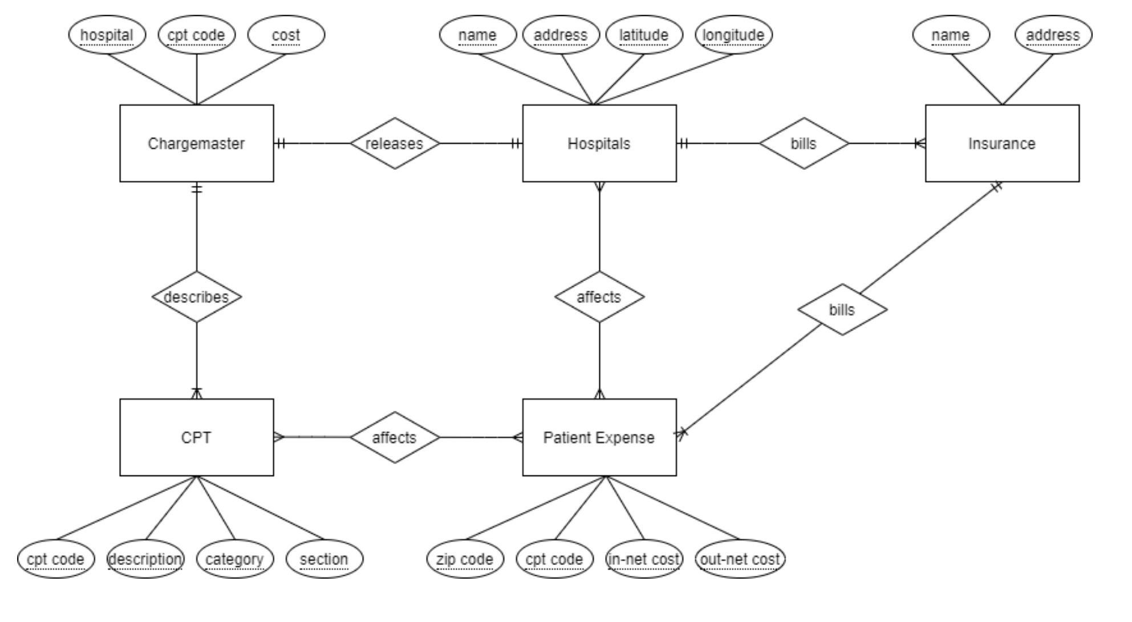
Overview

Slide 2
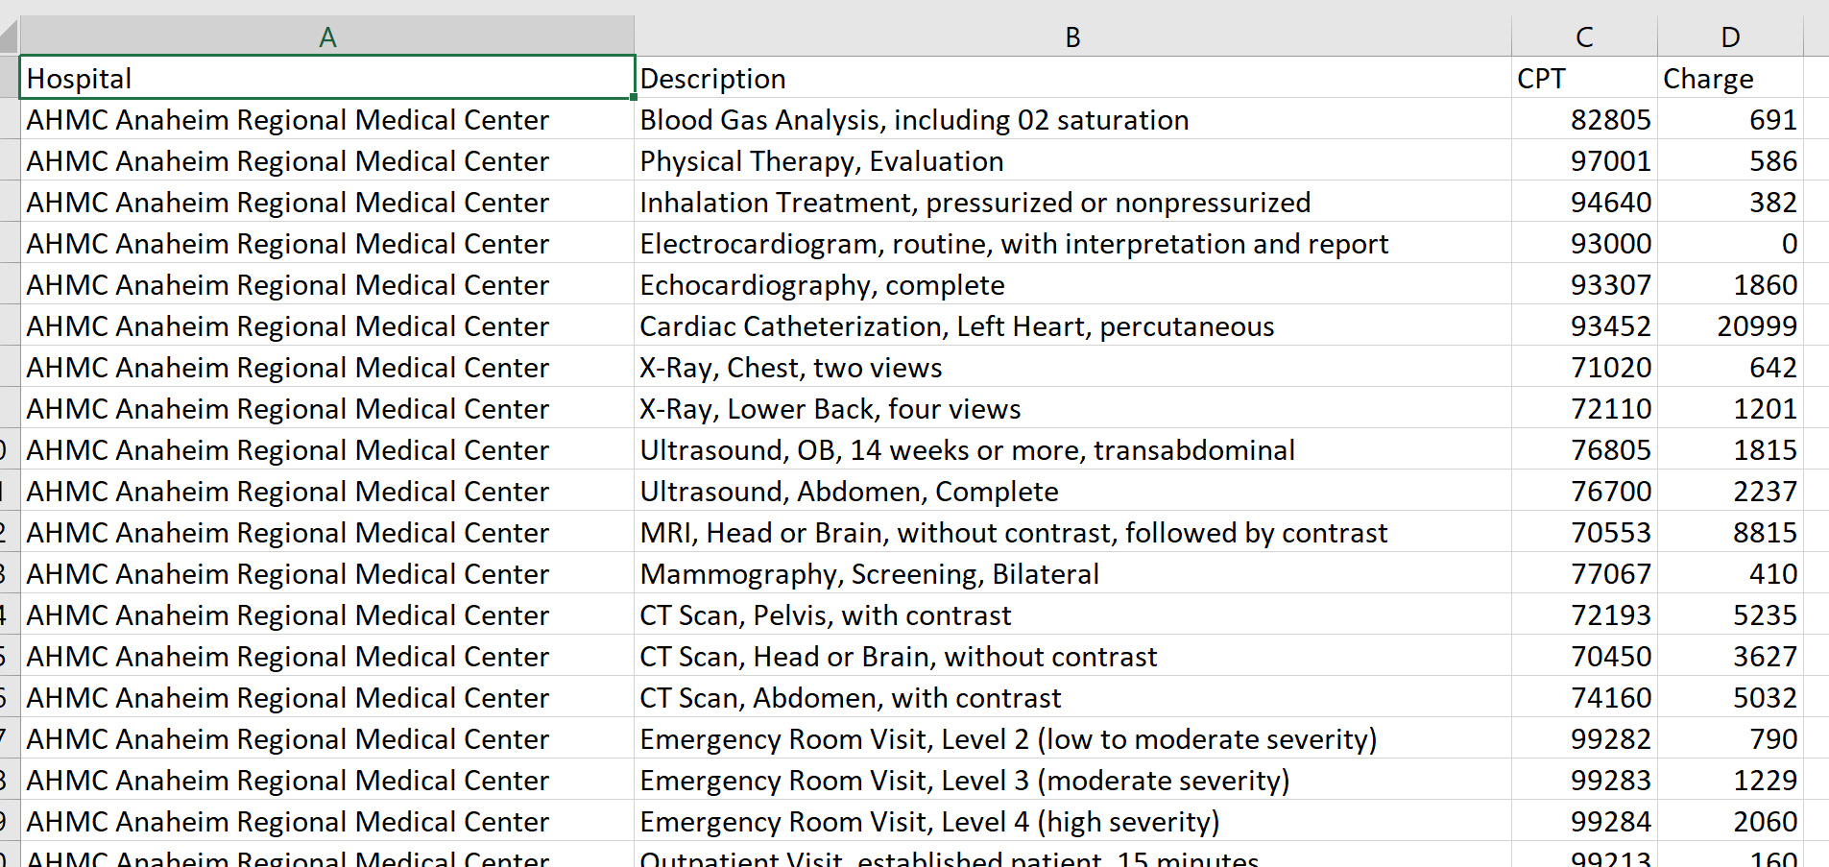
Chargemasters Per Hospital

Slide 3
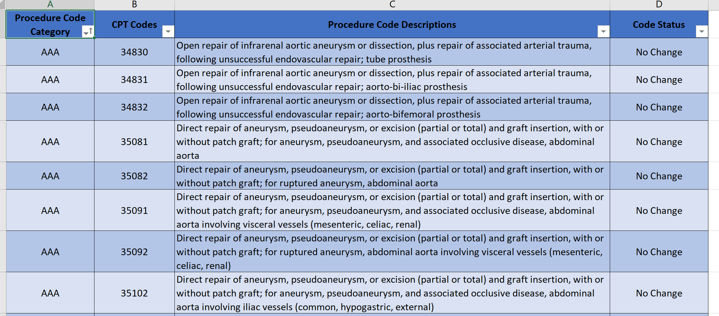
CPT

Slide 4
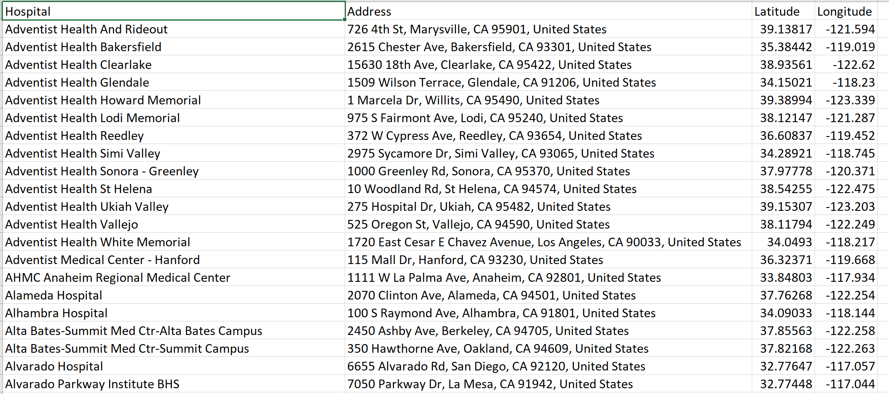
Addresses

Slide 5
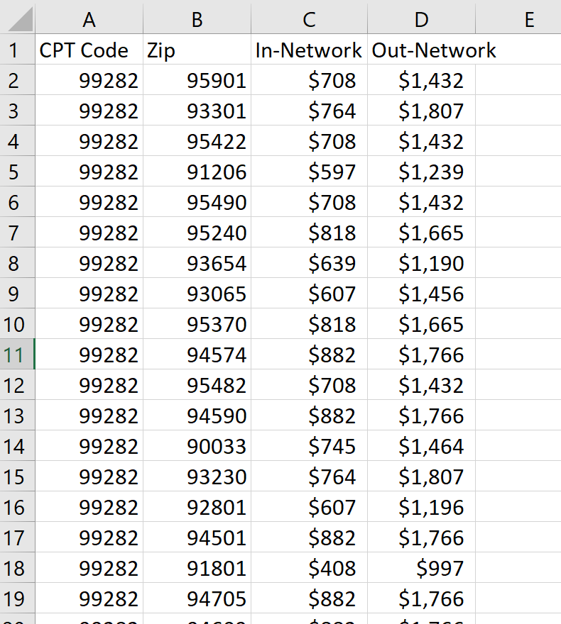
Patient Expenses

Slide 6
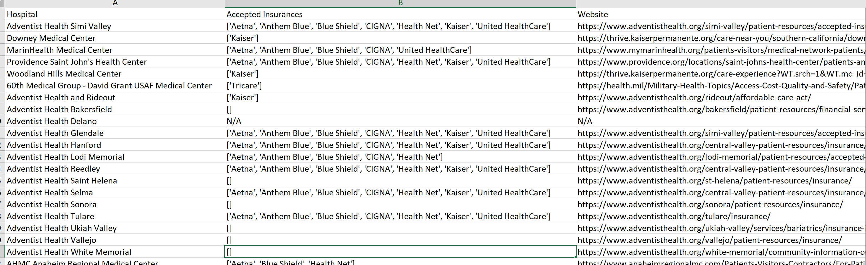
Accepted Insurances Per Hospital (WIP)

