Slide 1
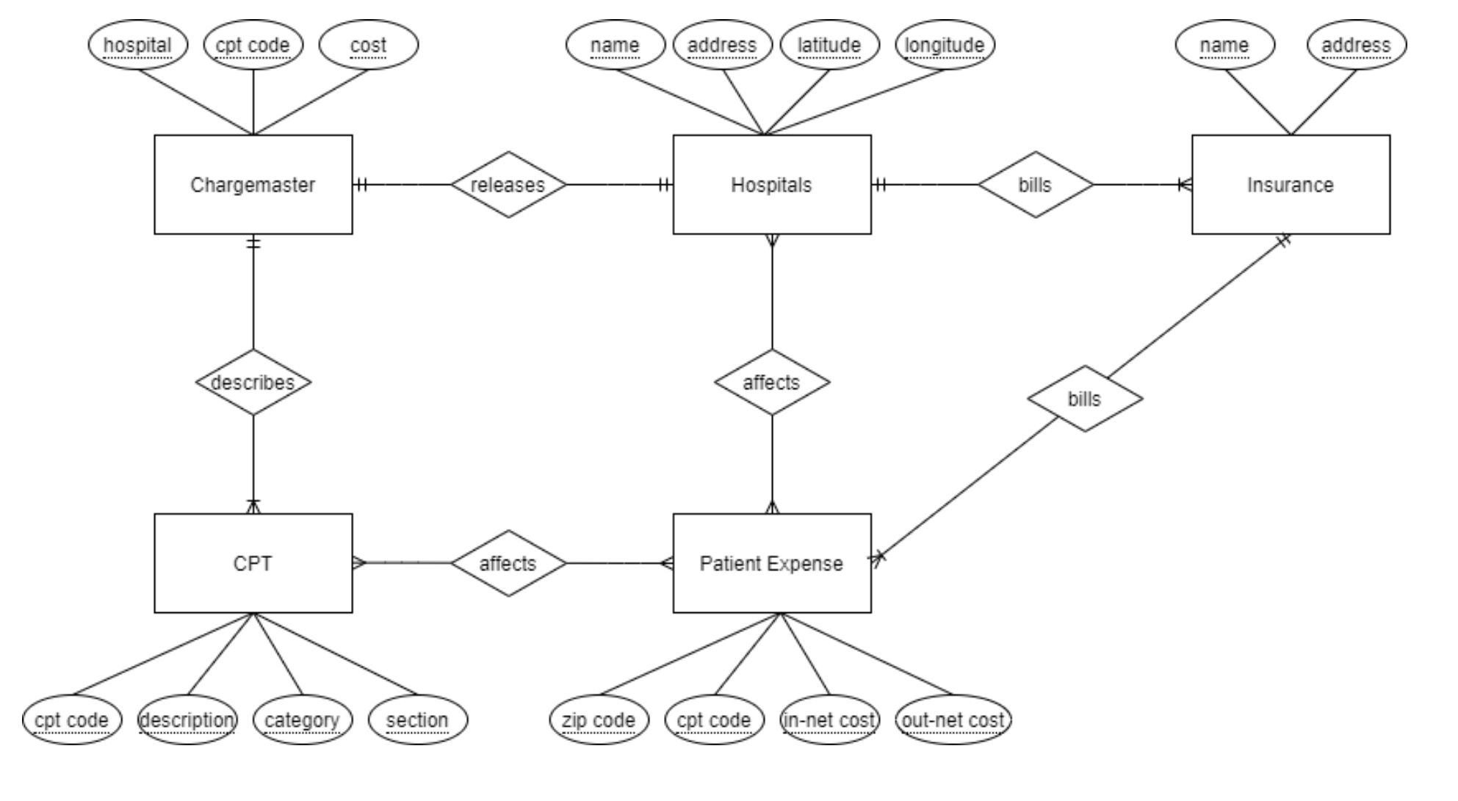
Overview
1
2
3
4
5

Slide 2
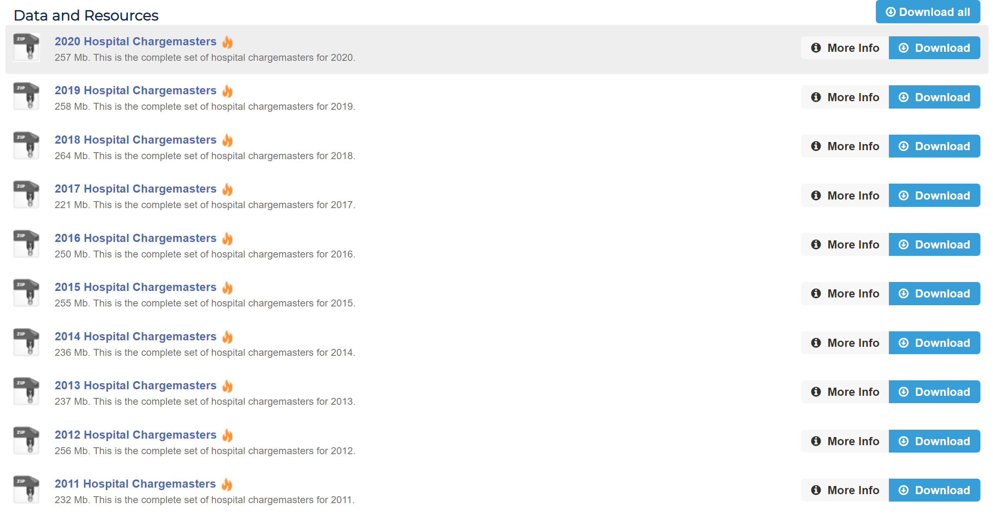
1. Charge Master Dataset
1.1 Downloaded from https://data.chhs.ca.gov/dataset/chargemasters

Slide 3
1. Charge Master Dataset
1.2 Cleaning raw charge masters
Problem:
CA government only required excel files (no uniform format).
Each hospital submitted data under different excel files, sheet names, table formats, etc.
Makes it hard to find the target ‘Common OP Procedures’ table.
Solution:
Script to extract all target sheets (next slide)
Look through each sheet in every excel file in each hospital folder
Check if known header of target form exist in the sheet
Track excel file path and sheet name that meets criteria.

Slide 4
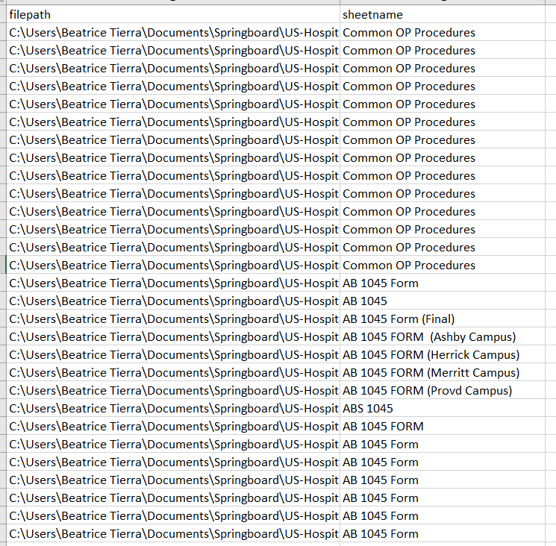
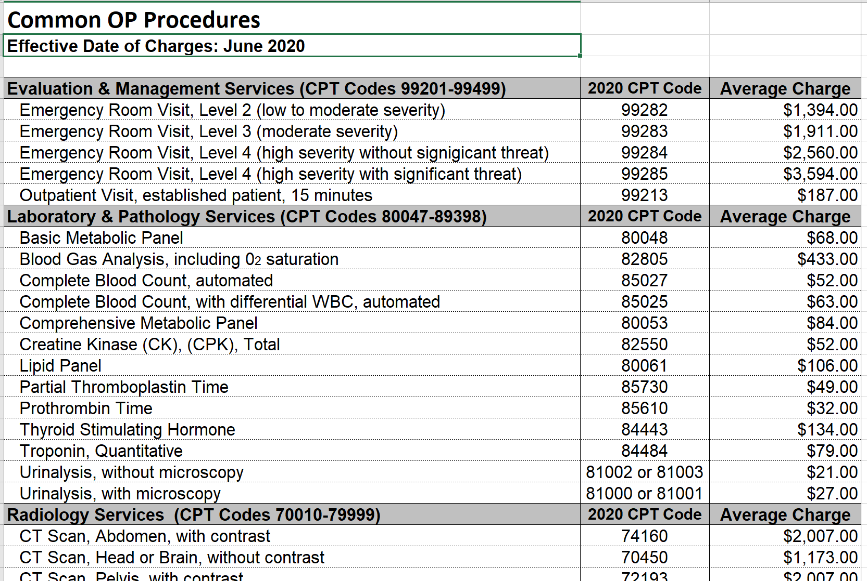
1. Charge Master Dataset
1.2 Cleaning raw charge masters (cont.)
Each hospital’s form (raw data)
Found filename and sheet name of target forms

Slide 5
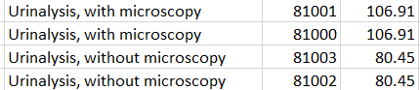
1. Charge Master Dataset
1.2 Cleaning raw charge masters (cont.)
After finding all target form locations:
Read each sheet
Extract only rows with valid CPT code
Clean CPT codes
Combine all data frames to include all hospitals.
Final table columns: Hospital, Description, CPT Code, Cost

Slide 6
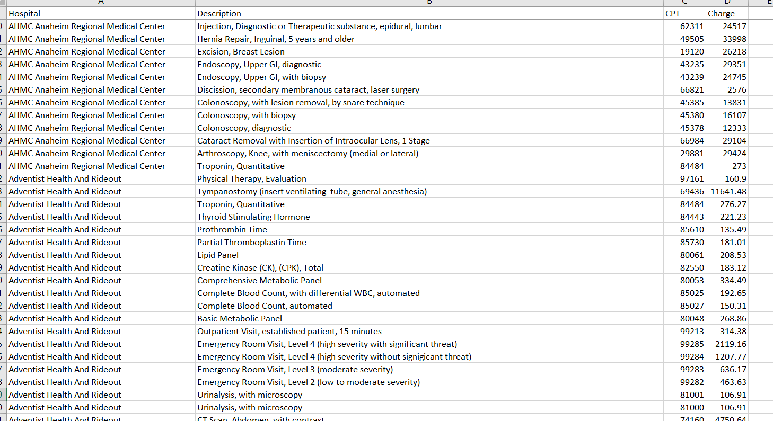
1. Charge Master Dataset
1.3 Final charge masters dataset

Slide 7
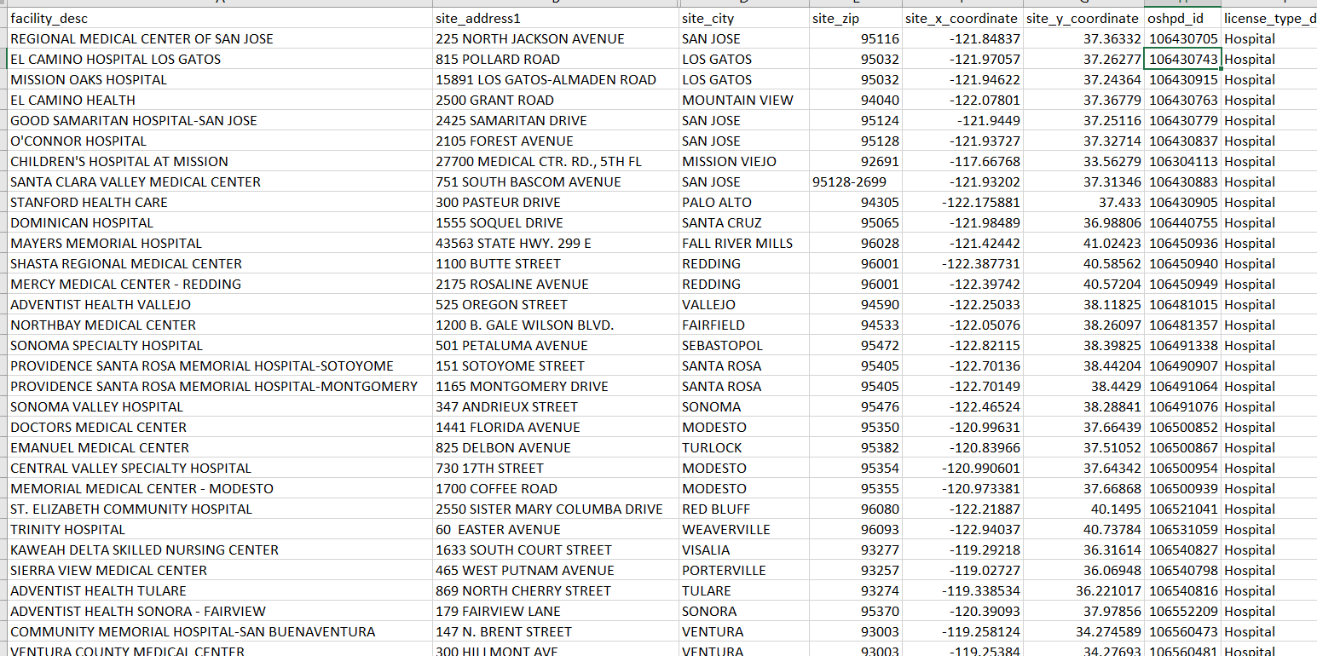
2. Hospitals
Downloaded from https://data.chhs.ca.gov/dataset/facility-profile-attributes

Slide 8
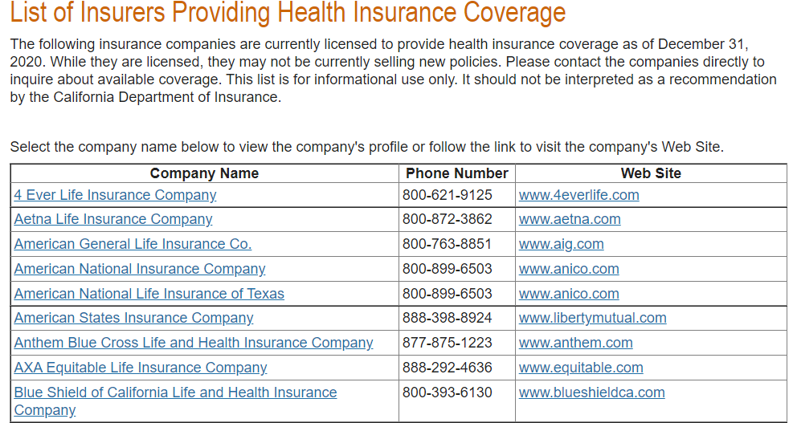
3. Insurance
Table copied from http://www.insurance.ca.gov/01-consumers/110-health/20-look/hcpcarriers.cfm

Slide 9
4. CPT
1.1 Downloaded from https://www.cms.gov/Medicare/Medicare-Fee-for-Service-Payment/PhysicianFeeSched/PFS-Relative-Value-Files
1.2 HCPCS vs CPT codes
https://www.medicalbillingandcoding.org/hcpcs-codes/
“Level one is identical to CPT, though technically those codes, when used to bill Medicare or Medicaid, are HCPCS codes”
1.3 Which file to use:
Updated every quarter, use part D (last quarter of year)
Use RVU files (Relative Value Units) in text format

Slide 10
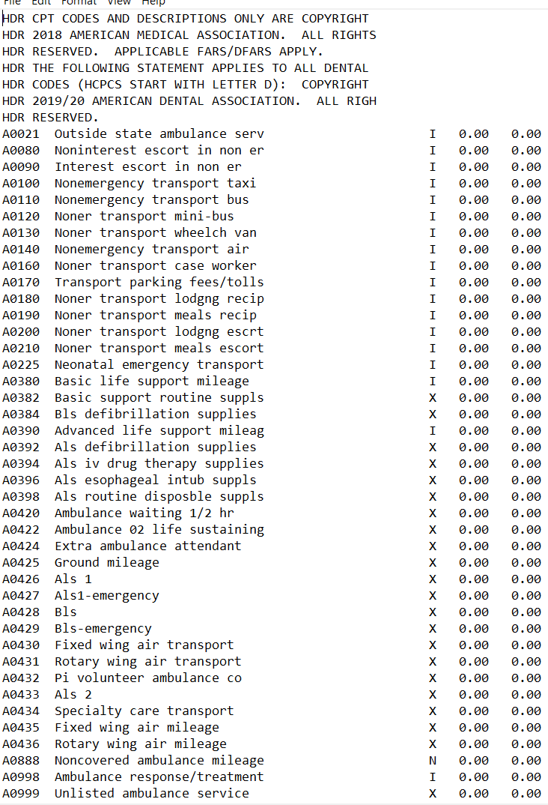
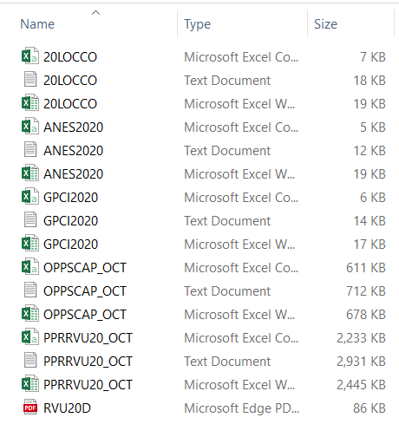
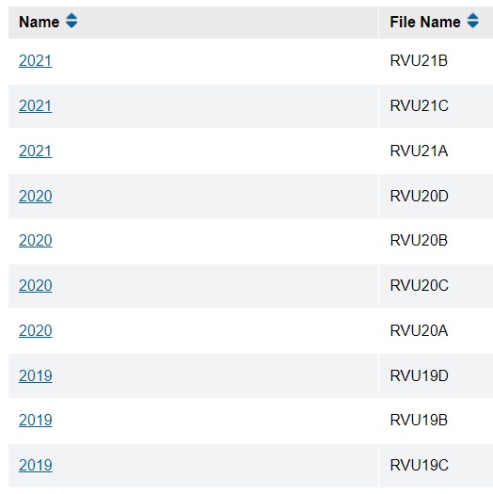
4. CPT
1.3 Which file to use (cont):
Ex. Get CPT codes for 2020

Slide 11
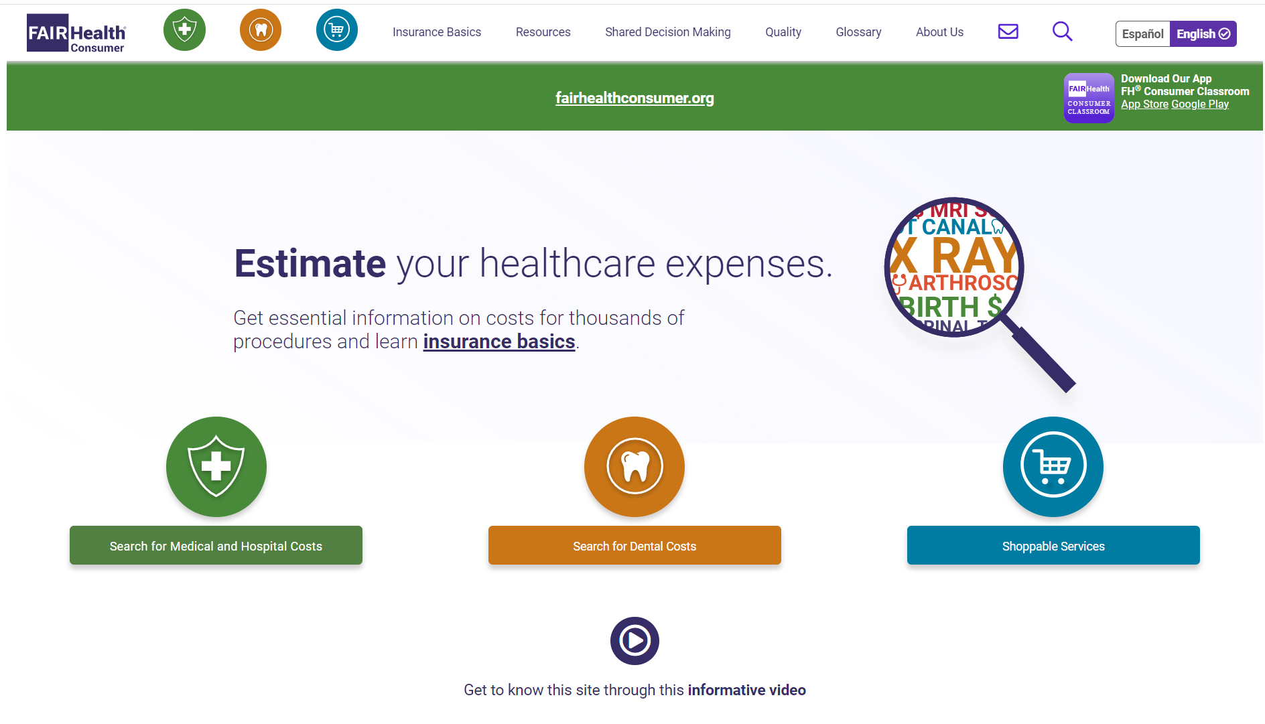
5. Patient Expenses
1.1 Scraped from https://www.fairhealthconsumer.org/

Slide 12
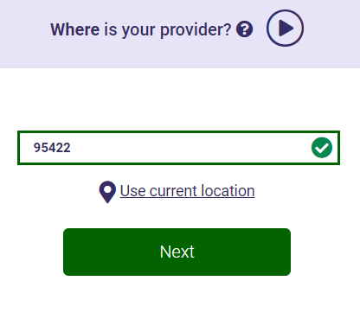
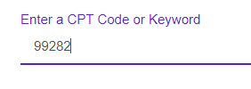
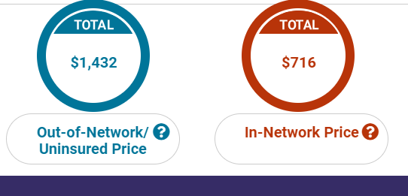
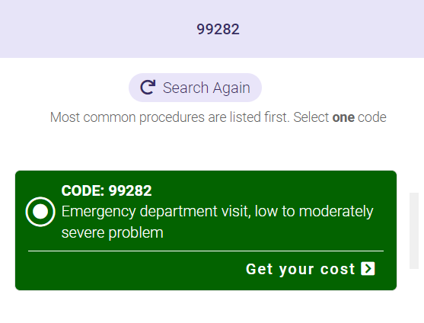
5. Patient Expenses
1.2 Process
Use Selenium to enter CPT and zip code to find the cost of a certain procedure in an area
Use BeautifulSoup to extract the in-network and out-of-network (hospital accepts insurance or not) cost
Enter Zip Code
Enter CPT Code
Get Out-of-Network vs In-Network Price

