Slide 1
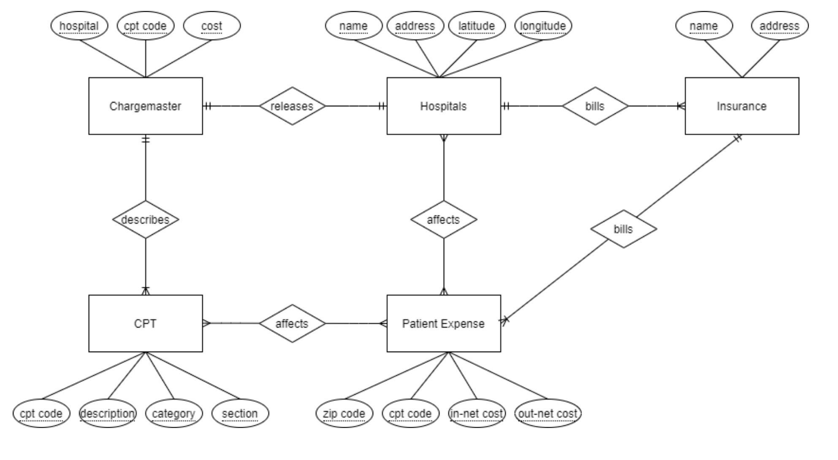
Overview

Slide 2
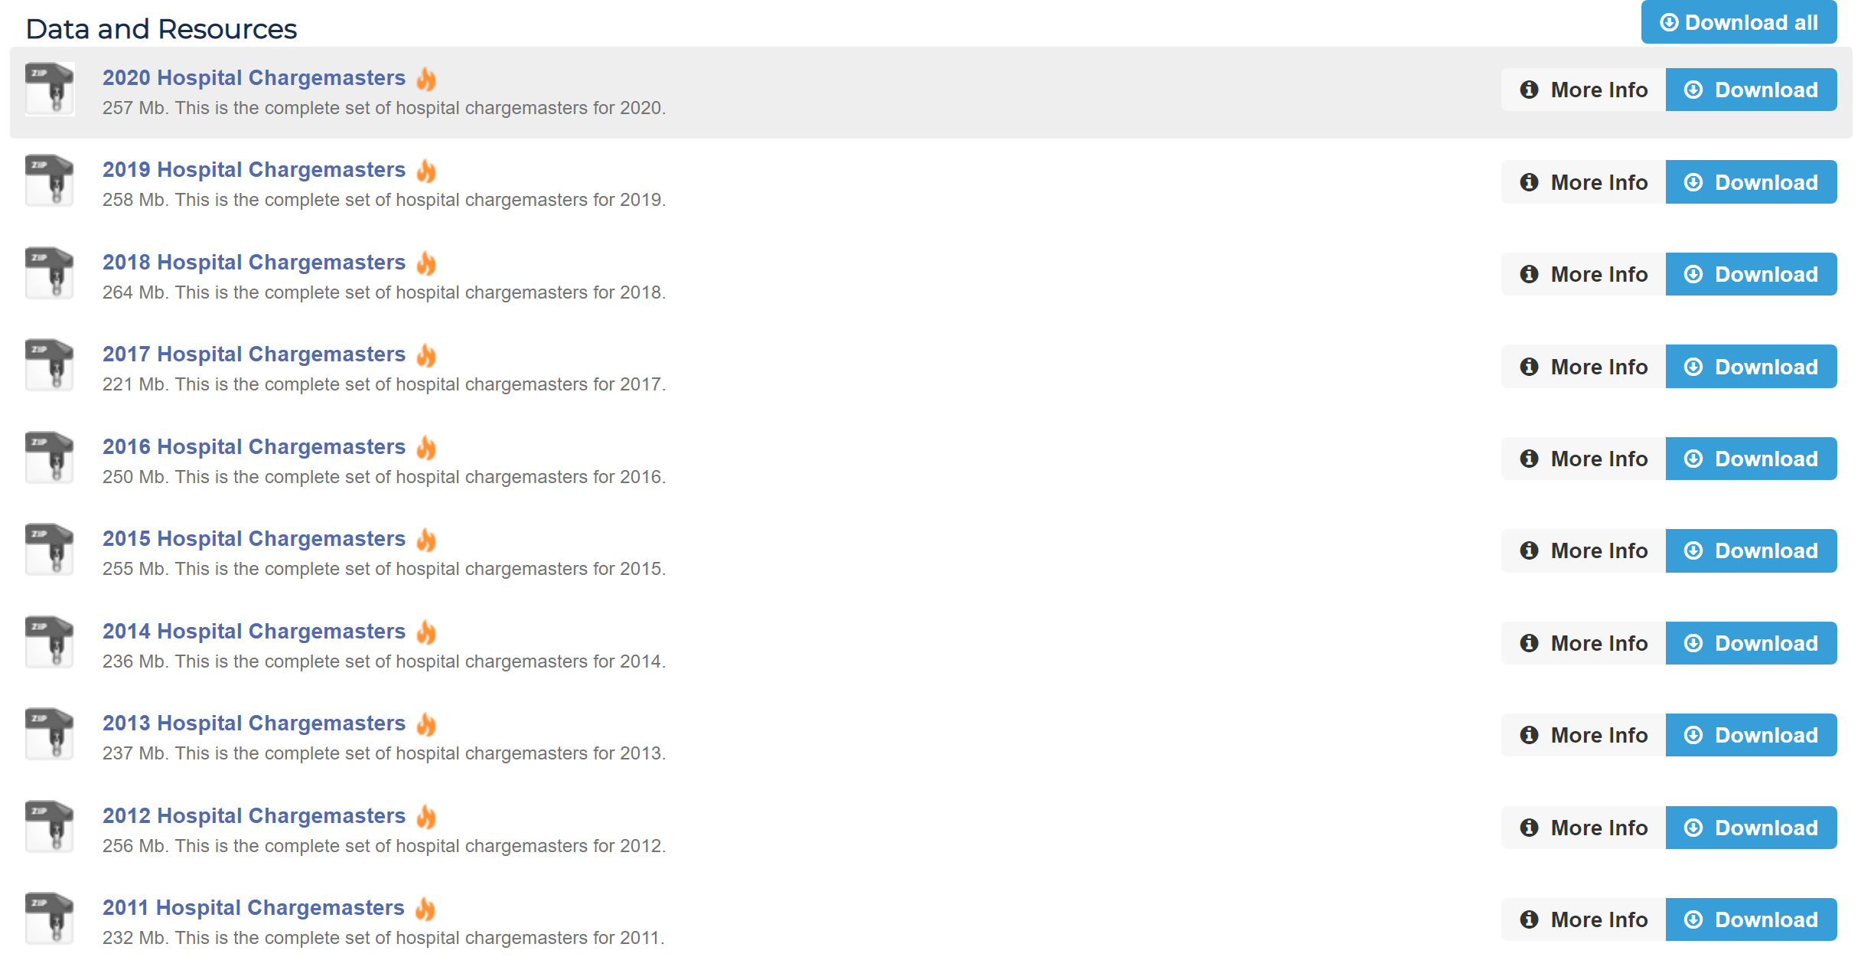
1. Chargemaster Dataset
Downloaded from https://data.chhs.ca.gov/dataset/chargemasters

Slide 3
2. Script to extract all target sheets
Problem:
CA government only required for info to be submitted in excel files (no uniform format).
Each hospital submitted data under different excel files, sheet names, table formats, etc.
Makes it hard to find the ‘Common OP Procedures’ table.
Solution:
Look through each sheet in every excel file in each hospital folder
Check if known header of target form exist in the sheet
Track excel file path and sheet name that meets criteria.

Slide 4
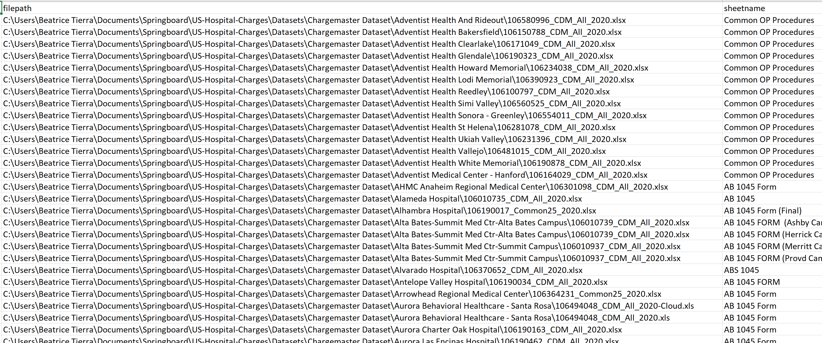
2. Solution Output

Slide 5
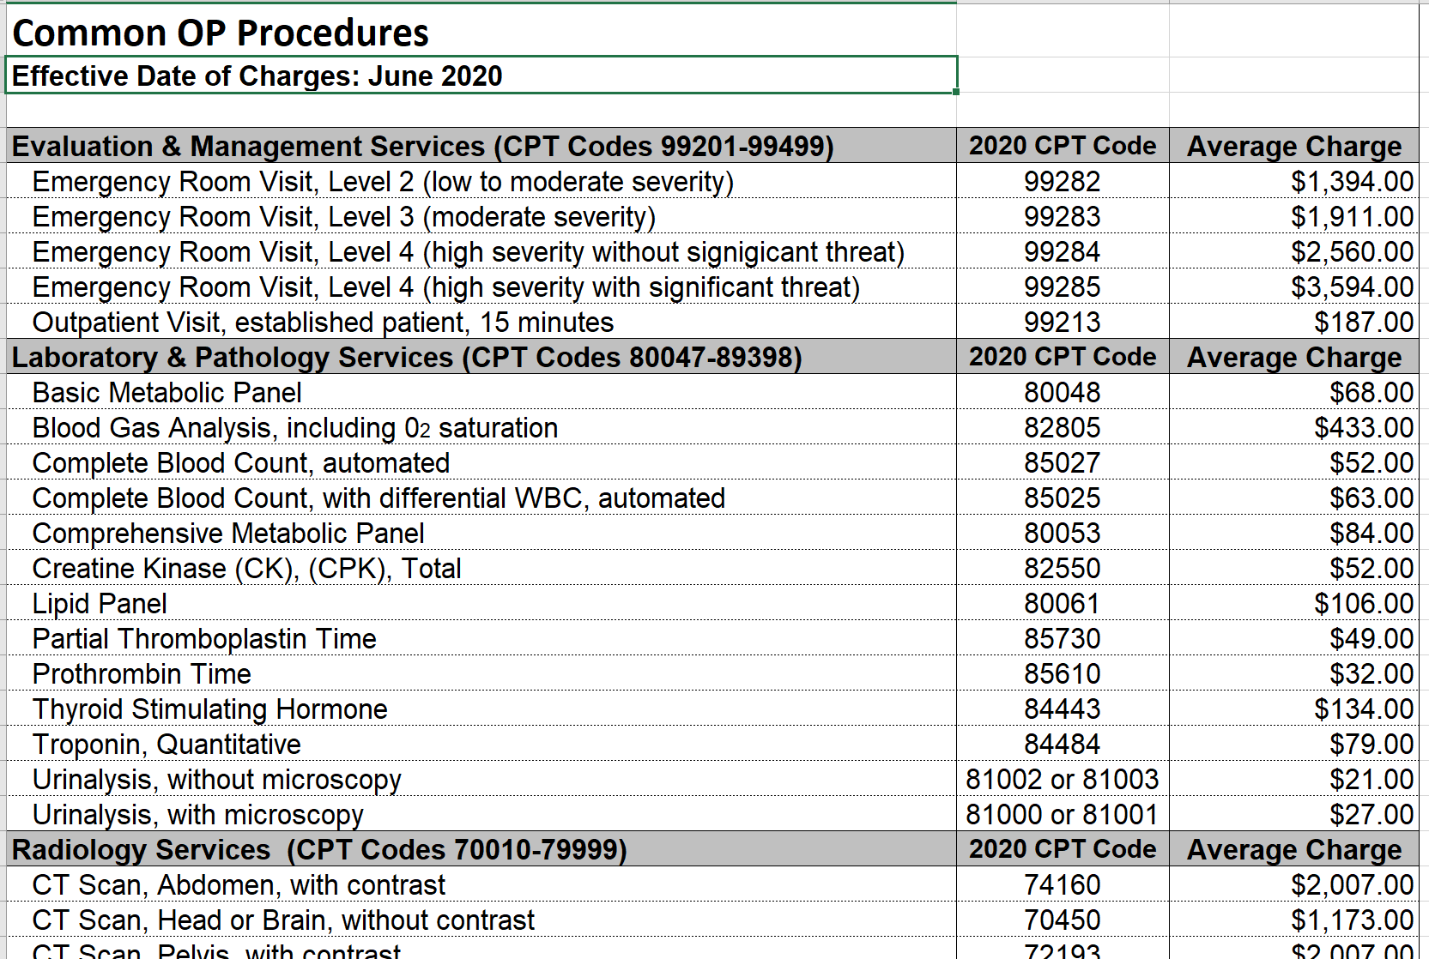
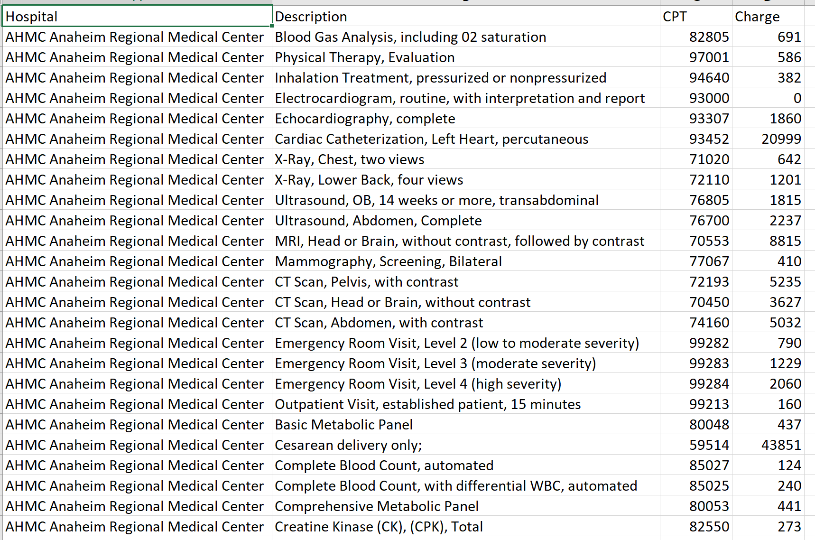
3. Script to transform form table
Each hospital’s form
Compile Description, CPT, and Charge for all hospitals

Slide 6
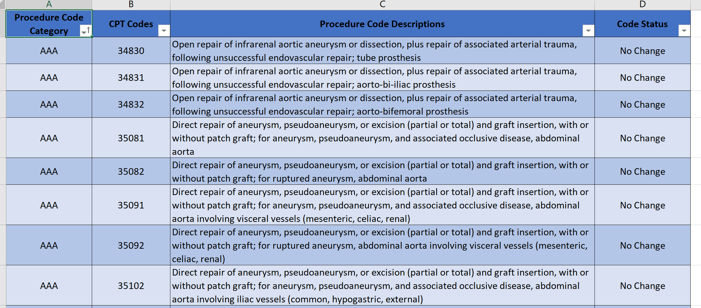
CPT

Slide 7
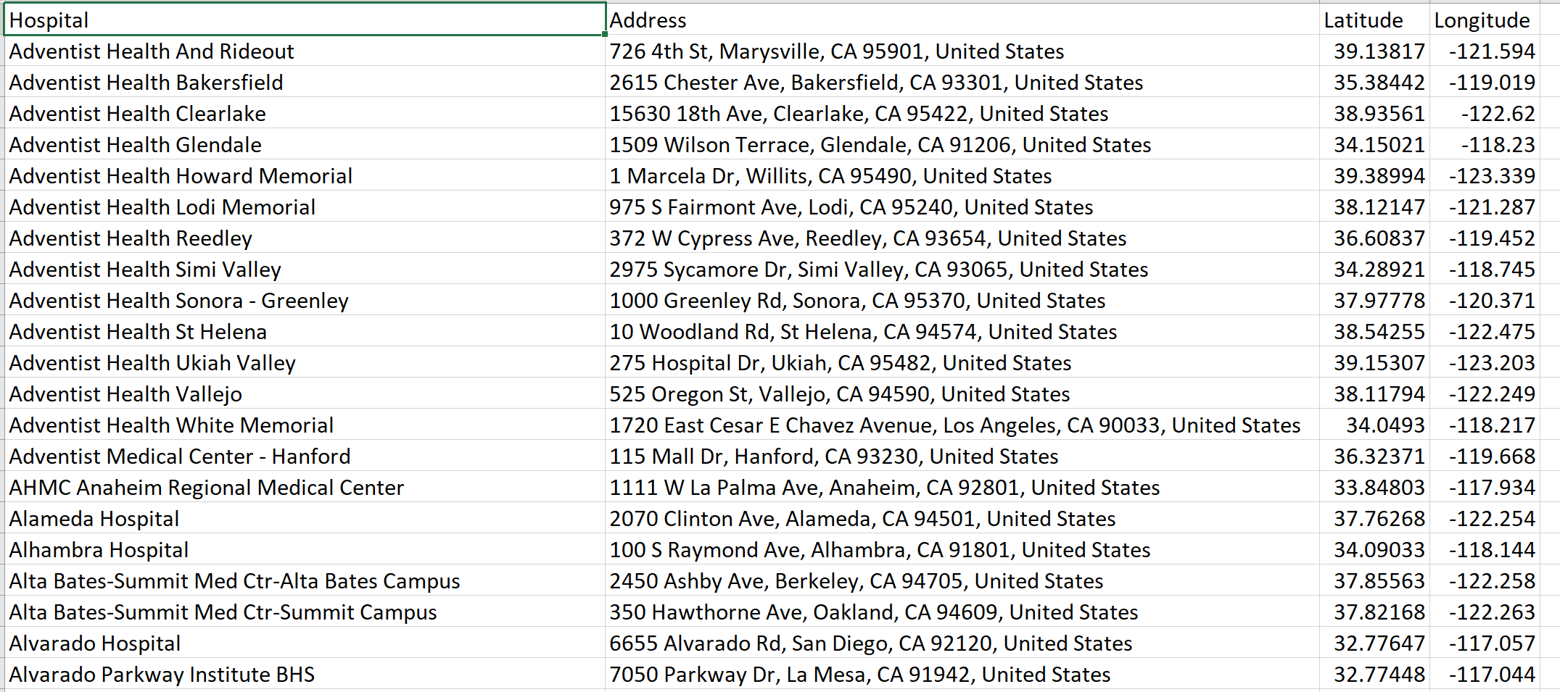
Addresses

Slide 8
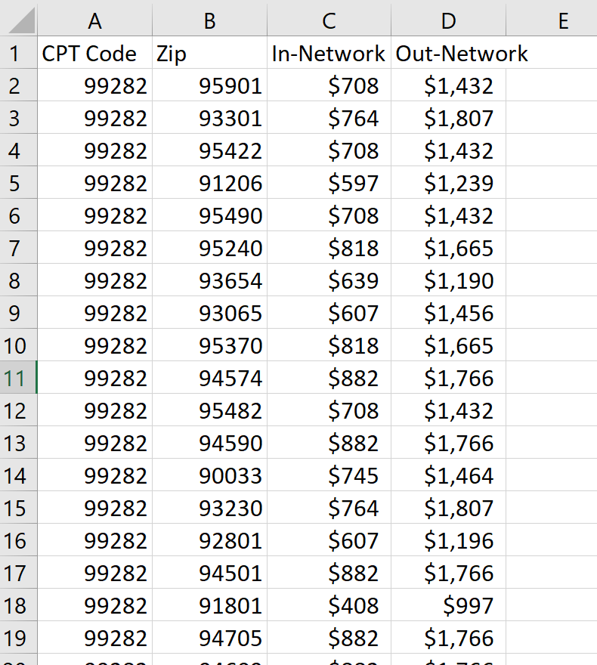
Patient Expenses

Slide 9
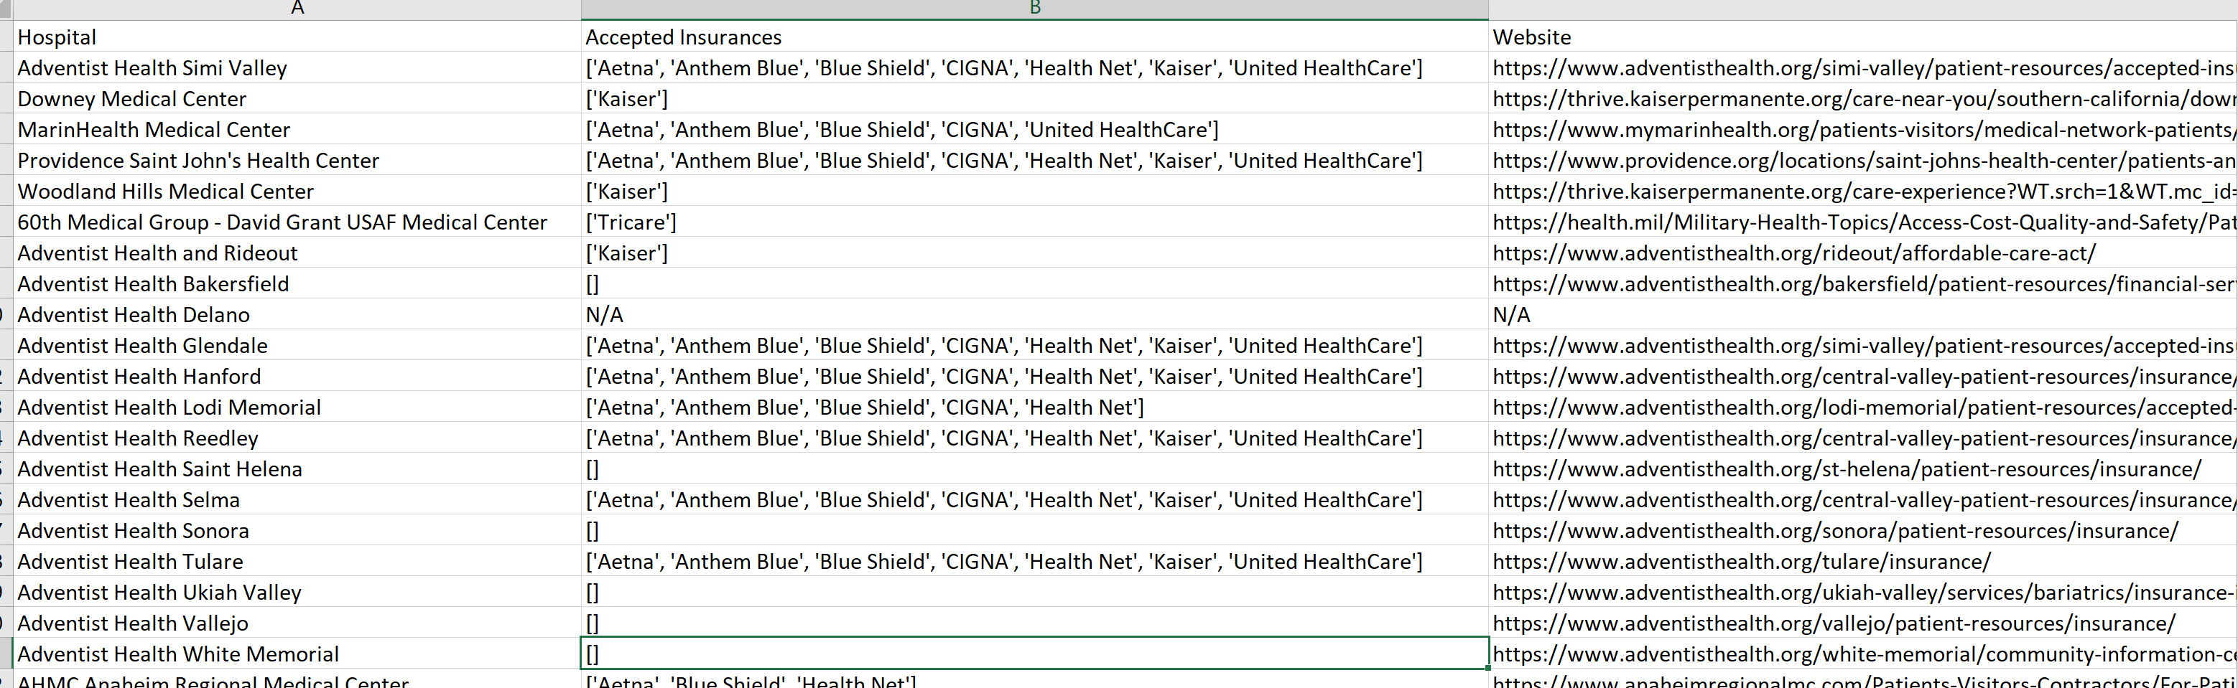
Accepted Insurances Per Hospital (WIP)

