Slide 1
USA Retail Sales Performance Analysis (2011–2014)
A Deep Dive into Sales, Profit, and Market Performance Across US Regions

Slide 2
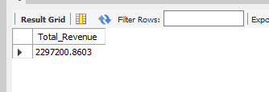
KPI’S Total Revenue
SELECT
SUM(Sales) AS Total_Revenue
FROM kalundusalestable;

Slide 3
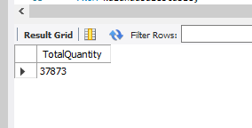
Total Quantity sold
SELECT
SUM(Quantity) AS TotalQuantity
FROM kalundusalestable;

Slide 4
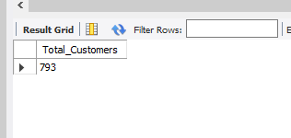
Count of customers
SELECT
COUNT(DISTINCT Customer_ID) AS Total_Customers
FROM kalundusalestable;

Slide 5
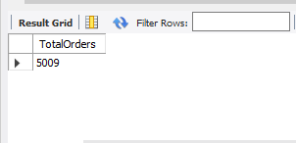
Number of orders
SELECT
COUNT(DISTINCT Order_ID) AS TotalOrders
FROM kalundusalestable;

Slide 6
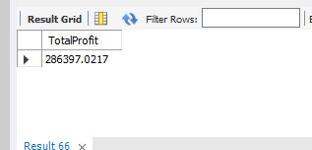
Total Profit
SELECT
SUM(Profit) AS TotalProfit
FROM kalundusalestable;

Slide 7
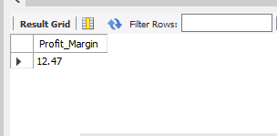
Profit Margin
SELECT
ROUND(SUM(Profit)/SUM(Sales)*100,2) AS Profit_Margin
FROM kalundusalestable;

Slide 8
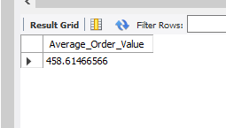
average order value
SELECT
SUM(Sales)/COUNT(DISTINCT Order_ID) AS Average_Order_Value
FROM kalundusalestable;

Slide 9
Executive Sales Summary
Kalundu generated total revenue of $2,297,200.86 across 2011–2014, suggesting strong and consistent performance over the period. From 37,873 total units sold across 5,009 unique orders placed by 793 unique customers, the average quantity per order was approximately 7.5 units, and each customer placed an average of ~6.3 orders over the period. Total profit recorded was $286,397.47, with a profit margin of 12.47%, reflecting a healthy and sustainable level of profitability.

Slide 10
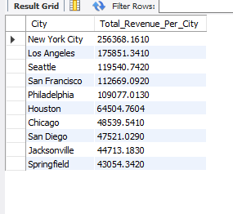
Top 10 Cities that generates most revenue
SELECT
City,
SUM(Sales) AS Total_Revenue_Per_City
FROM kalundusalestable
GROUP BY City
ORDER BY Total_Revenue_Per_City DESC
LIMIT 10;

Slide 11
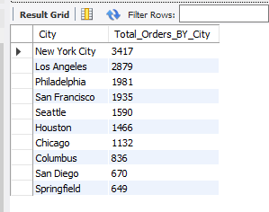
Top 10 cities that sells most units
SELECT
City,
SUM(Quantity) AS Total_Orders_BY_City
FROM kalundusalestable
GROUP BY City
ORDER BY Total_Orders_BY_City DESC
LIMIT 10;

Slide 12
Regional City Revenue Breakdown
Among all cities, New York City led revenue generation with $256,368.16, followed by Los Angeles, Philadelphia, San Francisco, Seattle, Houston, Chicago, Columbus, San Diego, and Springfield in descending order. New York City also recorded the highest quantity sold at 3,417 units, maintaining the same city ranking pattern across both metrics.

Slide 13
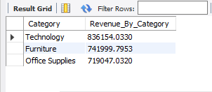
Category that generates most revenue
SELECT
Category,
SUM(Sales) AS Revenue_By_Category
FROM kalundusalestable
GROUP BY Category
ORDER BY Revenue_By_Category DESC;

Slide 14
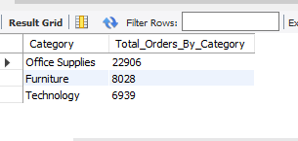
units sold by category
SELECT
Category,
SUM(Quantity) AS Total_Orders_By_Category
FROM kalundusalestable
GROUP BY Category
ORDER BY Total_Orders_By_Category DESC;

Slide 15
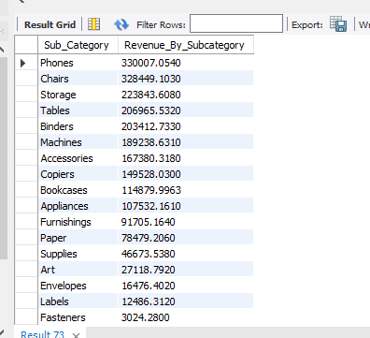
revenue by sub_category
SELECT
Sub_Category,
SUM(Sales) AS Revenue_By_Subcategory
FROM kalundusalestable
GROUP BY Sub_Category
ORDER BY Revenue_By_Subcategory DESC;

Slide 16
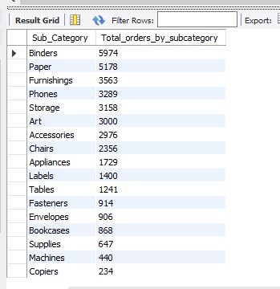
units sold by subcategory
SELECT
Sub_Category,
SUM(Quantity) AS Total_orders_by_subcategory
FROM kalundusalestable
GROUP BY Sub_Category
ORDER BY Total_orders_by_subcategory DESC;

Slide 17
Product Category Performance
By category, Technology generated the highest revenue at $836,154.03, followed by Furniture at $741,999.79 and Office Supplies at $719,047.03. Notably, Office Supplies recorded the most orders at 22,906, while Technology had the fewest at 6,939 — demonstrating that Technology products drive high revenue despite lower order volumes.
At the subcategory level, Phones topped revenue at $330,007.05, followed closely by Chairs at $328,449.10. The remaining subcategories in descending order were: Storage, Tables, Binders, Machines, Accessories, Copiers, Bookcases, Appliances, Furnishings, Paper, Supplies, Art, Envelopes, Labels, and Fasteners. Technology subcategories dominated the upper rankings, reinforcing the category-level trend.

Slide 18
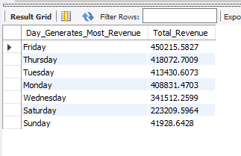
Revenue generated per day
SELECT
DAYNAME(Order_Date) AS Day_Generates_Most_Revenue,
SUM(Sales) AS Total_Revenue
FROM kalundusalestable
GROUP BY Day_Generates_Most_Revenue
ORDER BY Total_Revenue DESC;

Slide 19
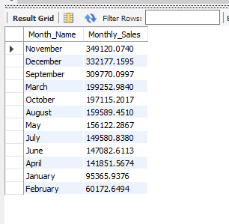
Revenue generated per month
SELECT
MONTHNAME(Order_Date) AS Month_Name,
SUM(Sales) AS Monthly_Sales
FROM kalundusalestable
GROUP BY Month_Name
ORDER BY Monthly_Sales DESC;

Slide 20
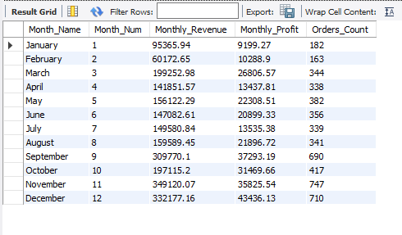
MOM Growth
SELECT
MONTHNAME(Order_Date) AS Month_Name,
MONTH(Order_Date) AS Month_Num,
ROUND(SUM(Sales), 2) AS Monthly_Revenue,
ROUND(SUM(Profit), 2) AS Monthly_Profit,
COUNT(DISTINCT Order_ID) AS Orders_Count
FROM kalundusalestable
GROUP BY Month_Name, Month_Num
ORDER BY Month_Num ASC;

Slide 21
Temporal Sales Trends
Friday recorded the highest daily revenue at $450,215.58, consistently outperforming other days, indicating that most orders are placed on Fridays.
November led monthly revenue at $349,120.07, remaining the top-performing month over the years.

Slide 22
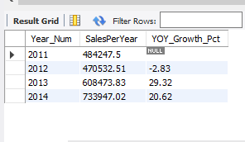
YOY GROWTH
SELECT
Year_Num,
ROUND(SUM(Sales), 2) AS SalesPerYear,
ROUND(
(SUM(Sales) - LAG(SUM(Sales)) OVER (ORDER BY Year_Num)) /
LAG(SUM(Sales)) OVER (ORDER BY Year_Num) * 100, 2
) AS YOY_Growth_Pct
FROM kalundusalestable
GROUP BY Year_Num
ORDER BY Year_Num ASC;

Slide 23
Annual Revenue Growth Analysis
Year-over-year, 2012 saw a slight decline of -2.83%, followed by a strong recovery of 29.32% in 2013 and a further increase of 20.62% in 2014, reflecting sustained revenue growth. The 2013 peak suggests that consistent marketing efforts had a significant impact.

Slide 24
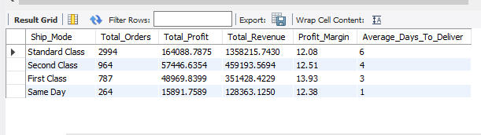
ship mode is most used and most profitable
SELECT
Ship_Mode,
COUNT(DISTINCT Order_ID) AS Total_Orders,
SUM(Profit) AS Total_Profit,
SUM(Sales) AS Total_Revenue,
ROUND(SUM(Profit)/SUM(Sales)*100,2) AS Profit_Margin,
CEIL(AVG(DATEDIFF(Ship_Date,Order_Date))) AS Average_Days_To_Deliver
FROM kalundusalestable
GROUP BY Ship_Mode
ORDER BY Total_Revenue DESC;
Standard class a ship mode registed the highest revenue in comparison of the other ship mode by

Slide 25
Shipping Preference Insights
Standard Class was the most preferred shipping mode, generating $164,088.79, followed by Second Class at $57,446.63, First Class at $15,891.76, and Same Day recording the least. This indicates Standard Class is the most affordable and widely used shipping option.

Slide 26
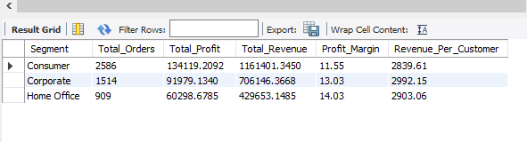
Segment that drives most value
SELECT
Segment,
COUNT(DISTINCT Order_ID) AS Total_Orders,
SUM(Profit) AS Total_Profit,
SUM(Sales) AS Total_Revenue,
ROUND(SUM(Profit)/SUM(Sales)*100,2) AS Profit_Margin,
ROUND(SUM(Sales)/COUNT(DISTINCT Customer_ID), 2) AS Revenue_Per_Customer
FROM kalundusalestable
GROUP BY Segment
ORDER BY Total_Revenue DESC;

Slide 27
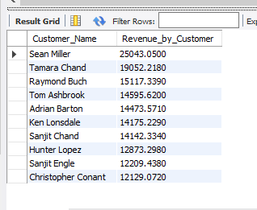
Top 10 Customers That generates most revenue
SELECT
Customer_Name,
SUM(Sales) AS Revenue_by_Customer
FROM kalundusalestable
GROUP BY Customer_Name
ORDER BY Revenue_by_Customer DESC
LIMIT 10;

Slide 28
Customer Segment Performance
On the customer side, Sean Miller was the top revenue-contributing customer, generating $25,043.05 in total sales.
Consumers were the highest revenue generating segment at $1,161,401.35, followed by Corporate at $706,146.37 and Home Office at $429,653.15, confirming that the majority of customers fall under the consumer segment.

Slide 29
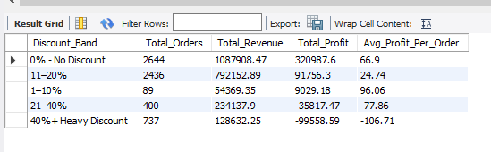
impact of discount on revenue and orders made
SELECT
CASE
WHEN Discount = 0 THEN '0% - No Discount'
WHEN Discount <= 0.10 THEN '1–10%'
WHEN Discount <= 0.20 THEN '11–20%'
WHEN Discount <= 0.40 THEN '21–40%'
ELSE '40%+ Heavy Discount'
END AS Discount_Band,
COUNT(DISTINCT Order_ID) AS Total_Orders,
ROUND(SUM(Sales), 2) AS Total_Revenue,
ROUND(SUM(Profit), 2) AS Total_Profit,
ROUND(AVG(Profit), 2) AS Avg_Profit_Per_Order
FROM kalundusalestable
GROUP BY Discount_Band
ORDER BY Total_Profit DESC;

Slide 30
Discount Impact on Revenue
Regarding discounts, non-discounted items generated the highest revenue at $1,087,908.47, while heavily discounted items recorded the least at $128,632.25, suggesting limited awareness or reach of discount campaigns.

Slide 31
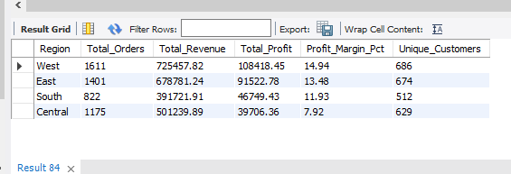
region performance
SELECT
Region,
COUNT(DISTINCT Order_ID) AS Total_Orders,
ROUND(SUM(Sales), 2) AS Total_Revenue,
ROUND(SUM(Profit), 2) AS Total_Profit,
ROUND(SUM(Profit)/SUM(Sales)*100, 2) AS Profit_Margin_Pct,
COUNT(DISTINCT Customer_ID) AS Unique_Customers
FROM kalundusalestable
GROUP BY Region
ORDER BY Total_Profit DESC;

Slide 32
Regional Sales Distribution
The West region led regionally with $725,457.82, while the Central region recorded the lowest at $501,239.36, indicating stronger demand and higher value purchasing in the West.

