Slide 1
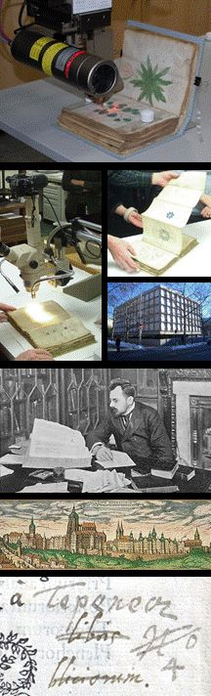
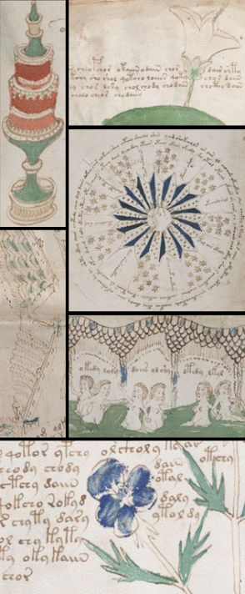
Voynich Transliterator
Using Swing
Presented by: Beatrise Opmane & Kristina Irišina

Slide 2
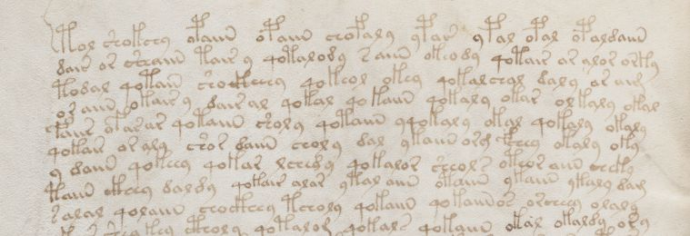
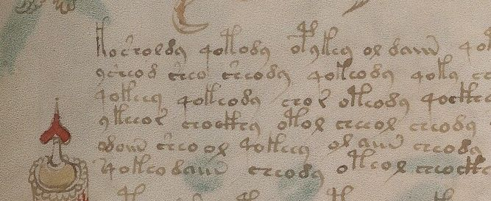
Business Analysis
Target audience - scholars researching the Voynich Manuscript. To reach this audience, the resulting product:
must have - an efficient transliteration function and possibility to customize transliteration rules;
should have - GUI design that is user friendly
could have - function that allows user to load source text from web.
won’t have this time- a function that allows user to compare transliteration rule tables

Slide 3
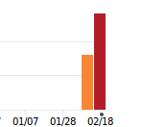
Project planning
Planner - to create and update the project plan
GitHub - for version control
  Week 1: 8 commits
  Week 2 : 14 commits

Slide 4
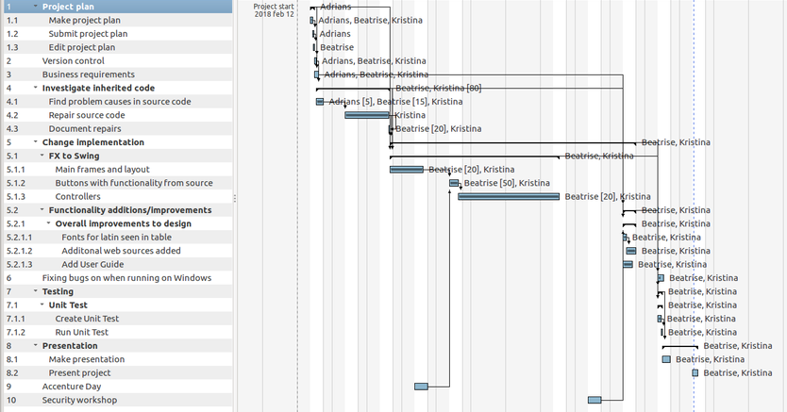

Slide 5
Analysis of inherited code
Inherited code
  was not used to build Voynich.jar and can’t be built into a working application
  Compilation returns numerous errors in the console
  Compilating with different IDEs has the same result
Voynich.jar can only be executed from terminal
  The execution creates a VoynichData folder
  After repeat executions, transliteration tables do not appear if the VoynichData folder is not manually deleted after every launch
Several functions do not work properly

Slide 6
System design
“Hybrid” project (has both JavaFX and Swing files)
Rewriting from JavaFX to Swing
Partial MVC design pattern implementation
On first launch creates folder VoynichData for transliteration table data
  Creates default table files from inner data
Frameworks: JUnit for testing
Tools /Plugins: Eclipse WindowBuilder
Libraries: javax.swing*, java.awt*, java.io*, java.net*, java.util*

Slide 7
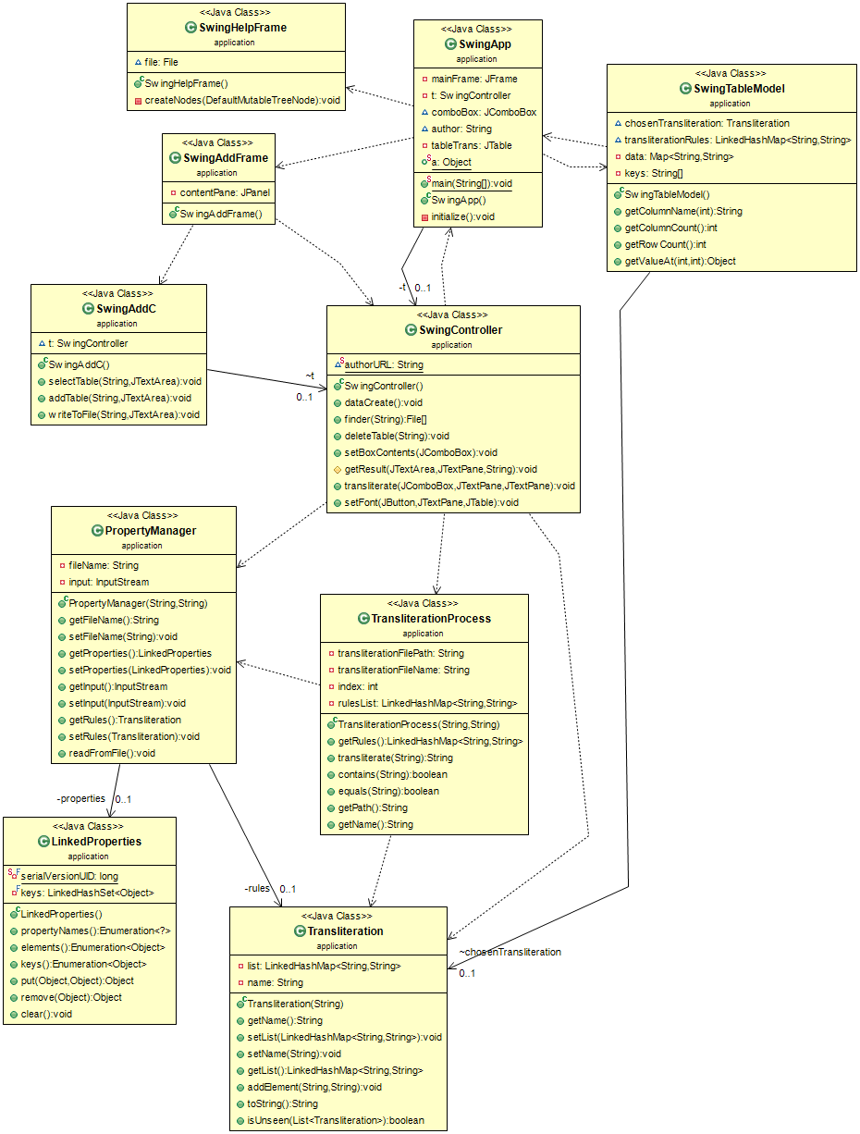
System UML

Slide 8
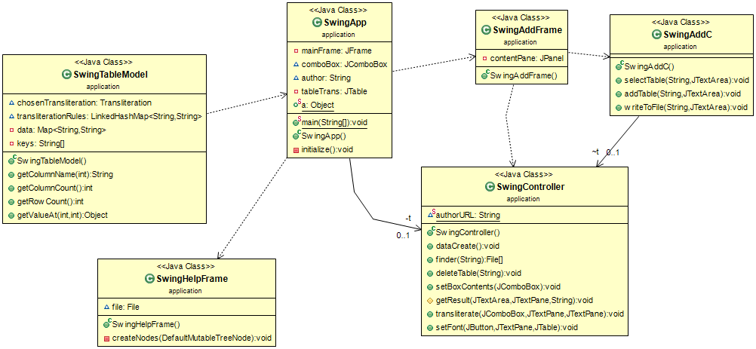
Swing class UML
UML diagram for added Swing models, controllers and frames

Slide 9
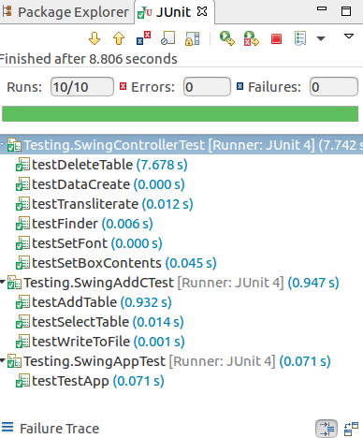
Testing
Junit test cases for SwingApp, SwingController and SwingAddC classes.
Assertion is used to test table file creation and deletion, transliteration process, the setting of table ComboBox contents and file finding.
Testing did not find any major bugs in the Swing classes

Slide 10
Documentation
Main information about the project: readme.md
Overview
  Features
  General improvements
Getting started
  Prerequisites
  Installing
Deployment
Versioning
Authors
Dependencies

Slide 11
Documentation
Inherited code issues: sourceInvestigation.md
Inherited code initial issues
Inherited code fixes list
Full list of improvements made in the new app: improvements.md

Slide 12
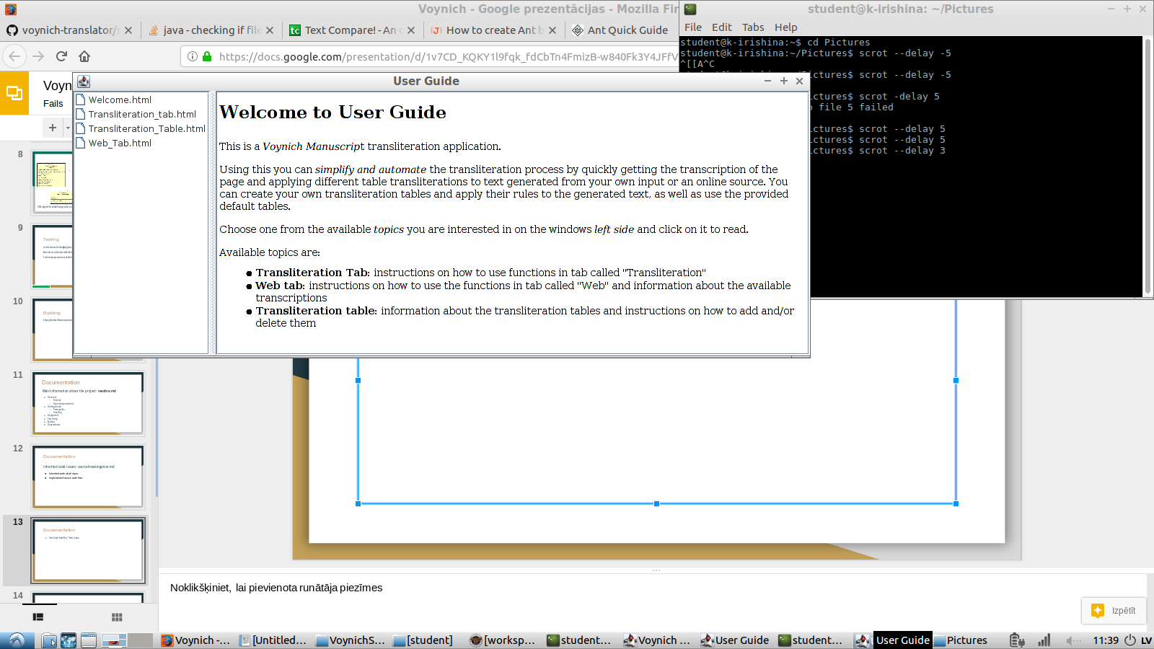
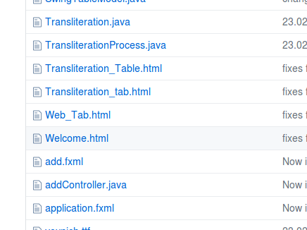
Documentation
User Guide: in-app, application/*.html

Slide 13
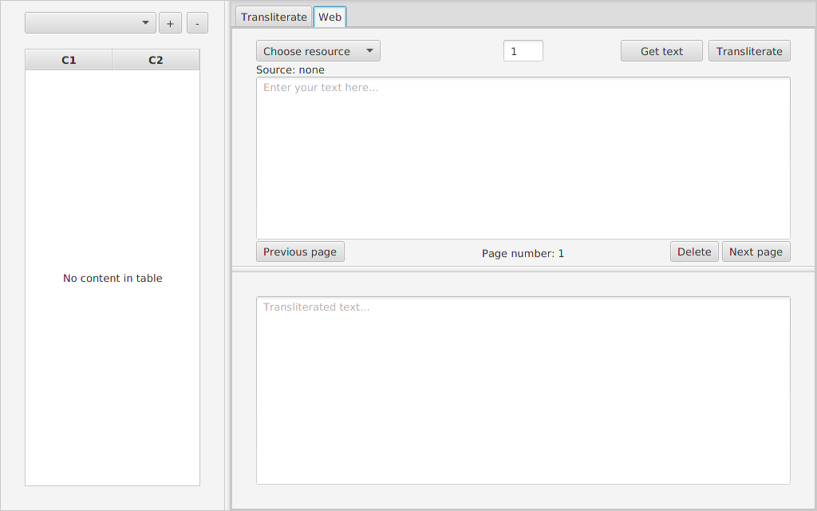
Screenshot of the inherited application

Slide 14
Demonstration

Slide 15
Overview
Project: https://github.com/beatrise/voynich-translator/
Main features:
Text transliteration
- Font change (Manuscript/Latin)
- Custom transliteration tables
- Load transcribed pages from a web source

Slide 16
Biggest Challenges
Severe issues with the source code
  The inherited code was not functional, but the added .jar was (partially)
  The source code did not match the code used in the included .jar file
  Only worked on 8 pages of the manuscript (out of ~200 in the source)
  Other bugs and poorly functioning features
Less team members than expected

Slide 17
Future work
Support for pages with different transcription formatting and numbering
Structure to view and compare tables
More automated tests (and application changes to properly implement them)
Implement Maven build

Slide 18
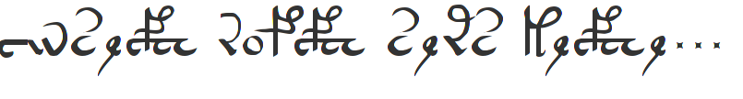
Thank you for your attention!

