Slide 1
SAFENET abril - presente
Beatriz Neves

Slide 2
Table of contents
01
02
03
Tratamento do Excel
Hypothesis
Objectives
04
05
06
Methodology
Analysis
Conclusions
You can describe the topic of the section here
You can describe the topic of the section here
You can describe the topic of the section here
You can describe the topic of the section here
You can describe the topic of the section here

Slide 3
Excel Dados IP_clean
20 propriedades
3 195 pontes
Longitude
Latitude
Número de Obra
Designação
Tipo de Obra
Distrito
Concelho
M à Entrada da Obra
P à Entrada da Obra
Dono Obra
Ano de Construção
Tipo de Estrutura
Número de Vãos
Comprimento Total
Largura da Obra
Vão Máximo
Altura do Pilar mais Alto
TMD
Zona Sísmica
Material

Slide 4
Excel Dados IP_clean
20 propriedades
3 195 pontes
Longitude
Latitude
No Google Maps procurar latitude, longitude.
Os valores de latitude e longitude têm que ter um ponto (.) a separar as casas decimais.
Ano de Construção
403 casos sem valor

Slide 5
Excel Dados IP_clean
20 propriedades
3 195 pontes
Tipo de Estrutura
13 atributos e 19 casos sem valores
Alvenaria Alargada; Arco (simples ou múltiplos); Arco Pré-Fabricado;
Estrutura Tubular; Estrutura Tubular tipo "ARMCO“; ...
Material
17 atributos
Aço; Aço (tipo ARMCO); Aço aparafusado; Aço rebitado; …

Slide 6
Ano de Construção
Antes de 1960 (897) | 1960-1983 (293)
1983-2010 (1877) | Depois de 2010 (128)
403 casos sem valores
Foram eliminados
3 195 => 2 792

Slide 7
Pontes Repetidas
Pontes com a mesma Longitude e Latitude e mesmo Número de Obra
218 pontes
Pontes com diversos materiais.
Pontes com 2 materiais:
Material da Estrutura (importante) e material do Tabuleiro.
2 792=> 2 556
N. da Obra | N. de Materiais | Material 1 | Material 2 | Material 3 | Material 4
191 | 3 | Alvenaria Rebocada | Betão Armado | Betão Armado Pré-esforçado | -
272 | 3 | Alvenaria de Pedra | Betão Armado | Ferro | -
330 | 4 | Alvenaria de Pedra | Alvenaria de Tijolo | Betão Armado | Ferro

Slide 8
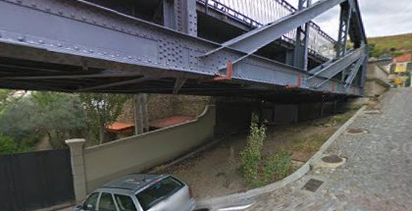
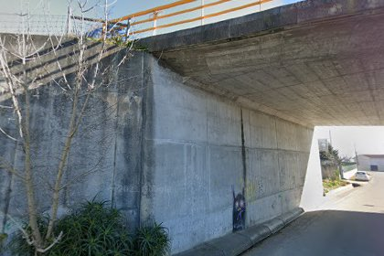
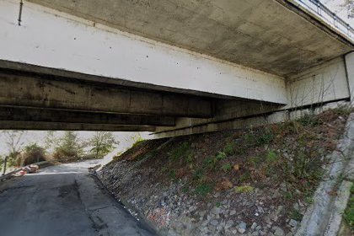
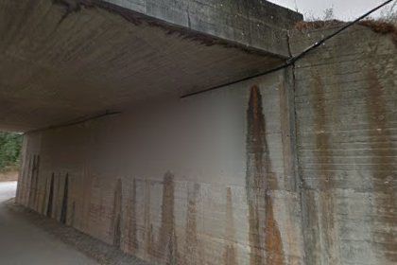
Fotos
Pontes | 2 556
Sem foto | 870
Com foto | 1 686
Média | 3,83
Nº de fotos | 6 459
Notes:
Falar de como fazer o código

Slide 9
<?xml version='1.0' encoding='utf-8'?> <annotation verified="yes"> <folder>Pasta Final</folder> <filename>1_1.jpg</filename> <path>C:\Users\beatr\Documents\GitHub\SAFENET-Bea\Pasta Final\1_1.jpg</path> <source> <database>Unknown</database> </source> <size> <width>224</width> <height>224</height> <depth>3</depth> </size> <segmented>0</segmented> <structure><type>Tabuleiro simples/apoiado</type><material>Betão Armado</material><year_range>Antes de 1960</year_range></structure></annotation>
Notes:
Explicar que existia ficheiros JSON e XML mas para ResNet usamos TFRecords

Slide 10
Combinações
Antes
74 combinações
26 combinações com 1 a 5 ficheiros (35,62%)
15 combinações com 6 a 10 ficheiros (20,55%)
5 combinações com 100 a 500 ficheiros (11,63%)
3 combinações com mais de 500 ficheiros (4,11%)
Intervalo de Anos: 4 atributos
Estrutura: 12 atributos
Material: 12 atributos
Depois
43 combinações
13 combinações com 1 a 5 ficheiros (30,23%)
6 combinações com 6 a 10 ficheiros (13,95%)
6 combinações com 100 a 500 ficheiros (13,95%)
2 combinações com mais de 500 ficheiros (4,65%)
Intervalo de Anos: 4 atributos
Estrutura: 5 atributos
Material: 5 atributos

Slide 11
ResNet
Prós Profundidade: Pode ser extremamente profunda, melhorando a capacidade de aprendizado. Eficiência: Conexões residuais ajudam a mitigar problemas de treino em redes profundas. | Contras Complexidade: Estrutura mais complexa devido às conexões residuais. Overfitting: Modelos muito profundos podem overfitting se não houver dados suficientes ou regularização adequada.
Resumo do código

Slide 12
Resultados
Tempo: 44,78 min
Accuracy
Treino: 99,21%
Validação: 77,36%
Teste: 74,96%
Accuracy
Treino: 0,1466
Validação: 24,63
Teste: 23,1
647 ficheiros de teste e 485 casos estão na classe correta (75%)
16 classes sem casos de treino

Slide 13
Contents of this template
This is a slide structure based on a thesis defense presentation
You can delete this slide when you’re done editing the presentation
Fonts | To view this template correctly in PowerPoint, download and install the fonts we used
Used and alternative resources | An assortment of graphic resources that are suitable for use in this presentation
Thanks slide | You must keep it so that proper credits for our design are given
Colors | All the colors used in this presentation
Icons and infographic resources | These can be used in the template, and their size and color can be edited
Editable presentation theme | You can edit the master slides easily. For more info, click here
For more info: SLIDESGO | SLIDESGO SCHOOL | FAQS
You can visit our sister projects: FREEPIK | FLATICON | STORYSET | WEPIK | VIDEVO

Slide 14
Whoa!
Bridge Construction Thesis Defense
By Slidesgo
This can be the part of the presentation where you introduce yourself, write your email...

Slide 15
01
Purpose statement
You can enter a subtitle here if you need it

Slide 16
Introduction
You can give here a brief description of the topic you want to talk about. For example, if you want to talk about Mercury, you can say that it’s the smallest planet in the Solar System

Slide 17
Purpose statement
What about Venus?
What about Earth?
What about Mars?
Venus has a beautiful name, but also high temperatures
Earth is the beautiful planet where we all live
Mars is actually a cold place. It’s full of iron oxide dust

Slide 18
—Someone Famous
Bridge Construction Thesis Defense
By Slidesgo
“This is a quote, words full of wisdom that someone important said and can make the reader get inspired.”

Slide 19
Current situation & problems statement
Current situation
Problems
Venus has a beautiful name and is the second planet from the Sun. It’s terribly hot and its atmosphere is extremely poisonous. It’s the second-brightest natural object in the night sky after the Moon
1
2
3
Jupiter
Mars
Mercury
It’s the biggest planet in the Solar System
Despite being red, it’s actually a cold place
Mercury is the smallest planet in the System

Slide 20
02
Hypothesis
You can enter a subtitle here if you need it

Slide 21
Hypothesis
Hypothesis 1
Hypothesis 2
Hypothesis 3
Mercury is the smallest planet
Venus has a beautiful name
Saturn is composed of hydrogen

Slide 22
Studies objectives
Venus
Mars
Venus is the second planet from the Sun
Despite being red, Mars is a cold place
Mercury
Saturn
Mercury is the closest planet to the Sun
Saturn is composed of hydrogen and helium

Slide 23
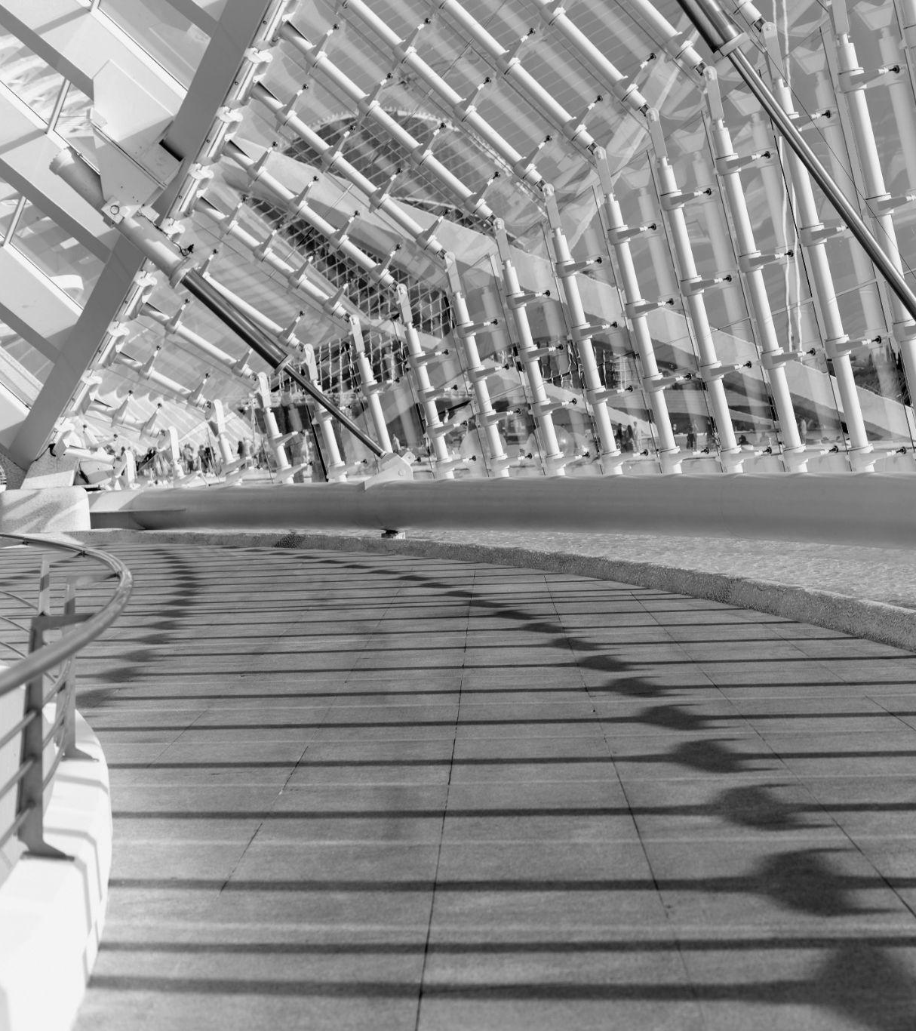
A picture always reinforces
the concept
Bridge Construction Thesis Defense
Images reveal large amounts of data, so remember: use an image instead of a long text

Slide 24
Literature review
AUTHOR (YEAR). Title of the publication. Publisher
Mercury is the closest planet to the Sun and the smallest one in the Solar System
AUTHOR (YEAR). Title of the publication. Publisher
Mars is full of iron oxide dust, which gives the planet its reddish cast
AUTHOR (YEAR). Title of the publication. Publisher
Jupiter is a gas giant and the biggest planet in the Solar System
AUTHOR (YEAR). Title of the publication. Publisher
Venus has a beautiful name and is the second planet from the Sun

Slide 25
Theoretical framework
Key terms
Relevant theories
Framework
Pluto is considered a dwarf planet
Ceres is located in the main asteroid belt
Mercury is the closest planet to the Sun
Theory 1
Earth is the third planet from the Sun and the only one that harbors life in the Solar System
Jupiter is the biggest planet of them all
Theory 2
Saturn is a gas giant and has several rings

Slide 26
Awesome words
Bridge Construction Thesis Defense
By Slidesgo

Slide 27
Schedule
Task | Description | Sep | Oct | Nov | Status
Task 1 | Mars is full of iron oxide dust |  |  |  | Completed
Task 2 | Earth is the planet that harbors life |  |  |  | In progress
Task 3 | Jupiter is the biggest planet |  |  |  | Delayed
Task 4 | Saturn is a gas giant planet |  |  |  | In progress
Sep 1 - Oct 18
Oct 1 - Nov 30
Oct 15 - Nov 15
Oct 10 - Nov 30

Slide 28
Porcentages
75%
85%
Jupiter
Venus
It’s the biggest planet of them all
Venus has high temperatures

Slide 29
Locations
Mercury
Mars
Mercury is a small planet
Mars is a very cold planet

Slide 30
150,000
Bridge Construction Thesis Defense
By Slidesgo
Earth is the third planet from the Sun and the only one that harbors life in the Solar System

Slide 31
Methodology
Type of data
Mercury is the closest planet to the Sun and the smallest one
Motives
Venus has a beautiful name and is the second planet from the Sun
Mercury
Data collection
Despite being red, Mars is a cold place. It’s full of iron oxide dust
Specific sampling
Jupiter is a gas giant and the biggest planet in the System

Slide 32
Analysis & development
Phase 1
Phase 2
Mercury is the closest planet to the Sun and the smallest one in the entire Solar System
Venus has a beautiful name and is the second planet from the Sun. It has high temperatures!

Slide 33
Evolution
01
02
03
04
Jupiter
Mars
Mercury
Venus
It’s the biggest planet of them all
Mars is actually a very cold place
It’s the closest planet to the Sun
It’s the second planet from the Sun

Slide 34
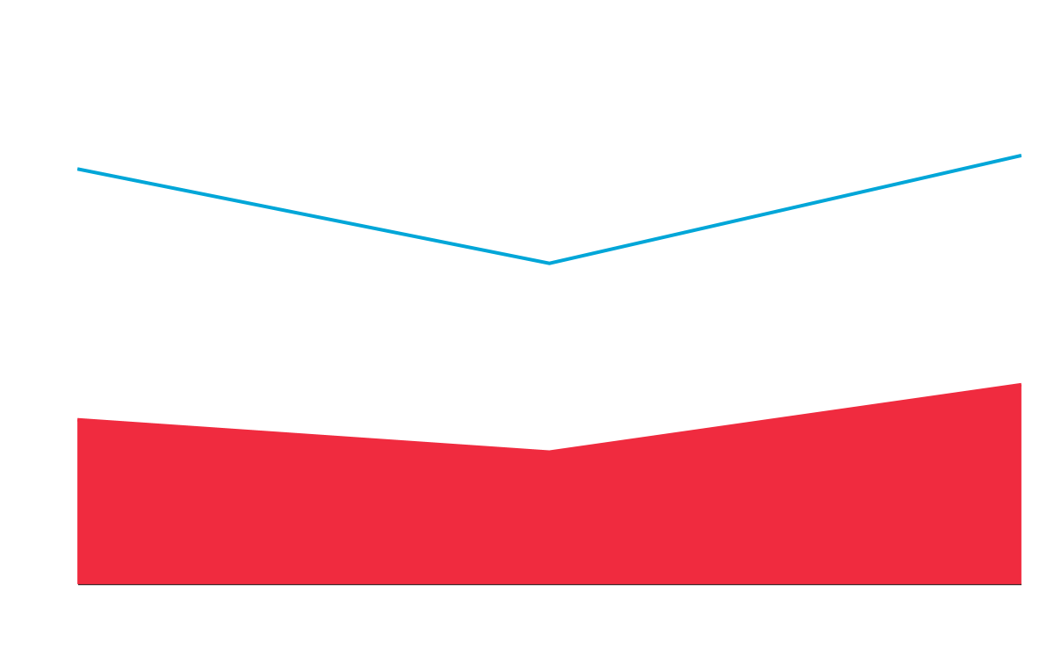
Analysis & development
Mars
Mercury
Mars is a very cold planet
Mercury is a small planet
Neptune is the farthest planet from the Sun. It's also the fourth-largest by diameter in the Solar System:
Despite being red, Mars is actually a cold place
Jupiter is the biggest planet in the Solar System
Follow the link in the graph to modify its data and then paste the new one here. For more info, click here

Slide 35
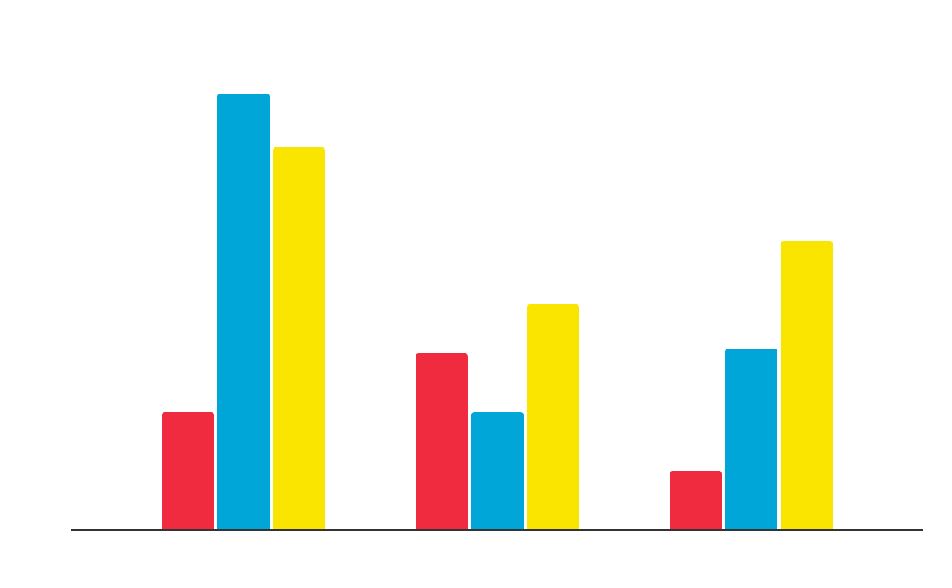
Analysis of the results
Mars
Despite being red, Mars is a cold place
Venus
Venus is a beautiful name and planet
Neptune
Neptune is the closest planet to the Sun
Follow the link in the graph to modify its data and then paste the new one here. For more info, click here

Slide 36
Discussions
Mars
Saturn
Despite being red, Mars is cold
Saturn is one of the planets with rings
Jupiter
Venus
Jupiter is a gas giant planet
Venus has a beautiful name

Slide 37
Conclusions
Venus
Mercury
Mars
Jupiter
Saturn
Neptune
Venus is the second planet from the Sun
Mercury is the closest planet to the Sun
Despite being red, Mars is a cold place
Jupiter is the biggest planet of them all
Saturn is composed of hydrogen and helium
It’s the farthest planet from the Sun

Slide 38
A picture is worth a thousand words
Bridge Construction Thesis Defense
By Slidesgo

Slide 39
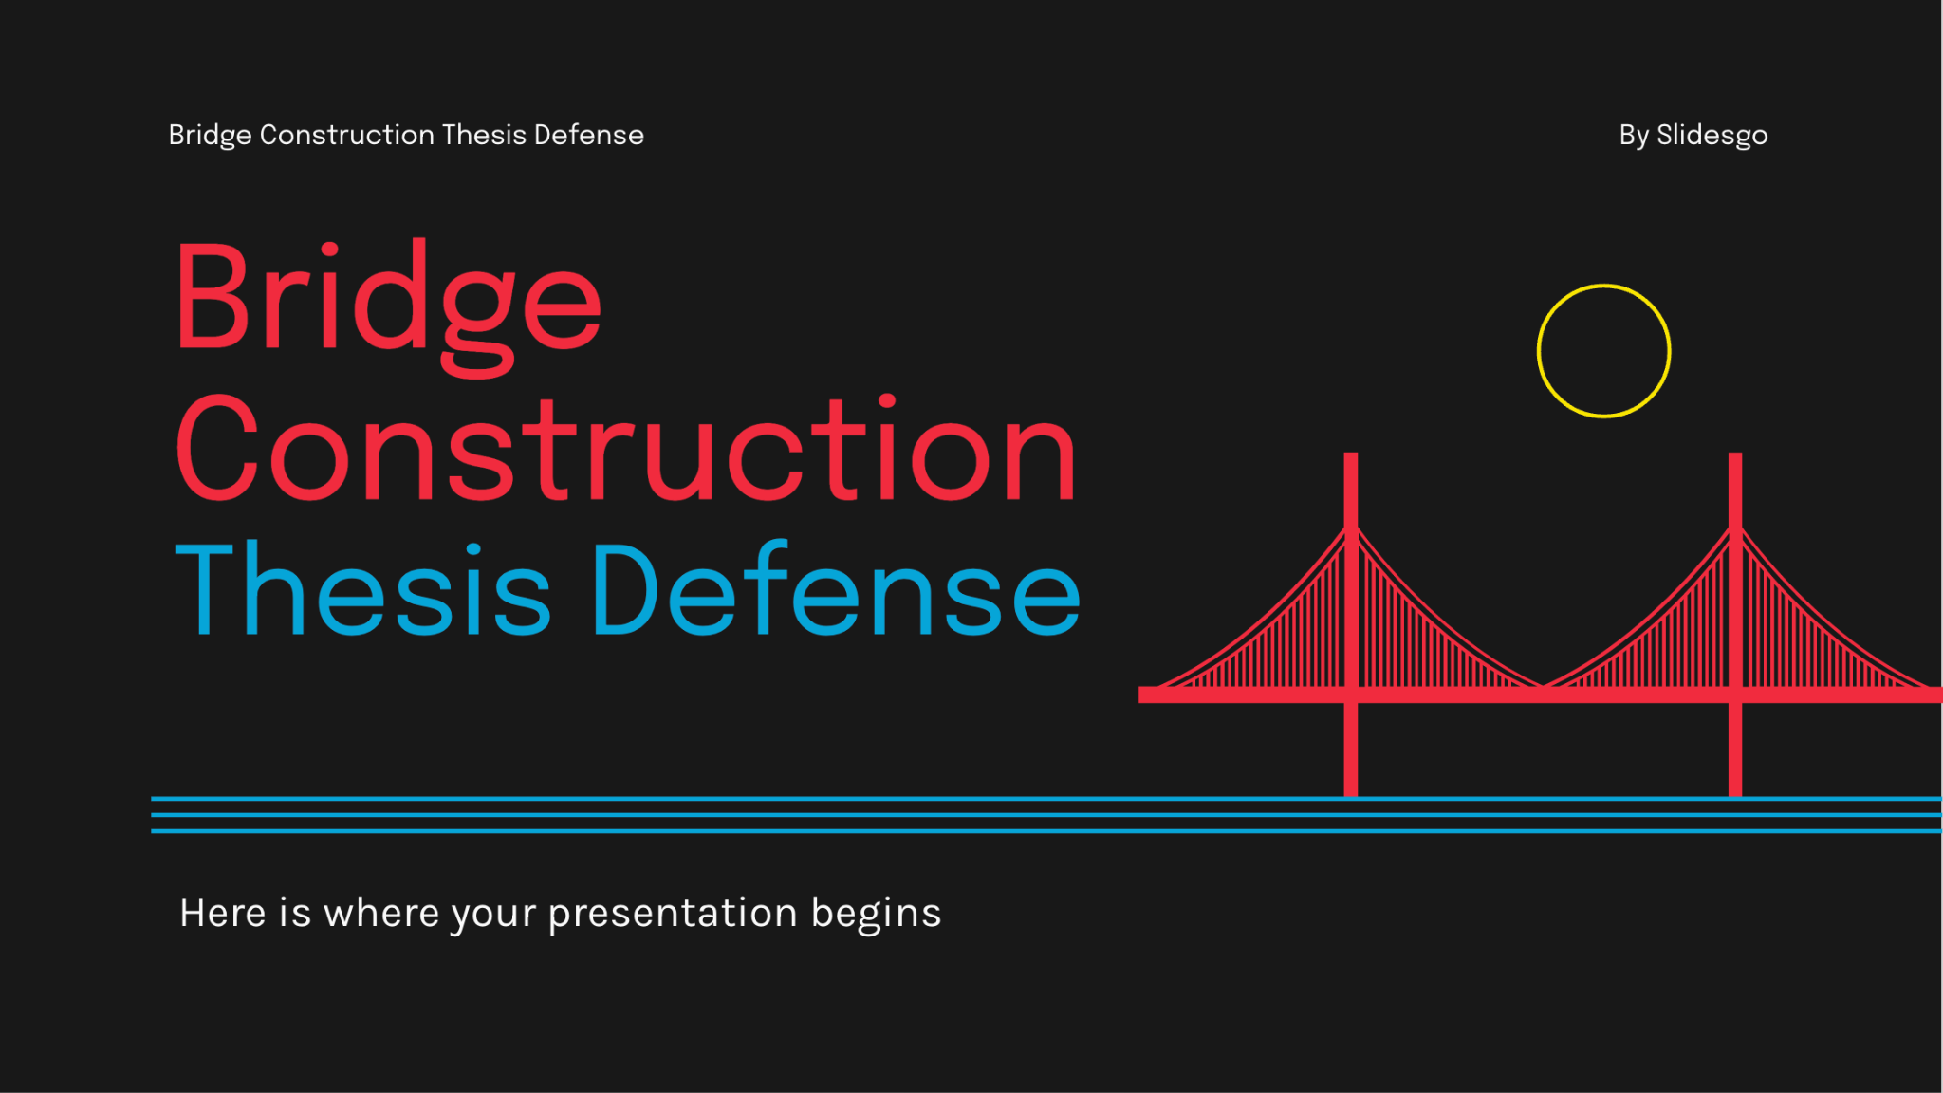
Desktop web
You can replace the image on the screen with your own work. Just right-click on it and select “Replace image”

Slide 40
Bibliographical references
Do you know what helps you make your point clear? Lists like this one:
They’re simple
You can organize your ideas clearly
You’ll never forget to buy milk!
And the most important thing: the audience won’t miss the point of your presentation at all. Let’s use lists!

Slide 41
Thank you!
Do you have any questions? youremail@freepik.com
+91 620 421 838
yourcompany.com
Please keep this slide for attribution

Slide 42
Alternative resources
Here’s an assortment of alternative resources whose style fits that of this template:
Vector
Flat travel background
Welcome landing page template with landscape
Vintage london elements cards

Slide 43
Resources slide
Did you like the resources on this template? Get them for free at our other websites:
Photos
Manhattan bridge in new york
Modern bridge
Vectors
Night skyline of lisbon
Welcome landing page template with landscape
Flat music festival poster template
Skyline of san francisco
Skyline of lisbon in flat style
Beautiful skyline of lisbon
Gradient 15 temmuz illustration with man and child next to bridge
Hand drawn mumbai illustration
Australia day background
Pink skyline of sydney
New york flyer

