Slide 1
UI trends

Slide 2
overview
Design methodologies
navigation
icons
Flat design
Card layout
AI

Slide 3
1. Design methodologies
Responsive design
Mobile first design
Journey driven design
Offline First design

Slide 4
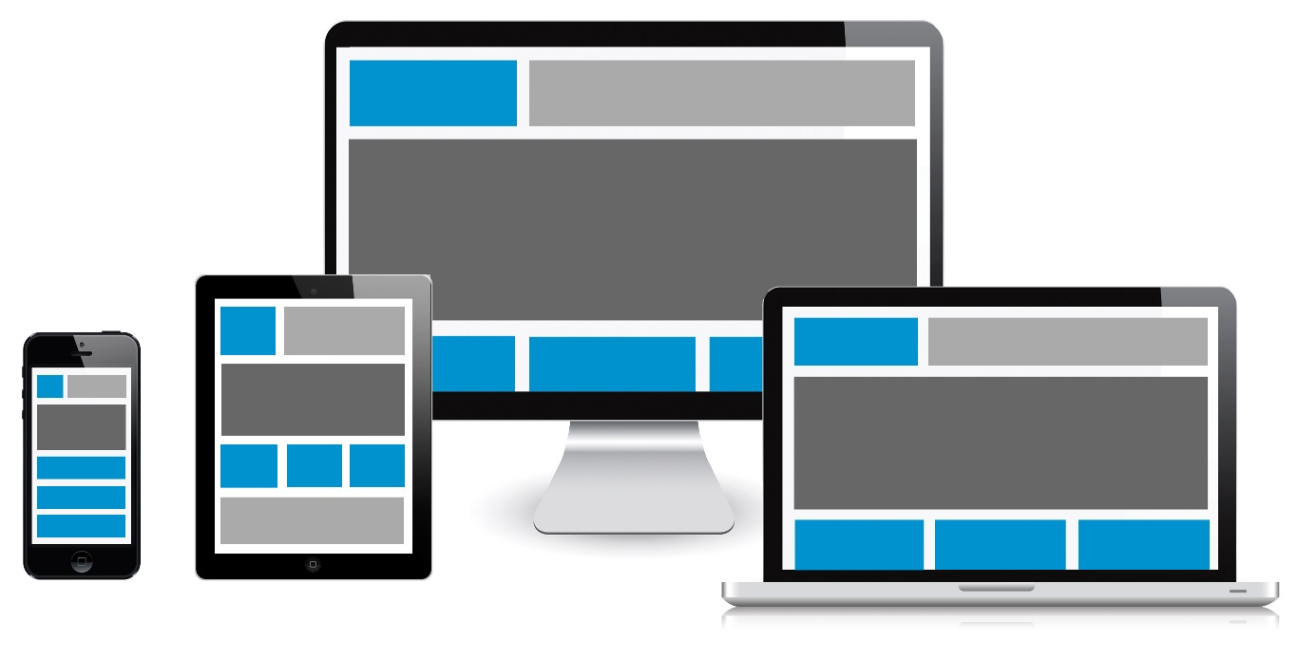
1.1 Responsive design
display the same content and functionality on screens of different sizes
Notes:
= moving content or rearranging blocks

Slide 5
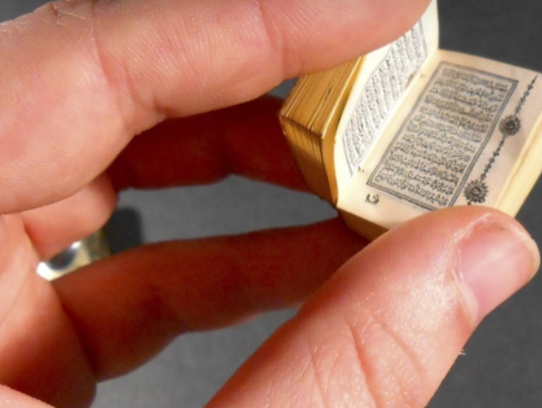
Mobile?
very small display
  If all information is placed below
  one another=>scroll
  Navigation structures sometimes
  difficult to display
  Tables become too small
  No hover
  …
Present information differently / filter
Time-consuming extra step
Start from the smallest screen

Slide 6
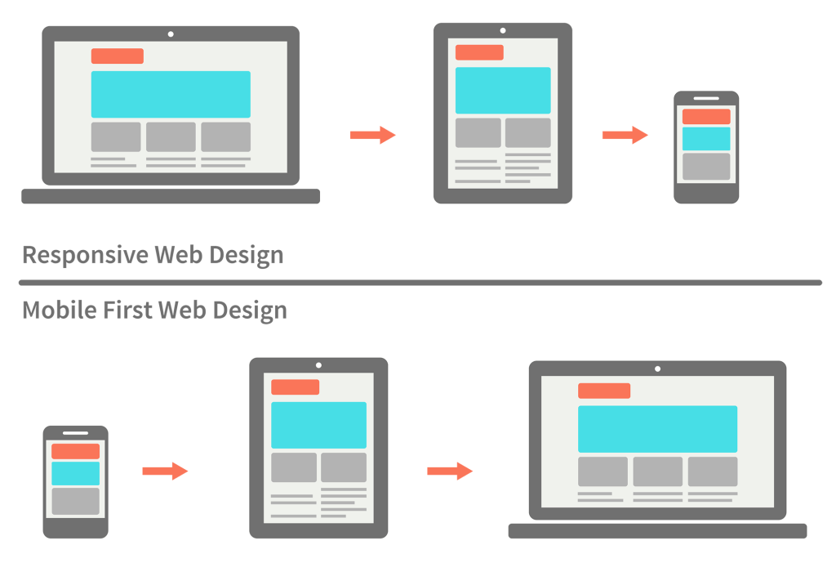
1.2 Mobile first

Slide 7
Mobile first
Design UI with constraints of mobile:
  only display important things
  content more important than layout
  frequently or quickly used items => quickly available
  other things => further away
  lack of space => information is placed several levels deep => more clicks needed, but if they are clear it is not a problem

Slide 8
Mobile first: pros / cons
+ Redundant (screen filling) content is removed
(e.g.: welcome message, ...)
+ Downloading of content must be faster
+ Improved mobile UX
Design choices for mobile do not always work on a larger screen: e.g. hamburger menu
Often leads to poorer UX on desktop

Slide 9

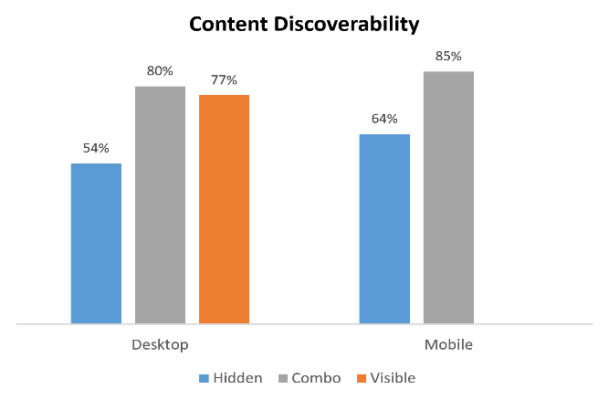
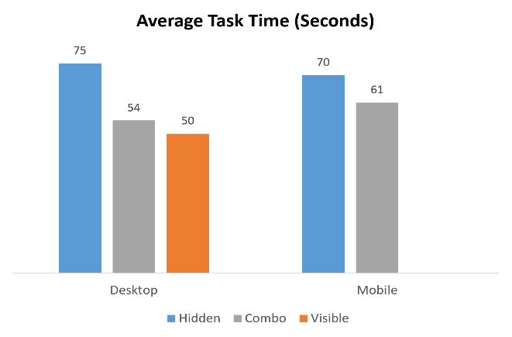
Hamburger menu
Navigation takes up a lot of space => hide under hamburger menu icon
Notes:
Nielsen Norman Group: Combo = make a few menu items visible, hide the rest

Slide 10
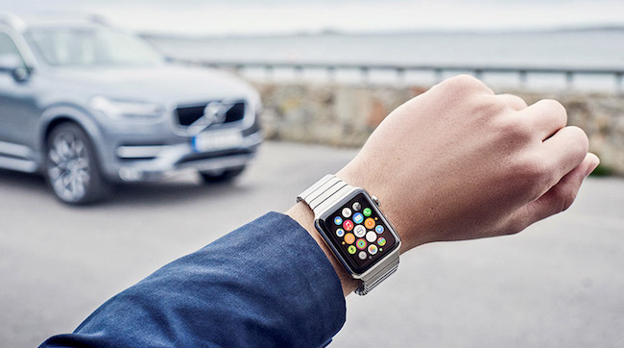
1.3 Journey driven
IoT => user interactions on laptop, phone,
tablet, TV, smart watch, fridge, ...
Start from the “user journey”:
  What functionality is most important on the different devices?
  Learn from the user which
  tasks should be highlighted
  on each device
Notes:
Example: finding the car with the smartwatch is useful, with a laptop it is much less useful

Slide 11
1.4 Offline first
Progressive Web App = web application that behaves as a native app
Traditional web app:
logic and data
of the application
Host 131.39.7.1
Host 131.39.7.4
Host 130.145.55.244
Browser
Browser
Webserver
Client
Client
Server
display page
Internet
application stops

Slide 12
Frontend frameworks
application logic in frontend:
  Javascript frameworks:
    Angular
    React
data storage in frontend:
  browsers:
    built-in local database
    local storage

Slide 13
Offline first
Since 2016
start designing webapp without server connection
add functionality for server connection
clearly indicate which function is available
do users need to know if they are offline?
resolve possible conflicts in data storage by,
for example, allowing users to choose which
version to keep

Slide 14
2. navigation
grid menu
tab menu
pull down of drop down
mega menu
pie menu
accordion
sequential menu
landing pages / category

Slide 15
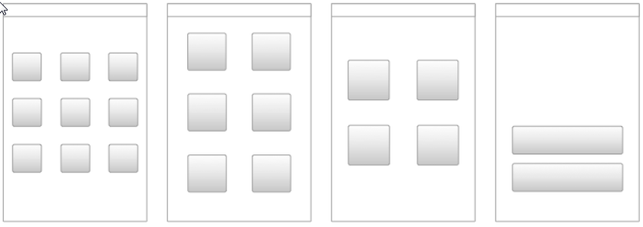
2.1 Grid menu
Grid structure in which links are placed

Slide 16
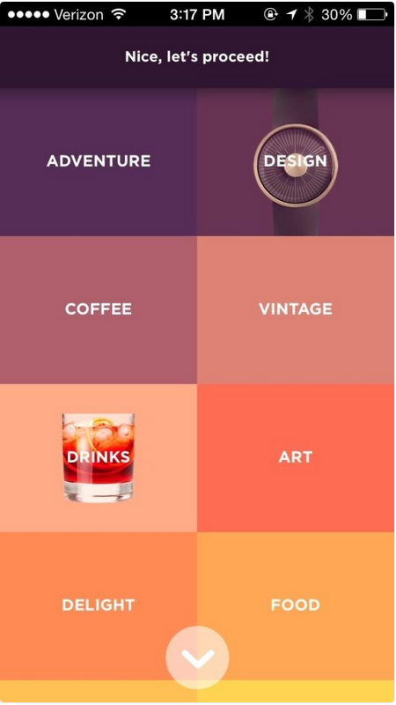
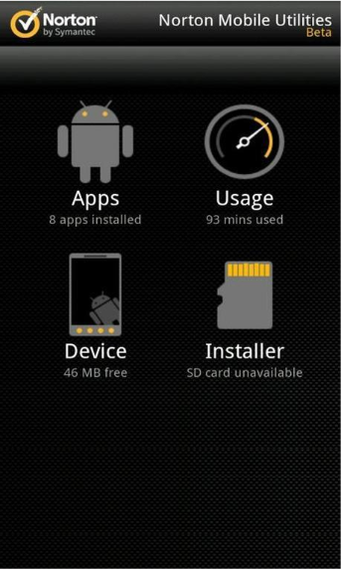
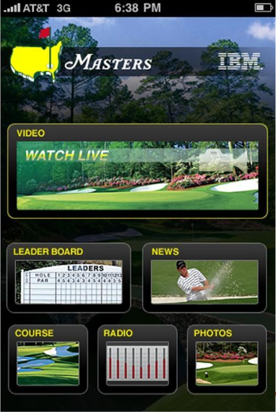
Grid menu
icons
irregular structure
squares

Slide 17

Grid menu
Mainly good for navigation with limited options:
  text takes up less space than figures
  figures load more slowly
  Example: shoe shop with figure for each shoe category
  Pictures help users to differentiate.

Slide 18
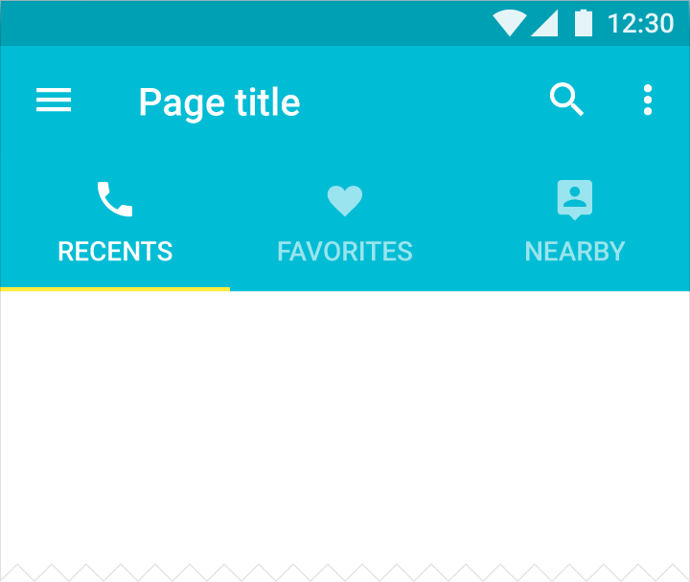
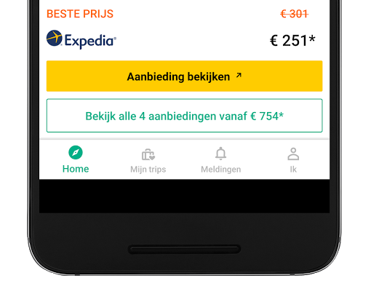
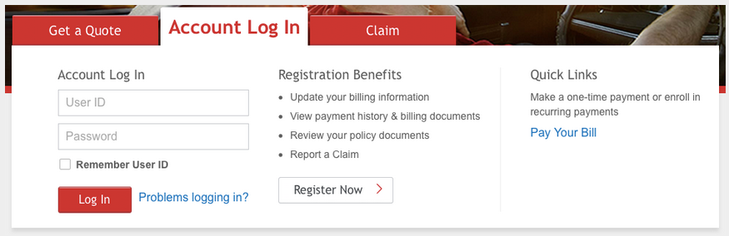
2.2 Tab menu
bottom tabs or top tabs

Slide 19
Tab menu: pros and cons
+ navigation always visible
+ clear where you are in the application
(selected tab is formatted differently)
number of menu items is limited (max 5 on smartphone)
space consuming compared to hamburger menu

Slide 20
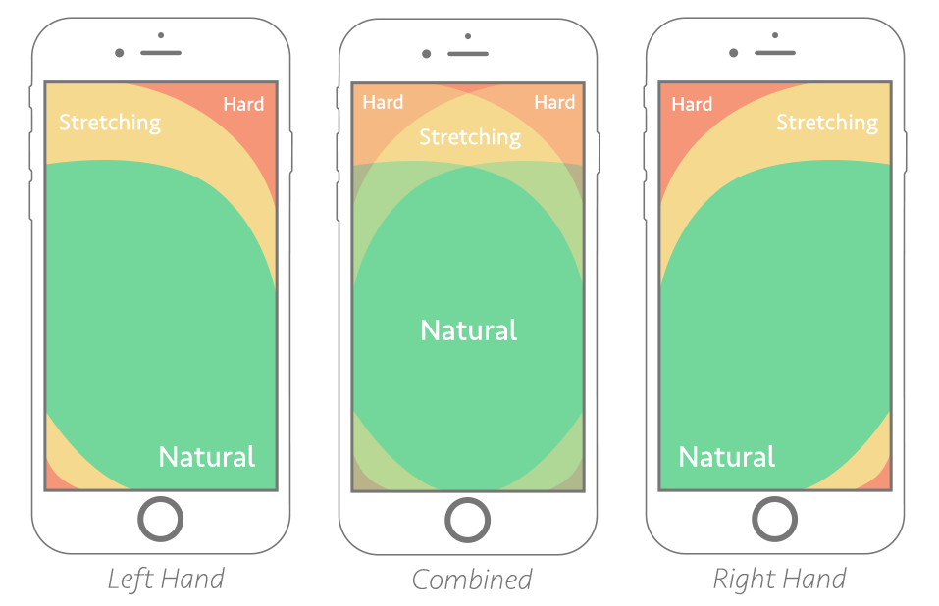
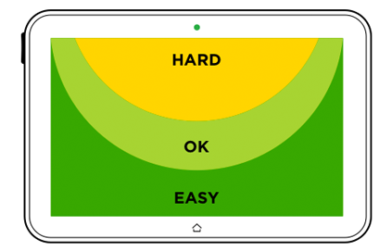
Tab menu: positioning and layout
mobile/tablet:
  thumb zone
  1 row of max 5 items
  obvious (combine icons with text)
  large enough (thumb thickness)
  indicate where the user is in the application

Slide 21
Tab menu: positioning and layout
desktop/laptop:
  mostly controlled via mouse and keyboard
  place navigation at the top
  obvious: short text with or without icon
  indicate where the user is in the application
  only for independent options (make sure the user does not have to get info from other tabs)

Slide 22
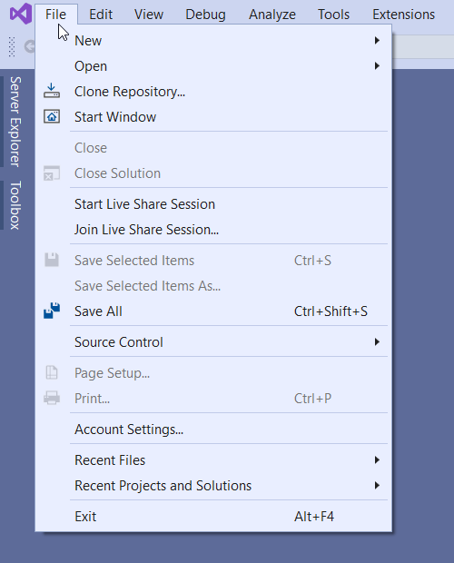
2.3 Pull/drop down menu
Operation with mouse:
Click on item in main menu
Move mouse to desired option
top items faster
limit number of items
avoid scrolling

Slide 23
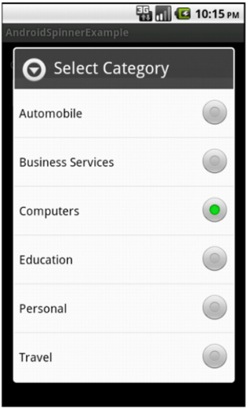
Pull/drop down menu
Touch screen:
Press item in main menu
Release finger to read the submenu
Press desired option
distance to main item not that important
anymore
large list items needed (fingers are quite thick)
overview is lost use accordion or sequential
menu

Slide 24
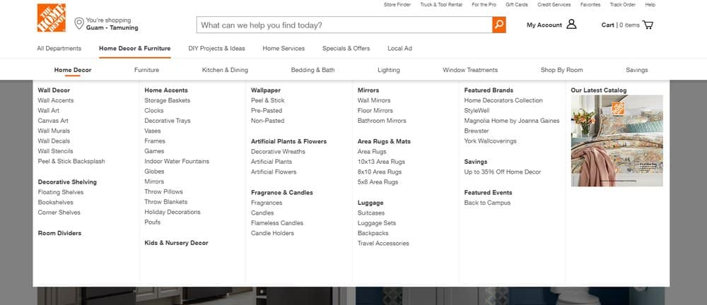
2.4 Mega menu
2-dim panel with
options divided
into groups
many options without scrolling
distance more evenly distributed
only for operation with mouse on large
screens

Slide 25
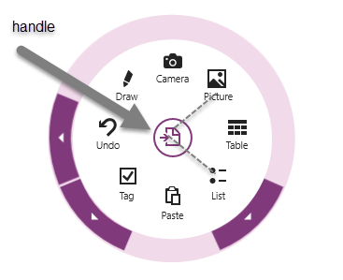
2.5 Pie menu
= radial menu around clicked item
  + equal distance to all options
  less known, so that the search for the right option takes longer
  limited number of options (click zones must be large enough)
  difficult to make a circle around a menu item at the top or bottom of a page
especially useful as a context menu that appears when you
click on a particular item on the page

Slide 26
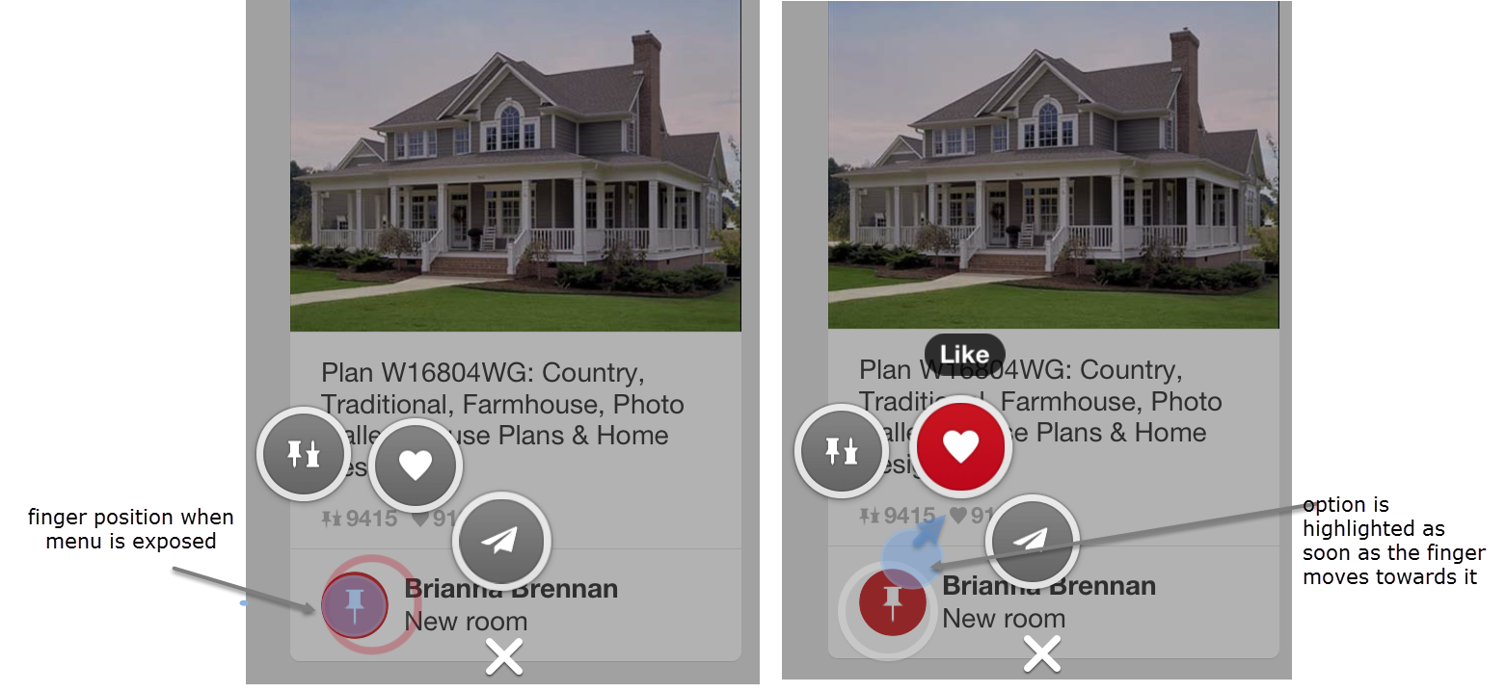
Marking menu
= pie menu where a choice lights up when
finger or mouse moves in the right direction
Notes:
Also handy with touch screens because you don't have to press so precisely on the right surface

Slide 27
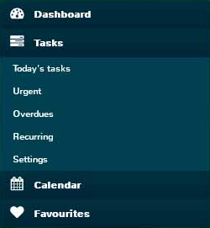
2.6 accordion
= Menu items slide apart and sub-menus appear
after clicking
+ clearly laid out, also for small screens
+ No need for an extra screen
with dropdown menu
+ also usable on large screens
- Number of items is limited
(must fit on screen)

Slide 28
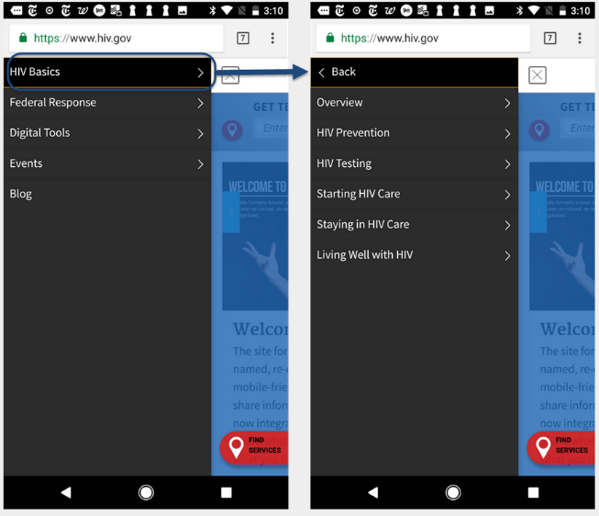
2.7 sequential menu
Show only submenu of clicked item
Main menu no longer visible
Return is possible via back option
Especially for large number of sub levels on mobile devices

Slide 29
sequential menu
+ good for deep hierarchy on small screen
- navigation between options on different sub-
levels is very difficult
structure is less clear => disorientation
large screen => use accordion menu

Slide 30
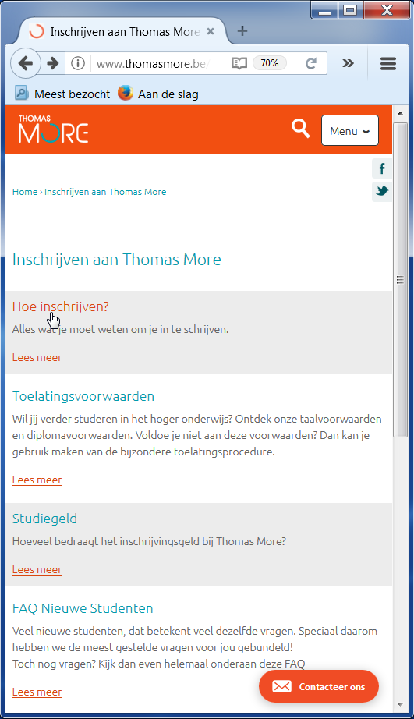
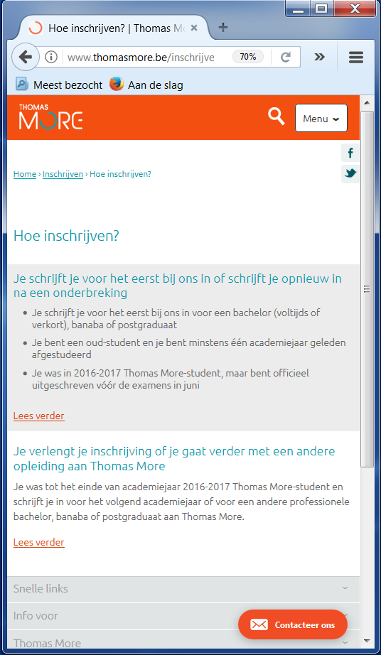
2.8 landing pages by category
Number of sub categories too large
Actually navigates to another page
Offers same advantages and disadvantages as sequential menu

Slide 31
What type of navigation for app?
Clear, well-organised navigation
Device dependent
  small screen: hamburger, grid, accordion, tabs, pie,
  sequential, …
  large screen: drop down or mega menu
User dependent:
  Frequent internet use?
  Frequent use of mobile phone?
  …

Slide 32


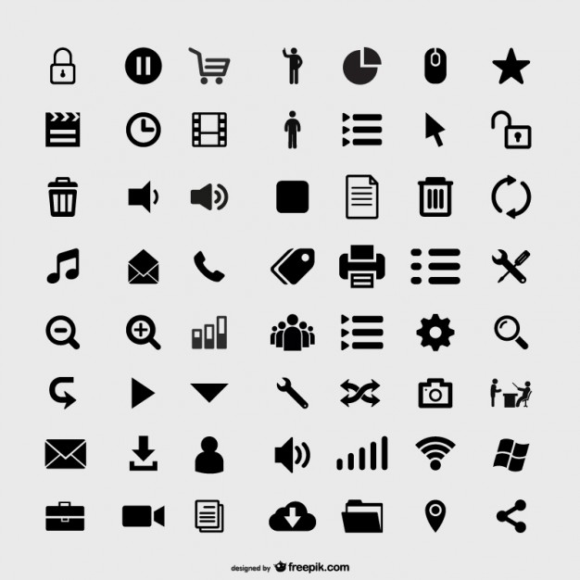
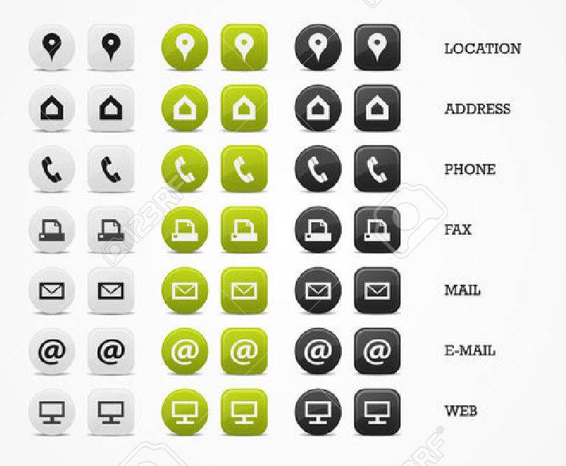
3. icons

Slide 33
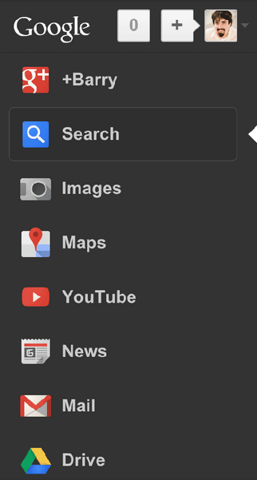
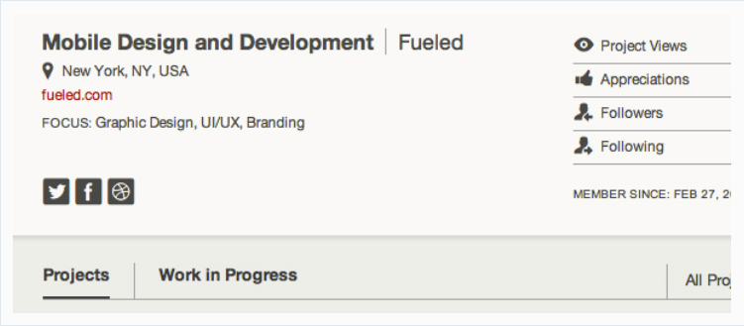
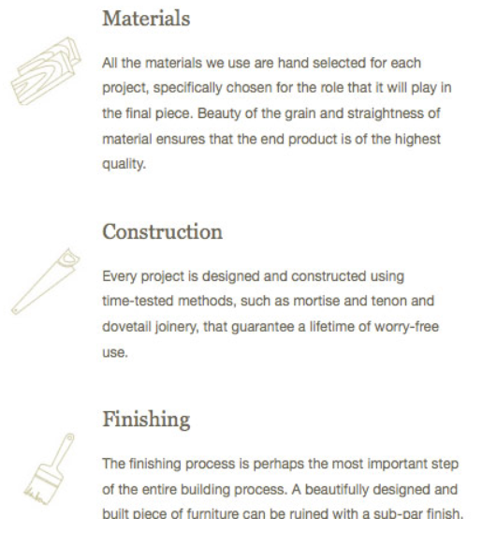

Why?
clarify options
guide attention
increase
readability
toolbar

Slide 34

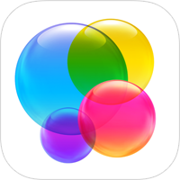



types
Unique icons
Universal icons

Slide 35

Unique icons
used as a start button for an application
easy to remember
Attractive
use meaningful icons
Apple game center logo
Notes:
Icon from 2013 contains only spheres that do not really remind you of games. Older icon was clearer

Slide 36
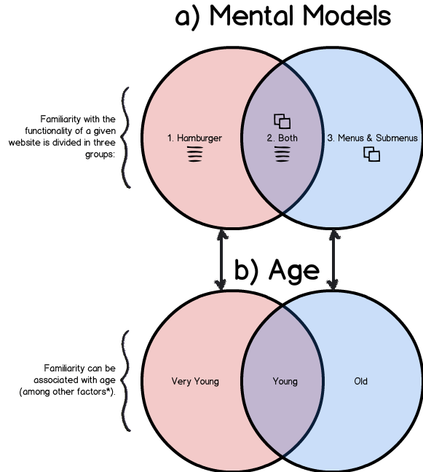
Universal icons
commonly known icons
simple drawings
Making an icon known worldwide is difficult
Meaning can differ:
  from one person to another
  based on culture
  based on religion
  based on age
Anzaldúa, 2014
Notes:
Older people better recognize the structure of menus and submenus, young people recognize both, very young people are more familiar with the hamburger menu

Slide 37








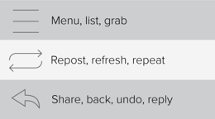
Unique meaning?

Slide 38


Outdated icons
Some frequently used icons no longer have any meaning in themselves, especially for younger people.

Slide 39


magnifying glass
search function important part of the application
small screen => only magnifying glass icon
Research Sherwin (2014):
  Better to have an input field next to the icon
  Clicking on the icon should best start a search
  Place search field and icon at the top right
  Use a simple icon with a lot of contrast

Slide 40

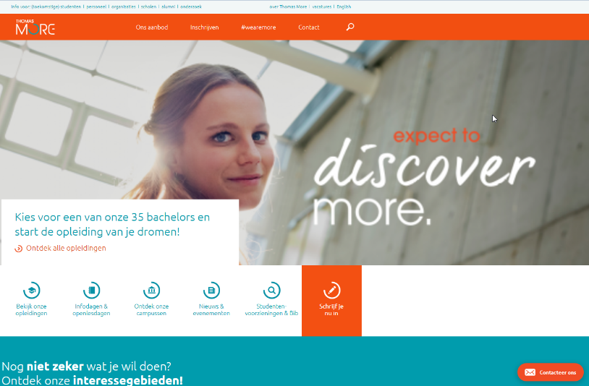
Screen dimensions
Where does search icon stand out the most?

Slide 41
Testing icons
Recognition:
  Let users guess what the icon means
  Do not add a label during the test
  Concept phase of the UI design
Predictability:
  Concept phase:
    what function could be behind the icon?
    give some context to test subject
  Later design phase:
    A/B testing => choice between different versions of icon
    exclude probing (if user goes back to main screen quickly, icon did not give expected result)

Slide 42
Testing icons: positioning
postioning:
  Measure how long it takes for users to click the correct icon
  Was the correct icon clicked first?
  too long => icon is badly positioned
  not first => too little difference from other icons
attractivity:
  How attractive on a scale of 1-10
  More versions: Best? Why?

Slide 43
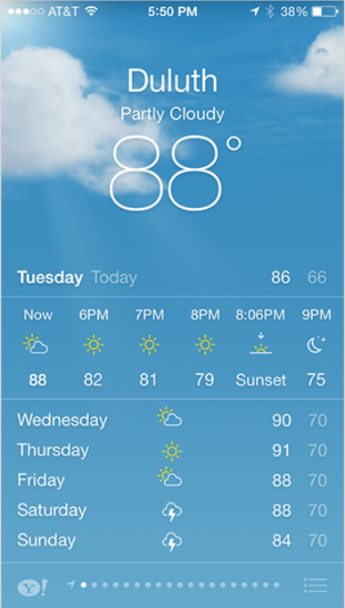
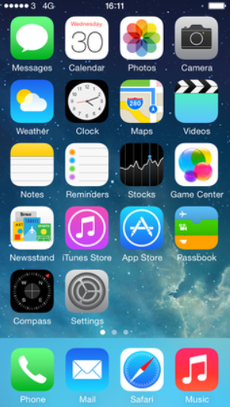
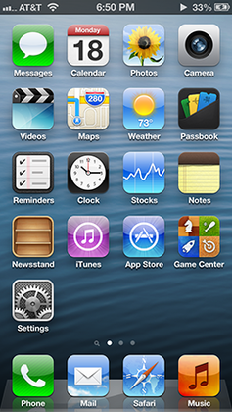
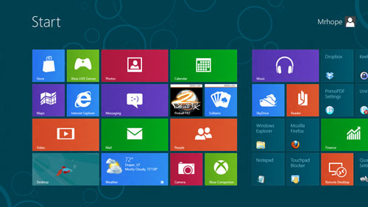
4. Flat design
Popular trend
2012: starts by releasing
Windows8
2013: iOS7 released in flat
design style

Slide 44
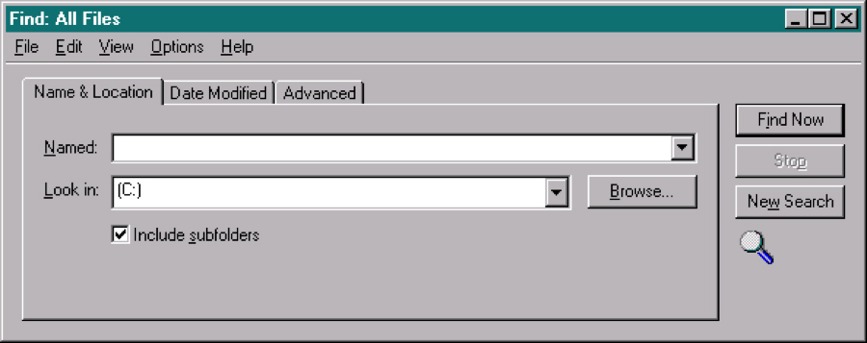
3d effects
Digital interface was new => 3D effects to make clear what was clickable, where the input fields are, ...
Windows 95
Notes:
Tab stands out a bit to make it clear that we are working on this part of the application
Buttons are shaded so that they look like something that can be pressed
Input fields are deeper so they look like places to insert something into

Slide 45
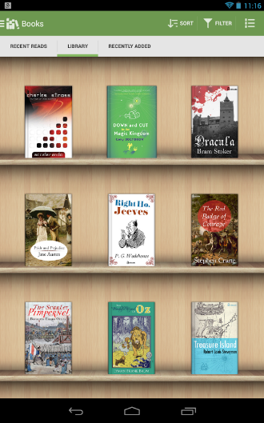
skeuomorphism
UI elements that look like the real world
Shadows and 3D effects for realism
+ clearly recognizable
takes up a lot of space
longer loading times
Aldiko book reader

Slide 46
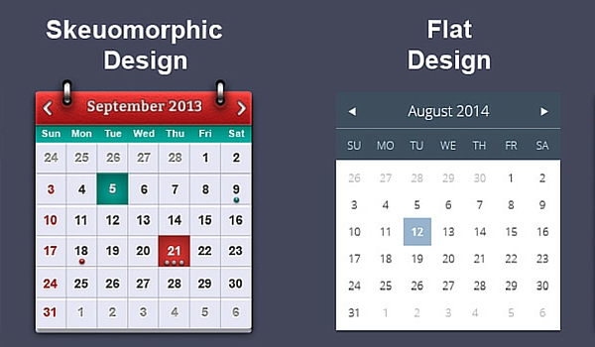
Flat design
Digital interface better known
=> realism is no longer needed
+ focus on content
+ grid based layout
=> responsive design
+ simple geometric forms
=> easy to adjust
+ easier to read

Slide 47
Flat design: problems
Kate Meyer (2015):
  User efficiency decreases
  Uncertainty about what is clickable
  Some functions are not discovered
  Place clickable elements at the top
  Use a box, an underline or a colour to indicate
  clickable elements
Applications look more and more alike

Slide 48
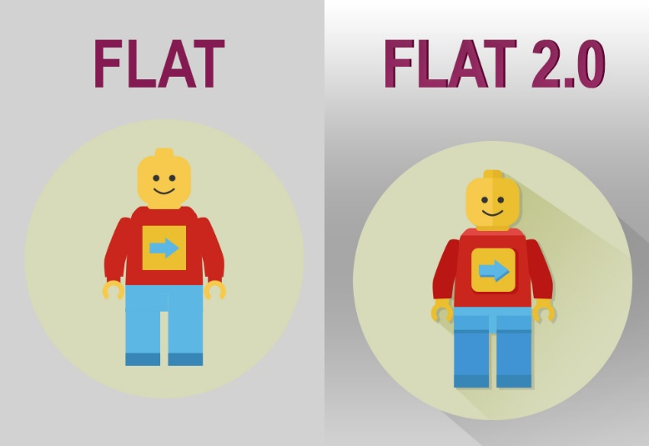

Flat design 2.0
Introducing hints of shadows, highlights, and layering along the z-axis (or third dimension) to create depth
Use of gradients:
Larger color palette

Slide 49
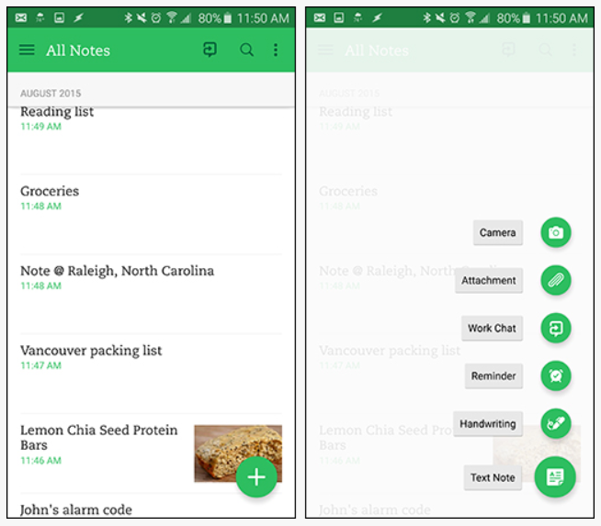
Flat design 2.0
semi
transparent
to create
depth
shadow to
raise the +
button

Slide 50
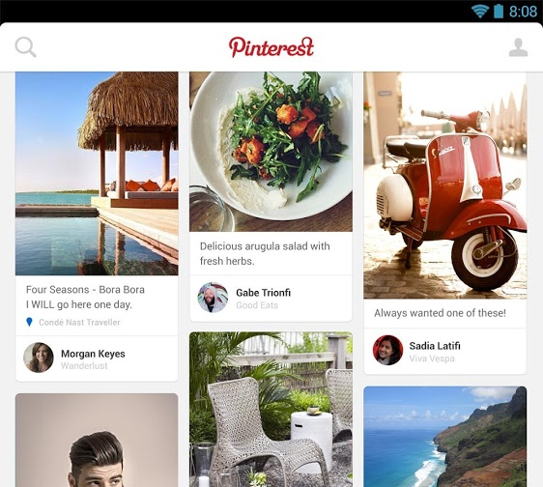
5. Card layout
Card:
  groups together pieces of related info
  link to further info or start of task
Flat design 2.0:
  shadows at the edges
  colour differences

Slide 51
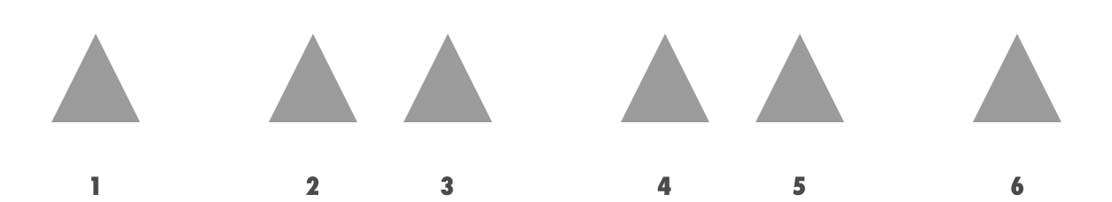
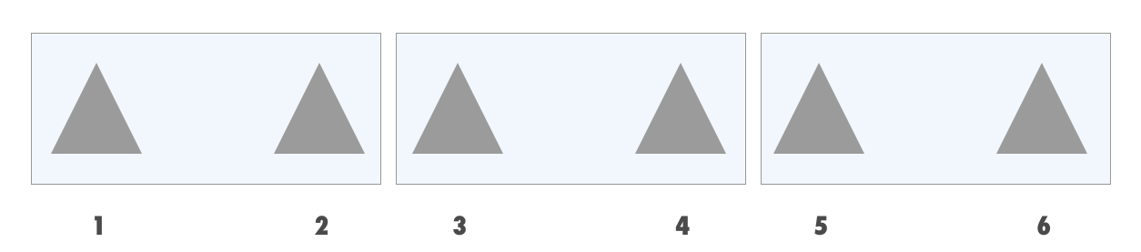
Why?
without borders:
with borders:

Slide 52
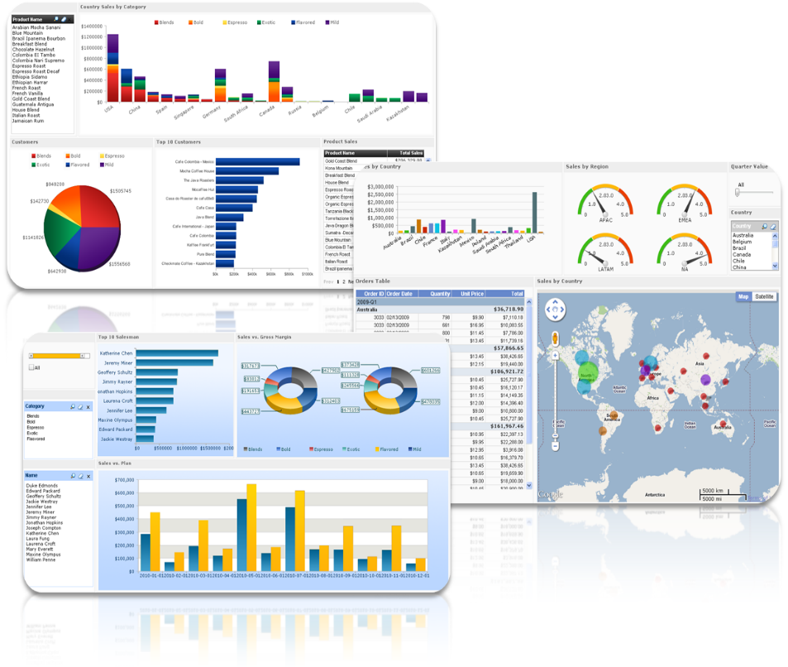
Why?
+ grouping possible without loss of space
+ easily adaptable to different screen sizes
− larger than list elements
− different form factors => no ranking
Better for unrelated subjects
(e.g. dashboard applications,
list unrelated info)

Slide 53
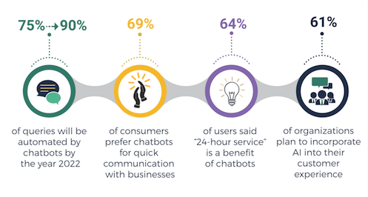
chatbot
Chatbots are domain-specific conversational user interfaces that mimic chatting with another human to help and guide users.
Mainly 2 types:
  Customer service:
  Interaction

Slide 54
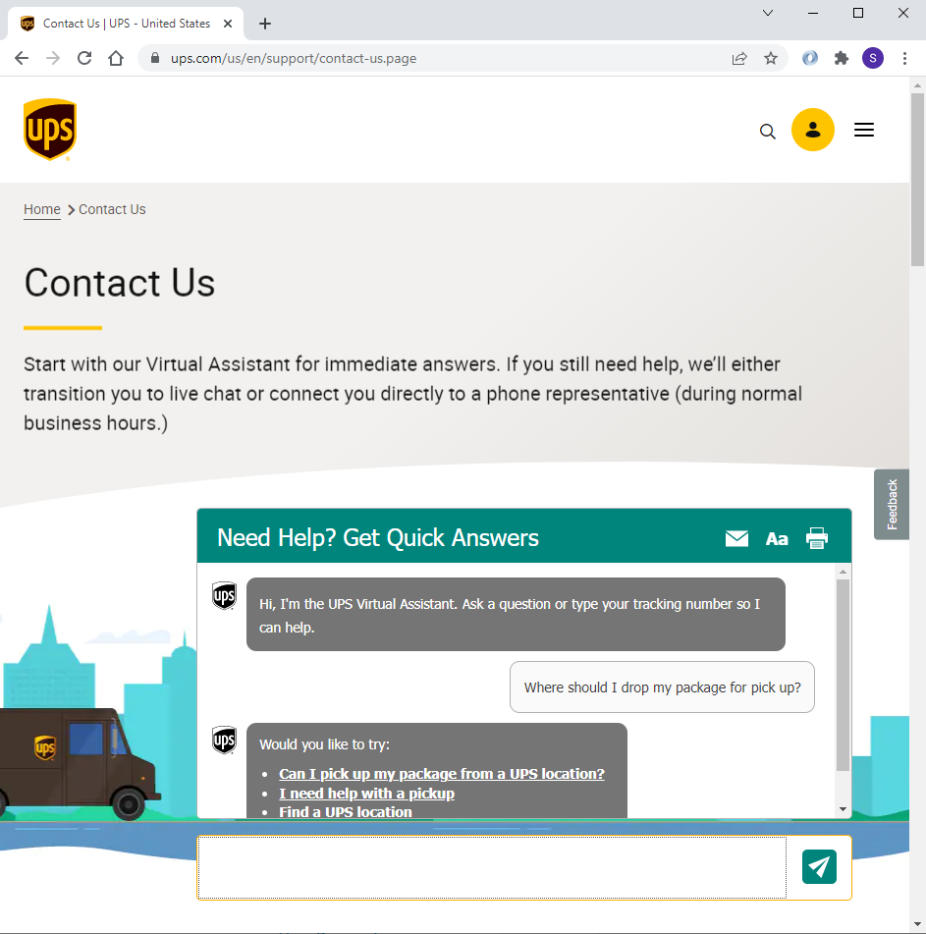
Customer-service chatbot
typically text-only
offload support team by chat between business and customer

Slide 55
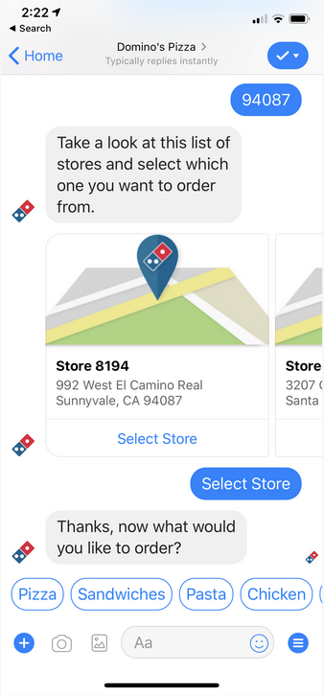
Interaction bot
contributes additional functionality and helps provide a service
  Get a quote
  Place an order
  …
More visual elements

Slide 56
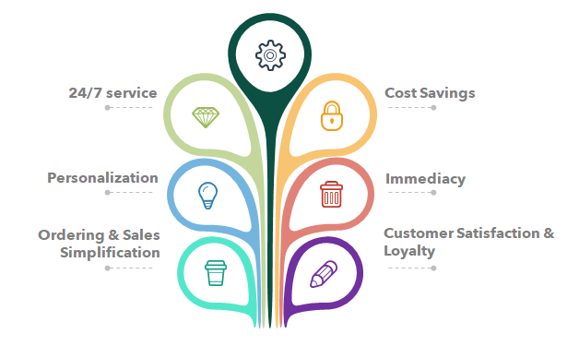
Chatbot Benefits for UX
Faster response times:
  24/7
  can handle more questions at once
Simplified tasks:
  bot directs users through each step
  more likely to complete tasks
Brand humanization:
  enhance experience of interacting with brand
Personalization:
  user experience feels more one-on-one
Informative data:
  gather useful data about people using the app to improve UX

Slide 57

Chatbot UX problems
Language complexity:
  Human language is complex
  Synonyms not recognized since not stored as a keyword
Strict script => include AI
  No support for flow different from the scripted one
  Unnecessarily long path to find an answer

Slide 58

Chatbot UX problems
Design limitations:
  Limited space in chat bot to e.g. show different options
Questionable benefit:
  Not always better or more user friendly than conventional methods
  For example, a shopping bot may not be faster or more convenient when you have already spent years optimizing your site’s UX to include features like auto-login, wish lists or saved billing information.

Slide 59

Use of AI in UI
UI enhanced with
AI functions to
improve the
interaction between
humans and machines
the AI has the ability to understand user’s commands and present the user the best possible predictions based on all the available data it has.
Beter interface personalisation
BUT:
  AI will make mistakes => make sure user can easily recover from them
  Correct expectations (what can the tool do and what not?)
  Not fully trusted yet (privacy, what data is stored, …)

Slide 60
Use of AI to improve UX
User research in UX design => lots of data and video material => use of AI to interprete data gives better insides
AI incorporated in application to gather and interprete data on what elements of the UI work and which ones don’t
New tools are being developed to ease the UI design process based on AI

