Slide 1
Style guidelines

Slide 2
What?
a set of rules for UI elements and interactions in a Web or Mobile App
ensuring product consistency across different design teams, companies, and brands
a series of guidelines to help designers set the typography, UI elements and interactions, in the same way, all the time.
essential to keep the same visual design style all the time.

Slide 3
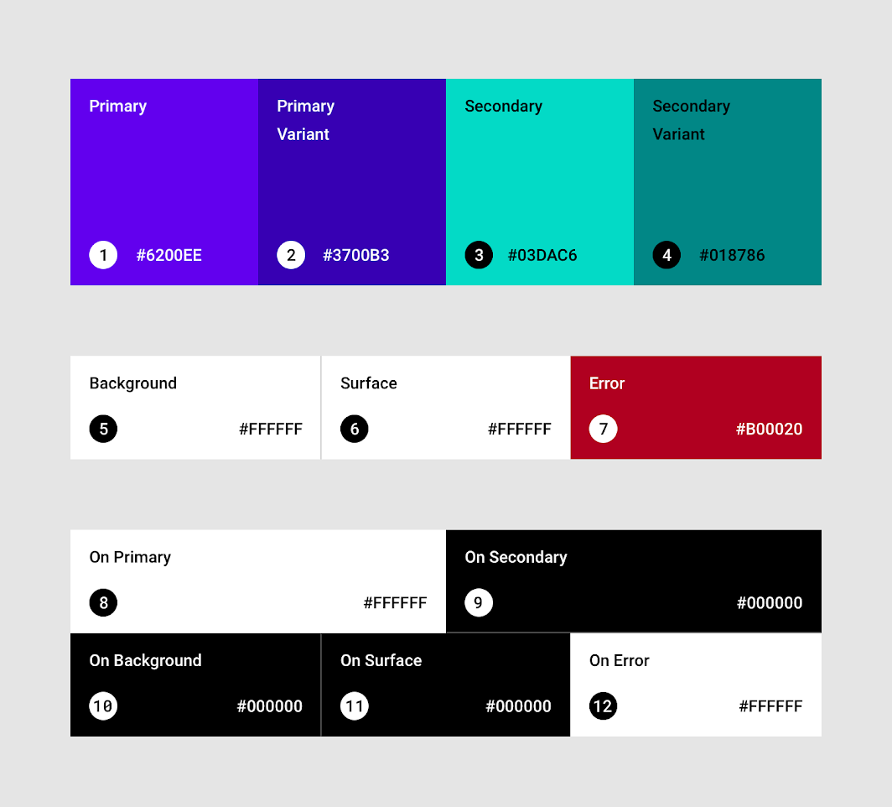
content
fonts:
  all variations of the Font Family within the App, such as the used Font Style, usage situations, Font sizes, etc
color palettes:
  for every possible UI theme

Slide 4
content
layouts:
  distributions, columns, bars, space management
graphics:
  Icons, charts, animations
menus and bars:
  types of menus and navigation bars (tab bars, top bars, hamburger menus, ...)
  specify usage of different kinds of menus
  what does it look like with one element, what happens if it hits 30 items, etc.

Slide 5
content
Dialogs, alerts and popups:
  may vary over different platforms
Components like:
  buttons
  slider
  dropdown
  checkbox
  text field
  tables
  …

Slide 6
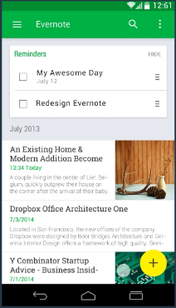
Material design (google)
general guidelines
Used for android
Flat Design 2.0

Slide 7
iOS design
General guidelines
UIKit
Apple devices:
  Mac
  Iphone
  Ipad
  Apple Watch
  …
Flat Design (iOS7) -> Flat Design 2.0

Slide 8
Universal windows platform (uwp)
Guidelines
On windows 10 based devices:
  PC, laptop
  Tablets and 2-in-1
  Phone
  phablet
  Xbox
  TV
  IoT devices
Flat 2.0

Slide 9
Android versus ios
 | android | iOS
style | Flat 2.0 | Flat / Flat 2.0
main navigation | hamburger top left | bottom tab bar
list | switches or checkbox | switches or checkmarks
font | Roboto | San Fransisco
primary button/ action | Floating action button, right bottom (shadow) | Flat style icon top right
https://www.tekrevol.com/blogs/android-vs-ios-app-key-differences/

Slide 10
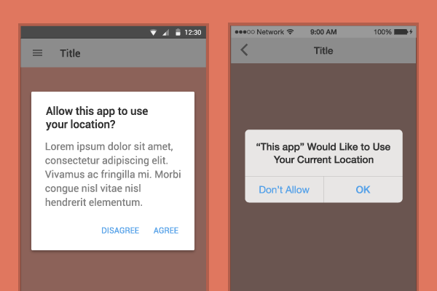
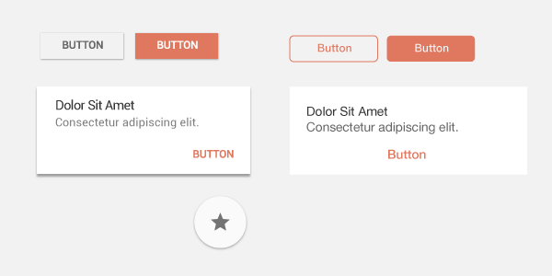
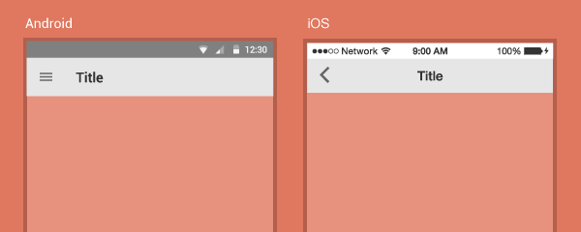
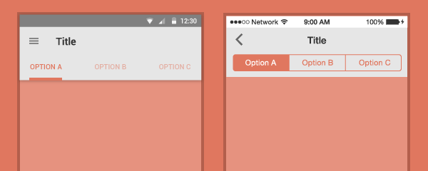
Android versus ios

Slide 11
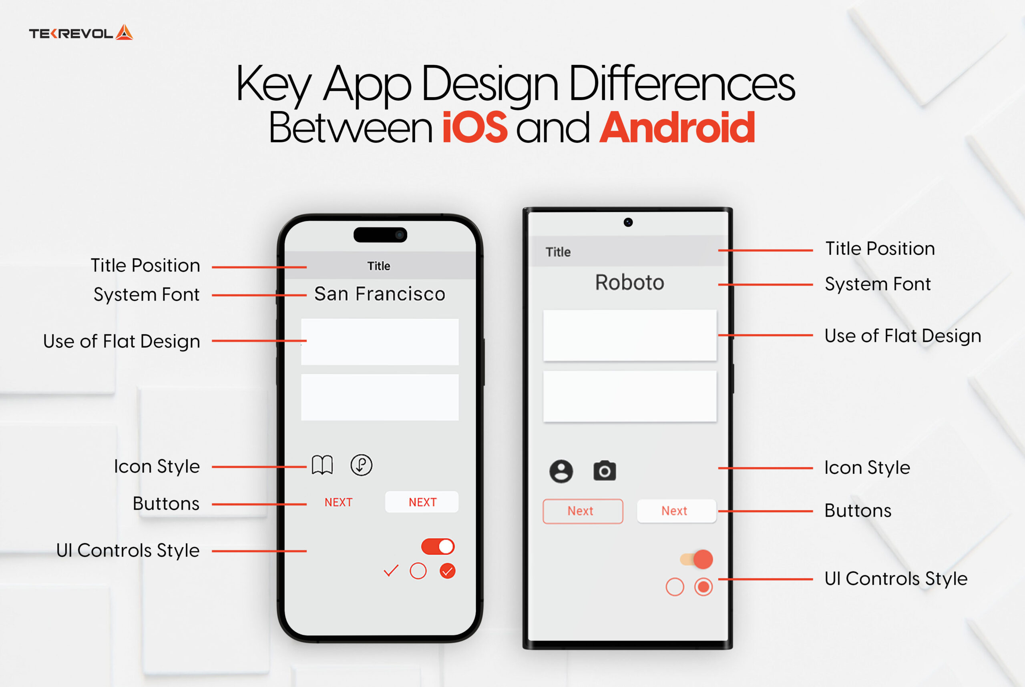
Android versus iOS

Slide 12
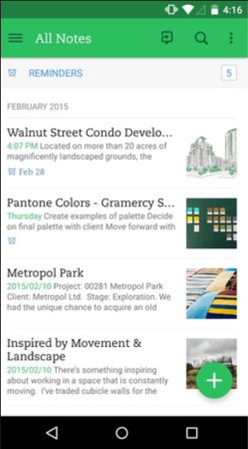
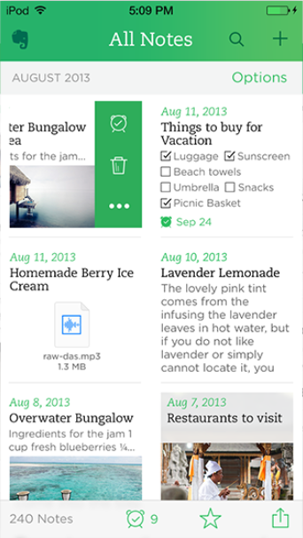
Evernote
Android
iOS

Slide 13
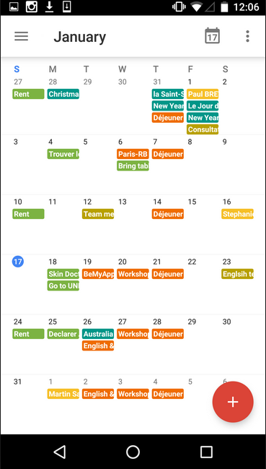
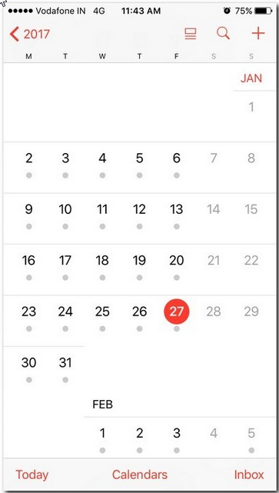
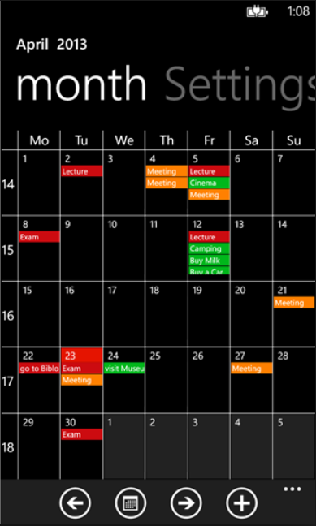
Callendar app
Android
iOS
Windows

Slide 14
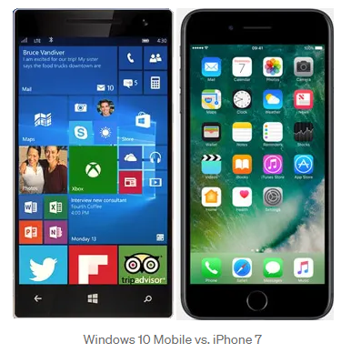
Ios vs windows

Slide 15
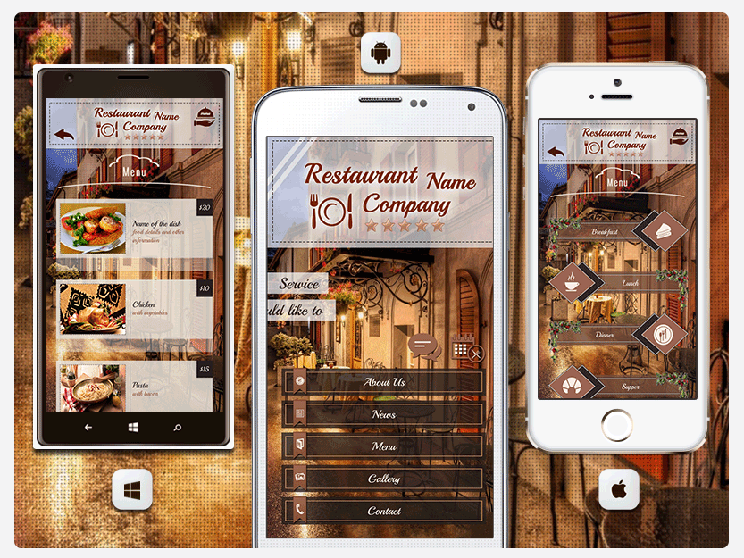
Ios vs windows

