Slide 1
Responsive design
Bootstrap – media queries

Slide 2
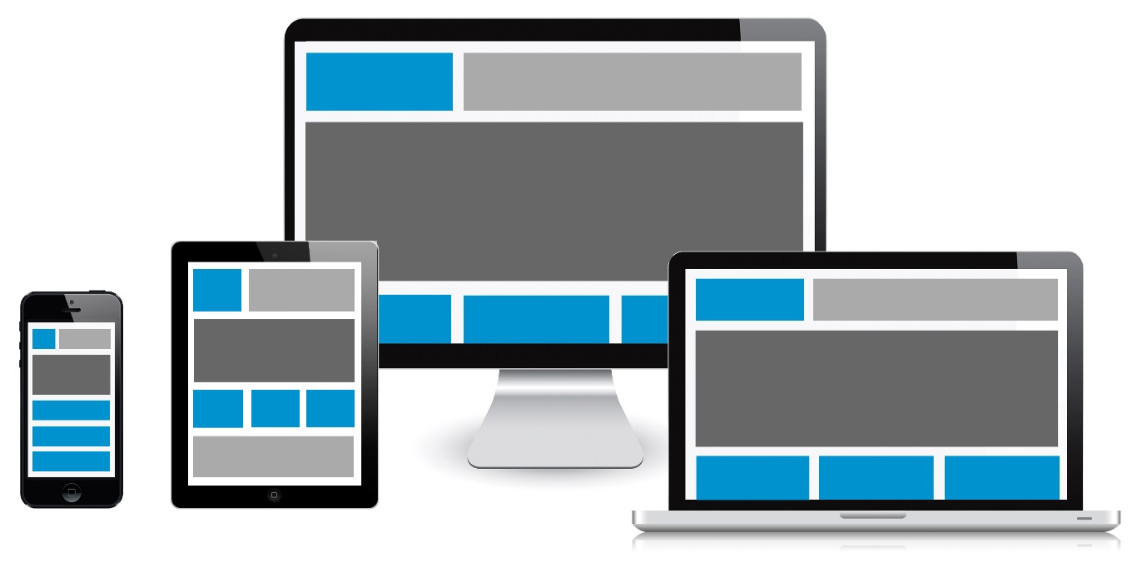
what?
display the same content and functionality on screens of different sizes
Notes:
= moving content or rearranging blocks

Slide 3
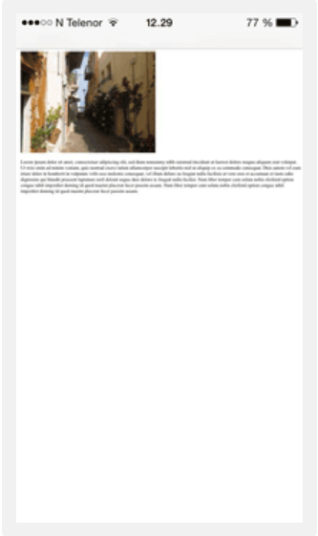
Default browser reaction
web page designed for computer screen is scaled down to make sure the entire web page fits the screen.
=> Control of viewport needed

Slide 4
viewport
the user's visible area of a web page
Set the viewport:
  width=device-width: sets the width of the page to follow the screen-width of the device
  initial-scale=1.0: sets the initial zoom level when the page is first loaded by the browser
<meta name="viewport" content="width=device-width, initial-scale=1.0">

Slide 5
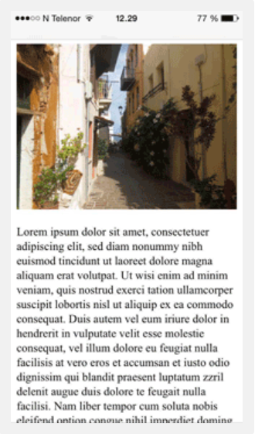
No viewport viewport

Slide 6
Css media Queries
allows to check for:
  width and height of viewport
  width and height of device
  orientation (landscape or portrait mode?)
  Resolution
Browser support:

Slide 7
Css media Queries
syntax:
  @media not|only mediatype and (expressions) {
  CSS-Code;
  }
or in css link:
<link rel="stylesheet" media="mediatype and|not|only (expressions)" href="style.css">

Slide 8
Css media queries
Media types
example:
Value | Description
all | Used for all media type devices
print | Used for printers
screen | Used for computer screens, tablets, smart-phones etc.
speech | Used for screenreaders that "reads" the page out loud
@media screen and (min-width: 480px) {
#leftsidebar {width: 200px; float: left;}
#main {margin-left:216px;}
}

Slide 9
Css media queries
Mobile first:
  default CSS for mobile screen
  Add media queries for larger screens
Typical device breakpoints:
  Different breakpoints needed for different devices
  Define around 5 groups
    < 600px phones
    600px -> 768px portrait tablets and large phones
    768px -> 992px landscape tablets
    992px -> 1200px desktop/laptop screen
    > 1200px large laptop and desktop screen
Orientation
@media only screen and (orientation: landscape) { … }

Slide 10
CSS Media queries
Pro:
  Very fine control over layout for all possible screen sizes and orientations
Con:
  Very labour intensive if you have to redefine the full screen layout for every possible screen size
=> Grid based layout

Slide 11
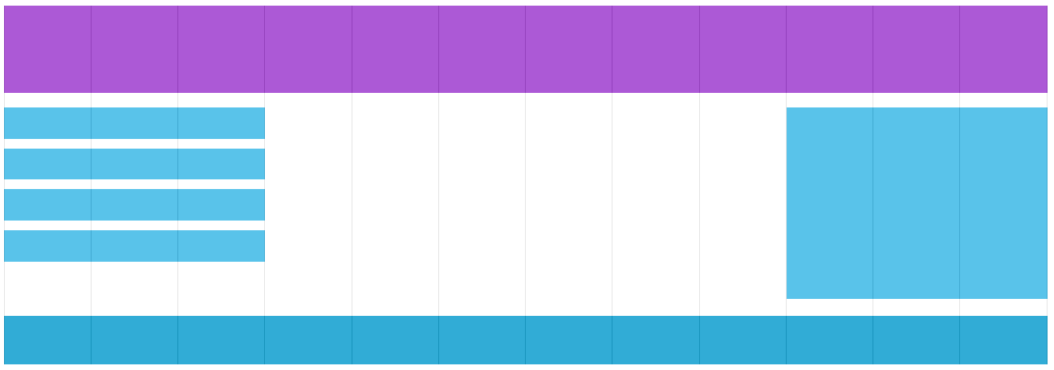
Grid based layout
Easier to place elements on the page
Responsive grid-view:
  12 columns
  total width of 100%
  columns resize with page width

Slide 12
Responsive grid
box-sizing property to border-box for all HTML elements => padding and border included in width and heigth of element
Define classes for all possible
col widths:
  (one col: 100% / 12 = 8.33%)
* {
box-sizing: border-box;
}
.col-1 {width: 8.33%;}
.col-2 {width: 16.66%;}
.col-3 {width: 25%;}
.col-4 {width: 33.33%;}
.col-5 {width: 41.66%;}
.col-6 {width: 50%;}
.col-7 {width: 58.33%;}
.col-8 {width: 66.66%;}
.col-9 {width: 75%;}
.col-10 {width: 83.33%;}
.col-11 {width: 91.66%;}
.col-12 {width: 100%;}

Slide 13
Responsive grid
To place cols next to each other => float
All cols float => do not define the height of the row anymore => add ::after
example
[class*="col-"] {
float: left;
padding: 15px;
}
.row::after {
content: "";
clear: both;
display: block;
}
<div class="row">
<div class="col-3">...</div>
<div class="col-9">...</div>
<!– always add up to 12 cols -->
</div>

Slide 14
Combine with media queries
Mobile first
  default layout = layout for extra small devices
  col width of 100% for all col classes
[class*="col-"] {
width: 100%;
}

Slide 15
Combine with media queries
Create col classes for all 12 col widths for every breakpoint:
@media only screen and (min-width: 600px) {
/* For tablets: */
.col-s-1 {width: 8.33%;}
.col-s-2 {width: 16.66%;}
.col-s-3 {width: 25%;}
.col-s-4 {width: 33.33%;}
.col-s-5 {width: 41.66%;}
.col-s-6 {width: 50%;}
.col-s-7 {width: 58.33%;}
.col-s-8 {width: 66.66%;}
.col-s-9 {width: 75%;}
.col-s-10 {width: 83.33%;}
.col-s-11 {width: 91.66%;}
.col-s-12 {width: 100%;}
}
@media only screen and (min-width: 768px) {
/* For desktop: */
.col-1 {width: 8.33%;}
.col-2 {width: 16.66%;}
.col-3 {width: 25%;}
.col-4 {width: 33.33%;}
.col-5 {width: 41.66%;}
.col-6 {width: 50%;}
.col-7 {width: 58.33%;}
.col-8 {width: 66.66%;}
.col-9 {width: 75%;}
.col-10 {width: 83.33%;}
.col-11 {width: 91.66%;}
.col-12 {width: 100%;}
}

Slide 16
Combine with media queries
Combine classes in HTML:
example
Basis for responsive CSS frameworks
<div class="row">
<div class="col-3 col-s-3">...</div>
<div class="col-6 col-s-9">...</div>
<div class="col-3 col-s-12">...</div>
</div>

Slide 17
Framework: bootstrap
Originally developed within Twitter under the name "Twitter Blueprint".
Released as open source project on August 19, 2011
Bootstrap 2: Released on 31 January 2012
Bootstrap 3: (better for mobile devices)
released on 19 August2013
Bootstrap 4: Completely new framework! Not compatible with older versions! Not for IE9 or lower
Released in December 2017

Slide 18
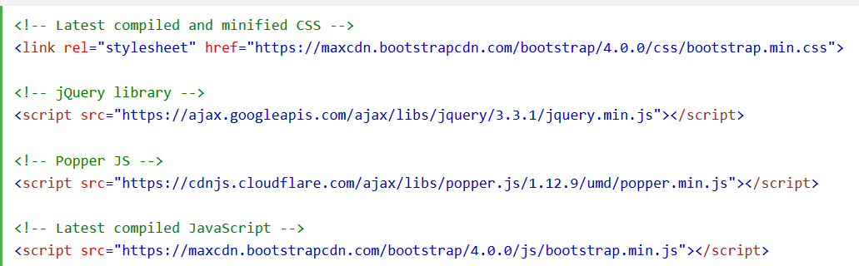
Installation
CDN:
Download: https://getbootstrap.com/

Slide 19
Page setup
In head:
In body:
  Use container wrapper with class:
    .container : responsive container with fixed width
    .container-fluid: full width container
Zoom level 1 after loading
<meta name="viewport" content="width=device-width, initial-scale=1">
Screen width = device width

Slide 20


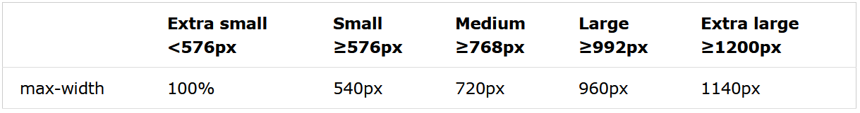
container
Fixed width container (class="container")
Full width container (class="container-fluid")

Slide 21
Framework: bootstrap
container with rows with up to 12 columns
1 | 1 | 1 | 1 | 1 | 1 | 1 | 1 | 1 | 1 | 1 | 1
span 4 |  |  |  | span 4 |  |  |  | span 4
span 4 |  |  |  | span 8
span 6 |  |  |  |  |  | span 6
span 12

Slide 22
Framework: bootstrap
Basic structure grid:
grid class
= dimension for tilting point
<div class="container">
<div class="row">
<div class="col-*-*"></div>
<div class="col-*-*"></div>
</div>
<div class="row">
<div class="col-*-*"></div>
<div class="col-*-*"></div>
<div class="col-*-*"></div>
</div>
<div class="row">
...
</div>
</div>
span

Slide 23
Framework: bootstrap
grid classes:
.col- xsmall devices screen width < 576px
.col-sm- small devices screen width ≥ 576px
.col-md- medium devices screen width ≥ 768px
.col-lg- large devices screen width ≥ 992px
.col-xl- xlarge devices screen width ≥ 1200px
Combining possible
<!-- 50%/50% split on xsmall devices and 75%/25% split on larger -->
<div class="row">
<div class="col-6 col-sm-9">col-6 col-sm-9</div>
<div class="col-6 col-sm-3">col-6 col-sm-3</div>
</div>

Slide 24
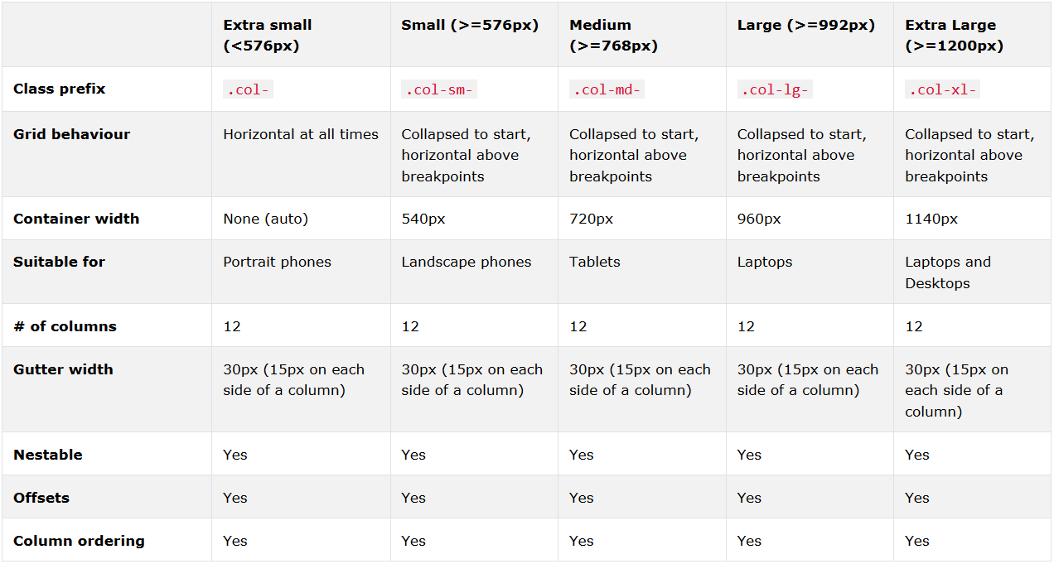
Framework: bootstrap

Slide 25
Bootstrap: info
More info on bootstrap:
  https://getbootstrap.com/docs/4.0/getting-started/introduction/
tutorials:
  https://www.tutorialspoint.com/bootstrap/index.htm
  https://www.w3schools.com/bootstrap/default.asp

Slide 26
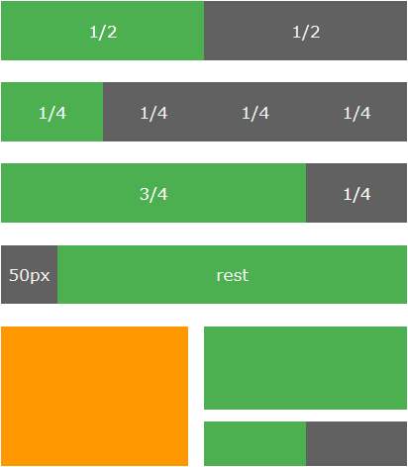
Framework: w3.css
Class | Description
w3-half | Occupies 1/2 of the window (on medium and large screens)
w3-third | Occupies 1/3 of the window (on medium and large screens)
w3-twothird | Occupies 2/3 of the window (on medium and large screens)
w3-quarter | Occupies 1/4 of the window (on medium and large screens)
w3-threequarter | Occupies 3/4 of the window (on medium and large screens)
w3-rest | Occupies the rest of the column width
w3-col | Defines one column in a 12-column responsive grid
w3-mobile | Adds mobile-first responsiveness to a cell (column). Displays elements as block elements on mobile devices.
example

