Slide 1
Installation - components

Slide 2
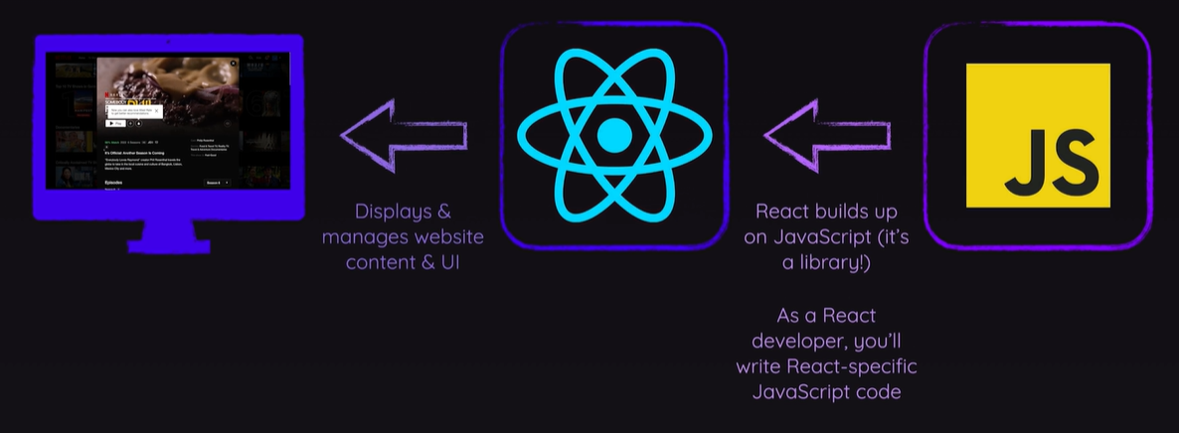
What is React?
JavaScript library for building user interfaces
Since javascript works in the frontend =>very fluid transitions in web apps by using javascript frontend “calculations”

Slide 3
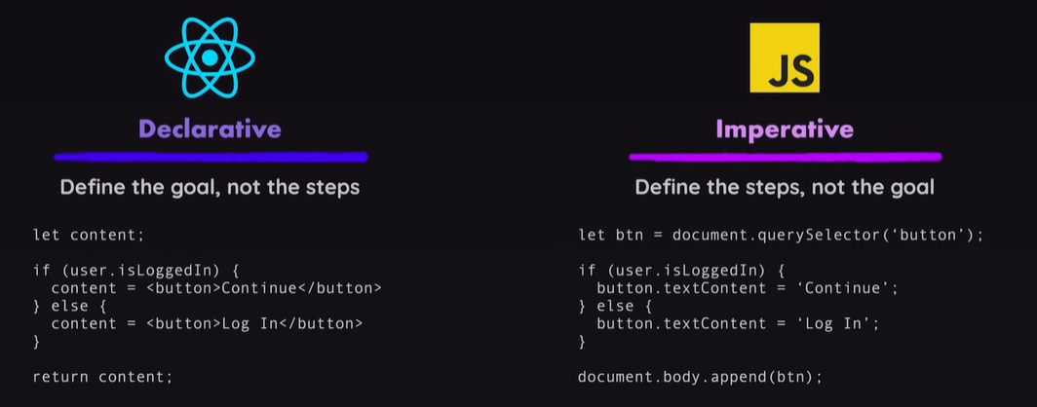
Why not plain JavaScript?
complex JavaScript code is:
  difficult to write
  hard to maintain or edit
  error-prone
React:
  Simpler mental model

Slide 4
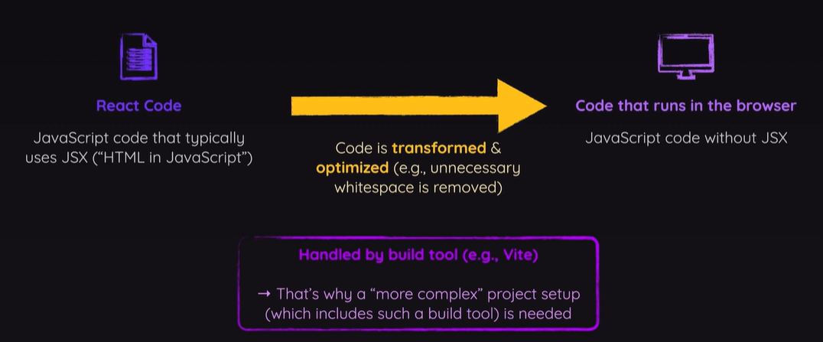
Installation
The react components are written in JSX, not understood by browser
=> node.js is needed for that

Slide 5

Installation: node and npm
Node.js:
  open source server framework
  run JavaScript outside the browser, in the JavaScript engine of Node.js itself
  contains a built-in HTTP server => possible to run a web server without Apache
  download: https://nodejs.org/en/download/
NPM:
  Node.js Package Manager
  Package or module = JavaScript library
  with NPM: install necessary packages

Slide 6

installation: cmder
React Vite
  = command line interface for React
  Very convenient to create projects, …
Runs in terminal but standard windows terminal (cmd) not so handy
Install cmder (full version) at
http://cmder.app/

Slide 7

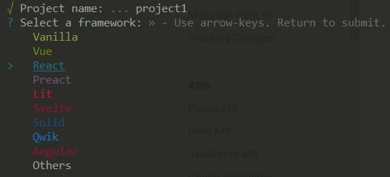
Create new Project
> cd [ToWorkingDir]
> npm create vite@latest
In cmder enter the following commands:
If npm suggests to install an extra package create-vite => choose ‘y’
Fill in project name and select
React framework:

Slide 8
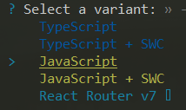
Create new Project
Finally, choose the JavaScript variant, select no to the question on the beta version usage and yes to npm install
To install all necessary build-in packages for your newly created project, run:
> cd [projectName]
> npm install
> npm run dev
launches a webserver, watches your files and rebuilds the app as you make changes to those files
Now surf to http://localhost:5173

Slide 9
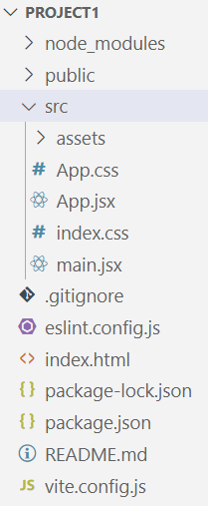
Project structure
node_modules: all locally installed node modules
(npm install)
assets: extra parts of the website such as images, …
index.html: start page of the app, does not need to be changed
package.json: contains versions for all packages
used in the project

Slide 10
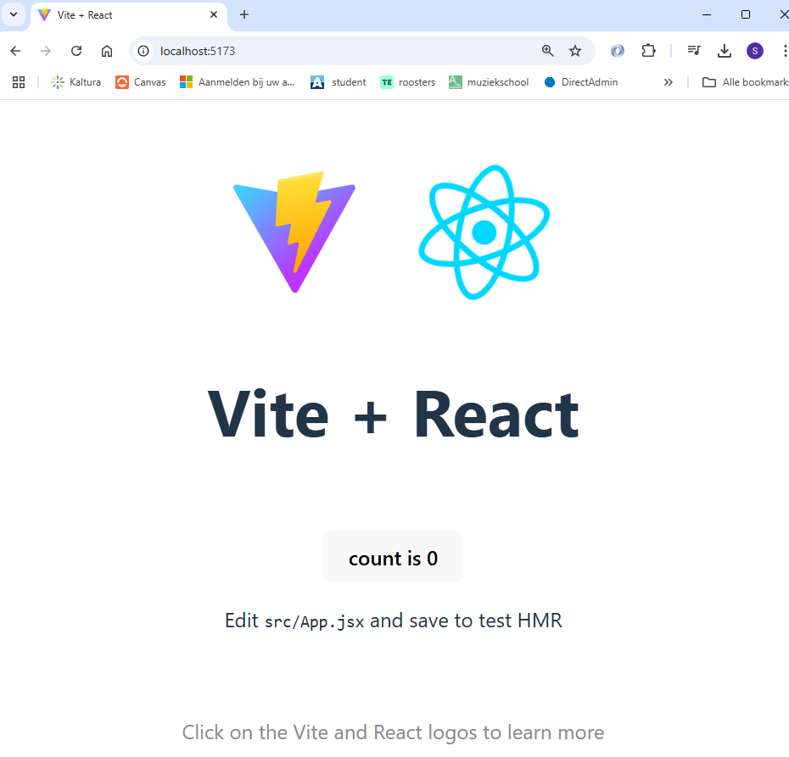
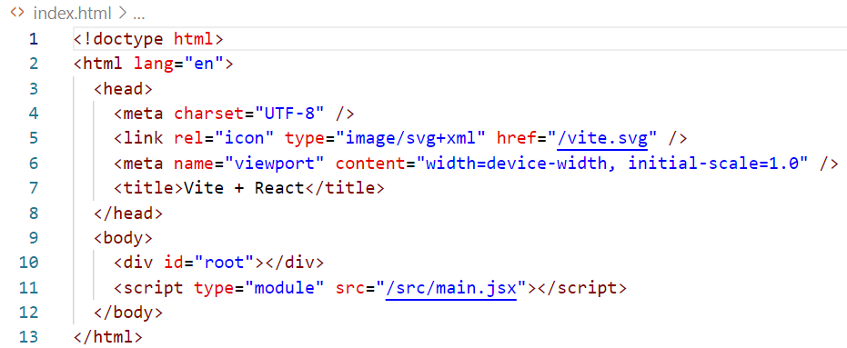
Demo project
Find “count is 0” in index.html
is filled by the App.jsx component with its own html template

Slide 11
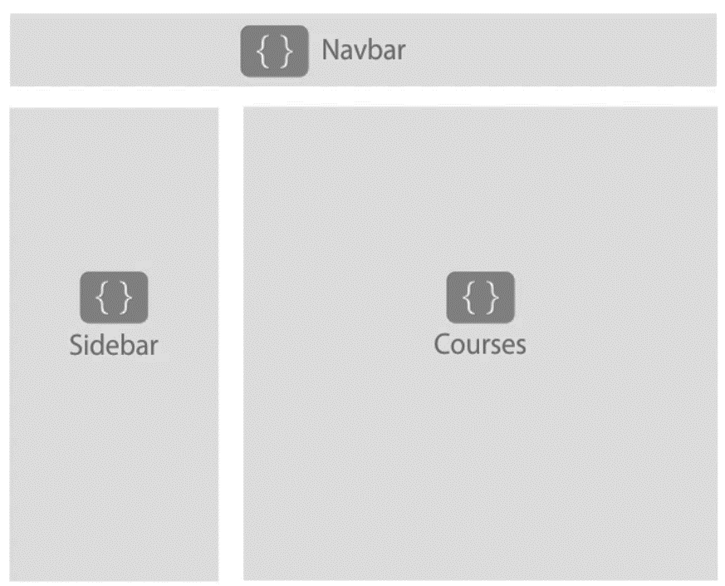
Architecture React app
app component
Navbar
Courses
Sidebar
Course
Course
Course
Pages are made up of components
Reusable
Can be nested

Slide 12
Why components?
Reusable Building Blocks
Compose UI from small building blocks
Reuse building blocks in different parts of the UI (e.g. reusable button)
Related code lives toghether
Related HTML, JS and CSS are stored together
Separation of concerns
Different components handle different data and logic:
  Some are used to show data
  Some to request data
  …
Simplifies working on complex apps

Slide 13
Component
Component is JS function with:
name:
  must start with uppercase (needed for React to make the difference with HTML build-in tags)
  multi-word must use PascalCase (e.g. “AppHeader”)
  use names that describe the UI building block
return:
  renderable content:
    JSX (Javascript XML)
    String, number, boolean, null, array
component
Logic and template
JSX
Style
CSS

Slide 14
Demo project
“count is 0” can not be found in index.html !!
Includes main.jsx file

Slide 15
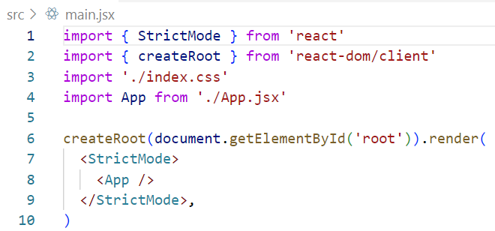
Rendering app component
Use the renderer to render inside this element
Call the App component
Select div with id root

Slide 16
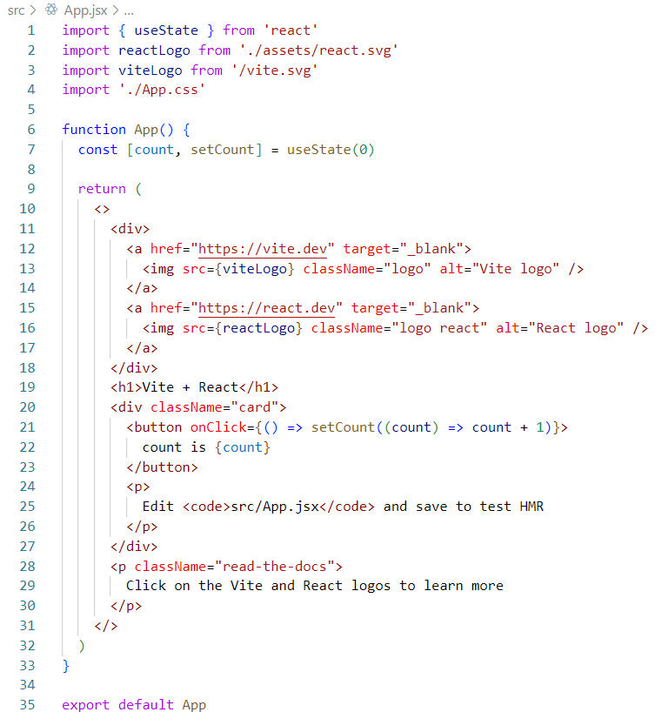
App component
Import of used elements
App component is a function with:
name:
App
return:
HTML and JS code
looks like HTML but is not
always the same!!
Export of app function to be able to use it in other JSX files

Slide 17
Markup in JSX
JSX is stricter then HTML => always close tags:
  <h1>….</h1>
  <br />
Return a single root element:
  wrap tags into shared parent like
    <div> … </div>: extra div
    <> …. </>: fragment (groups elements without impacting HTML tree in browser)
JS code inside JSX must be in between { }

Slide 18
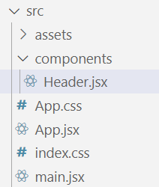
Create new component
Store all components inside a folder ‘components’ in ‘src’ folder
separate .JSX file for every component
name of .jsx file is the same as the name of the component

Slide 19
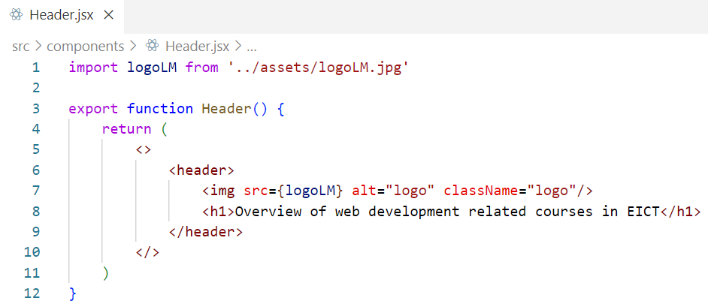
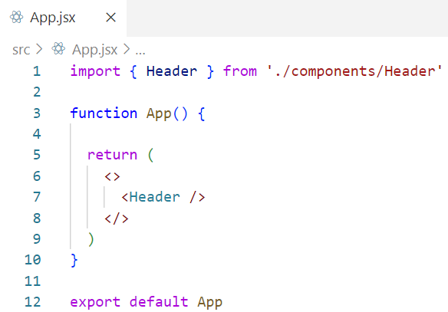
Import component in App.jsx file
Export component to be used in other .jsx files
Use component in JSX

Slide 20


Adding styles
Using classes:
  Inside JSX file: Inside index.css file:
use className instead of
class in HTML:
inline-style inside JSX (only one-time style definitions!):

Slide 21
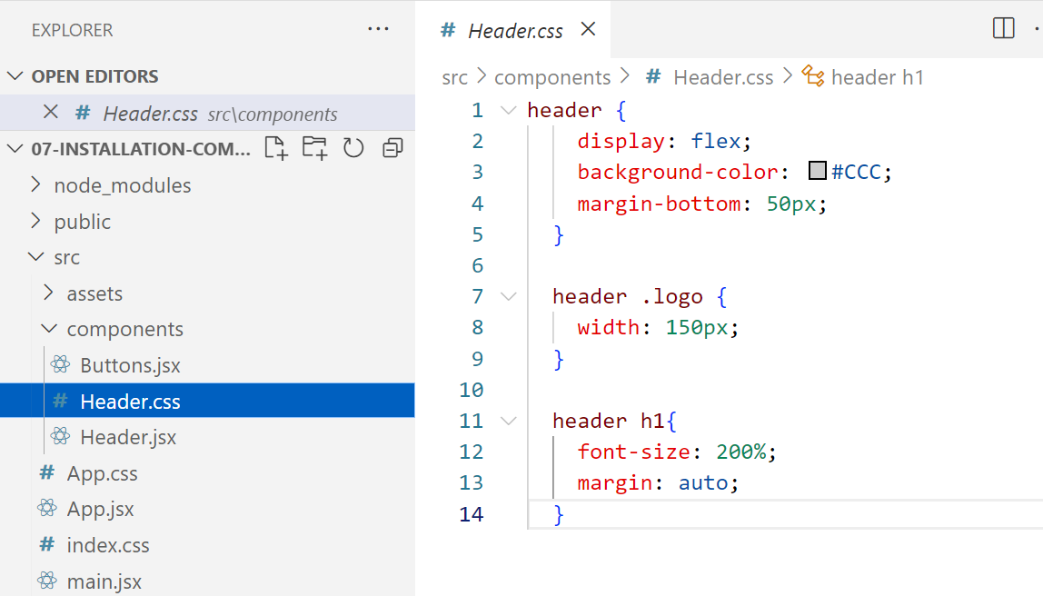
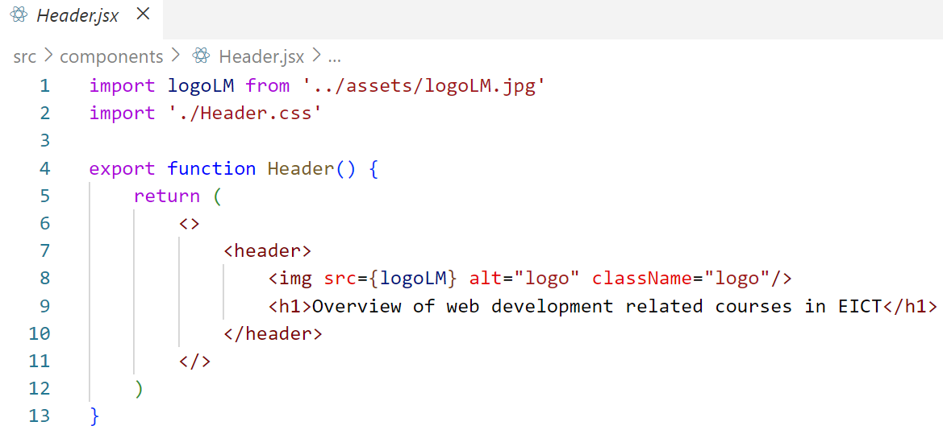
Add styles belonging to component
Styles are not limited to this component !!!
Keep using different class names
Include in Header.jsx
Create css file next to jsx file

Slide 22
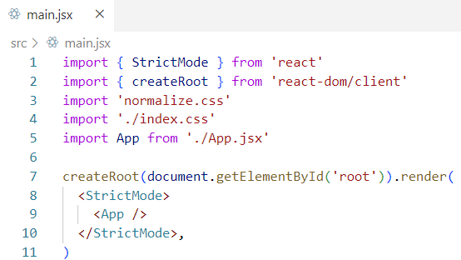
Adding CSS reset
Using npm, install a package called ‘normalize.css’
Import nomalize.css before the import of index.css in main.jsx:
> npm install normalize.css

Slide 23
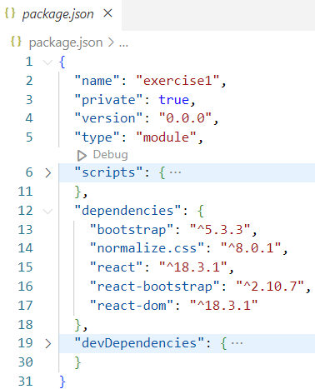

Adding bootstrap
Adding bootstrap as well allows you to use it also without the special react-bootstrap components
Using npm, install a package called ‘react-bootstrap’
Import bootstrap before the import of index.css and after nomalize.css in main.jsx:
In package.json:
> npm install react-bootstrap bootstrap

Slide 24
React-Bootsrap
Package created for React based upon the bootstrap framework
Contains React components for different UI elements
Documentation:
https://react-bootstrap.netlify.app/docs/getting-started/why-react-bootstrap

Slide 25

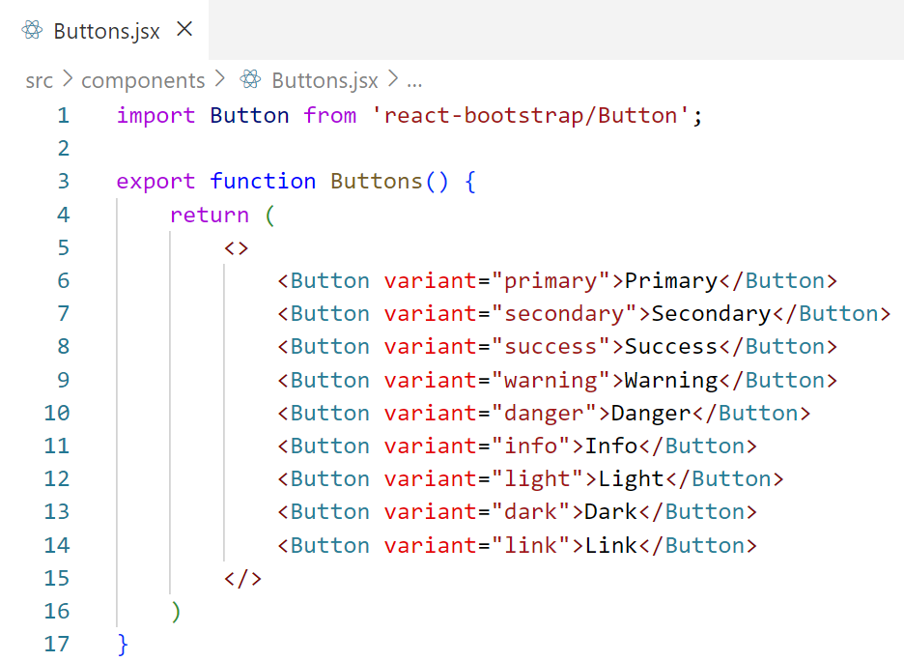
React-Bootstrap => button
import button component
Select a predefined style
Use Button component from React-Bootstrap library

Slide 26

Limiting css scope to component
Use CSS modules
For specific css belonging to only 1 component
Rename css file into .module.css
Import all css class names from module.css file into a JS object:
Use css class names from module.css file as follows:

Slide 27
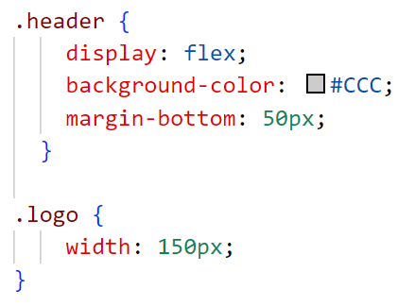


Limiting css scope to component
Css class names inside module.css file will be renamed to unique css class names to avoid collision:

Slide 28
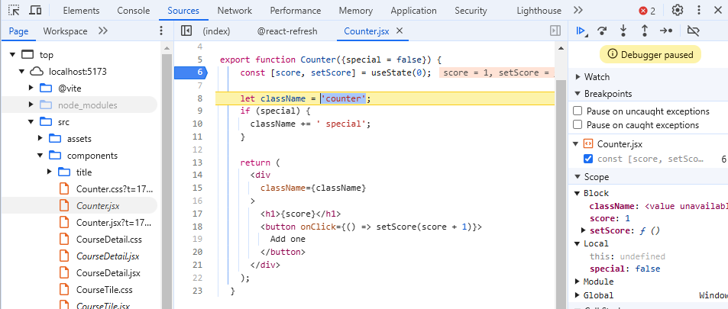
Debugging React Apps
F12 => developer tools:
  Tab sources:

Slide 29
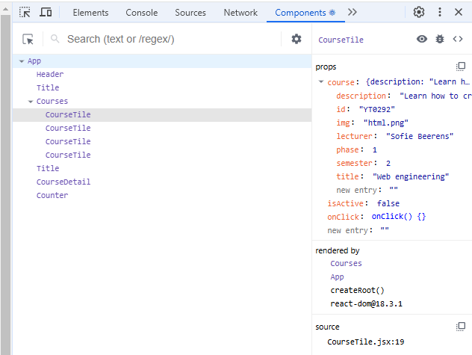
Debugging React Apps
Chrome plugin:
  React Developer Tools
  F12 => components
  List of components in app with extra info like props, state, … (see later)

