Slide 1
Dynamic content

Slide 2
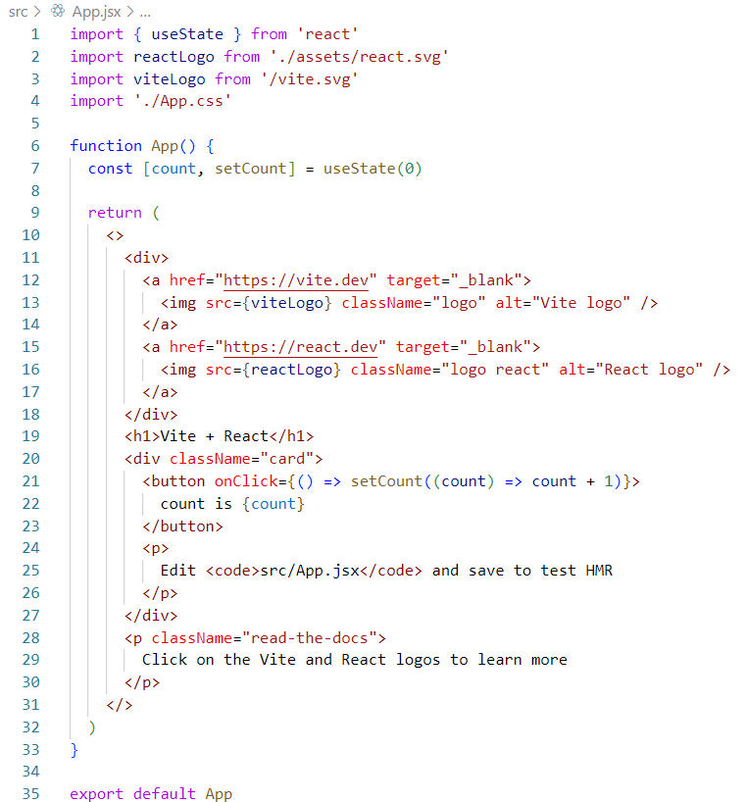
Dynamic content
To include dynamic content inside the HTML template of a component use { }
Inside { } all regular JavaScript expressions are possible but:
Only for expressions that result in a value, not for function definitions!
If possible, use only variable names inside { } and put all corresponding calculatons outside of the { }

Slide 3
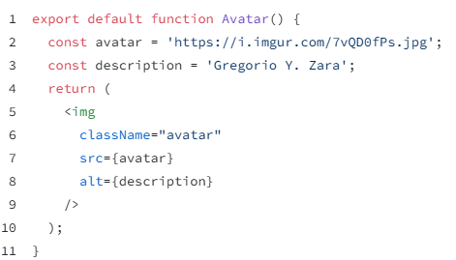

Dynamic attributes
Use { } to refer to JS const or var to determine the attribute value
No quotes allowed!!
avatar is a string that represents
the name of a CSS class
the value of the JS variable avatar is read and used as src for this img

Slide 4

Dynamic attributes => import images
Store images inside assets folder
Use import statement and { } to refer to image path
No quotes allowed!!

Slide 5
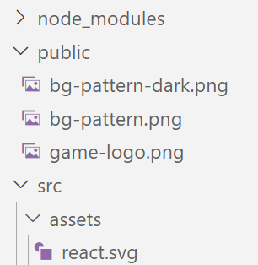
Where to store images?
public folder:
  everything stored in public is made publicly available
  http://localhost:5173/game-logo.png will show that image
  inside index.html or other components, just use file
  name to refer to it
src/assets folder:
  not publicly available
  http://localhost:5173/src/assets/react.svg => error
  addressed by importing in component via relative path
=> Use public folder only for images that are used inside index.html, not for component images

Slide 6
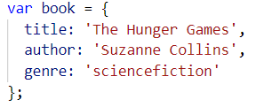
Javascript Objects (key:value)
An object can contain values for many properties:
Or with extra line breaks for readability:
Access object properties:
or

Slide 7
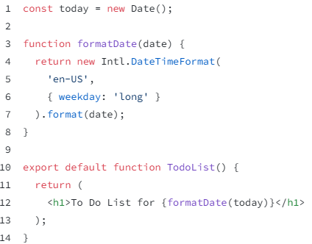
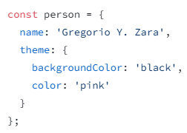



Dynamic content functions and objects
Using function calls
Using objects

Slide 8
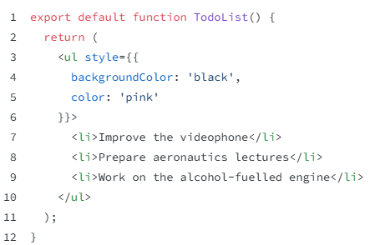
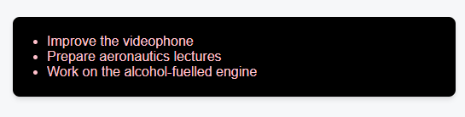
Dynamic content functions and objects
Using complete object inside { } => {{ }}

Slide 9
props

Slide 10
Reusable components with input data
Components can be reused:
course component to show content of 1 course
how do you pass info of 1 course into course component?
props
app component
Header
Courses
Sidebar
Course
Course
Course

Slide 11
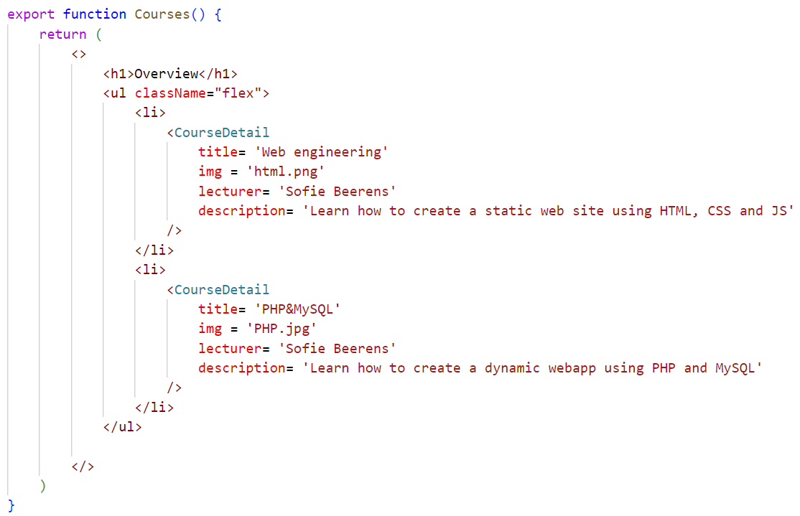
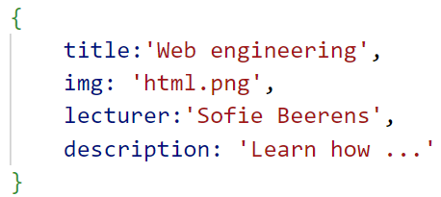
Call component with props
Add props to component as
attributes:
propname = value
Listed props will be converted
into a JS object by React:
Access props in child with
props input parameter

Slide 12
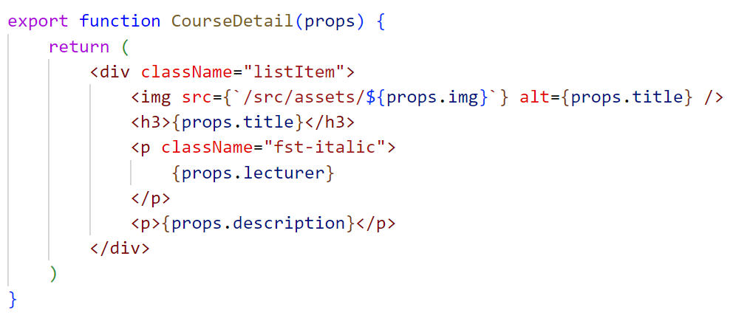
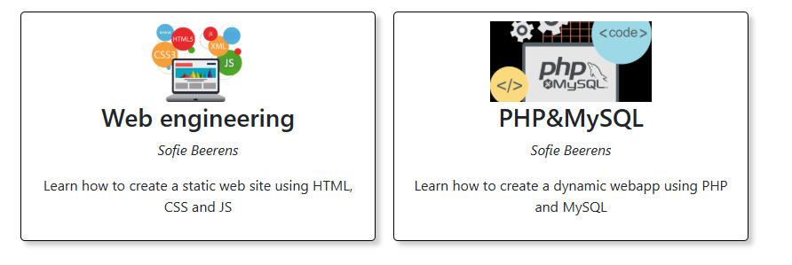
Use props inside component
Add props input parameter
props received object from parent
Access props fields like any JS object fields

Slide 13
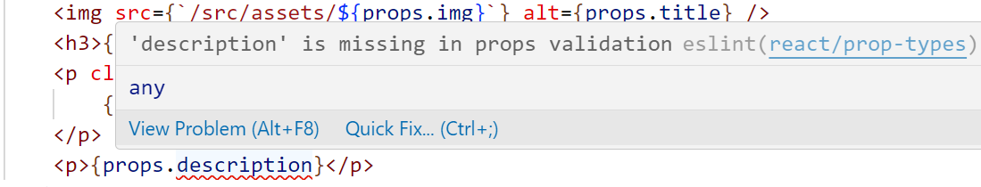
Solve VS code error
There will be an error shown in VS code when using props:
This is due to missing type checking for the props. However, this typechecking will be deprecated as of React19 and is often overcome by using TypeScript instead of JavaScript => we will disregard the error by adding at the top of every file:

Slide 14
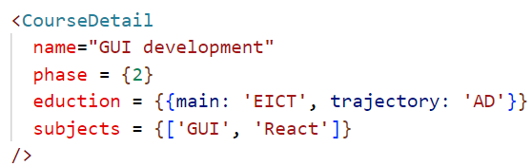
Props accept all value types
String value
Object value
{{ }} is no special
syntax!!
It is symply a JS object
passed as a value
Number value
Curly braces needed
to pass value as
number
With “ “, it would be
taken as a string
Array value

Slide 15
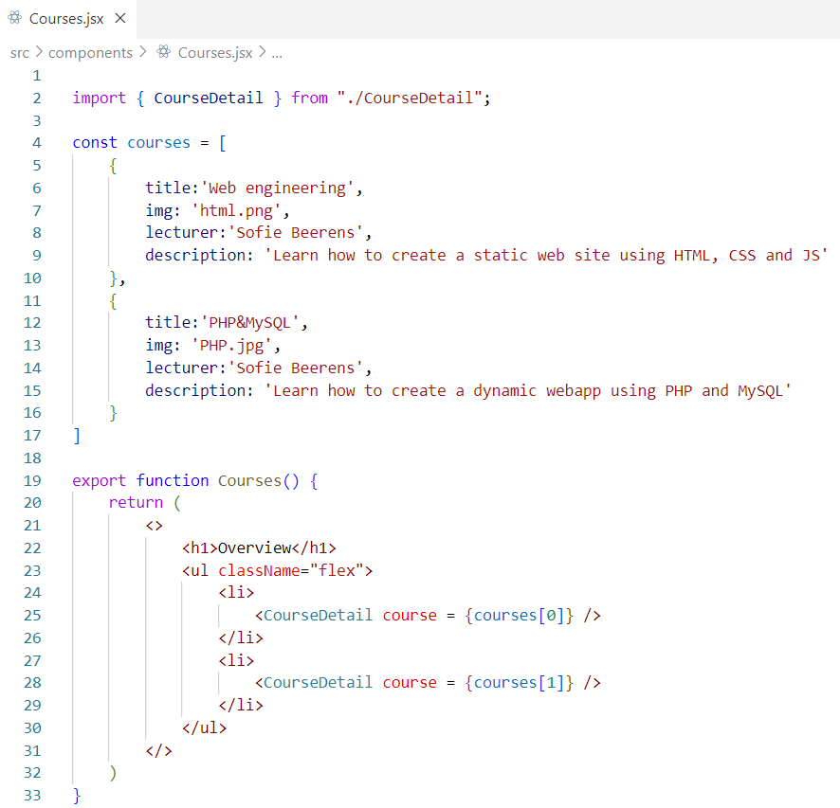
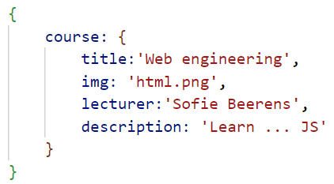
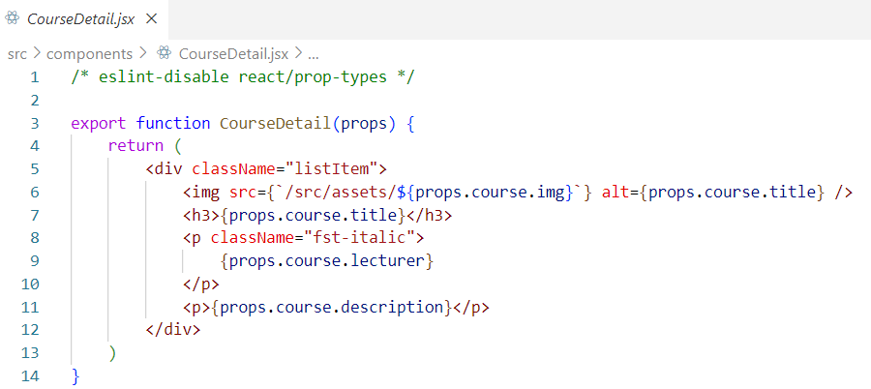
Pass object

Slide 16
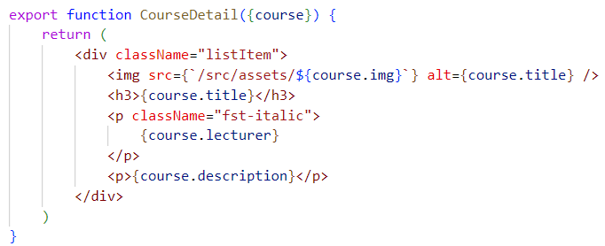
Using JS Object Destructuring
props object:
object props is being split into separate
variables.
Here props has only one field =>
{course} = props
will store the value of the course key
inside props into the object course for
further usage inside the function
{course} = props

Slide 17
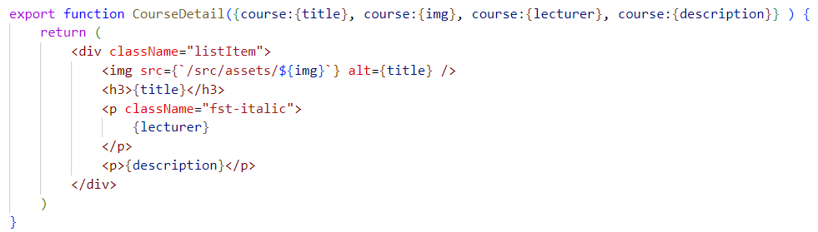
Object Destructuring nested objects
props object:
use separate variables for all fields inside course field:
adding a default value in
case a field is missing

Slide 18

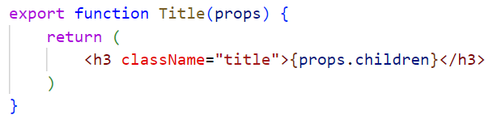
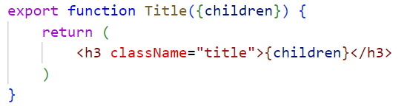

Special children prop
Mainly useful if only one piece of renderable content must be passed to component
automatically stored into props.children
or

Slide 19
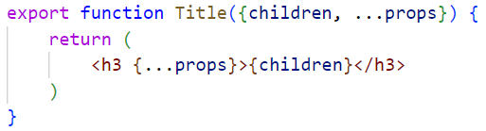

Forwarding props to wrapped elements
Spread operator used to merge all non-listed props from parent into props object
Spread operator used to spread all props in the object to the h3 element

Slide 20
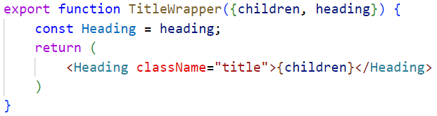


Setting HTML element through props
<…> will be transformed by React into corresponding HTML tag if the name in between <> starts with a capital letter

Slide 21
Arrow functions
Used for anonymous functions (function without a name)
  function() { equivalent to () => {
  console.log(‘Hello’); console.log(‘Hello’);
  } }
General syntax:
  (argument1, argument2, argumentN) => { statements }
  1 argument:
  argument => { statements }
  no arguments:
  () => { statements}
More info: https://developer.mozilla.org/en-US/docs/Web/JavaScript/Reference/Functions/Arrow_functions

Slide 22
Convert list data to component array

Slide 23

Outputting list data dynmically
In JSX an array can be outputted as follows:
To output a list of course detail components, convert array of course data into array of course detail components using the JS map function:
map stores new array to roots by modifying every element of numbers according to arrow function used inside map
const numbers = [1, 4, 9];
const roots = numbers.map((num) => Math.sqrt(num));
// roots is now [1, 2, 3]
// numbers is still [1, 4, 9]

Slide 24
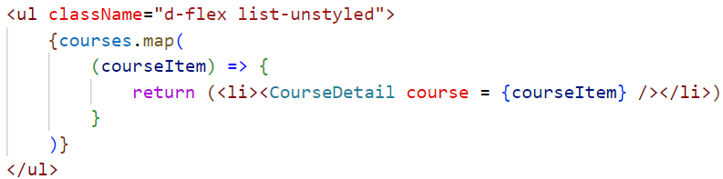
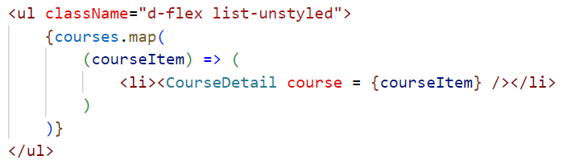
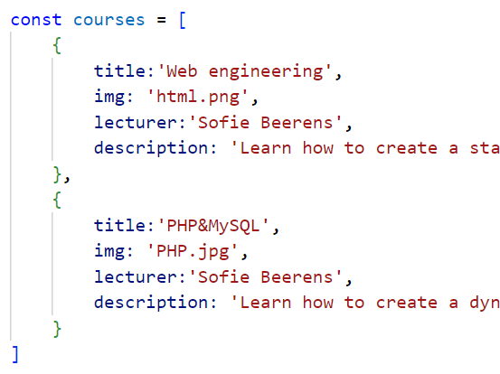


Outputting list data dynmically
If only return statement inside callback,
can be simplified to
courseItem => (
<li><CourseDetail course = {courseItem} /></li>
)
courseItem => (
<li><CourseDetail course = {courseItem} /></li>
)

Slide 25
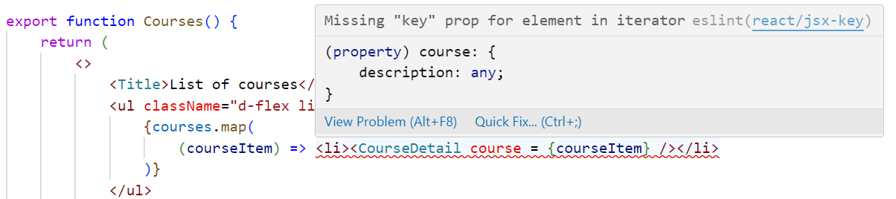
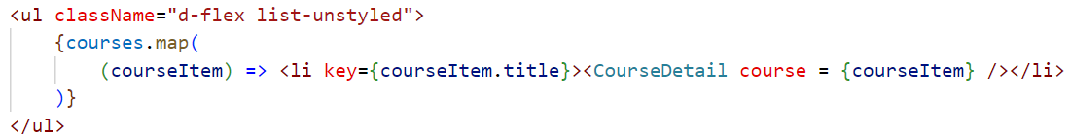
Key prop needed for array elements
In VS code => error message Missing “key” prop:
For efficient rendering, React needs to have a unique key for every iterative element. Here <li> is repeated with some content inside => add key to <li>:
Key must be unique for every element in the list => title of the course

Slide 26
component instances are independent
Every course component created by map works independently from the others
Suppose a click event is added to the courses component
Clicking Web development will only influence the Web development component, not the other instances
Components use shared logic but once used inside an app, they are independent

Slide 27
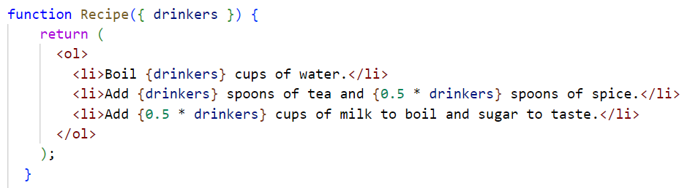
Keep components pure
JS function is pure if:
  it minds it own business
  same inputs => same outputs
pure component function:
  same inputs => return same JSX

Slide 28

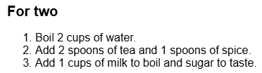
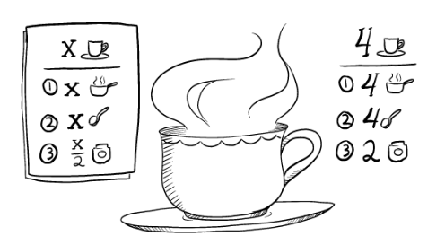
Keep components pure
drinkers = {2}
  always 2 cups of water, …
  no new elements are added inside component

Slide 29
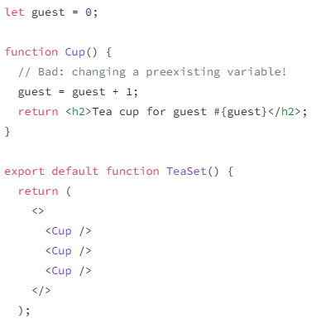
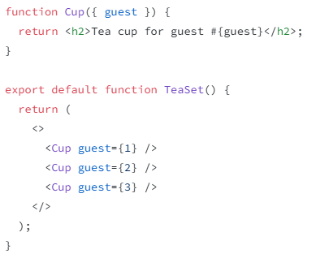
Unpure component
external variable guest is changed inside component Cup
calling cup multiple times results in different output each time!!
Use prop to make it pure:

