Slide 1
Events

Slide 2
Adding eventhandlers
JSX => add eventhandler to react components/ HTML tags using:
No quotes allowed!!
onEvent={ functionName }
onEvent prop
Value to pass to event prop is a reference to the function to be executed
No function call!!
No ()

Slide 3
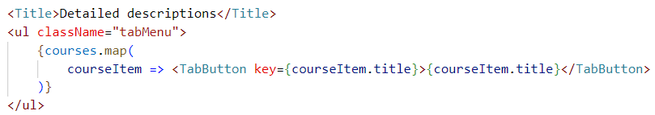
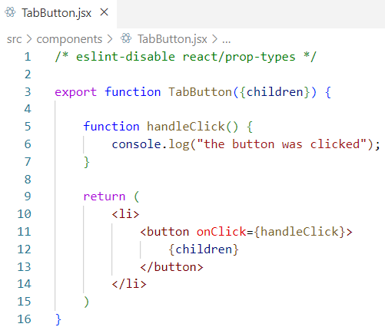
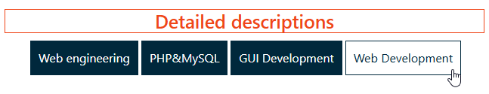
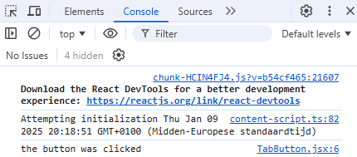
Click event => example
Create TabButton for every course in courses
onClick prop

Slide 4
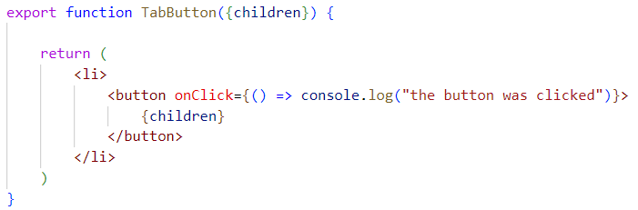
Click event example: remarks
handleClick function is defined inside the TabButton component:
  Needed to be able to access props of the component
For small handle functions, inline functions are also possible:

Slide 5
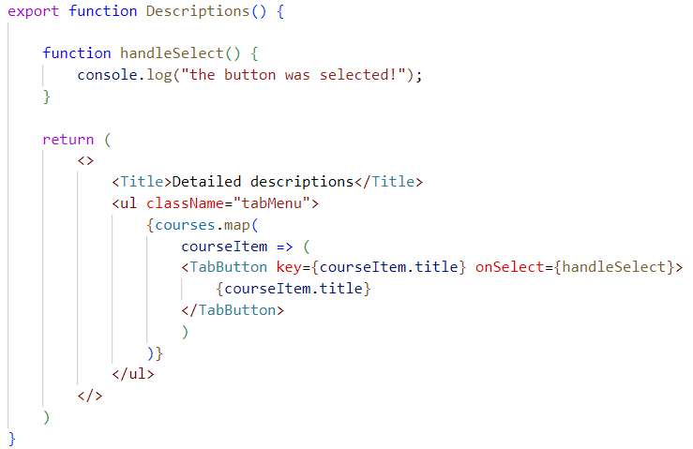
Add event to a parent component
Define eventhandler function inside parent
Add prop to child starting with on… to indicate it will be used to pass an eventhandler function
Pass eventhandler function to new prop
1
2
3

Slide 6
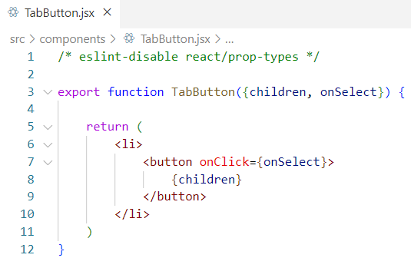
get eventhandler function in child
Add extra prop input
(object destructuring)
Pass value of onSelect prop to onClick event prop
1
2

Slide 7
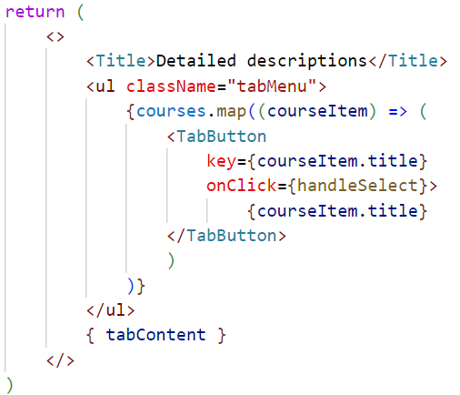
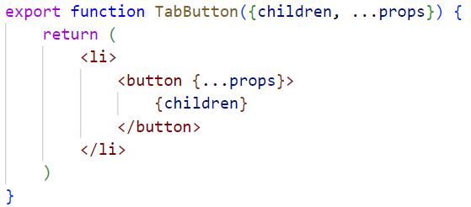
Passing event to child using prop forwarding
use directly onClick instead of custom onSelect since onClick is now also passed to the button element

Slide 8
Passing custom arguments to events
onEvent={ functionName }
onEvent prop
Value to pass to event prop is a reference to the function to be executed
No function call!!
No ()
Not possible to pass arguments
onEvent={() => handleSelect()}
arguments can be passed
in between ( )
Anonymous function is now passed as value to event prop

Slide 9
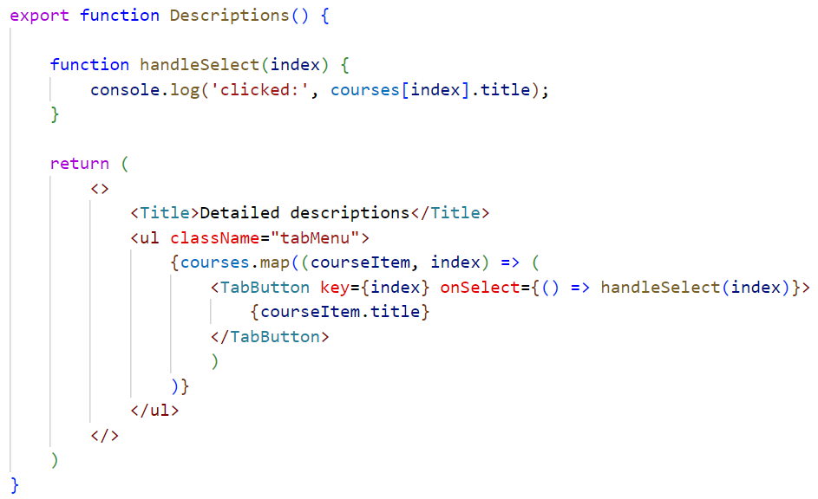
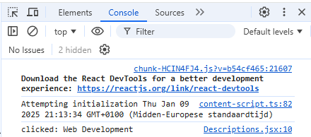
Passing arguments => example
use index in map to get course index inside courses array
pass index to handleSelect function

Slide 10
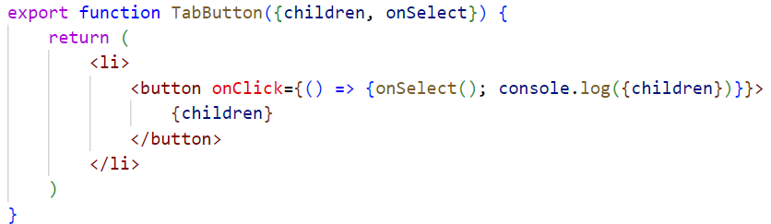
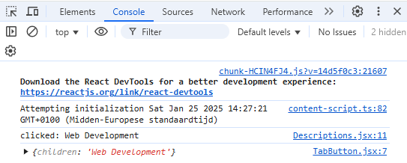
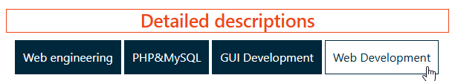
Reading props in event handlers
arrow function to execute both functions after clicking.

Slide 11
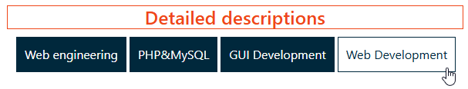
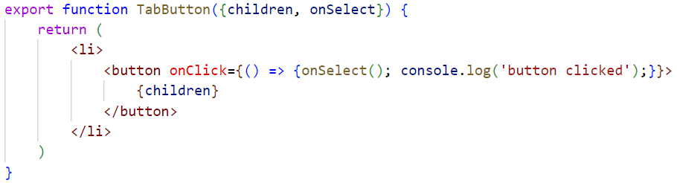
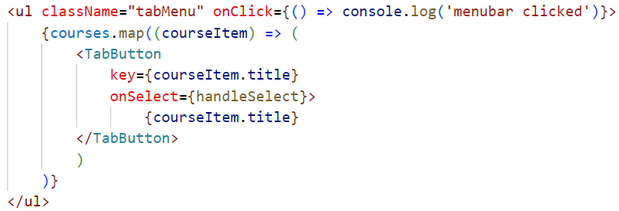
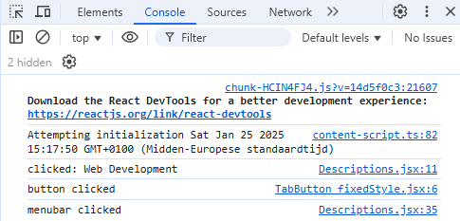
Event propagation
click button:
click event button executed first
click event is bubbled up to parent <ul> => click event parent executed
1
2

Slide 12
Event object
Event occurs
=> event object e is created and handed to eventhandler
event object contains:
  target: HTML event that triggered the event
  nativeEvent: the underlying JavaScript event
  preventDefault(): function to stop default behaviour of event (e.g.submit of
  form
  stopPropagation(): function to stop event from bubbling to parent

Slide 13
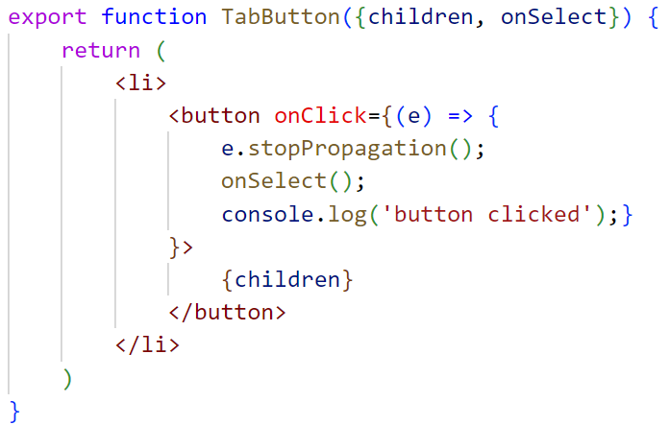
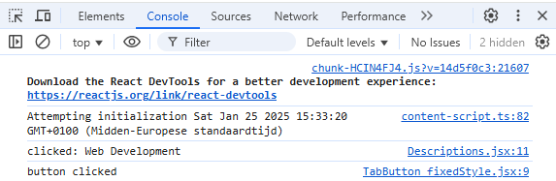
Event object
The click event does not propagate to the description parent component => no log from the menubar

Slide 14
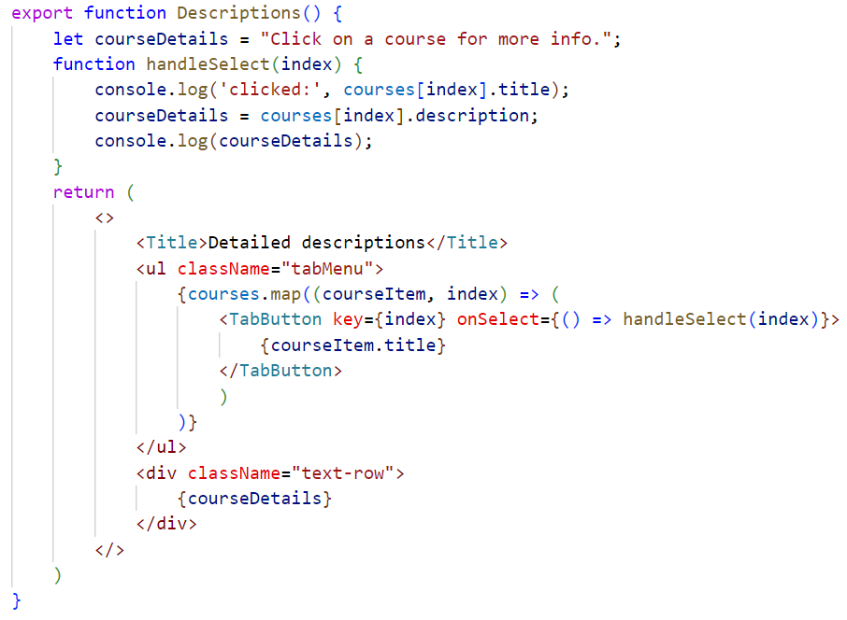
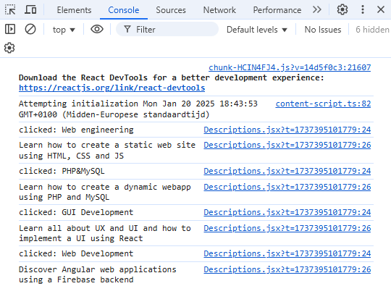

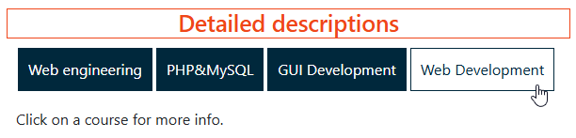
Change content depending on event
Starting value for courseDetails
change courseDetails content
Change of courseDetails is not shown?

Slide 15
UI updates in React
React component functions execute only once when component is first created
@creation of courses component:
  starting value of courseDetails is shown
After clicking a tab button:
  handleSelect function is executed (see console.log)
  component function is not executed again => no new rendering of courseDetails inside div
=> concept needed to force react to re-execute component function
=> state

Slide 16
Rendering in React
Rendering is done in 3 steps:
  trigger a render
    app loading
    state update
  rendering the component tree (see next slide)
    Based on virtual DOM
  commiting to the DOM
    initial: create and commit all HTML elements to DOM
    re-render: update only changed elements in HTML DOM

Slide 17
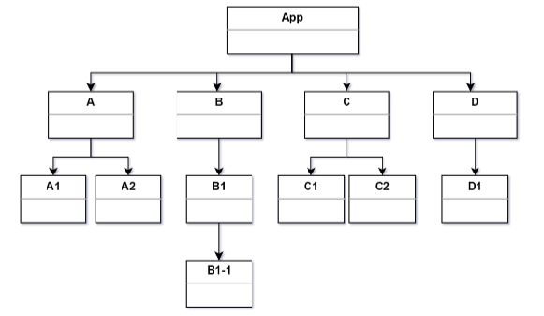
Initial rendering
tree structure is build starting from the App component
virtual DOM is created based upon component tree
= DOM consisting out of React elements instead of HTML elements

Slide 18
re-rendering
state of component B changes => new tree is created for B, B1 and B1-1
new virtual DOM with React elements
differences between old DOM and new DOM are determined
suppose only B1 and B1-1 are changed

Slide 19
State: component’s memory
useState hook provides:
  state variable:
    used to retain data between renders
  state setter function:
  update state variable and trigger React to render component again
import { useState } from "react";
array destructuring for returned array from useState
const [count, setCount] = useState(0)
Initial state value
holds value of state:
State updating function:
- updates value stored in count
- tells react to re-execute the component function

Slide 20
Hooks
hook:
  function starting with use
  special function that is only available while React is rendering
  allows to hook into different React features
  can only be called at the top of a component (not inside condition, loop, nested functions)
  can only be called from React funtions (components or hooks)
  can be seen as some kind of declaration about the component’s needs:
    Use React features at the top of the component like import modules at the top of a file

Slide 21
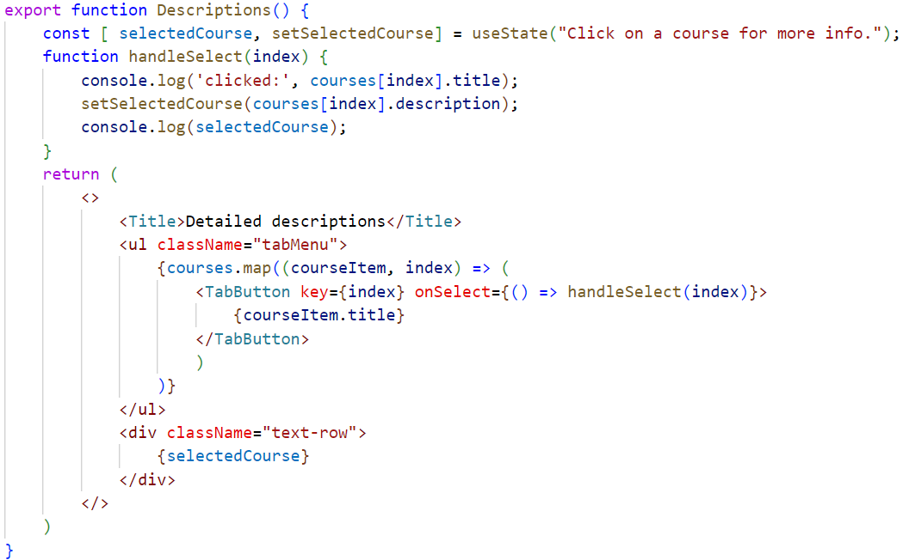
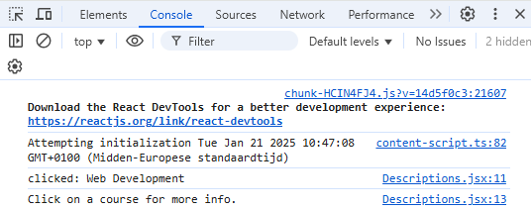

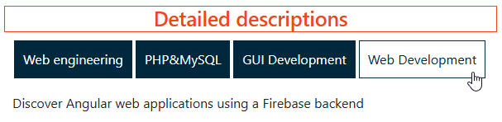
State: example
Starting value for selectedCourse state
change
state
State variable is updated only when re-rendering of component starts
new state content is shown

Slide 22
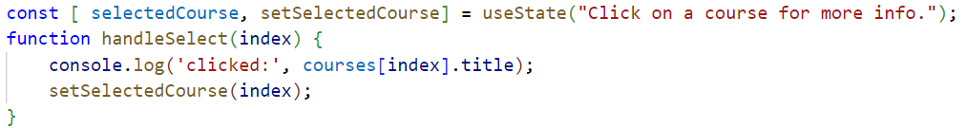

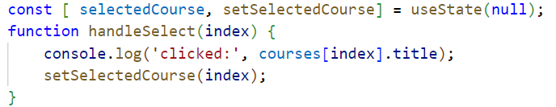
State: example
What if we want to output not only the description but also title, lecturer, … depending on current state?
use index of selected course as state value
integer vs string !!!

Slide 23
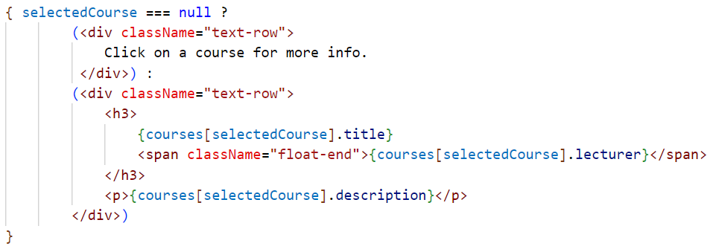
Conditional rendering => ternary operator
test
@ page load selectedCourse is null
true
Div to show when selectedCourse is no longer null
false
All renderable output must always be inside 1 one top level element (here div)
If for some conditions, nothing needs to be rendered, use null
{ } needed to use dynamic content/ JS inside JSX

Slide 24
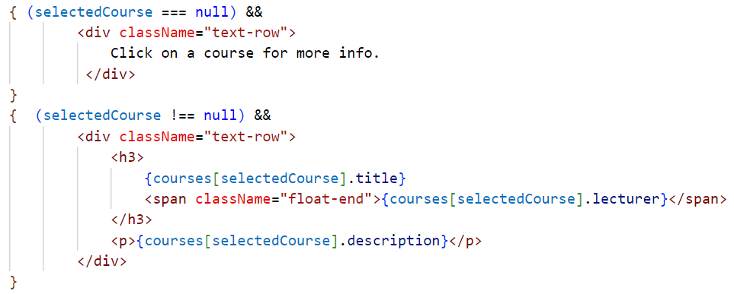
Conditional rendering => && operator
With && the righthand content is rendered if the lefthand condition is met
Using selectedCourse && … will not work here since an index of 0 will be seen by JS as false

Slide 25
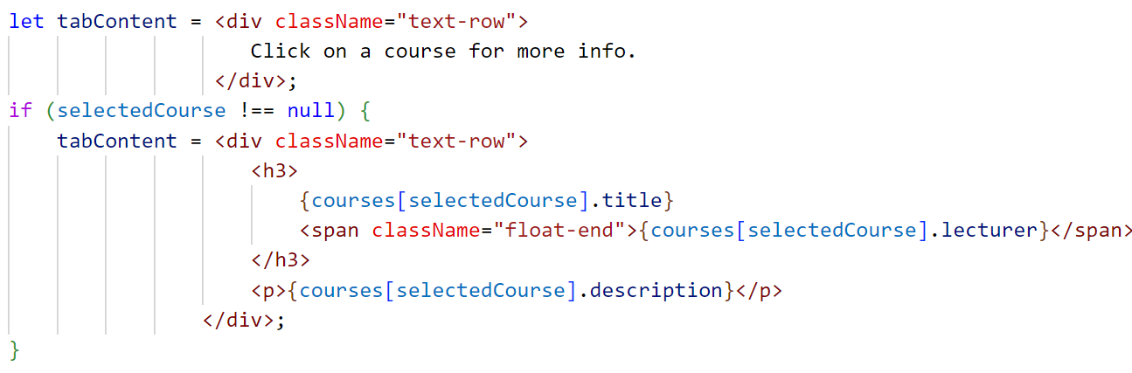
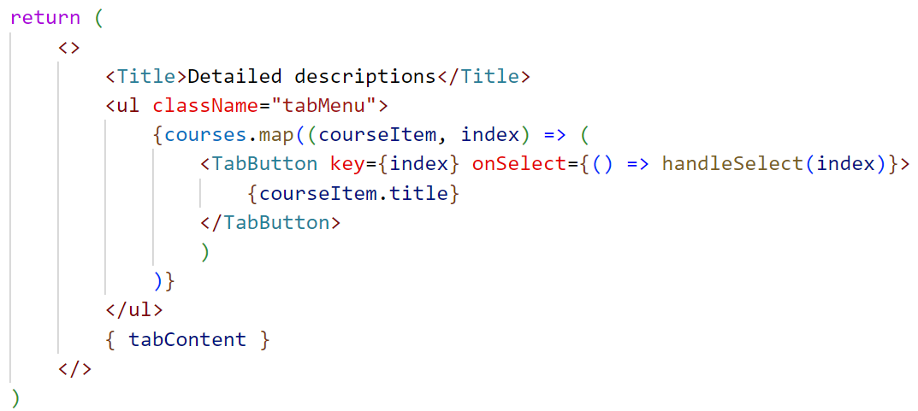
Conditional rendering => using var

Slide 26
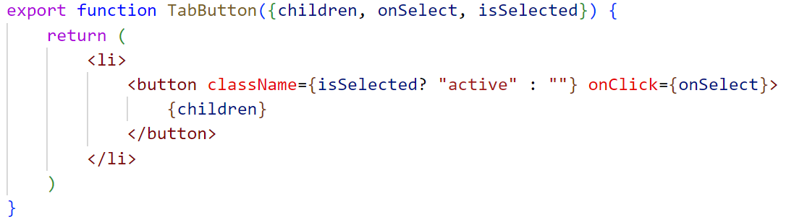
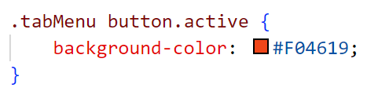
Dynamic styling
Conditions can also be used to set className:
With:

Slide 27
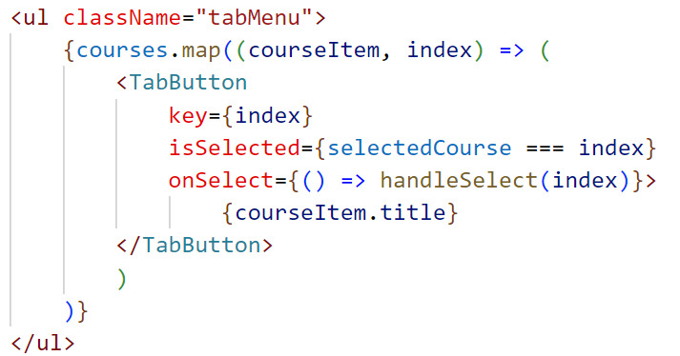
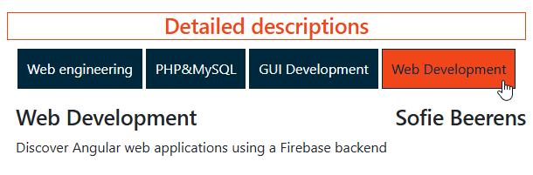
Dynamic styling
set isSelected prop to true for index stored in state

Slide 28
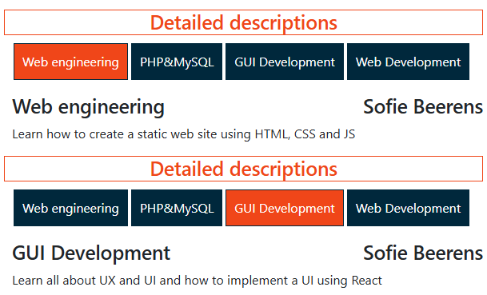
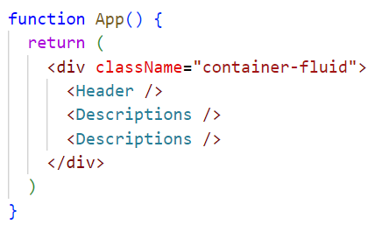
State is isolated and private
2 instances of description component:
each instance has own state
parent does not know about the state of the children
State is owned by component in which it is declared

Slide 29
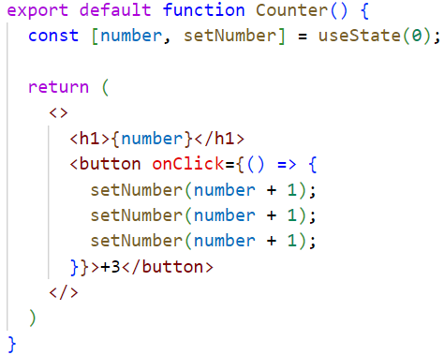



State is a snapshot

Slide 30
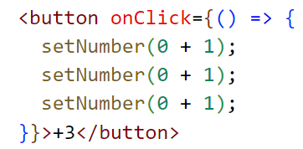
State is a snapshot
When component is rendered, current value of state is used to set all components elements:
button is clicked
setNumber sets the new number value to 1, three times
re-render is triggerd
component is re-rendered with current value of number set to 1

Slide 31


State: update based on old state
Use an updater function to update state when based upon old state value
React queues this function to be processed after all the other code in the event handler has run.
during the next render, React goes through the queue and gives you the final updated state.

Slide 32
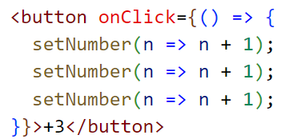

State: update based on old state
at start of new render, useState is called
React goes through the queue.
the previous number state was 0 => React passes 0 to the first updater function as the n argument.
React takes the return value of previous updater function and passes it to the next updater as n, and so on:
queued update | n | returns
n => n + 1 | 0 | 0 + 1 = 1
n => n + 1 | 1 | 1 + 1 = 2
n => n + 1 | 2 | 2 + 1 = 3

Slide 33
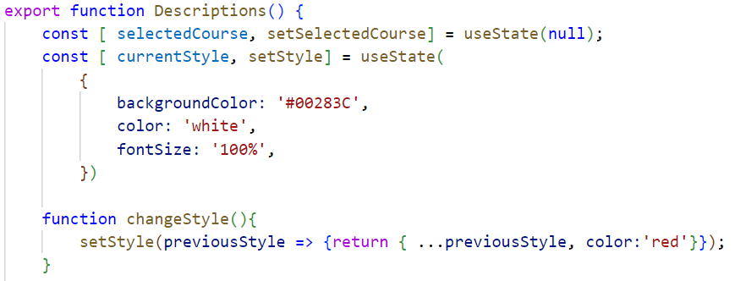
Updating object/array in state
Only change state using the setter function
Make a copy into a new object/array and return that as new state value
For multi-dimensional arrays a deep copy is needed
overwrite color in new object
copy old object into new object

Slide 34
Common array functions and state
 | avoid (mutates the array) | prefer (returns a new array)
adding | push, unshift | concat, [...arr] spread syntax
removing | pop, shift, splice | filter, slice
replacing | splice, arr[i] = ... assignment | map
sorting | reverse, sort | copy the array first
More explanation and examples: https://react.dev/learn/updating-arrays-in-state

Slide 35
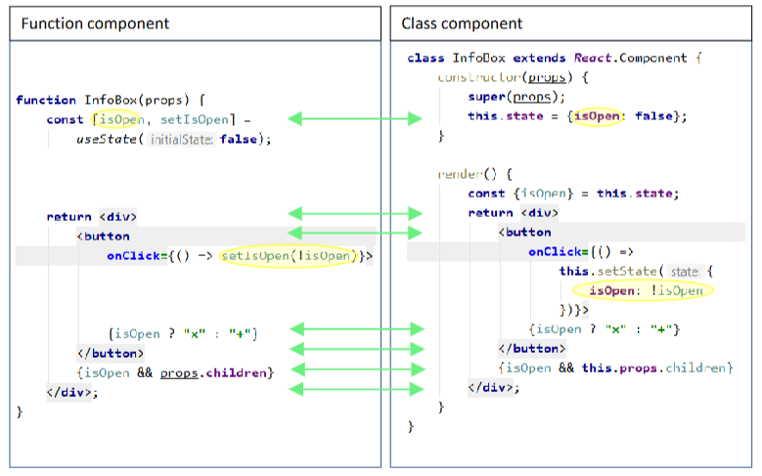
Class vs Function components
Older React code often still contains Class components. In this course only Function components

