Slide 1
User input fields

Slide 2
controlled vs uncontroled components
controlled
state managed by React:
state is stored in React’s memory and updated through props
state change => component’s UI update
need eventhandlers to update state and trigger re-rendering
predictable and centralized state management, easy to manipulate
uncontrolled
state managed inside component, directly interacting with DOM
syncing state and UI is done without React intervention
direct interaction with DOM to access and update state
can lead to more efficient updates for large or complex components

Slide 3
controlled input fields
use value/checked property to control UI of input fields
connect input field to a state variable
use setState function to change state on input field changes
to retrieve current value of input field => state
connect value of input to state var
event object contains information about change event
read current value of input field and store into state triggering a re-rendering with new state value

Slide 4
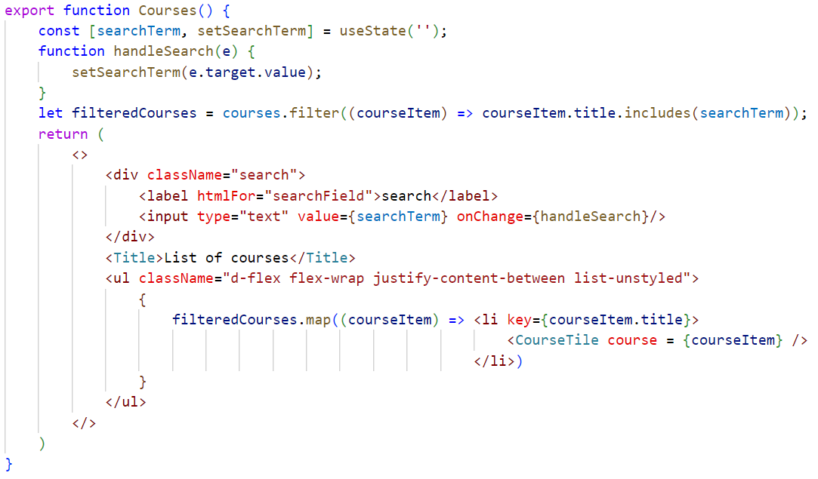
create state for input field
change state when input field changes
filter courses based on state variable
link input field to state
display filtered courses list

Slide 5
Forms
Needed if more inputs are to be threated together

Slide 6
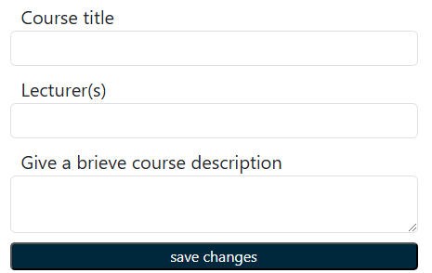
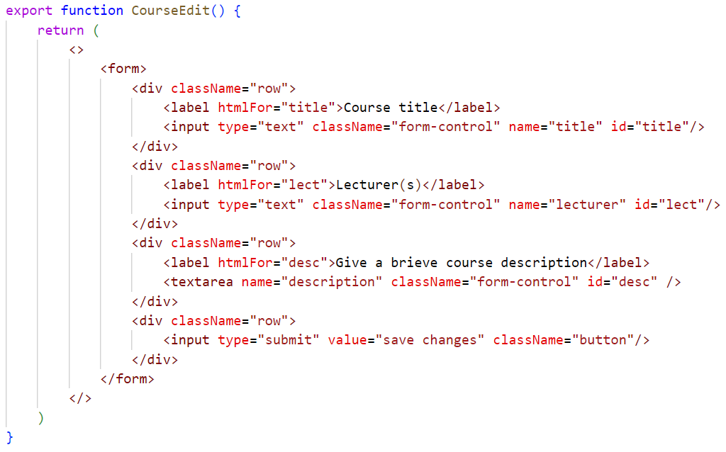

Handling forms: UI
‘htmlFor’ attribute to link label to input field instead of normal HTML attribute ‘for’

Slide 7

Form submission default behaviour
server serving the React app
server responds by resending index.html file + all other React files causing the app to reload in the browser
Browser sends HTTP request with form data to server
React app running in browser
All states, … are lost => we want to prevent this default behaviour by handling the form submission inside the component

Slide 8

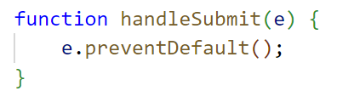
form onSubmit event
When form is submitted, form triggers submit event with corresponding event listener onSubmit
prevents default submit behaviour

Slide 9
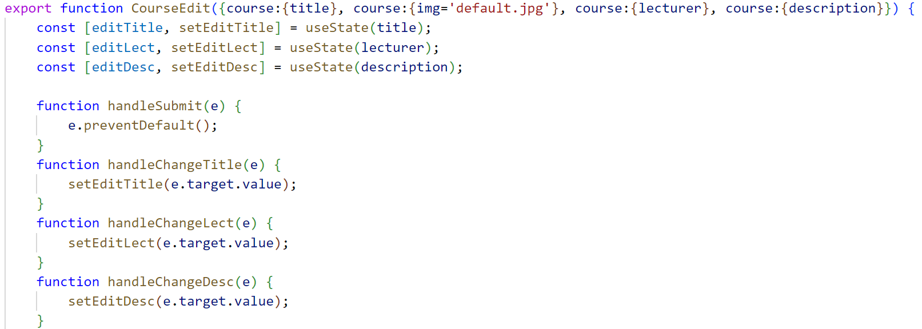
Using multiple states
in this handler as HTTP call to a backend can be made to store data in a DB (see later)

Slide 10
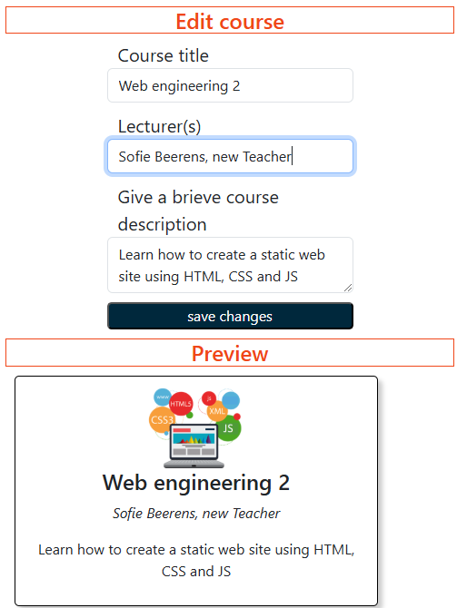
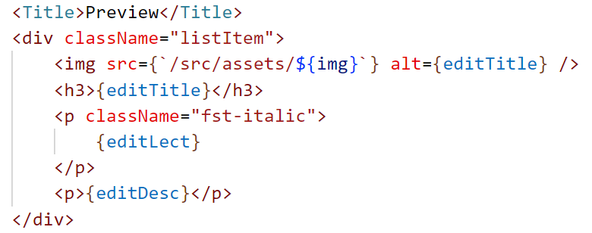
Use form values in preview window

Slide 11
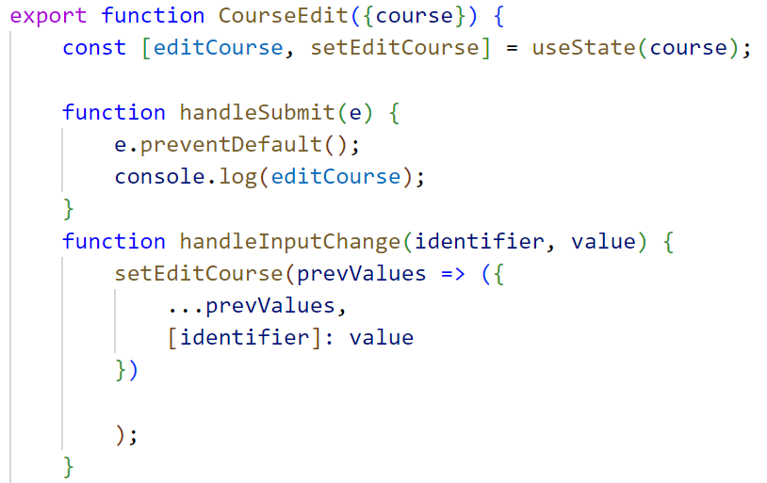
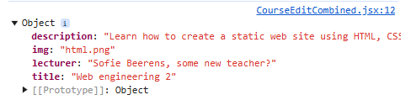
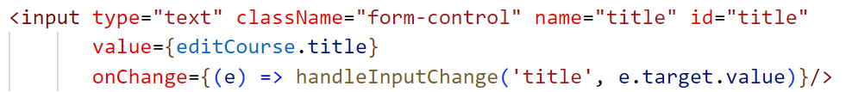
combine into 1 state
course object is not destructured
use course object as state variable
[ ] JS syntax to use variable as key
arrow function to pass identifier, but then arrow function gets event object

Slide 12
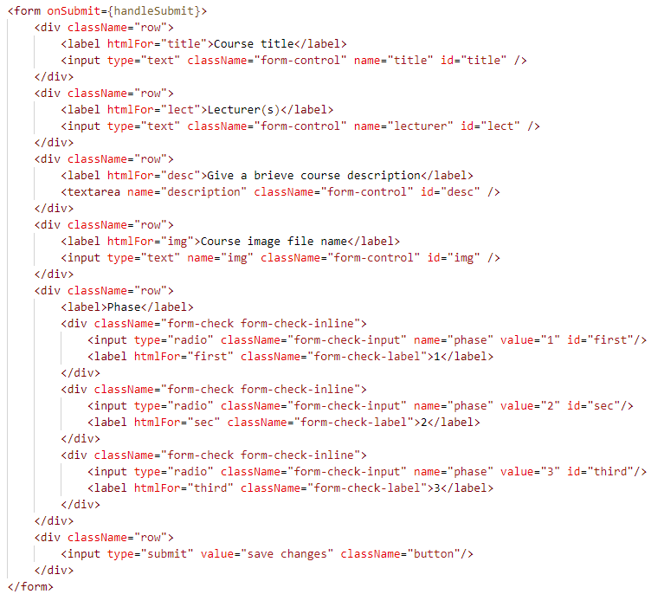
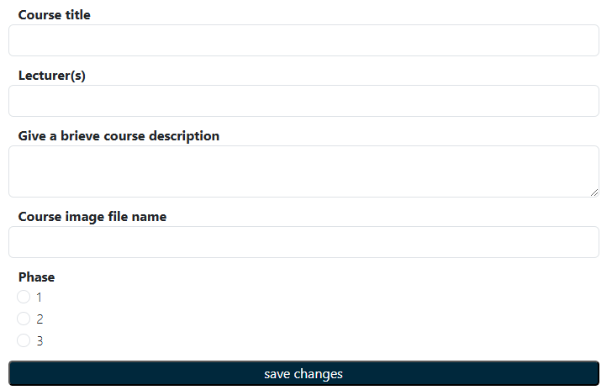
Using formData
Too many separate inputs to handle with onChange!

Slide 13
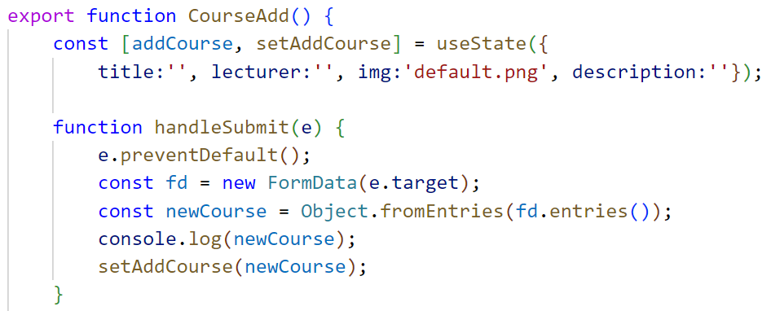
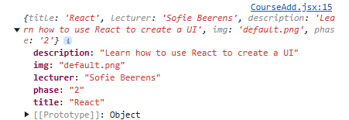
Using formData
extracts form entry data into object with as keys the names of the input fields
Creates new FormData object holding all data from form fields that have name attribute

Slide 14
Validating form inputs
Built-in HTML validators:
  required
  minlength,maxlength
  min, max
  same as plain HTML
Custom validators:
  @every keystroke
  @blur/focus
  @form submit

Slide 15
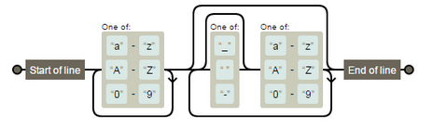
Writing input validators => regex
Check username versus following rules:
    only alphanumeric characters (letters (small or large) and numbers)
    May contain _ , - or space but immediately followed by an alphanumeric character
    No _, - or space at beginning or end of username
Regex:
/^[a-zA-Z0-9]+([_ -]?[a-zA-Z0-9])*$/

Slide 16
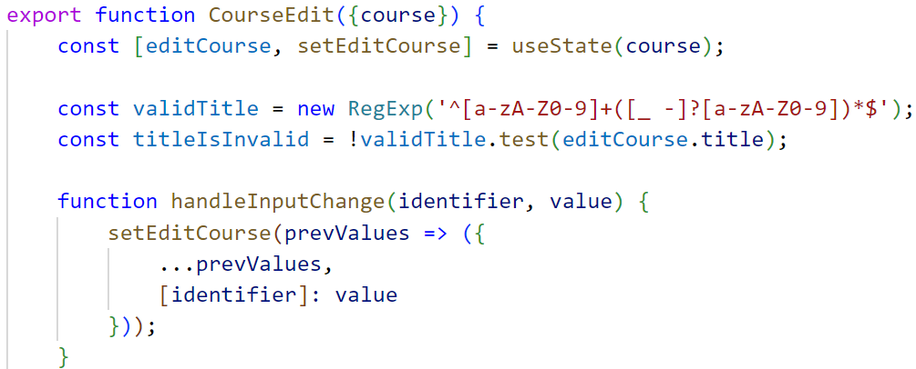
Validating @ every keystroke
state controlled inputs needed
Add boolean to compute input validity at every (re)-rendering

Slide 17
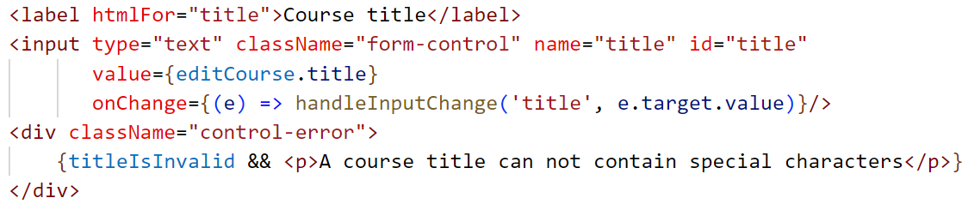
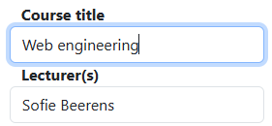
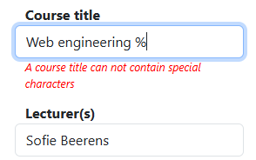
Validating @ every keystroke
Conditionally add paragraph to JSX based upon previously defined boolean
Use conditional styling of visibility of error paragraph to avoid jumps in the UI

Slide 18
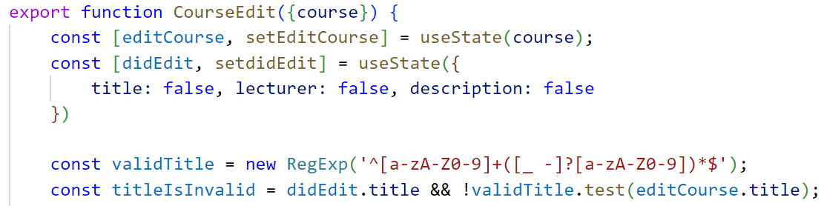
Validating @ out of focus
state controlled inputs needed
add state to remeber if an input has focus or not

Slide 19
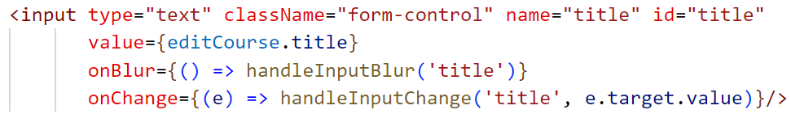
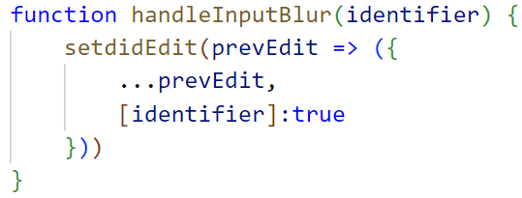
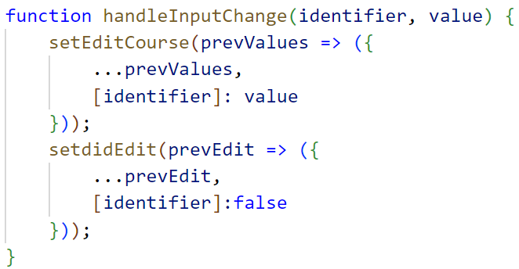
Validating @ out of focus
detect focus loss
set corresponding boolean to true in didEdit
reset boolean to false while editing

Slide 20
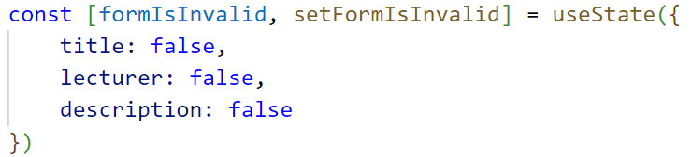
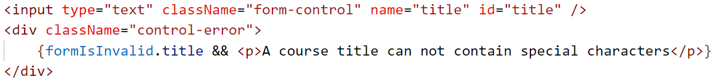
Validating @ form submission
Validation @keystroke/ @blur does not prevent submission
=> add validation @ form submission before sending data to backend
create a state to re-render UI after form submission

Slide 21
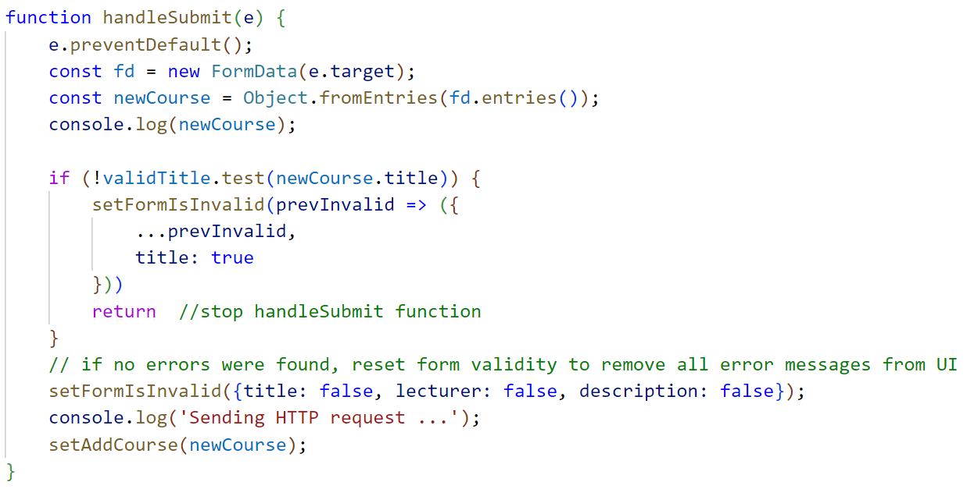
Validating @ form submission
use separate input states to determine validation if keystroke validation is also used

