Slide 1
State management

Slide 2
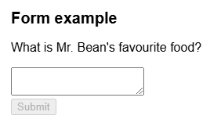
React = Declarative UI
Declare what you want to show and React figures out how to update the UI
Building component:
  Identify different visual states:
    empty => when form is empty, disable submit button
    typing => enable submit button
    submitting => disable submit button and show
    spinner
    success => thank you message is shown instead
    of a form
    …
Represent these states in memory using useState:
  isTyping, isSubmitting, isSucces, isEmpty, isError
  error (to hold an error message), answer (to hold the answer), …

Slide 3
React = Declarative UI
define state structure:
  are all state combinations valid?
    isTyping and isSubmitting can never be true at the same time
    => combine them into 1 state formStatus
  can one state be deduced from another?
    isEmpty ⬄ answer.length === 0, isError ⬄ error != null
    all information that can be deduced from props and/or other states must not be in a state
  group related states:
    if always updating 2 or more state variables at same time => combine into 1 state
    position ⬄ x-coord and y-coord
  avoid duplication in states
Connect eventhandlers to the different set-state functions

Slide 4
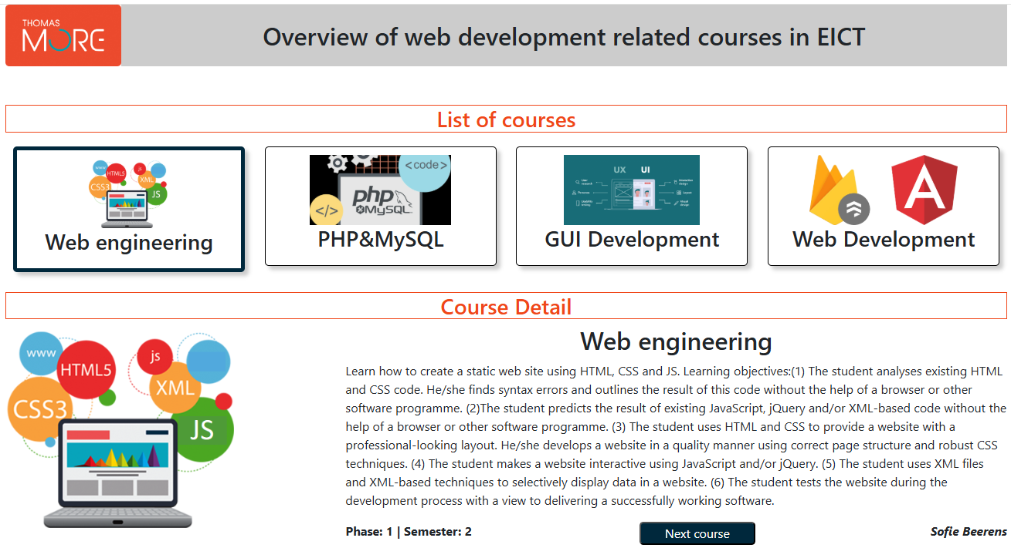
Courses component
CourseDetail component

Slide 5
Which states
Only one state is needed => id of selected course
  Limit the amount of states to what is really needed and use derived states if possible (e.g. course inside CourseDetail will be derived from selected course id)
  avoid duplicating state information. E.g. state selectedIndex and state course overlap so reduce to 1 state

Slide 6
sharing state between components
state: selected course
App
Courses
CourseDetail
show selected course
set next selectedcourse
set selected course
CourseTile
CourseTile
Am I selected?
Am I selected?

Slide 7
Lifting state up
Lift state up to the closest ancestor component that has access to all components that need that state => in this case App component
pass function via props to allows child component to initiate state change
manages
App
state: selected course
pass state value via props
set selected course
Courses
CourseDetail
- show selected course
- set next selected course
pass state value via props
CourseTile
CourseTile
Am I selected?
Am I selected?

Slide 8
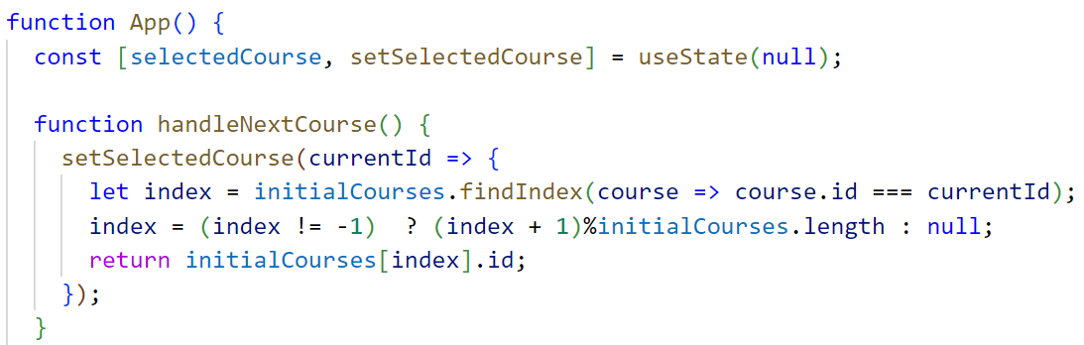
Lifting state up: App
manages
App
state: selected course
must be called when clicking ‘next’ button in
CourseDetail component

Slide 9
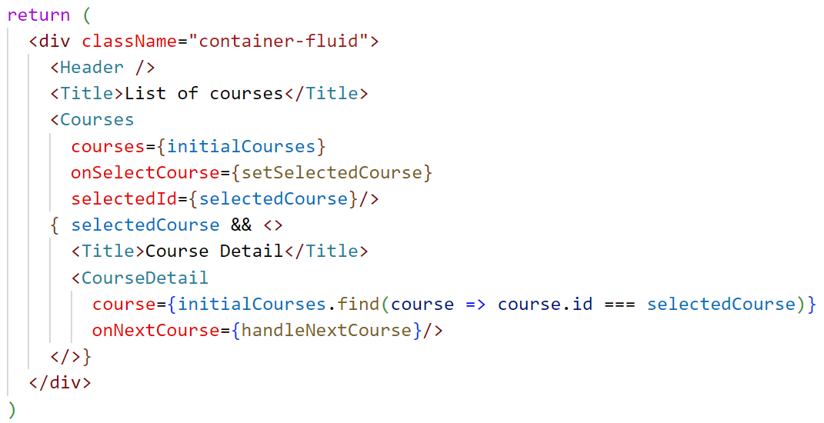
Example: App
pass function via props to allows child component to initiate state change
App
pass state value via props
Courses
CourseDetail
pass set-state function to Courses for usage inside
Courses component
pass selectedCourse state to Courses via selectedId prop
use selectedCourse state to show/hide detail part
use selectedCourse state to pass corresponding course
to CourseDetail as course prop
pass set-state function to CourseDetail for usage inside
CourseDetail component

Slide 10
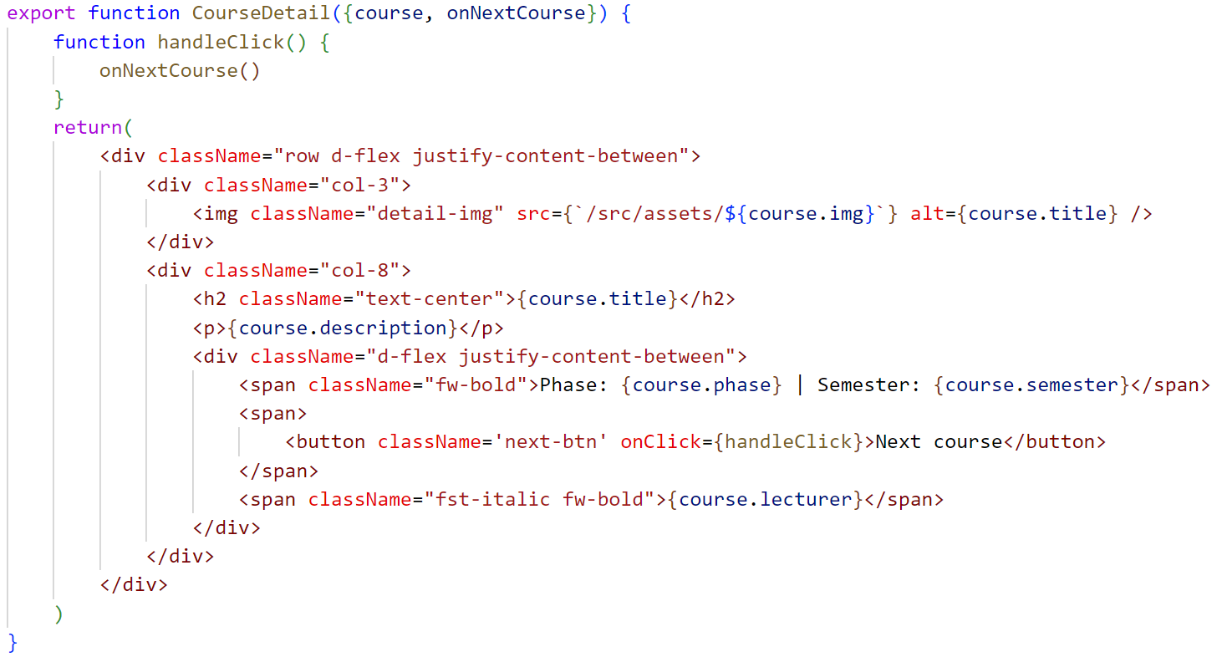
Lifting state up: CourseDetail
course contains the course derived from selectedCourse
onClick:
=> calls local function handleClick
=> calls passed setter function from the app component
=> next course is computed and set in app component

Slide 11
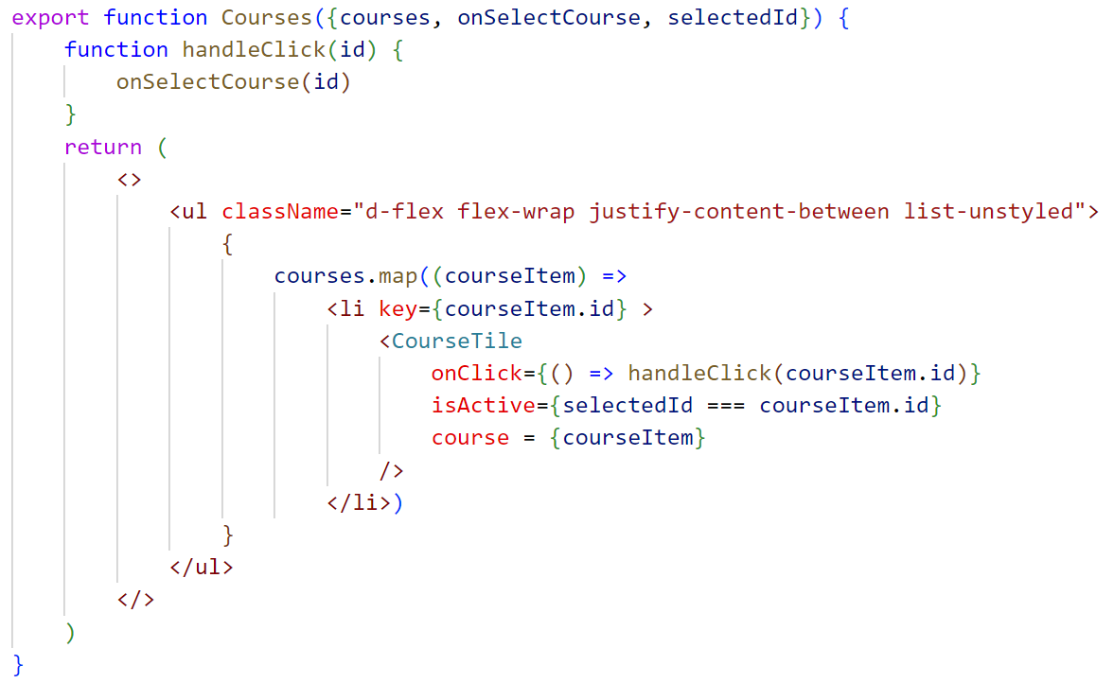
Lifting state up: Courses
set selected course
Courses
pass state value via props
CourseTile
CourseTile
selectedId contains the selectedCourse state value
let CourseTile know if it is selected or not
onClick:
=> calls local function handleClick with id of current course
=> calls passed setter function from the app component with same id
=> selected id is set in the app component

Slide 12
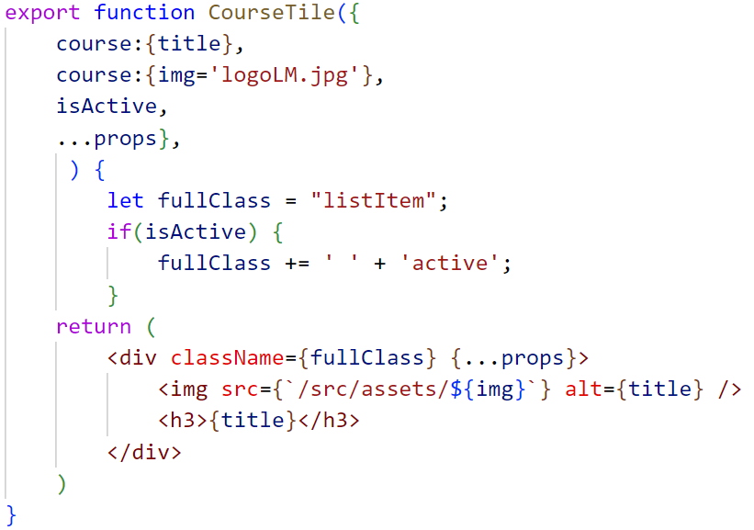
Lifting state up: CourseTile
Set onClick to outer div

Slide 13
Who owns the state?
State used by:
1 component
  component is owner of the state
  define state inside this component
2 or more components:
  they all need the same state and/or set-state function of this state
  find the lowest common ancessor
  this ancessor owns the state

Slide 14
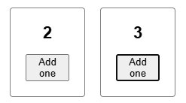
Preserving / resetting state
State is isolated and preserved for every instance of a component with state for as long as that component is not removed from the app
app
Counter
Counter
Count 2
Count 3

Slide 15


Remove first counter
app
app
app
Counter
Counter
Counter
Counter
Counter
Count 2
Count 3
Count 3
Count 0
Count 3
Both counters are rendered and clicked a few times such that states are 2 and 3 respectivily
(showCounter = true)
counter 1 is removed from DOM (showCounter = false)
=> replaced by empty slot
=> counter 2 remains in slot 2 in app
=> counter 2 does not loose state
counter 1 is re-rendered (showCounter = true)
=> counter 1 state is reset to starting value 0

Slide 16
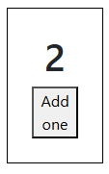
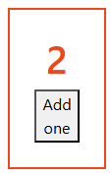
Replace counter with another counter
showCounter = true
showCounter = false
app
app
Counter
Counter
Count 2
Count 2
counter is rendered with special = false
another instance of the same counter component is rendered with special = true
Same component in same place in DOM preserves state:
=> in both cases component of type Counter as first element inside app in DOM
=> same state

Slide 17
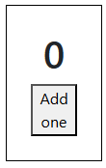
Replace counter with another component
showCounter = true
showCounter = false
showCounter = true
app
app
app
Counter
p
Counter
Count 2
Count 0
counter is rendered in first pos in app tree
paragraph is now rendered in first position in app tree
counter is re-rendered in first pos in app tree but state was reset
different components in same place in DOM resets state:

Slide 18
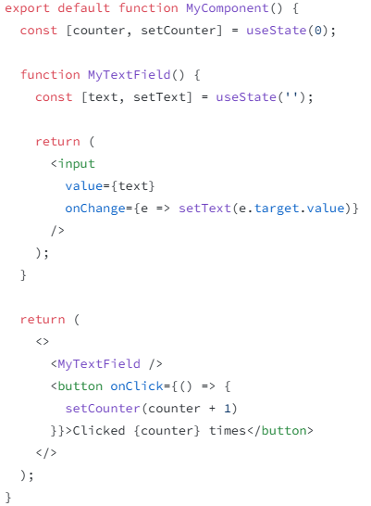


No nested components!
MyTextField component is defined inside MyComponent component
Click button
=> setCounter changes state of MyComponent
myComponent is re-rendered
MyTextField is redefined as a new component
Text field is now a new component in the same place
State of MyTextField is reset

Slide 19
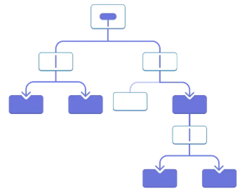
Prop drilling
= passing shared data through multiple layers of components
Leads to extra code to handle all that prop sharing
Some components only need to pass props from parent to child
context: allow ‘teleporting’ data to components in the tree that need it without passing props

Slide 20
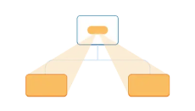
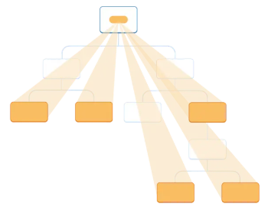
Context
‘teleporting’ data to components in the tree that need it without passing props
Create a context
Use the context in the component
that needs the data (consumer)
Provide the context from the
component that has the data (provider)

Slide 21
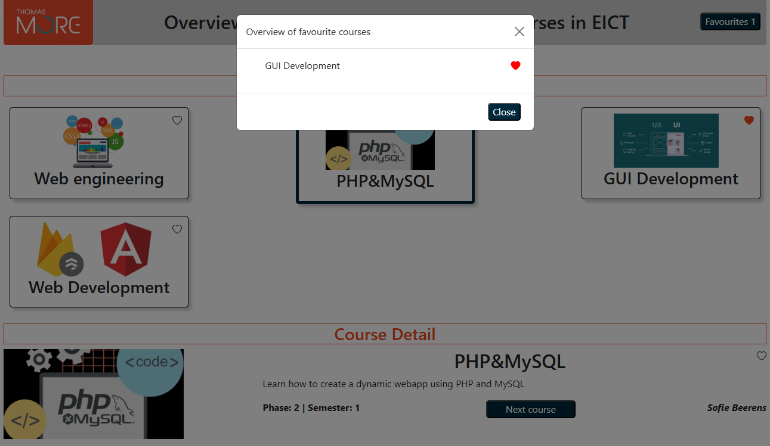
Context: example
state: favourites

Slide 22
App structure, no context
manages
state: favourites
App
Courses
CourseDetail
Header
state prop
state handling props
Modal
CourseTile
Favourites

Slide 23
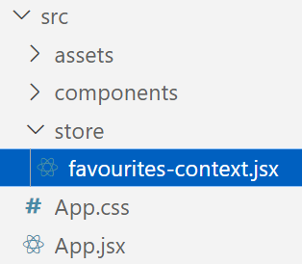
Create context
store all context files in separate dir ‘store’
can be created to just pass state/state setters to components
when combined with a nested provider component, also all state management regarding that data can be grouped inside the context file

Slide 24
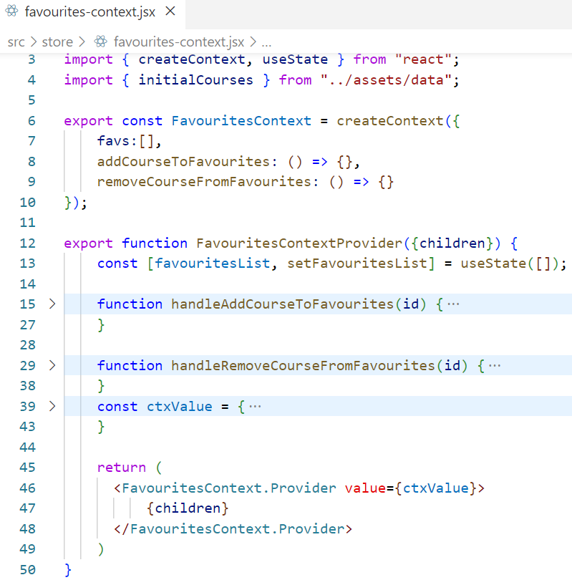
Create context
create an object that holds all data / functions to pass
to components
set default value for object, only used to define object
structure => can be empty [], empty functions
create provider component to be used as a wrapper
around all components that want to use this content
state definition
state handling functions
starting value for context
rendering code for provider component
all components inside provider component will be passed on to Provider that is created by React for every context

Slide 25
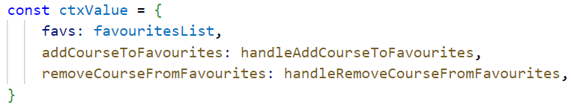
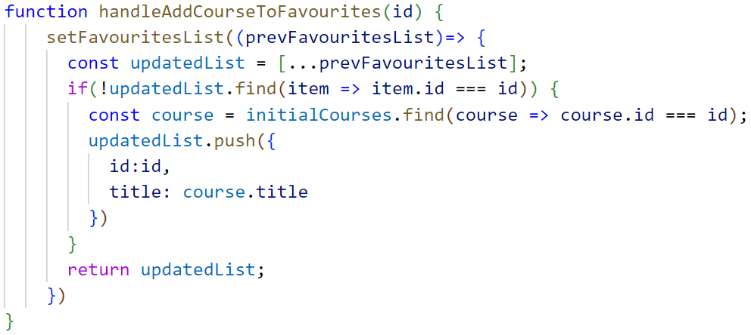
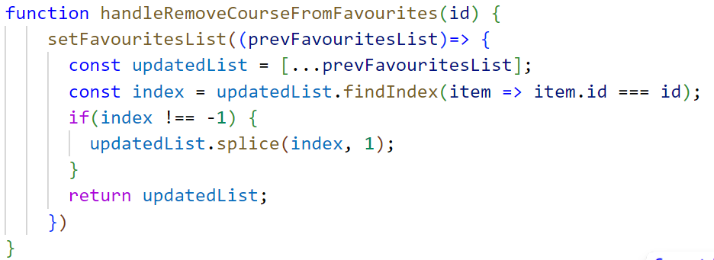
Context starting value
connect context favs to state
connect context functions to state update functions

Slide 26
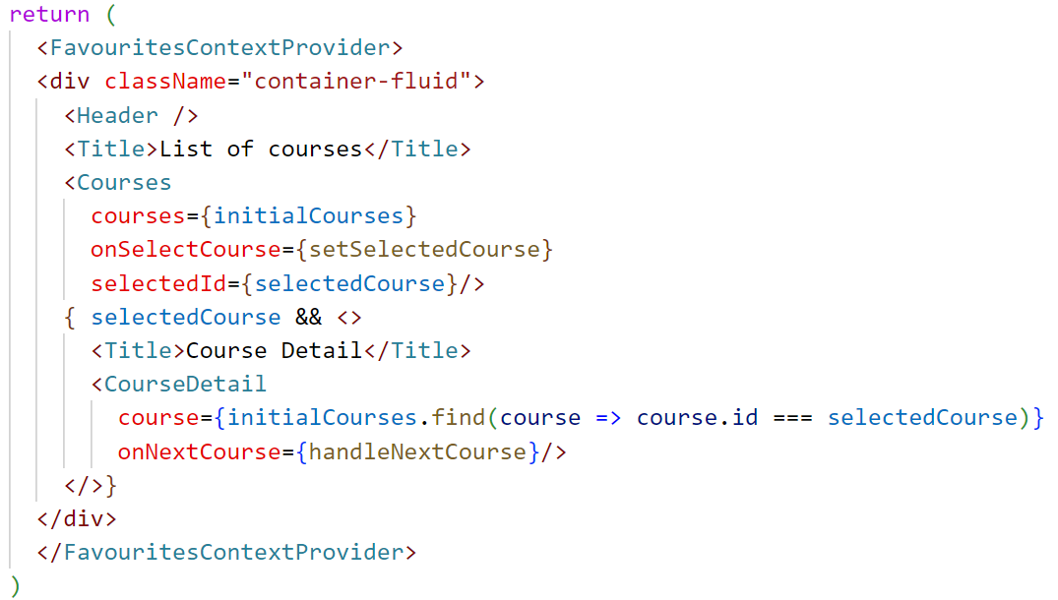
Wrap context
Wrap around all components that want to use the context
no props concerning
favourites state and/or state
update functions

Slide 27
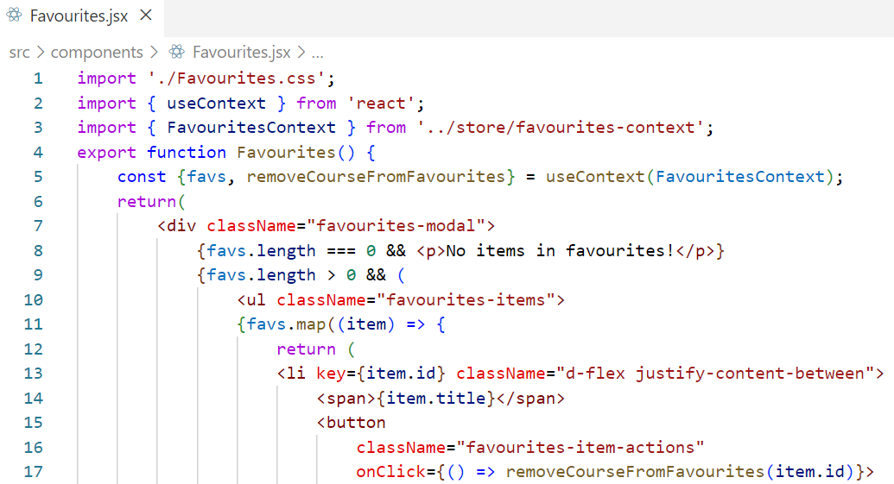
Consume context
object destructuring
changing context causes component function to be re-executed
Import context and useContext hook
setup useContext hook in component
use list from context instead of prop
use remove function from context

