Slide 1
HTTP requests – useEffect hook

Slide 2
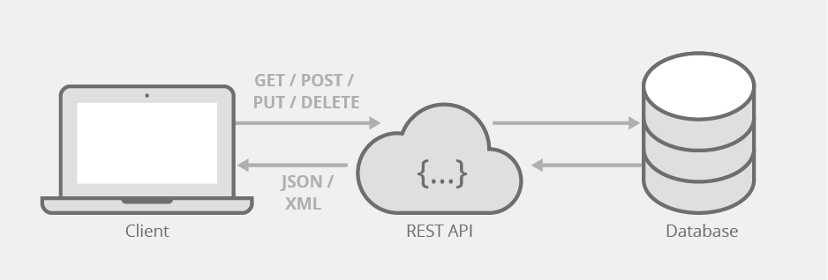

React is frontend SPA
React is frontend only
All datachanges inside react app are lost whenever app reloads
=> Use a DB to store data permanently
HTTP requests
React app running in browser
Backend

Slide 3
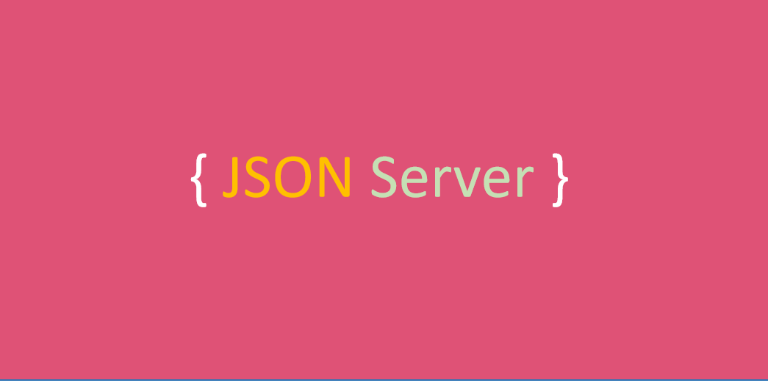
Backend => json-server
To quickly test the front end for this course, we will be using 'json-server'.
Installation:
npm install –g json-server
Run the server:
json-server db.json
db.json is a database file in the current directory containing the data in JSON format

Slide 4
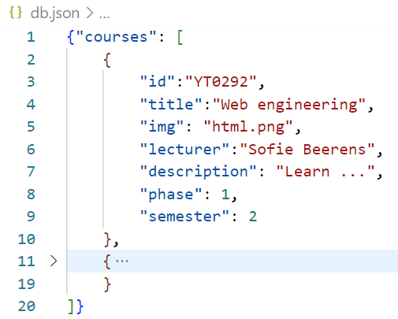
JSON format
Exchanging data between backend and frontend should be in text format (because of HTTP protocol) but often we want to exchange objects
=> JSON format.
JSON (JavaScript Object Notation)
  text, written in the JavaScript
  object notation
Data can be accessed via:
http://localhost:3000/
Here one endpoint:
http://localhost:3000/courses
Both keys and values have double quotes!

Slide 5
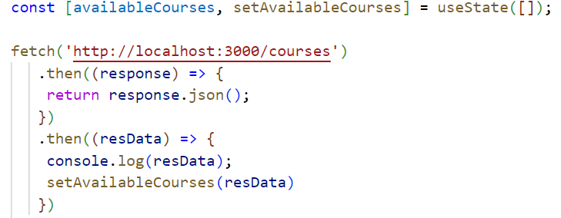
Get data using fetch
http request takes time => answer from fetch is a promise
.then waits until answer from fetch is ready and stores that into response
response.json() converts json object into array of objects with a promise => return to expose that promise
.then to catch that data and use set state function to set data to state
1
2
3
4

Slide 6
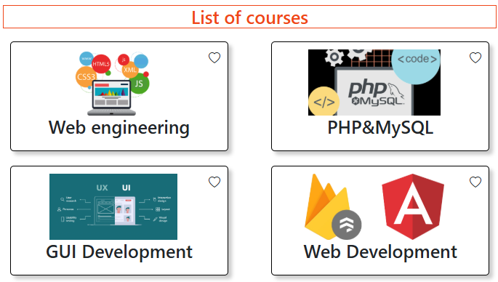
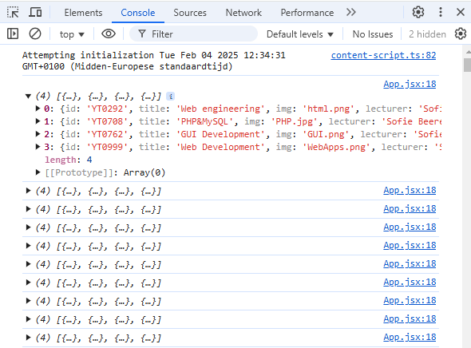
Problem using fetch like that!!
Fetching data works correctly but is repeated endlessly!!

Slide 7
Why endless loop?
at startup of app component: fetch is not yet completed => availableCourses = [ ]
after some time, fetch is finished:
  availableCourses state is set to response data
  state changes
  app component function is
  executed again
  new fetch request is sent
  state changes again
  …
We need another hook useEffect

Slide 8
useEffect hook
Used to do a setState after:
  a function that is async (like getting data from server)
  the first rendering of the component is done (because you need elements to be rendered before the setState can be executed)
  after another state change
Do not use useEffect for:
  code that should run only once when component is created => outside (on top) of component function
  async code (like adding an item to the DB) that does not needs to be re-executed every time the component renders, but only when a user clicks something => inside the click handling function

Slide 9

useEffect hook usage
when useEffect is executed => registers the input function for execution after rendering
2 input parameters:
  first: function (effect) to be executed
  second: array of dependancies
effect is executed when component function is executed (render/re-render) and one of the dependancies has changed
special dependencies arrays:
  [ ]: effect is executed only once the first time the component function is executed
  Undefined: effect is executed after every render => ! endless loops!

Slide 10
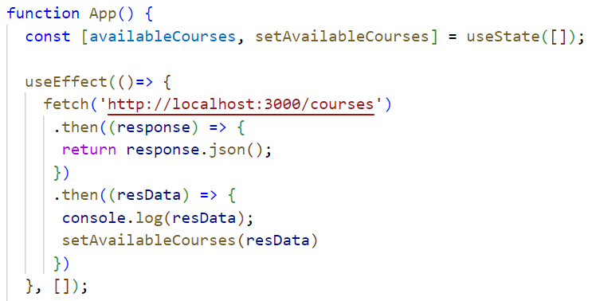
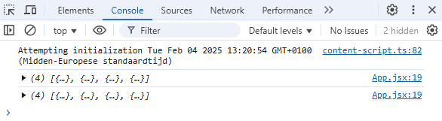
Fetch data using useEffect
dependancies array is empty =>
will only be executed once when
app function is executed the first time

Slide 11
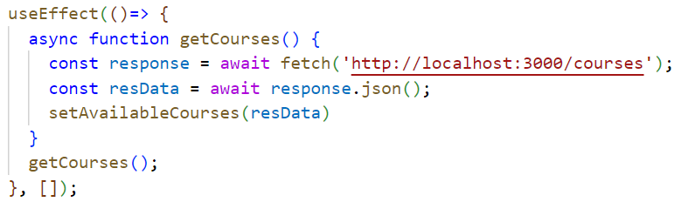
Async and await
to remove the .then syntax, use ‘await’
‘await’ can only be used inside a function decorated with async
do no place async in front of anonymous effect function!!
function definition inside useEffect function to assign the keyword await to
await waits until function execution is finished and returns result
call async function

Slide 12
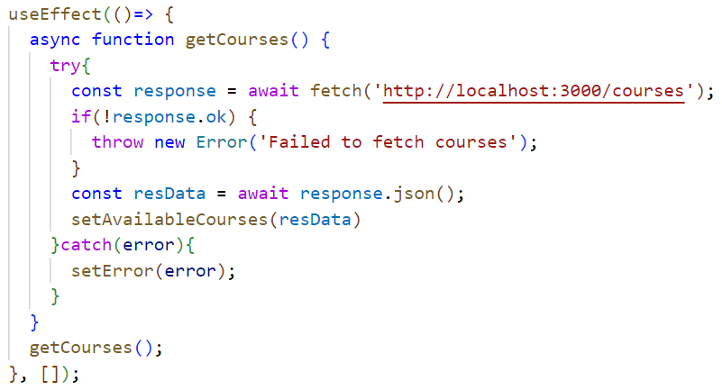
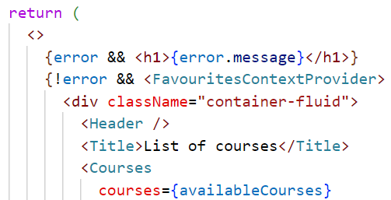
error handling
add state to store error
checks HTTP response status (ok means 200)

Slide 13
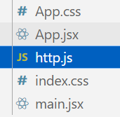
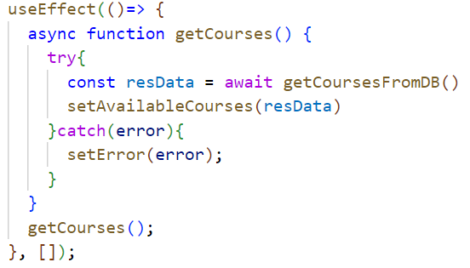
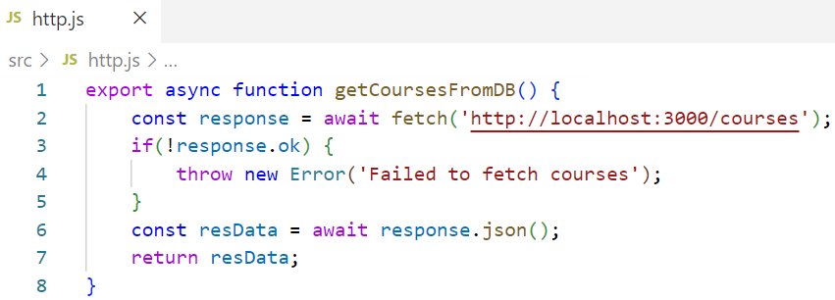
moving functions to separate file
In case getting courses from DB is needed in multiple components => move logic to a separate file
.js since only JS functions, no JSX rendering code

Slide 14
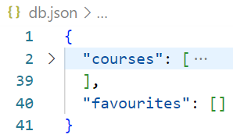
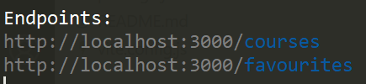
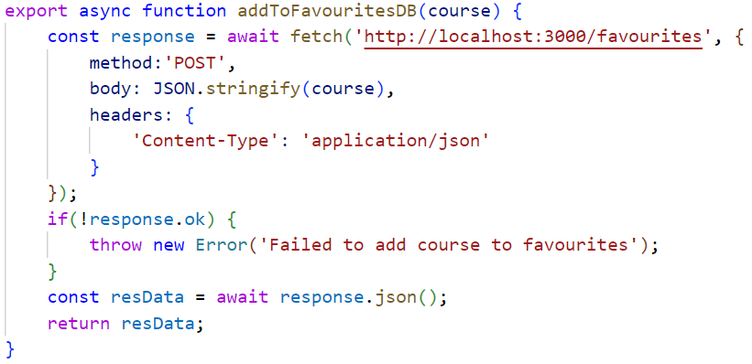
POST request => add data to DB
add empty array to store
favourite courses
new endpoint
http.js
pass object as second argument in fetch
convert object to json
set http headers for json data
json server returns added course on success

Slide 15
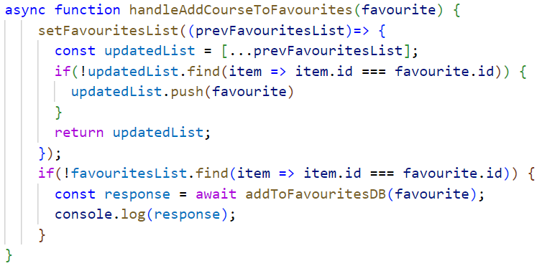

POST request => add data to DB
handle function called when clicking on heart
to be able to use await
state update
old state version since
state is only updated at
next rendering
DB update
state updated before data is sent to DB:
good for user experience (update is seen immidiately)
what if post request fails?

Slide 16
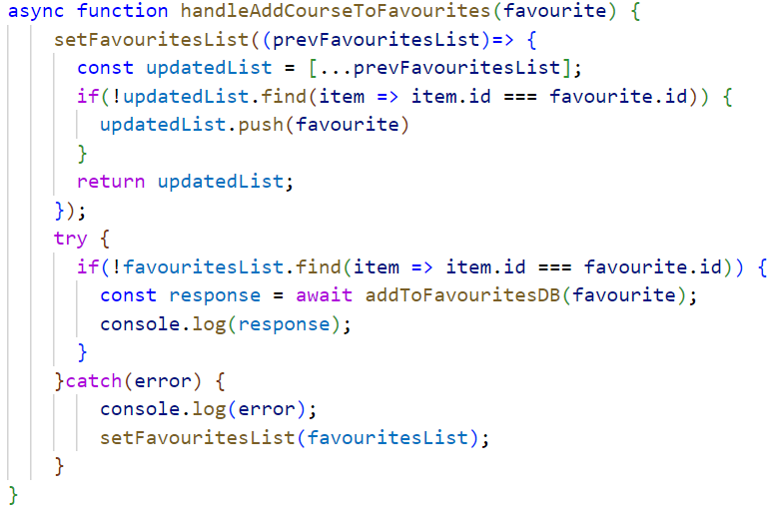
roll-back state update on fail
on error => set state back to previous state value

Slide 17
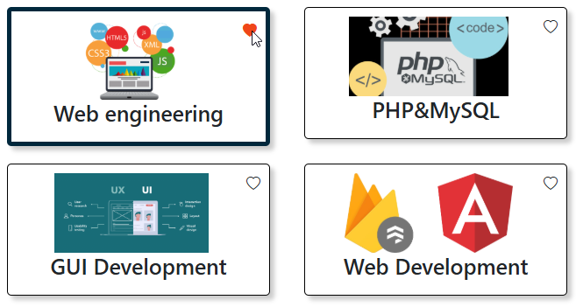
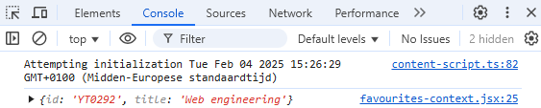
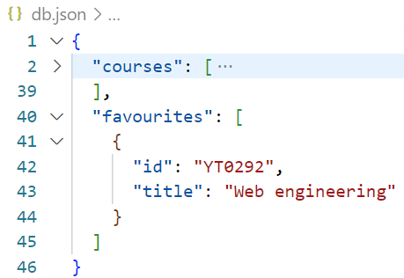
POST request => result

Slide 18
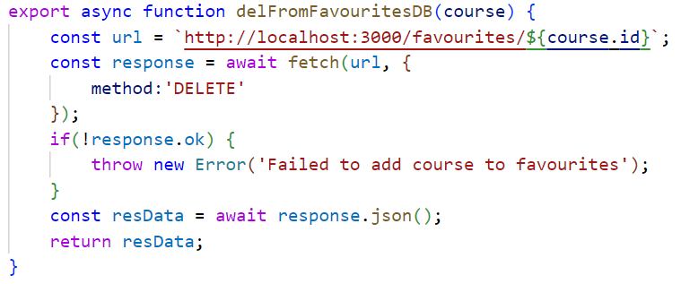
other requests
http.js
add id of element you want to delete
json server returns deleted course on success
get one item:
  url: node/id
overwrite all data of 1 item
  url: node/id
  method: PUT
Adjust part of data of 1 item
  url: node/id
  method: PATCH
  body: object with all to be changed fields converted to JSON

Slide 19
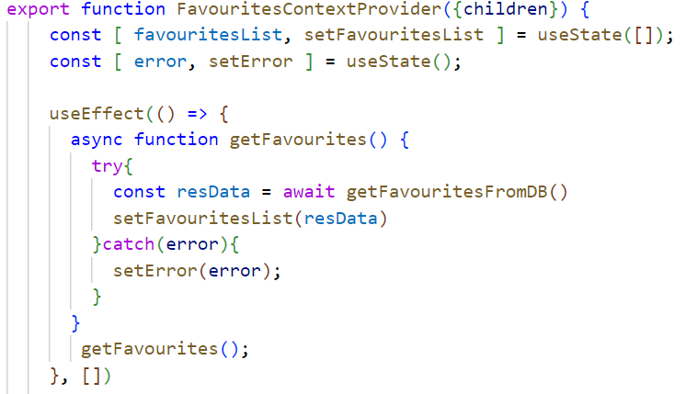
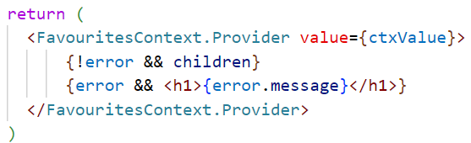
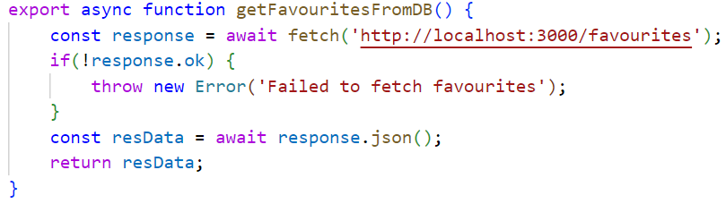
Fetch initial favourites inside context
use error state in context provider
http.js

Slide 20
Additional information on json server
  https://github.com/typicode/json-server

Slide 21
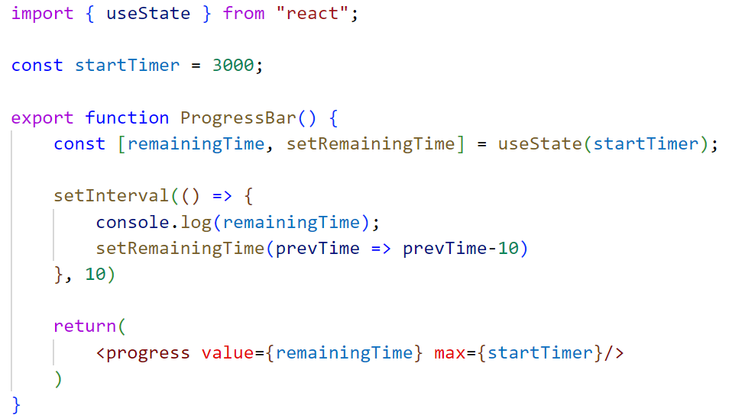

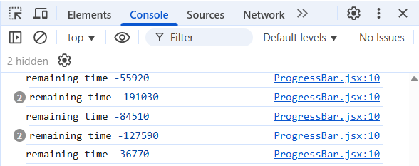
Creating a progress bar
Progress bar is empty almost immediately?
At first render a setInterval timer is created that changes the state after 10ms
Due to state change the function ProgressBar is executed again so a new setInterval timer is set that also changes the state after 10ms but in the main time the previous timer is also still running
New state change => new render => yet another extra setInterval, …

Slide 22
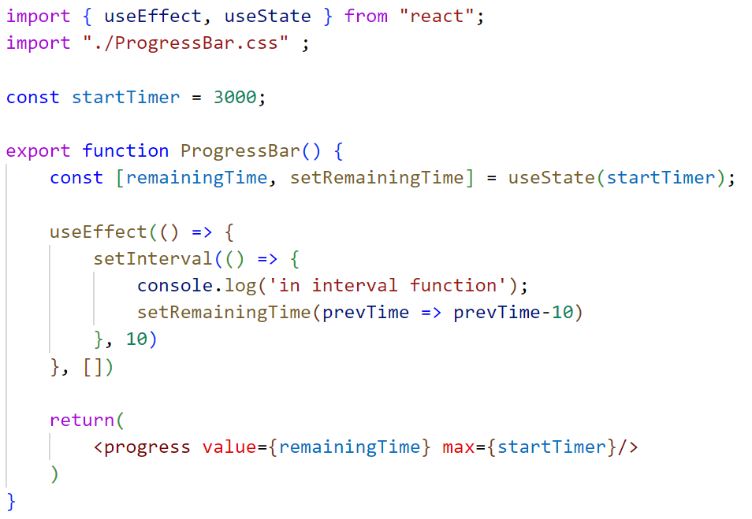
Stop endless loop using useEffect
Empty array => function inside useEffect is only executed at first render of the component

Slide 23
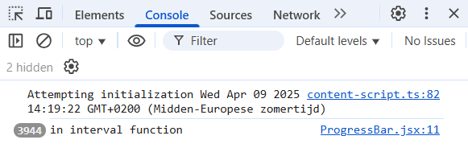
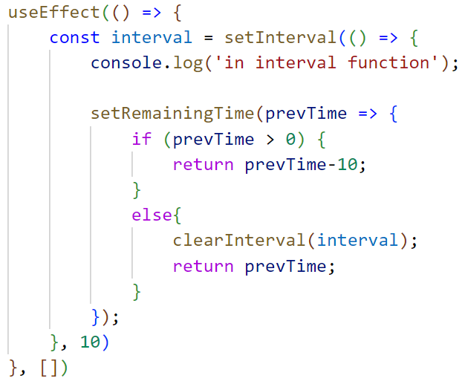
Still endless loop!
Remaining time < 0 => progress bar looks empty but setInterval
is still running
Stop inteval once bar is empty

Slide 24
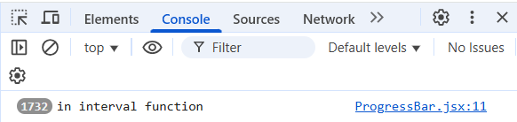
Still endless loop!
removing progress bar from the DOM with conditional rendering while bar is still running:
=> setInterval keeps running even after removing the component from the DOM
=> Memory leak!!

Slide 25
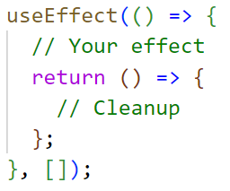
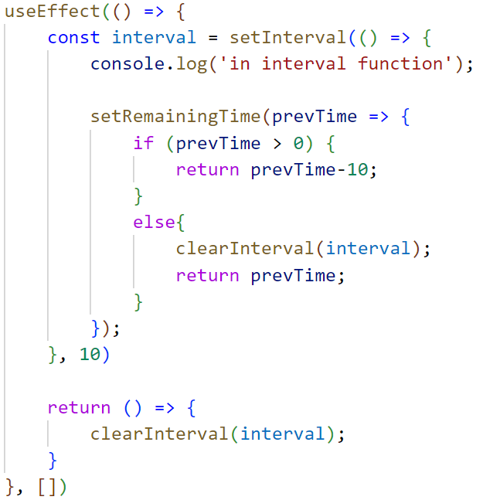
useEffect Cleanup function
General syntax:
Cleanup function will run
just before unmounting the
component

