Slide 1
React router

Slide 2
React: SPA
1 HTML file: index.html
Single page application
Changing "page" is really just changing view!!
Routing:
  load another component based on the path in the URL
  the user is given the illusion that he is requesting other pages, but in
  reality he remains on the same page

Slide 3






Routes
= link between path in URL and component to be displayed.
Home
About
Contact

Slide 4

Using routing
Routing is not build-in inside React
Extra package to allow for routing
Installation:
Usage:
  Define the routes
  Tell React where to render the components
> npm install react-router-dom

Slide 5
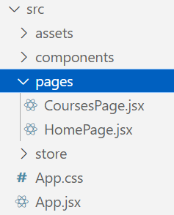
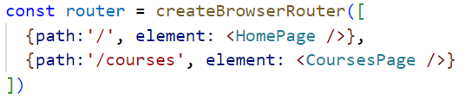
Define routes
Inside App.jsx before the function definition
1 route = JavaScript object with 2 key-value pairs:
    path: contains the path after the domain
    (e.g.: http://localhost:5173/about => path value = ‘/about’)
    element: contains the component to be activated via the route.
array of routes
2 routes
put components that will be loaded by routing in separate pages dir

Slide 6
Tell React where to render the components
Function App() :
  starting point of the application
  here you placed all the components you wanted to load
Insert component selected by route:
Import routerProvider:

Slide 7
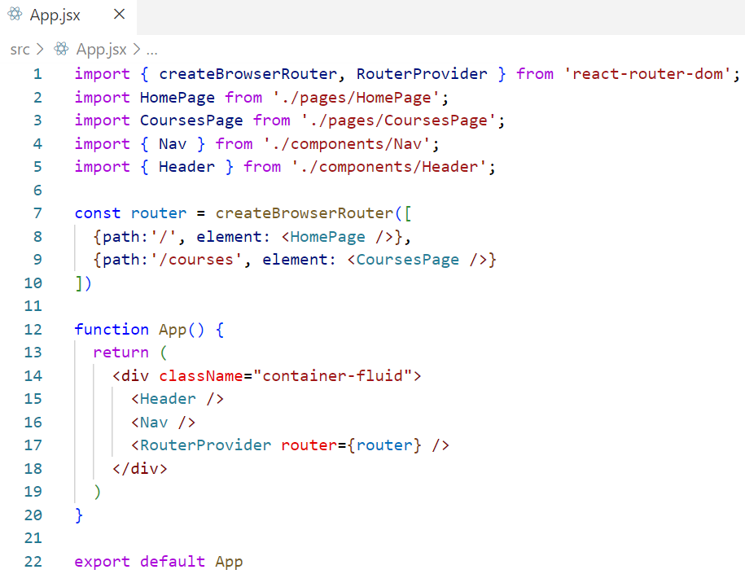
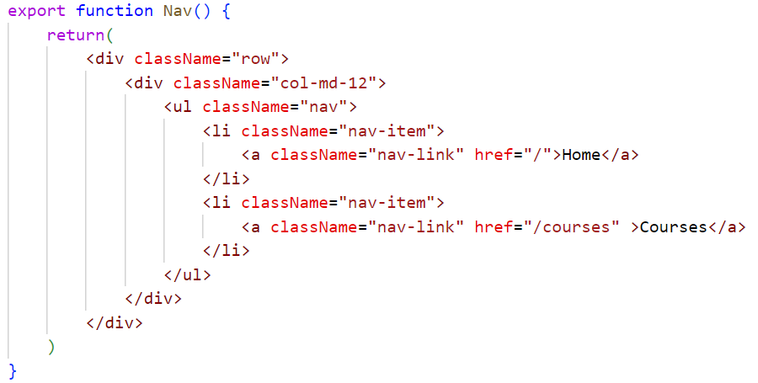
Example
define routes
render components

Slide 8
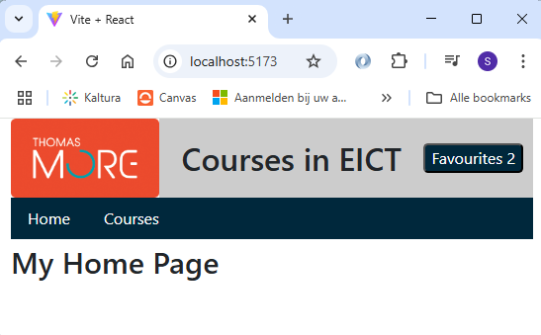
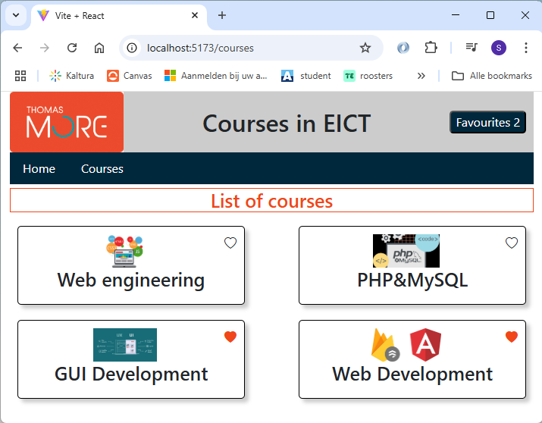
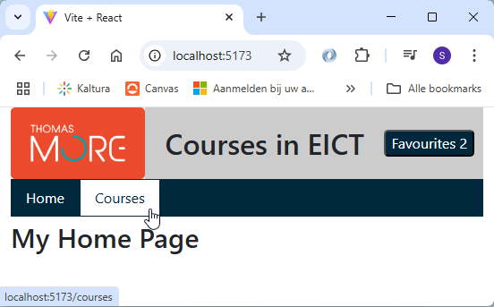

Example
HomePage
component
Click on ‘Courses’
New component is loading
CoursesPage component

Slide 9
Usage of links inside the SPA
If you look closer at the previous example, notice
that, when you click on a link, the entire
application is reloaded.
This is not the behaviour we want!!
  Loading a component takes considerably longer
  The state of the application has been reset!
This is also what you get if the url is entered manually!
use Link instead of a tag with href!

Slide 10
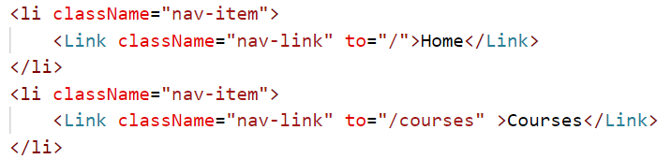
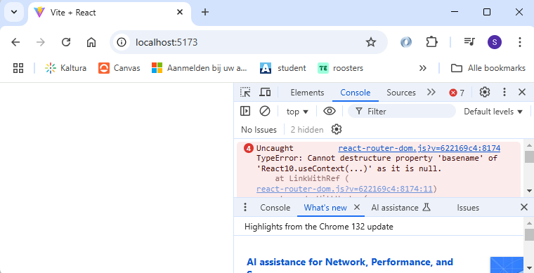

Link
= React-router-dom component that:
  changes the url
  prevents it from being sent to the backend
  needs ‘to’ attribute instead of ‘href’
Link is a React-router-dom component and therefore works only inside the components rendered by the router!!
=> use a wrapper layout for all common parts

Slide 11
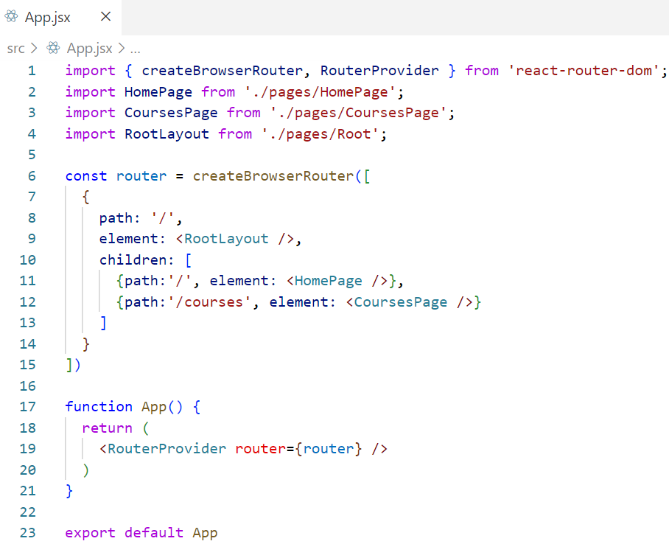
Wrapper layout: child routes
empty route points to RootLayout component
other routes are added as children
app now only contains RouterPovider

Slide 12
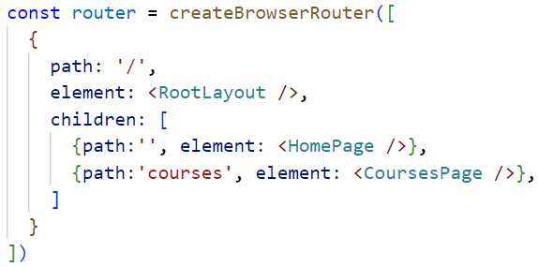
Relative vs absolute path
All routes start with ‘/’ => absolute path after domain name
Child routes have no leading ‘/’ => relative path after path of RootLayout component

Slide 13
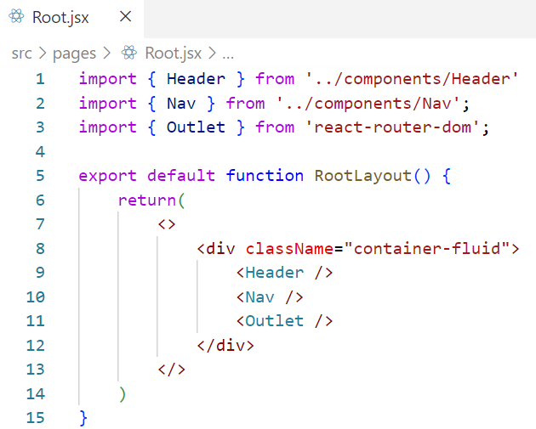
Wrapper layout: outlet component
all components common to all pages (context, header, nav) are placed inside RootLayout
Components from child routes will be rendered inside Outlet component

Slide 14
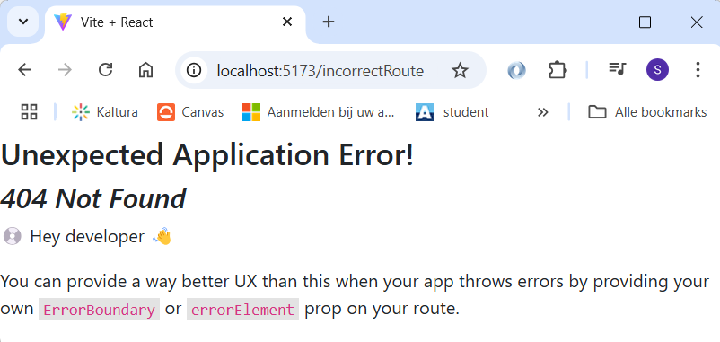
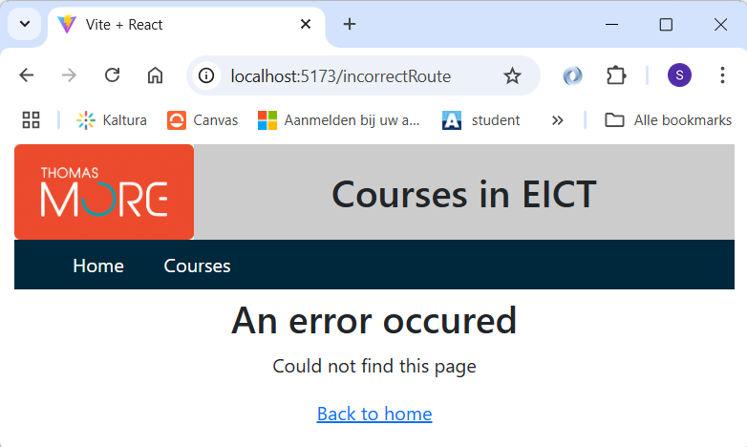
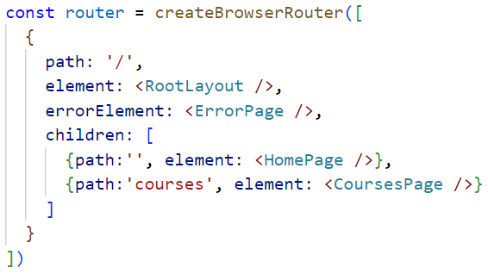
Catching incorrect routes
Incorrect route is entered
Default React-router-dom error page is loaded
Add errorElement to root path as a fallback in case of incorrect routes
points to custom
error page

Slide 15
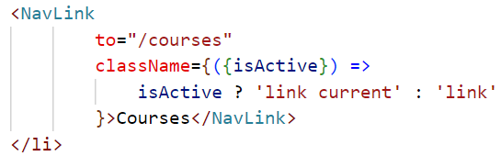
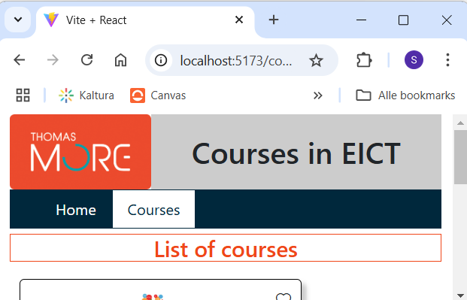
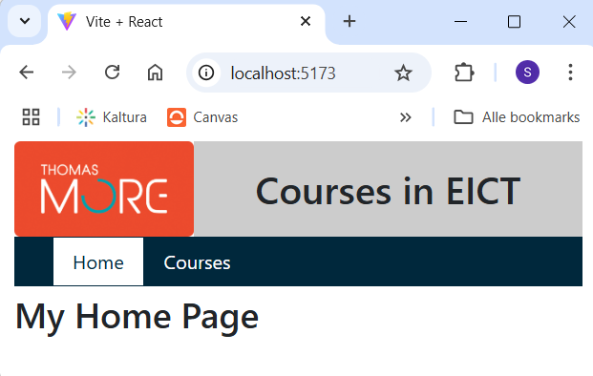
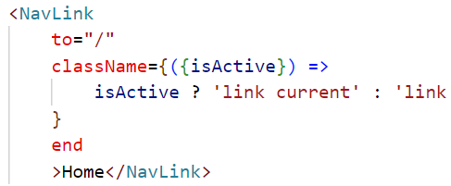
Change layout of currently active link
NavLink component provides isActive property to className:
class if link is active
class if link is not active
to indicate that / link can only be active it it is the last part of the path

Slide 16
Programmatic navigation
Click button, end of long operation, …
=> navigation needed in JavaScript
Go to a certain route in JavaScript code:
    Import useNavigate from react-router-dom:
    Store useNavigate result into constant for further use inside component function:
    Whenever you want to navigate:
  Only use programmatic navigation if a link is not possible

Slide 17
Define route with parameter(s)
not all routes have to be static
parameters like e.g. an ID, can be passed dynamically with routes
indicate dynamic part / parameter when defining the route with a ‘:’
{path:'/courses/:courseId', element: <CourseEdit />}
  courseId is the name of the parameter and can have any value
  without the parameter the route cannot be triggered.
  the CourseEdit component can request the parameters.

Slide 18
Read parameter from route
import { useParams } from react-router-dom';
  ⋮
export function CourseEdit() {
const params = useParams();
const [editCourse, setEditCourse] = useState(defaultCourse);
  ⋮
      useEffect(()=> {
      async function getCourse() {
      const resData = await getCourseWithIdFromDB(params.courseId)
      setEditCourse(resData)
      }
      getCourse();
      }, [params.courseId]);

Slide 19
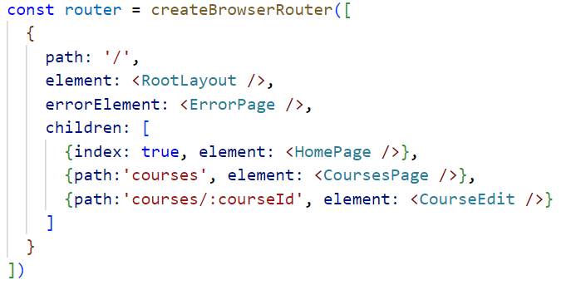
Index route
default route (‘/’) is set by using index:true

Slide 20
Loading data with a loader
Without loader, data is fetched in useEffect => after first rendering of the component and all its children
With loader:
  click on link
  data belonging to that path is loaded
  navigation to that link and rendering of components
Use loader attribute on the wanted path

Slide 21
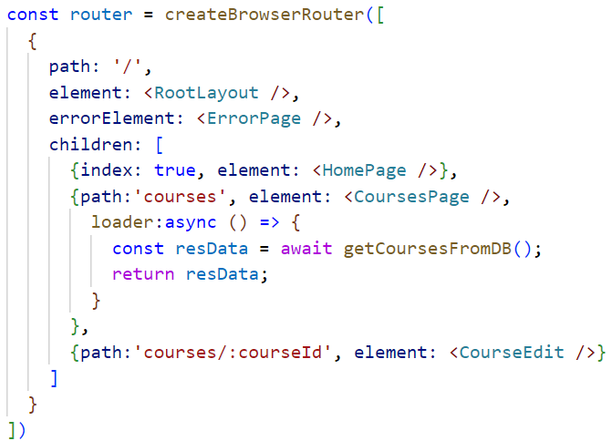

Loading data with a loader

