Slide 1


Predicting the most popular songs using the Spotify Top Hits from 2000-2019 Dataset
Machine Learning Foundations
Tiago Nazário 89980
Beatriz Gonçalves 115367

Slide 2
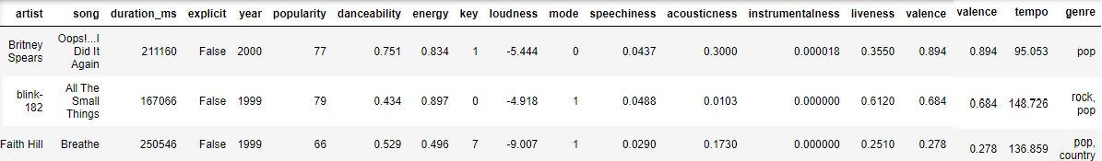
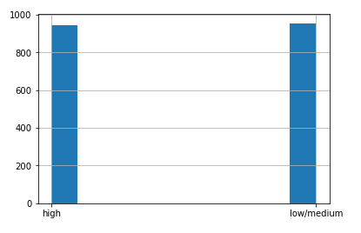
Data Preprocessing
Looking at the raw dataset, some assumptions can be made as to what can impact or not the predictive model.
Duplicates
Remove Song/Key parameter
Remove out of year range rows
Change the unit of measure for duration
Assign a genre to set()
Remove popularity parameter and create popularity_class

Slide 3

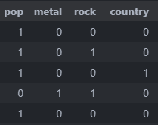
Data Preprocessing
Since this is a Multilabel Classification problem, it is necessary to encode the array of genres and artists into multiple columns. We opted to create a column for each genre and artist where the value representes whether the song has that genre or is from that artist.
Boolean parameter
to Binary Integer conversion
Substitute year by age
Normalize the columns: . danceability, energy, loudness, speechiness, acousticness, instrumentalness, valence, time, duration_min and age

Slide 4
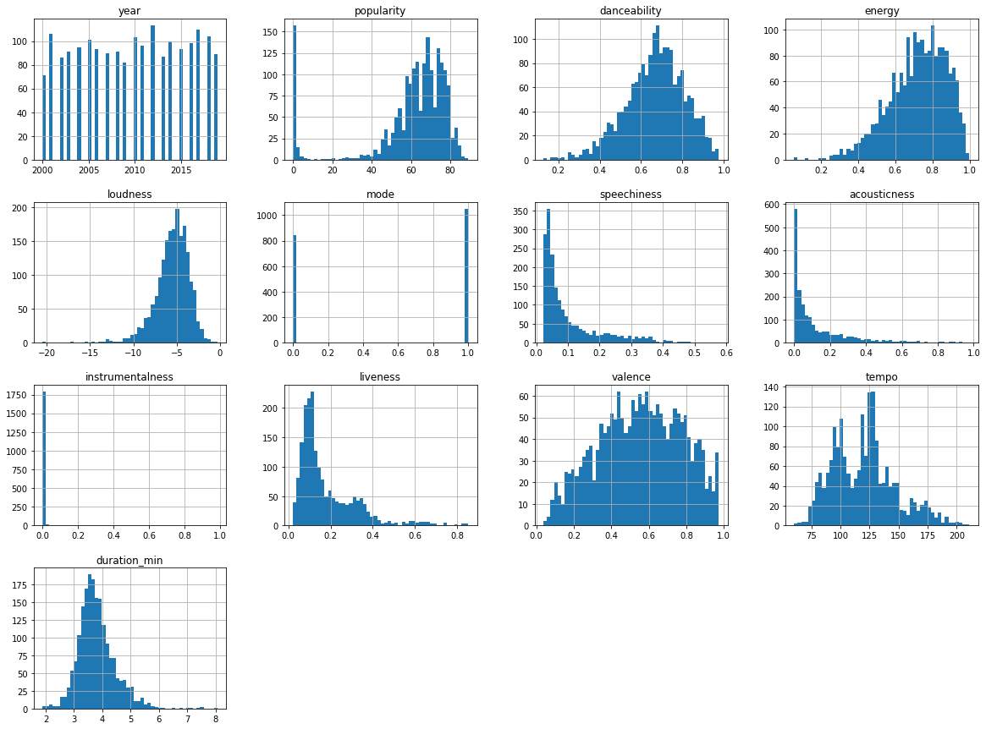
Data Visualization

Slide 5
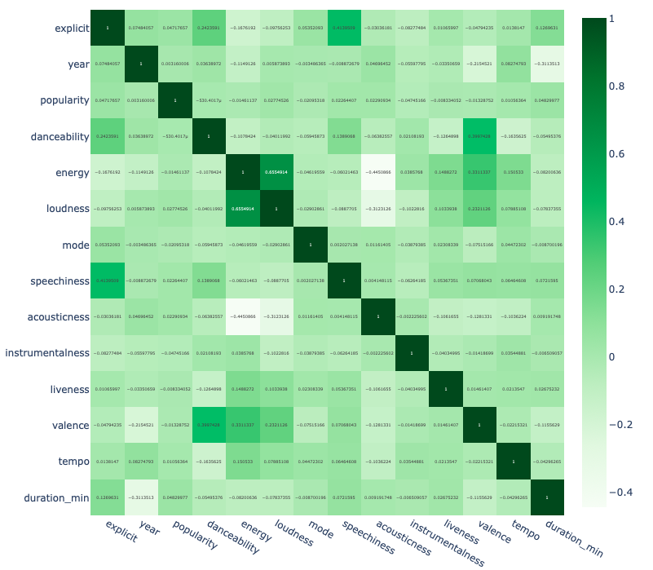
Data Visualization
Correlation Matrix
+ loudness and energy
+ speechiness and explicit
- energy and acousticness
- year and duration

Slide 6
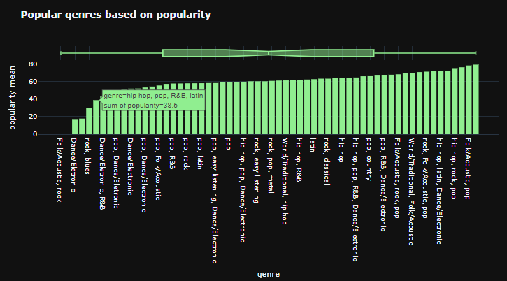
Data Visualization

Slide 7
Tools and Algorithms used
Models we used
DecisionTreeClassifier
K-nearest neighbors
LogisticRegression
What we get from each model
Accuracy
K-foldCrossValidation
ClassificationReport/
PerformanceMetrics
ConfusionMatrix
ROC curve

Slide 8
Tools and Algorithms used
Train/Test split
Training test (80%)
Datasets
Testing test (20%)
The training set was used for fitting and hyper-parameter tuning.
The testing set was used for validating the results.
We tried diferent hyper-parameters by wroapping the estimators in a GridSearchCV with 10-fold cross validation and using accuracy as the scoring metric.

Slide 9
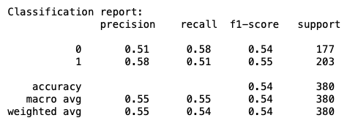
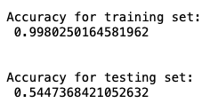
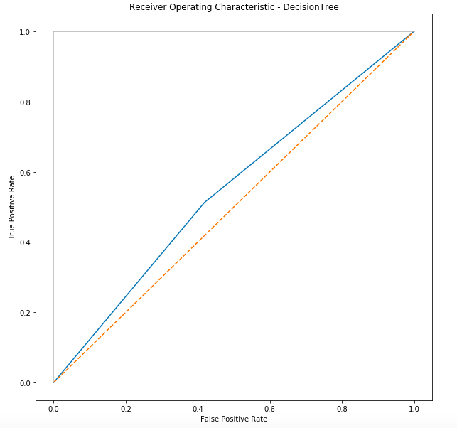
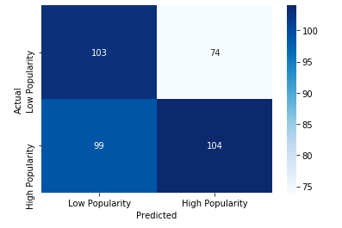
Results
Decision Tree Classifier Usind Default Parameters
ACCURACIES
ROC CURVE
CONFUSION MATRIX

Slide 10
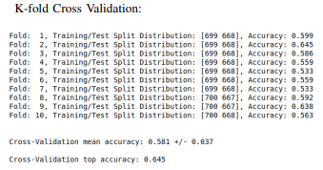
Results
Decision Tree Classifier Usind Default Parameters
The dataset is split into a K number of folds (10) and is used to evaluate the model’s ability when given new data. K refers to the number of groups the data sample is split into. Each fold is used as a testing set at one point in the process.

Slide 11
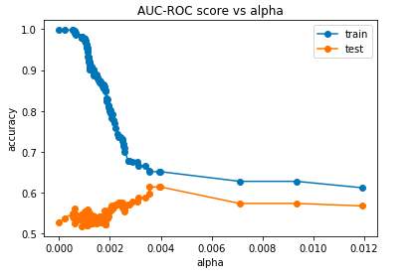
Results
Decision Tree Classifier Usind Default Parameters
COST COMPLEXITY PRUNING (CCP)
Ccp.alpha can be considered as the best parameter when it is the same for train and test, as AUC-ROC (Area Under the ROC Curve) scores for train and test are the correspondent ordinates.

Slide 12
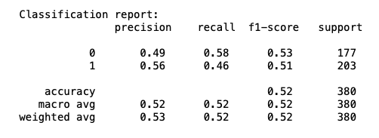
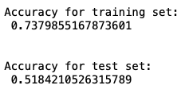
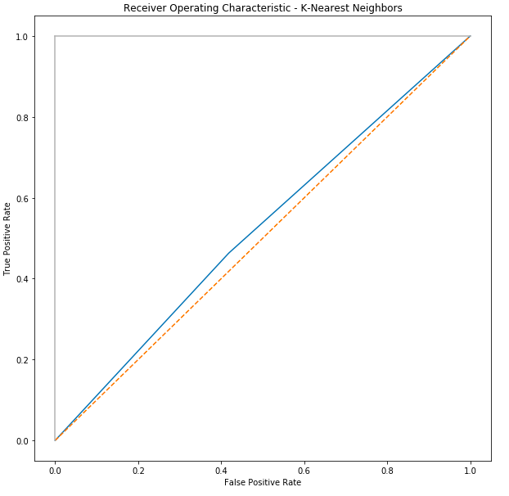
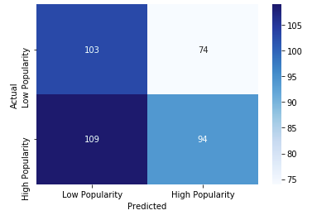
Results
K-Nearest Neighbors Usind Default Parameters
ACCURACIES
ROC CURVE
CONFUSION MATRIX

Slide 13
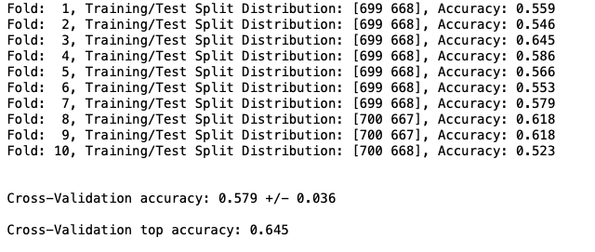
Results
K-Nearest Neighbors Usind Default Parameters

Slide 14
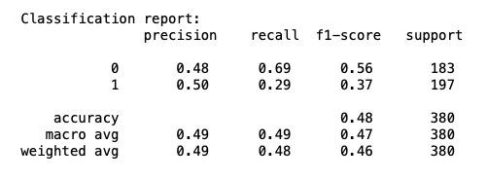
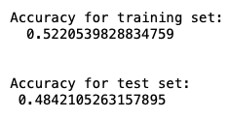
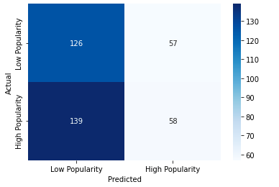
Results
Logistic Regression Usind Default Parameters
ACCURACIES
ROC CURVE
CONFUSION MATRIX

Slide 15
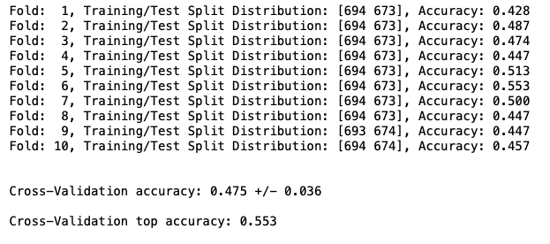
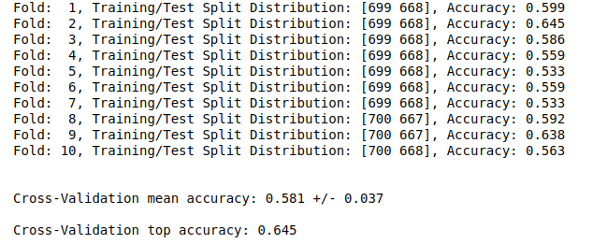
Results
Logistic Regression Usind Default Parameters

Slide 16
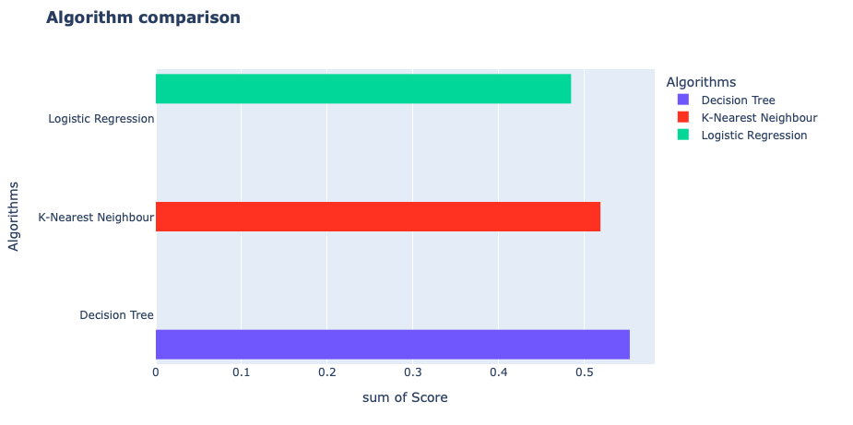
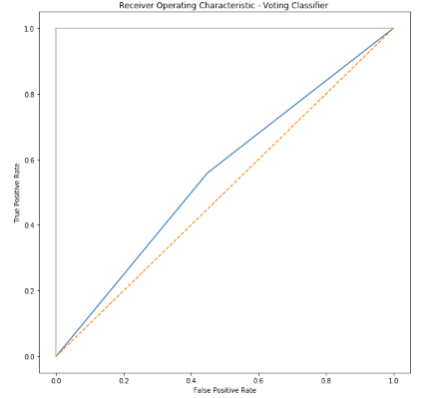
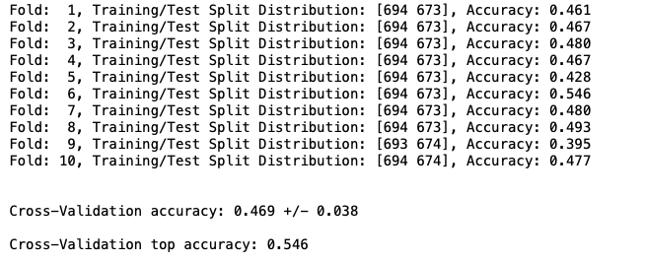
Models Comparison using default hyper-parameters
Results
ROC CURVE
Voting Classifier (accuracy ≃ 56% )
K-FOLD CROSS VALIDATION

Slide 17

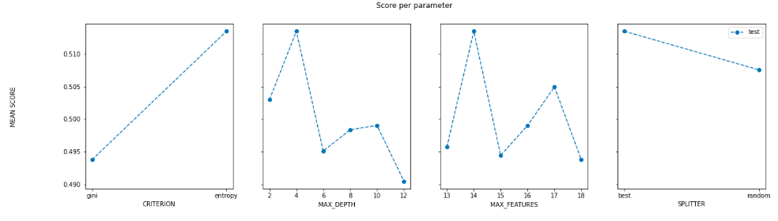
Results
Decision Tree Classifier Usind GridSearchCV
BEST SCORE, PARAMETERS AND ESTIMATOR
PERFORMANCE VS. HYPER-PARAMETERS

Slide 18
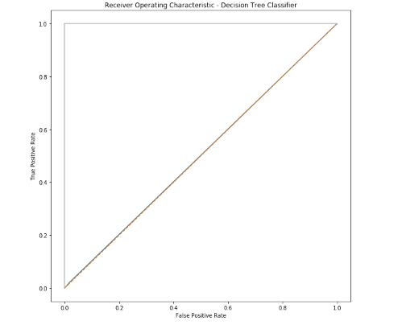
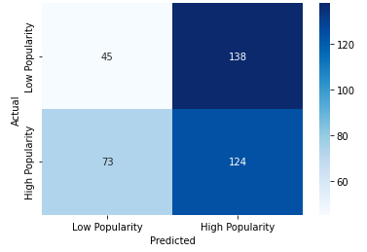
Results
Decision Tree Classifier Usind GridSearchCV
ROC CURVE
CONFUSION MATRIX

Slide 19
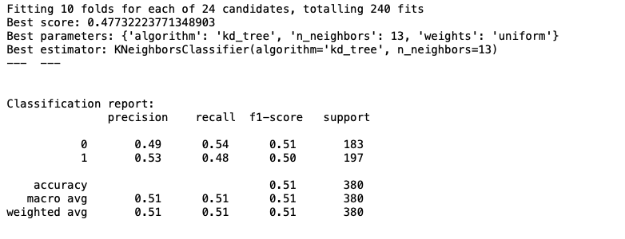
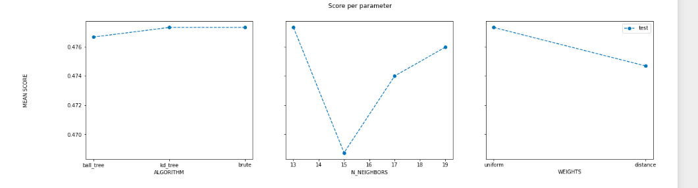
Results
K-NN Usind GridSearchCV
BEST SCORE, PARAMETERS AND ESTIMATOR
PERFORMANCE VS. HYPER-PARAMETERS

Slide 20
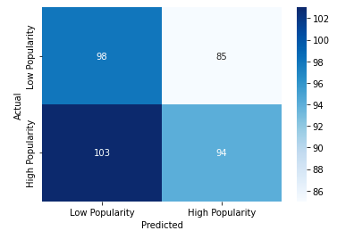
Results
K-NN Usind GridSearchCV
CONFUSION MATRIX
ROC CURVE
20

Slide 21
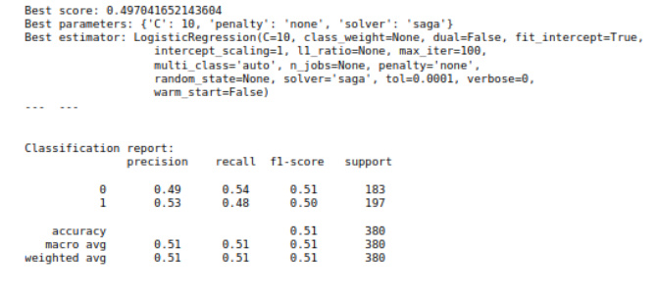
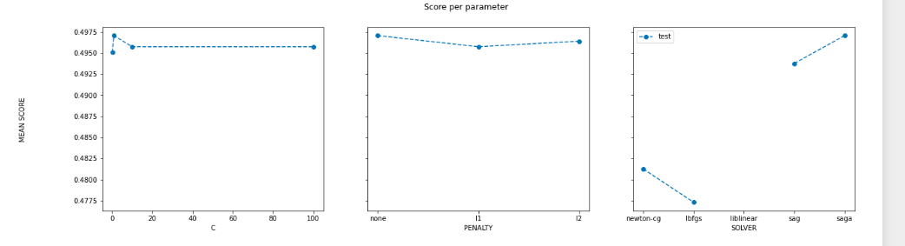
Results
Logistic Regression Usind GridSearchCV
BEST SCORE, PARAMETERS AND ESTIMATOR
PERFORMANCE VS. HYPER-PARAMETERS

Slide 22
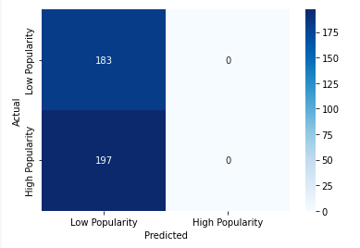
Results
Logistic Regression Usind GridSearchCV
CONFUSION MATRIX
ROC CURVE

Slide 23
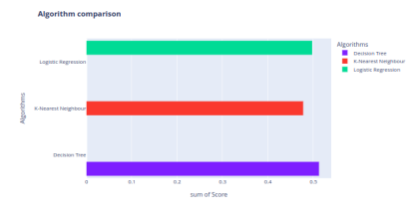
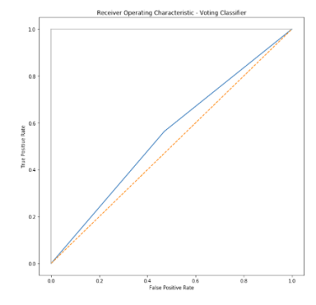
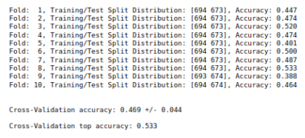
Models Comparison Usind GridSearchCV
Results
ROC CURVE
Voting Classifier (accuracy ≃ 55% )
K-FOLD CROSS VALIDATION
23

Slide 24
Conclusions
All data cleaning and pre-processing done revealed important to improve model accuracy, our implemented plots and graphics were a major assistance to decide how to manipulate data and the variety of models and how we applied also allowed us, not only to expand our knowledge on the topics, but also to increase results score.
We believe that our accuracy can be increased even more. A small dataset is likely the cause of the low performance in some of the models as the original dataset is biased towards popular songs in general.
Self-improvement (some things that we would do differently):
trying to increase the size of the dataset with more and more data, for example appending similar datasets or performing some Web Scrapping or accessing Spotify API;
splitting the dataset into smaller ones divided by ’genres’ to reduce multilabel without increasing the amount of data.

