Slide 1

A Fuzzy Inference System (FIS) to Evaluate the
Security Readiness of Cloud Service Providers
Beatriz Sofia Mesquita Gonçalves, 115367
Mathematical techniques for big data
Master in Data Science
Notes:
Hello everyone, in this presentation I will talk a little about what was done in the work about “A FIS to evaluate the security readiness of cloud service providers”.
Basically, as the title says, we intend to make an evaluation of cloud service users’ trust in cloud service providers. It also works a self-evaluation by the cloud service providers, as it works as feedback from users.

Slide 2
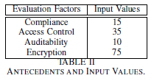
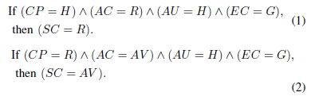
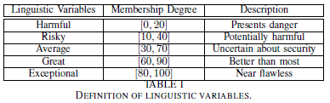
Problem’s Definition
Inference Rules
Crisp Input
Fuzzification
Defuzzification
Crisp Output
Notes:
Compliance: conformity with regulatory standards of cloud usage
· Access control: ability to restrict access to information stored on the cloud
· Auditability: considerations on the overall performance and security aspects
· Encryption: transformation of data from its original plain text format to an unreadable format before it is transferred and stored in the cloud

Slide 3
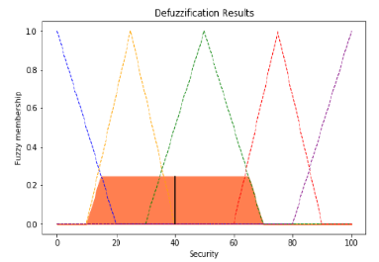
Results
Security Index = 40 (Average)
= centroid method
= bisector method
= mean of maxima method

Slide 4
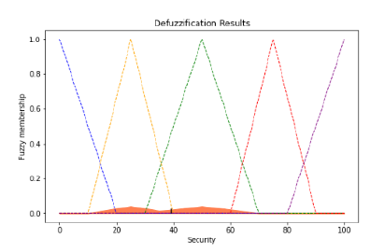




Results with different operators
Łukasiewicz’s Operators
(1)
(2)
Gödel’s Operators
(1)
Security Index = 39.7 (Average)
(2)

