Slide 1

Multivariate Exploratory Analysis on CO2 and Greenhouse Gas Emissions
Master in Data Science
Professor Adelaide Freitas
Work done by:
Diogo Pereira nº 114903
Nuno Gomes nº 114904
Beatriz Gonçalves nº 115367

Slide 2
Table of contents
01
02
03
Introduction
PCA
Clustering
04
05
FA
Constraints and Future Work

Slide 3
01
Introduction
Notes:
The main objective of this work is to pull information from our dataset that we wouldn't be able to pull out otherwise. The exploration methods used were principal component analysis, factor analysis and clustering (hierarchical and non-hierarchical).
Throughout this presentation we will explore each of these methods individually and analyze the results obtained.

Slide 4
02
PCA Analysis

Slide 5
PCA - Main Steps
Normalizing Data
The first step in running the PCA consists of normalizing the data, that is, standardizes a numeric dataset by centering the data at 0 and scaling it to have a standard deviation of 1.
Covariance Matrix
cov(X,Y) > 0: both dimensions are directly related to each other
cov(X,Y) < 0: both dimensions are inversely related to each other
cov(X,Y) = 0: the dimensions are independent of each other
Eigenvalues and Eigenvectors
Only exist in square matrices (NxN)
In an NxN matrix there are N eigenvectors
Are orthogonal to each other
They are calculated so that their length is unitary.

Slide 6
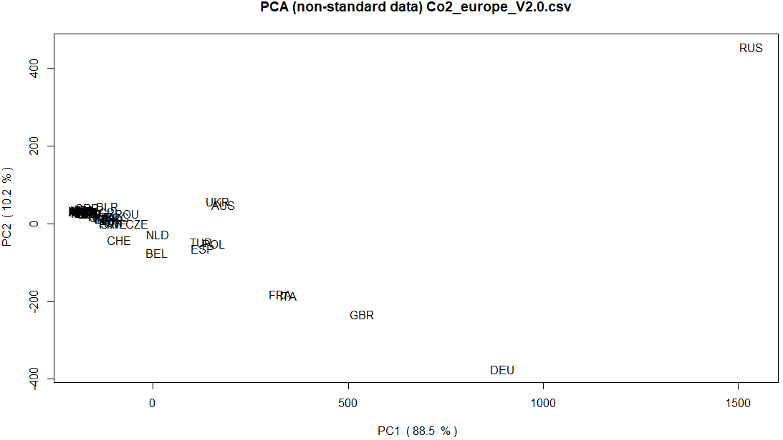
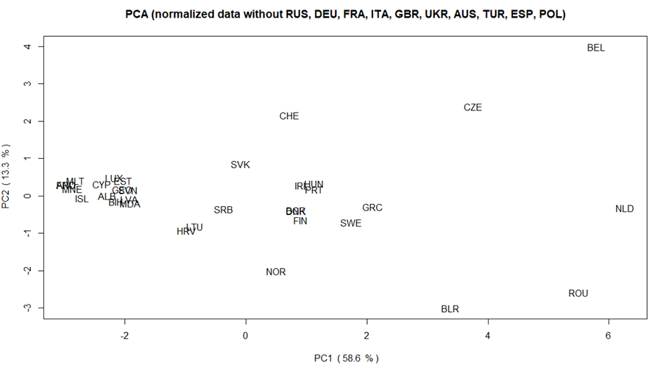
PCA Analysis - Scatterplot
At the beginning of our analysis, certain countries were quite distant and cohesive, which would hide information about the rest. So, we decided to keep removing countries until we were left with the data shown here.
In the data presented, we can see a division in the countries, the first cluster, closer to the axis of PC2.

Slide 7
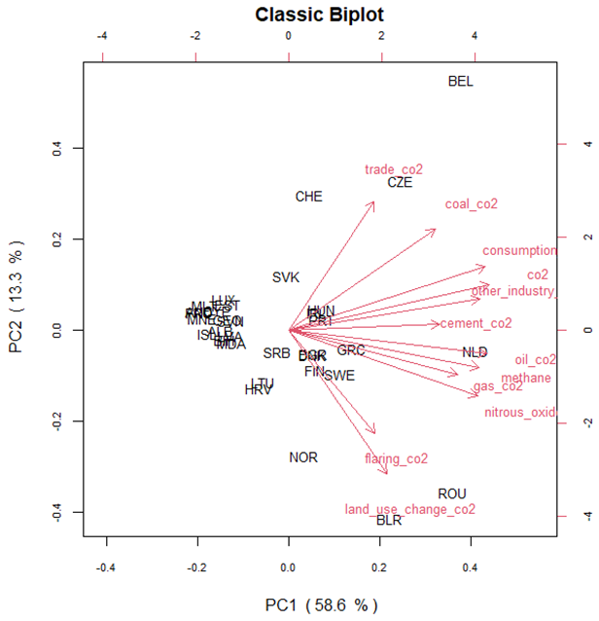
PCA Analysis - Biplot
Direction
We can see that trade_co2, flaring_co2 and land_use_change_co2, are more explained by PC2;
Length
The variables trade_co2, nitrous_oxide, land_use_change_co2 , coal_co2 and consumption are the ones with the greatest vector length, while the variables flaring_co2, cement_co2 and gas_cos2 have the smallest length;
Angles
We can’t clearly see clusters of variables;

Slide 8
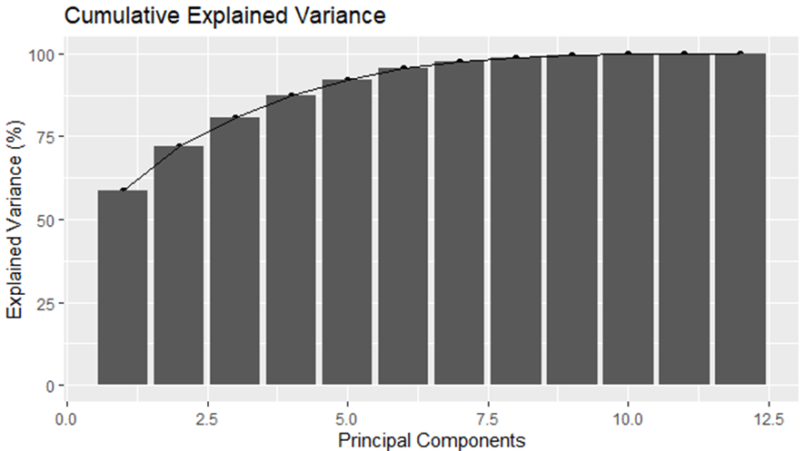
PCA - Variance
Variance
In the Cumulative Variance plot, we observe the sum of the proportion of explained variance corresponding to each principal component.
The first 2 PCs explain about 72% of the variance, and the first 3 PCs explain about 80.5% of the variance.

Slide 9
Clustering
03

Slide 10
Clustering
Cluster analysis is a technique of multivariate statistics that allows identifying homogeneous groups of data, based on variables.
Hierarchical clustering:
works via grouping data into a tree of clusters
K-means:
division of objects into clusters that share similarities and are dissimilar to the objects belonging to another cluster

Slide 11
K-means
03.1

Slide 12
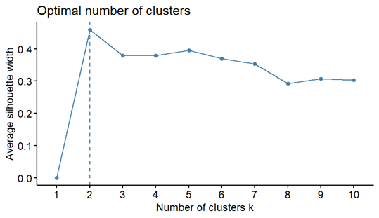
Clustering Analysis - K-means
Optimal number of clusters

Slide 13
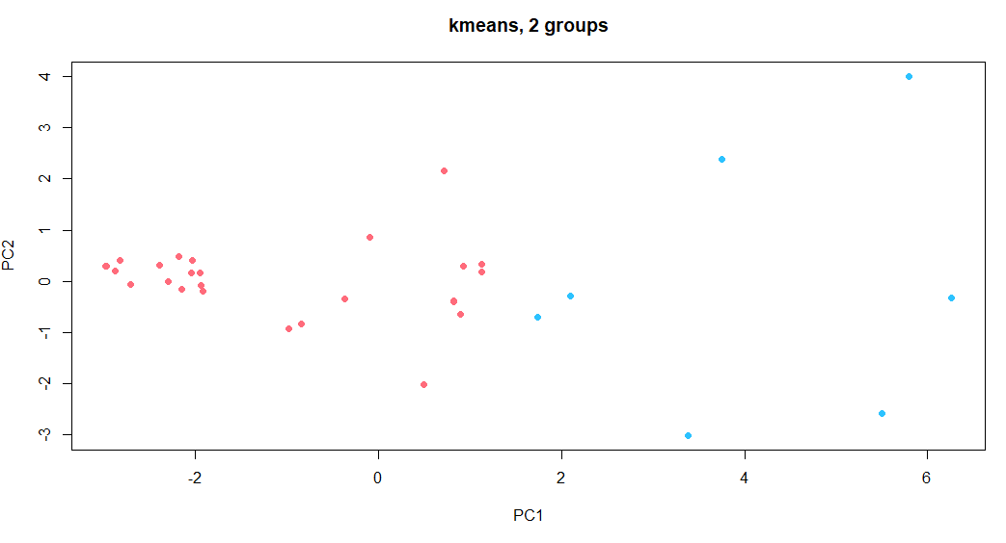
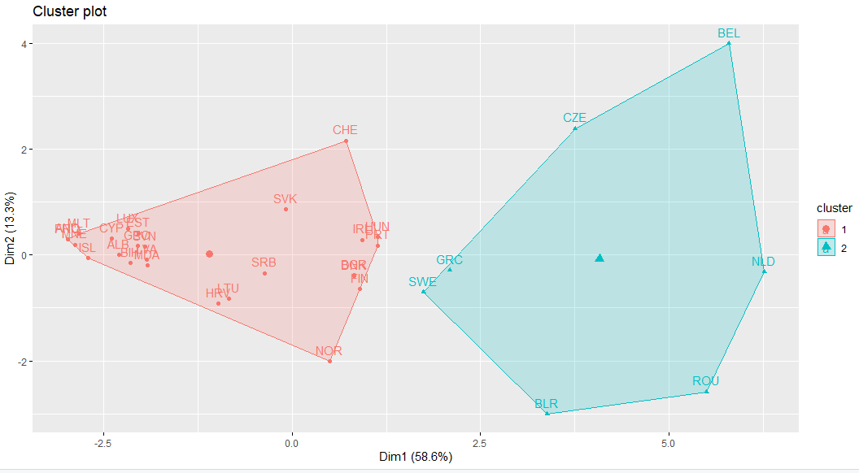
Clustering Analysis - K-means
K-means plot
We can see that PC1 discriminates the two clusters. When the 1st principal component is approximately greater than 1.25, we see the blue cluster. When it is smaller, we find the red cluster;
PC2 does not discriminate between either cluster.

Slide 14

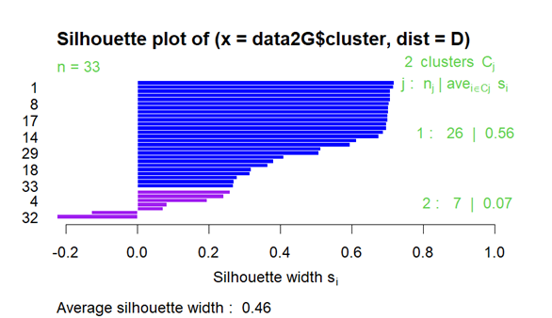
Clustering Analysis - K-means
Silhouette
The silhouette result presents an average of the similarity between two clusters;
We got a low ARI measure using K-means (0.383). The average silhouette is 0.459.

Slide 15
03.2
Hierarchical Methods

Slide 16
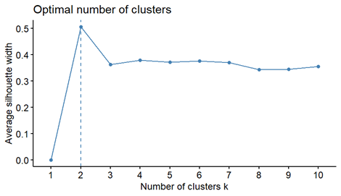
Clustering Analysis - Hierarchical Methods
Optimal number of clusters

Slide 17
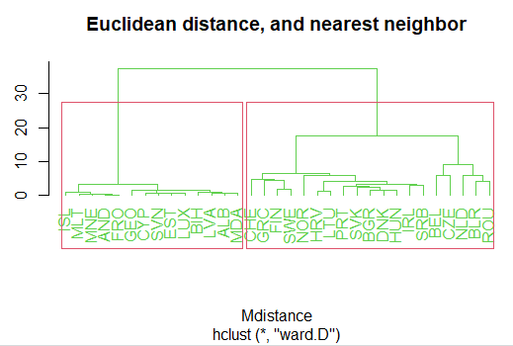
Clustering Analysis - Hierarchical Methods
Dendrogram

Slide 18
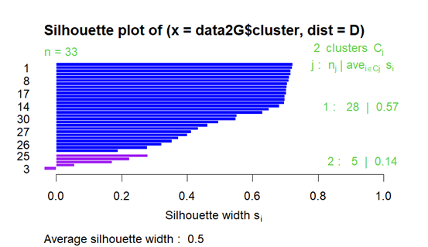

Clustering Analysis - Hierarchical Methods
Evaluation of clustering - ARI and Silhouette
We got a lower ARI using hierarchical clustering (0.237). However the average silhouette is 0.505, which is better than the one we got using k-means (0.46).

Slide 19
04
Factor Analysis
Notes:
Factor analysis is a statistical technique used to identify patterns in a dataset by examining the relationships between
several variables. It is based on the idea that the observed variables are correlated because they are measuring the same underlying latent variables, or factors. The goal is typically to identify a smaller number of underlying factors that can explain the variance in the data, that is, identify these latent variables and to understand how they relate to the observed variables.

Slide 20
Factor Analysis - Main Steps
Compute the KMO (Kaiser-Meyer-Olkin)
Tells us the suitability of data for factor analysis;
Measures the proportion of variance among all the variables that can be explained by the common factors.
Variable selection based on the comparison with reference table provided by Kaiser (1970)
Normalize the data
Determine the number of factors
Perform a parallel analysis;
Plot parallel analysis output.
Perform a factor analysis method
Via PCA
Via Maximum Likelihood
Analyse the residual matrix for the correlation matrix
Helps us to see if the model fits the data well
Estimate the scores of each factor

Slide 21
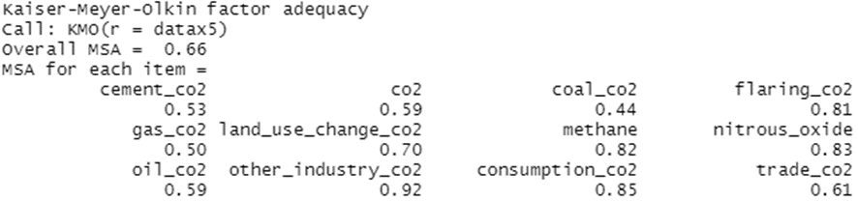
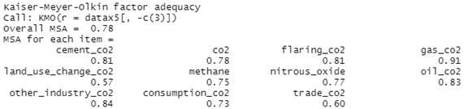
Factor Analysis - KMO
In the first example we can see the overall value of a KMO analysis, using all the columns, which is 0.66.
We can see as well that the value of the 3rd variable is really low, so it is better to drop it.
In this second example, we see better results in the overall KMO (0.78), so we can say that, globally, the model works better without the feature coal_co2.

Slide 22
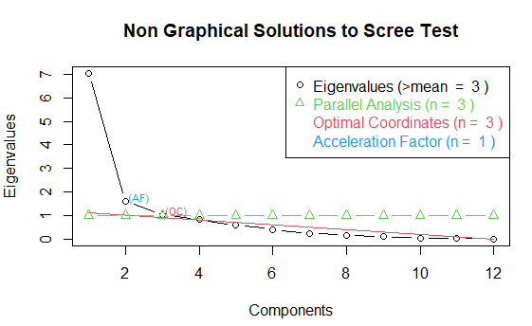

Factor Analysis - Number of factors
We choose the number of factors that is consistent across these four strategies (3).
Through the graph we can see that y-value of the third component is still slightly above 1 (eigenvalues), which indicates that the 3-factor split is still a legitimate option.

Slide 23
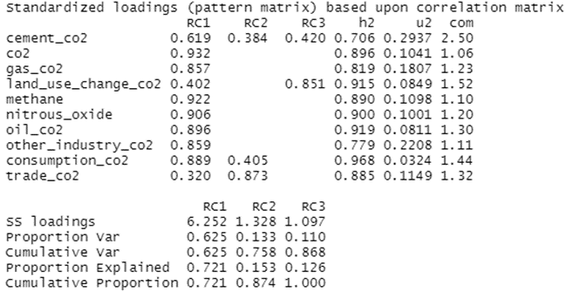
Factor Analysis - Via PCA and quartimax rotation
The first component, RC1, is explanatory of most features.
The features land_use_change_co2 and trade_co2. Have a low measure in RC1. land_use_change_co2 has a better measure in RC3 and trade_co2 has a better measure in RC2.
We can see the the 1st RC explains 72% of the variance in the data, the 2nd PC, 15%, and the 3rd, 12.6%. Together they explain 87.4% of the variance in the data.
Factor Analysis - Via PCA

Slide 24
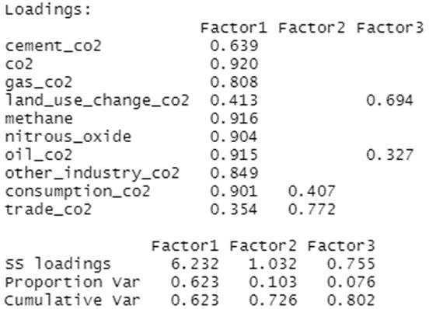
Factor Analysis - Via Maximum Likelihood
The data does not come from a multivariate normal distribution. Therefore, it is not advisable to use factor analysis via maximum likelihood.
The resulting factorial structure, via maximum likelihood, is equal to the one obtained when the factors were extracted using PCA.
The factorial structure found is strong enough, since it does not change with other procedures (even if these fail in some assumptions).
Factor Analysis - Via Maximum Likelihood

Slide 25
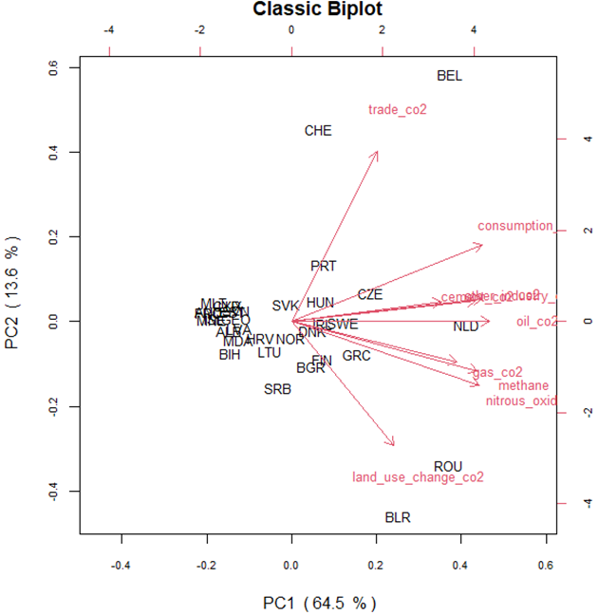
PCA Analysis - Updated Biplot
New biplot without the features coal_co2 and flaring_co2.
In this biplot we can notice some differences such as some clusters of variables closer and more cohesive than in the previous results. However the variables trade_co2 and land_use_change_co2, are still quite distant from the others, which is proven by the analysis of the previous results, since they are not explained by the same factor as the others.

Slide 26
Constraints and Future Works
Constraints
The population is not good to compare with our clusters, mainly because we took out some of the most populated countries in the beginning;
The data does not follow a normal distribution;
Future Work:
Work with GDP per capita, geographical region, mineral richness among other possibilities, as real clusters.

