Slide 1
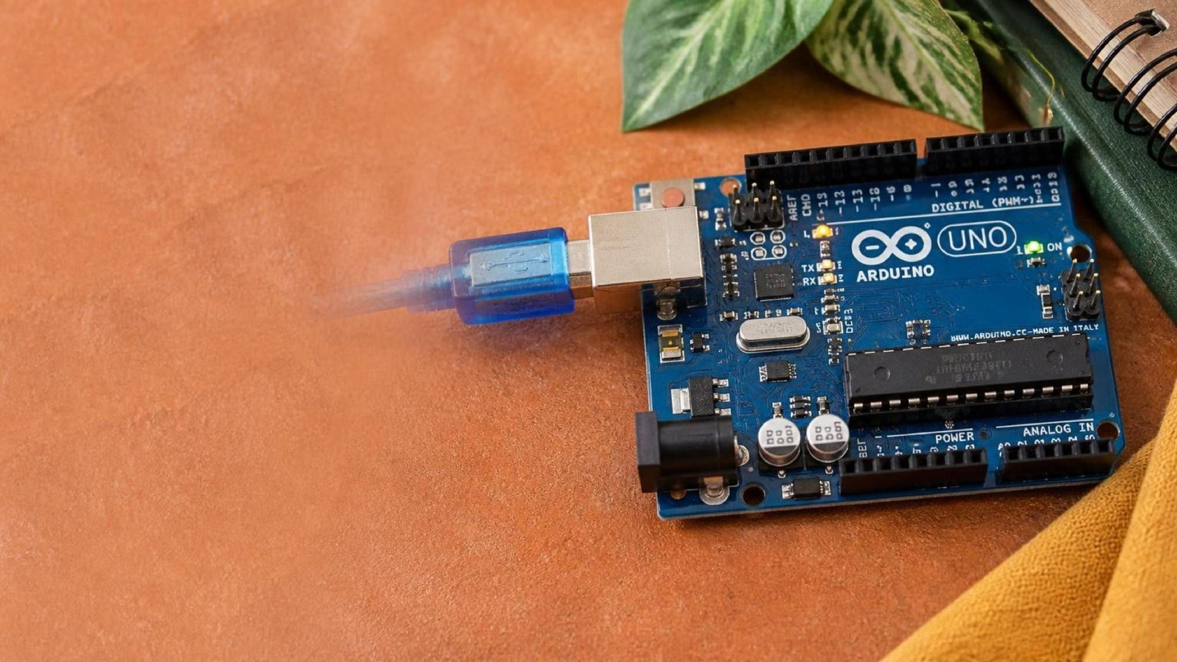
PHYSICAL COMPUTING
Introduction to Arduino & Hardware Coding
Controlling the physical world with software
Notes:
SLIDE 1 · COVER. Eyebrow, title, one-line claim, one photograph.
Keep the title under about 60 characters or it collides with the rule.

Slide 2
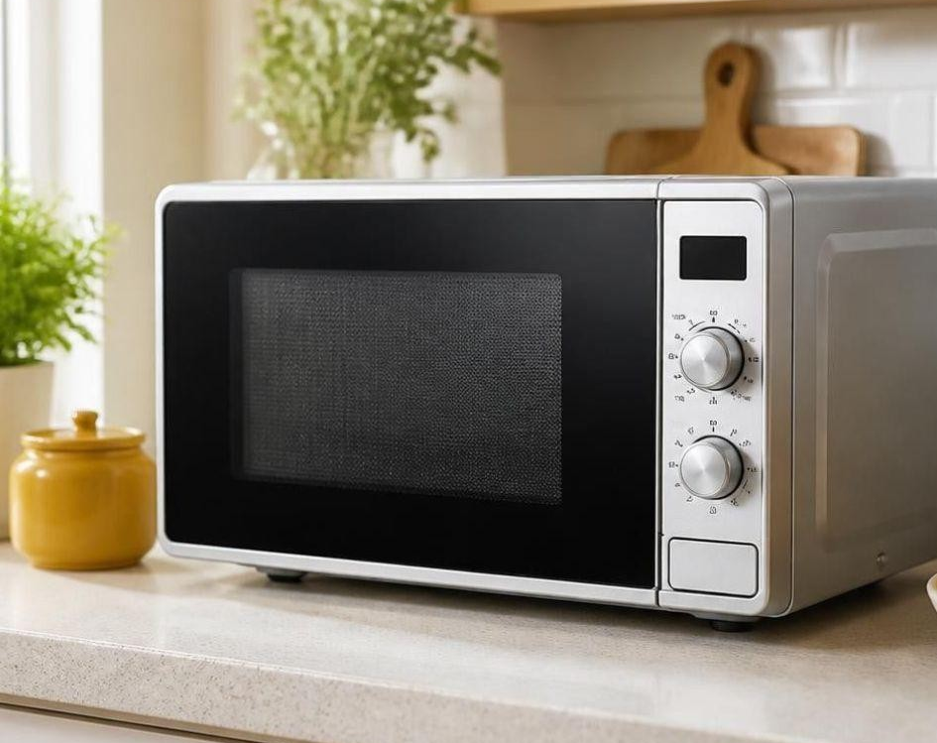
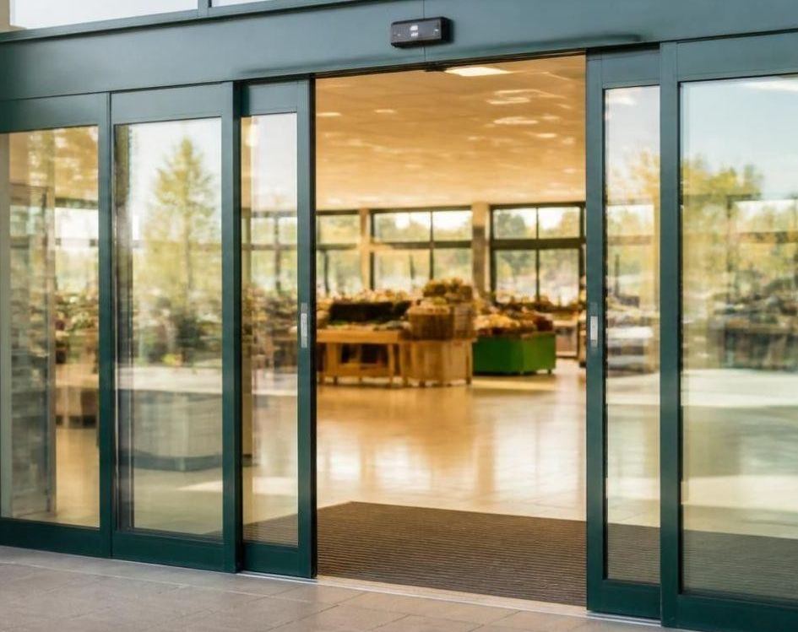
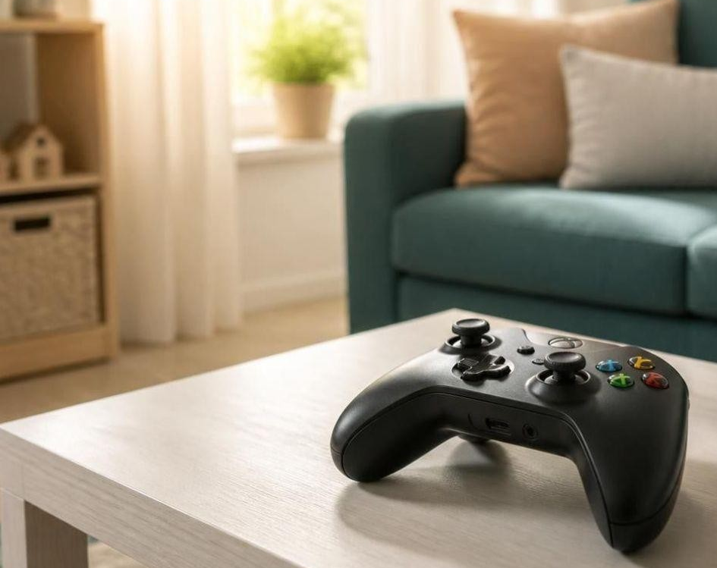
What do a microwave, a sliding door and a game controller share?
Microwave oven
Automatic sliding door
Game controller
None is a full laptop. All react to inputs and trigger outputs.
Each runs on a microcontroller, a tiny single-purpose computer.
Notes:
SLIDE 2 · HOOK. A question about the student's own kitchen, three
pictures, then the gold band that answers it. Think about how these work — none
are full laptops, but all react to inputs and trigger outputs.

Slide 3

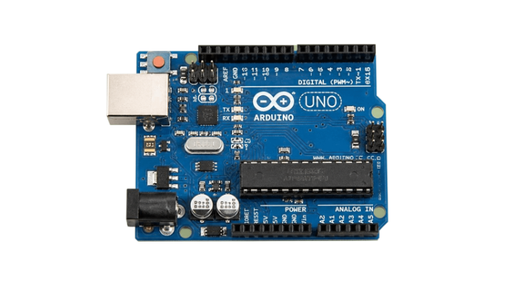
A microcontroller does one job, over and over
Laptop
Arduino
General-purpose: runs many apps at once.
One program repeats while powered. No operating system.
Input
Brain
Output
A sensor detects you.
The microcontroller follows its code.
A motor opens the door.
Inputs can be sensors. Outputs can be motors or LEDs.
Notes:
SLIDE 3 · THE ONE BIG IDEA. Two cards to compare, a three-box strip
for the chain, then one footnote. Unlike your laptop, an Arduino has no operating
system: it holds one program and runs it over and over.

Slide 4
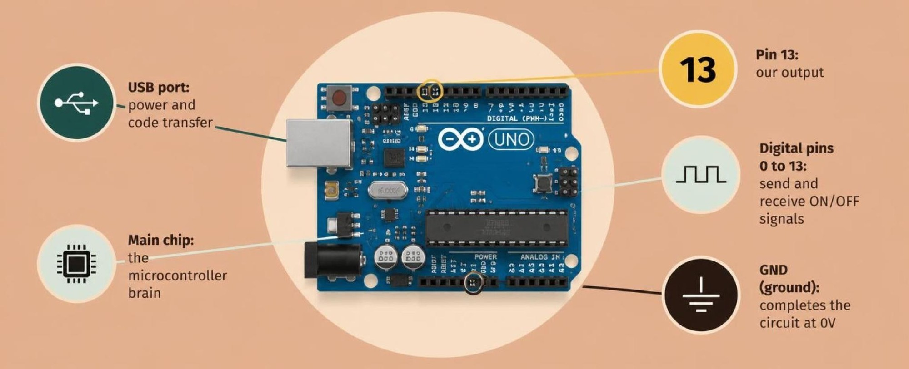
Meet the Arduino Uno
Notes:
SLIDE 4 · PICTURE. A breather slide, four words of text. Point at
Pin 13 and at GND. If the photograph does not already label them, add two small
callouts before you teach it.

Slide 5

Set up your circuit in Tinkercad
Two-minute challenge
1
Go to Tinkercad, then Circuits, then Create New Circuit.
2
Open the Components sidebar on the right.
3
Switch the dropdown to Starters, then Arduino.
4
Drag the Blink starter onto the canvas.
Illustrative interface. Use the live Tinkercad menus.
Notes:
SLIDE 5 · SET IT UP. Four steps, one action each, and a screenshot
that is labelled illustrative on purpose. Log into Tinkercad and drag the Blink
starter in.

Slide 6
Decode the code
void setup() {
pinMode(13, OUTPUT);
}
void loop() {
digitalWrite(13, HIGH);
delay(1000);
digitalWrite(13, LOW);
delay(1000);
}
setup() = get ready once
pinMode(13, OUTPUT) makes Pin 13 an output.
loop() = replay forever
digitalWrite(13, HIGH) turns the LED on (5V). digitalWrite(13, LOW) turns it off (0V).
delay() = pause
delay(1000) waits 1000 milliseconds, which is 1 second.
Notes:
SLIDE 6 · DECODE THE CODE. Three cards, never more. setup() runs
once; loop() runs endlessly line by line; HIGH sends 5V, LOW drops it to 0V.

Slide 7
Mission 1: Rapid Strobe
1
Run the simulation as it is and watch the 1-second blink.
WATCH CLOSELY
What happens to the LED speed?
2
Click Code, top right.
3
Change both delay(1000) values to delay(100).
Both pauses are now 100 ms.
4
Click Start Simulation.
Notes:
SLIDE 7 · MISSION. Four numbered steps and a question in the gold
panel. Run it once as-is, then change 1000 to 100 and start it again. What
changed? The answer is in the panel — cover it if your class reads ahead.

Slide 8
QUICK CHECK
ANSWER
Quick check: milliseconds
500
1000 milliseconds = 1 second
To keep the LED ON for half a second, what number goes in delay()?
delay(500); A half-second pause.
Think first. Then raise your hand.
Notes:
SLIDE 8 · CHECK OR WRAP-UP. This layout does both. The answer sits
in the gold panel, so decide before the lesson whether you want it visible or on
the next click.

