Slide 1
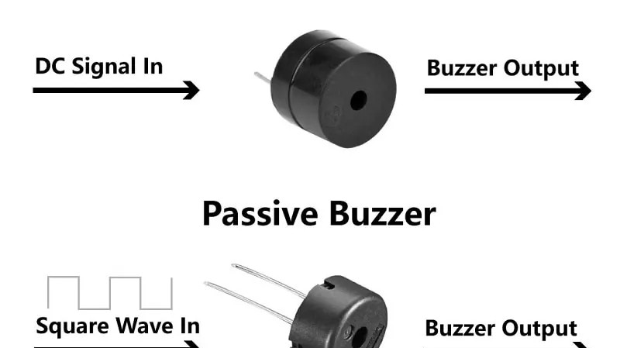
YEAR 7 · ELECTRONICS · LESSON 6
Eight Keys, Eight Notes
A table of frequencies and eight inputs
Notes:
The last lesson of the year. Everything from the year is in
this one build: inputs, outputs, a table of values, and one buzzer.

Slide 2
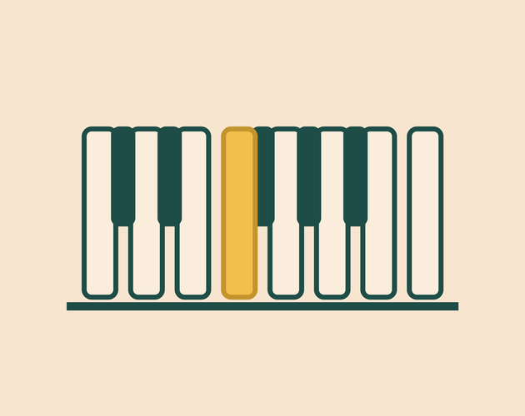

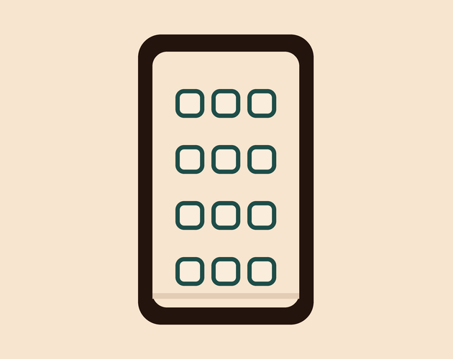
A piano has 88 keys. How does it know which one you pressed?
Piano. A hammer hits one string.
Keyboard. One switch under each key.
Phone keypad. A finger completes a circuit.
Every one of them is a set of switches.
Eight switches, eight numbers, one buzzer.
Notes:
They have wired one switch already, so this is familiar ground
scaled up. Ask what changes when there are eight instead of one.

Slide 3
One key, one note
Eight inputs
One output
Each key is a switch on its own pin.
One buzzer plays whichever key is down.
Press
Read
Play
A key joins its pin to ground.
digitalRead says LOW.
tone() plays that key's number.
C 262 · D 294 · E 330 · F 349 · G 392 · A 440 · B 494 · C 523
Notes:
The footnote is the table they will copy. Write it on the board
as well - it is the one thing they need to keep.

Slide 4
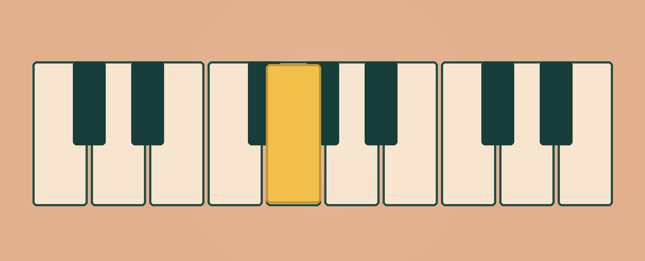
Eight keys in a row
A row of switches. The buzzer sits at the end.
Notes:
SLIDE 4 · PICTURE. No new words. Let them count the keys and see
the pattern before the code arrives.

Slide 5
Build the mini piano
Ten-minute challenge
1
Eight buttons on pins 2 to 9. One side to the pin, one to GND.
2
The buzzer goes on pin 10.
3
Set every key pin to INPUT_PULLUP in setup().
4
Press each key once. Nothing may be loose.
Notes:
No external resistors at all - that is the headline. If a key
does nothing, it is one wire, not the code. Test as they build.

Slide 6
Decode the code
void setup() {
for (int p = 2; p <= 9; p++) {
pinMode(p, INPUT_PULLUP);
}
}
void loop() {
if (digitalRead(2) == LOW) tone(10, 262, 200);
if (digitalRead(3) == LOW) tone(10, 294, 200);
if (digitalRead(4) == LOW) tone(10, 330, 200);
if (digitalRead(5) == LOW) tone(10, 349, 200);
// four more lines, one per key
}
INPUT_PULLUP = no resistor
The pull-up is inside the chip. One wire per key.
Eight ifs = eight keys
The loop asks each key in turn, then plays its note.
One pin, one note
A second tone replaces the first, so two keys give one sound.
Notes:
Read the first four lines aloud as a rhythm: if this key, play
this note. They will spot the pattern themselves, which is the point.

Slide 7
Mission 1: Play It
1
Press each key from low to high.
WATCH CLOSELY
Two keys down. How many notes?
2
Hold two keys down at once. How many notes?
3
Find the one key that sounds wrong.
One. tone() on one pin replaces what was playing.
4
Swap the numbers on 262 and 523. Play again.
Notes:
The two-key question is the marked thinking here. Make them try
it before anyone explains why.

Slide 8
Mission 2: Write a Tune
1
Pick six notes of a song you know.
THINK FIRST
Why does doubling sound the same?
2
Write their frequencies in order.
3
Play them one after another.
Same note, higher. The pattern of gaps is what we hear.
EXTENSION · AN OCTAVE
Double any frequency and the note jumps an octave. 262 becomes 524.
Notes:
Six notes is enough for a recognisable tune and short enough to
finish. Twinkle, Happy Birthday and the Nokia ringtone all work.

Slide 9
QUICK CHECK
ANSWER
Quick check: eight keys
Pull-up
Every key is wired from its pin to ground.
So why does a pressed key read LOW?
INPUT_PULLUP holds the pin at 5 V. The key pulls it down to 0 V.
Think first. Then raise your hand.
Notes:
This is the same question as lesson 2, asked again at the end
of the year. If they can answer it cold, the year worked.

Slide 10
BEFORE YOU LOG OFF
Wrap-up and exit ticket
Eight switches, eight numbers, one buzzer.
If you had a ninth key, what frequency would it play?
Write your answer on a slip or in the chat.
C 262 to C 523. One octave.
EXIT TICKET
My piano has ________ keys. The highest is ________ Hz.
Notes:
The ninth key should be 587, the D above C5. Accept 523 again
if they explain that an octave repeats.

