Slide 1
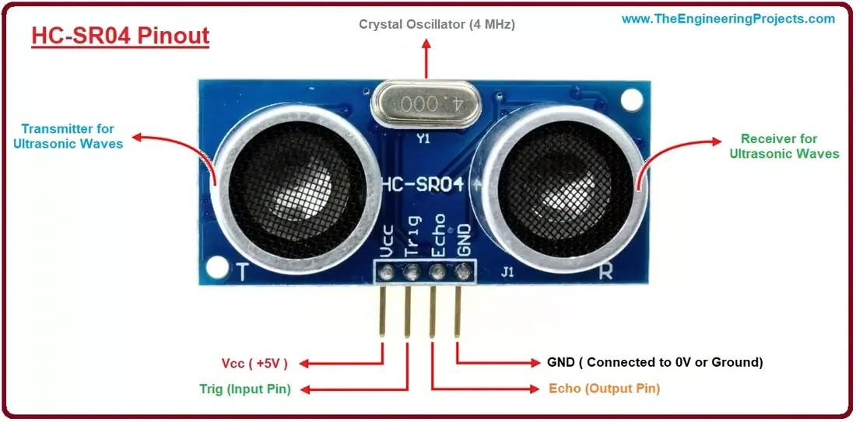
YEAR 8 · ELECTRONICS · LESSON 3
Seeing with Sound
An echo is a distance
Notes:
The board has only ever measured what it touches. Today it
measures something across the room, without touching it at all.

Slide 2

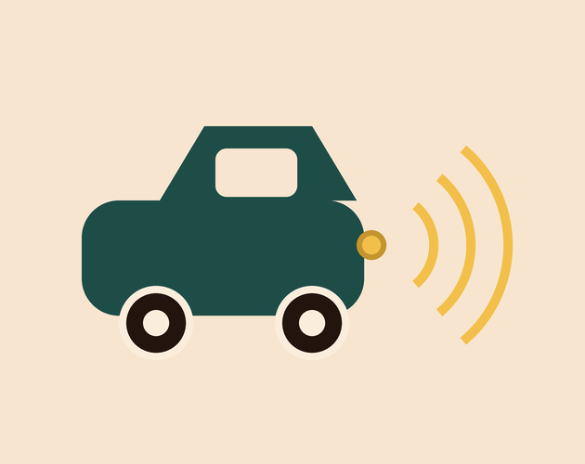

A bat, a car park and a submarine. What are they all doing?
Bat. Clicks, then listens.
Parking sensor. Beeps faster as you close in.
Submarine. Pings the water.
None of them can see in the dark.
They send a sound and time the echo. The delay is the distance.
Notes:
Ask how a bat finds a moth at night before you show the sensor.
The idea - send, listen, time - is the whole of concept one.

Slide 3
Send a sound, time the echo
TRIG starts it
ECHO times it
A short pulse, ten microseconds long.
This pin stays high while the sound travels.
Send
Listen
Divide
A ping leaves the sensor.
ECHO stays high for the round trip.
Microseconds ÷ 58 gives centimetres.
The sound goes there and back, so the time is doubled.
Notes:
The divide by 58 always needs saying twice. It is not a magic
number: it is the speed of sound, with the round trip already halved.

Slide 4
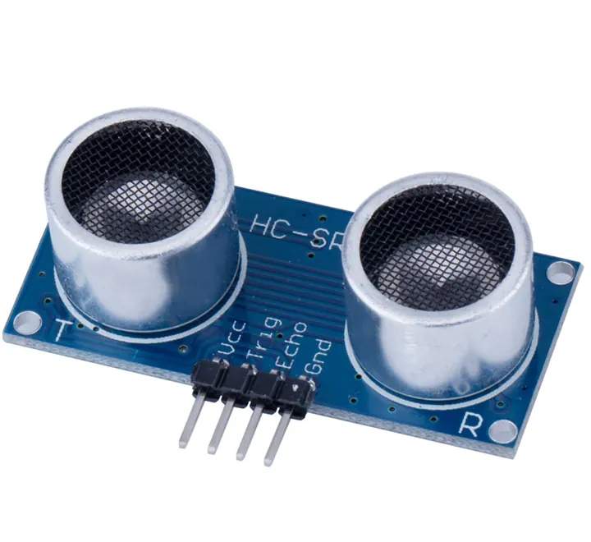
The sensor, front on
Two eyes: one sends, one listens.
Notes:
SLIDE 4 · PICTURE. Two circles, two jobs. Nothing else on this
slide - they need to see the part before the wiring arrives.

Slide 5
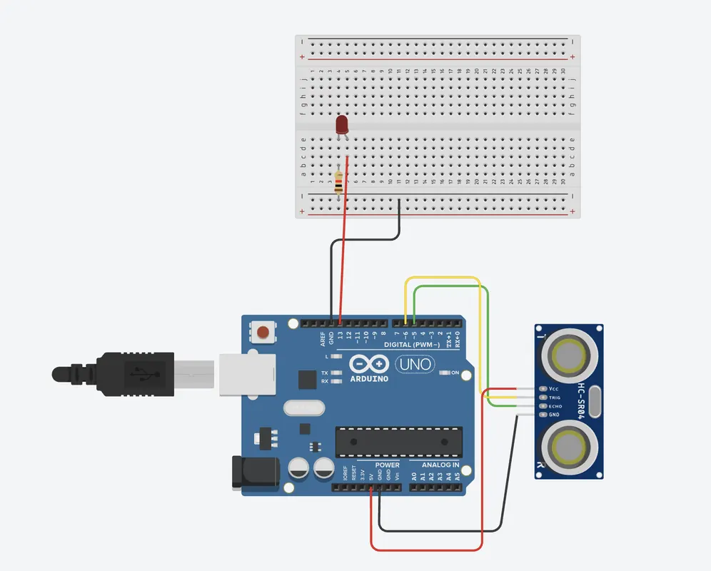
Wire the distance sensor
Four-minute challenge
1
VCC to 5V, GND to GND. Four wires in total.
2
TRIG to pin 9. ECHO to pin 10.
3
Point it at a wall or at your hand.
4
Open the Serial Monitor to see the numbers.
Illustrative interface. Use the live Tinkercad menus.
Notes:
TRIG and ECHO swapped is the classic mistake: the numbers then
sit at zero. Have them check those two wires before touching the code.

Slide 6
Decode the code
void setup() {
pinMode(9, OUTPUT);
pinMode(10, INPUT);
Serial.begin(9600);
}
void loop() {
digitalWrite(9, HIGH);
delayMicroseconds(10);
digitalWrite(9, LOW);
long t = pulseIn(10, HIGH);
Serial.println(t / 58);
delay(200);
}
TRIG high, then low
A ten-microsecond ping. That starts the sound.
pulseIn(10, HIGH)
Waits, then returns how long ECHO stayed high, in µs.
÷ 58 = centimetres
Speed of sound, with the round trip already halved.
Notes:
delayMicroseconds, not delay: the pulse is ten microseconds,
and delay(10) would be ten milliseconds - a thousand times too long.

Slide 7
Mission 1: Measure Your Hand
1
Open the Serial Monitor.
WATCH CLOSELY
What should one metre read?
2
Hold your hand about 10 cm away. Note the number.
3
Move to arm's length. Note it again.
100. If the maths is right, the number says 100.
4
Find something exactly one metre away.
Notes:
A ruler makes this real. One metre reading about 100 is the
check that the divide by 58 is doing what the slide says.

Slide 8
Mission 2: Too Slow to Help
1
Change delay(200) to delay(1000). Run it.
THINK FIRST
Why can it not read once a second?
2
Move your hand slowly. Does it keep up?
3
Now try 20. What goes wrong?
The car has moved. A late reading is a wrong reading.
EXTENSION · A PARKING SENSOR
Beep faster as the distance falls. You need a threshold and a tone.
Notes:
This is the first time 'how often' has been a design decision
rather than a detail. Take answers before naming it.

Slide 9
QUICK CHECK
ANSWER
Quick check: the halved time
Closer
The echo comes back in half the time.
What happened to the object?
Half the time means half the distance. The sound did not travel as far.
Think first. Then raise your hand.
Notes:
The reason matters more than the answer. Half the time, half the
distance, because the sound did not go as far.

Slide 10
BEFORE YOU LOG OFF
Wrap-up and exit ticket
A reading is only useful if it is fresh enough to act on.
Name a machine that needs a fast reading. Why?
Write your answer on a slip or in the chat.
Two eyes: send and listen.
EXIT TICKET
My ________ needs a reading every ________ ms.
Notes:
Good answers: a parking sensor, a drone, a robot vacuum, a
reversing alarm. Anything with a speed they can name.

