Slide 1
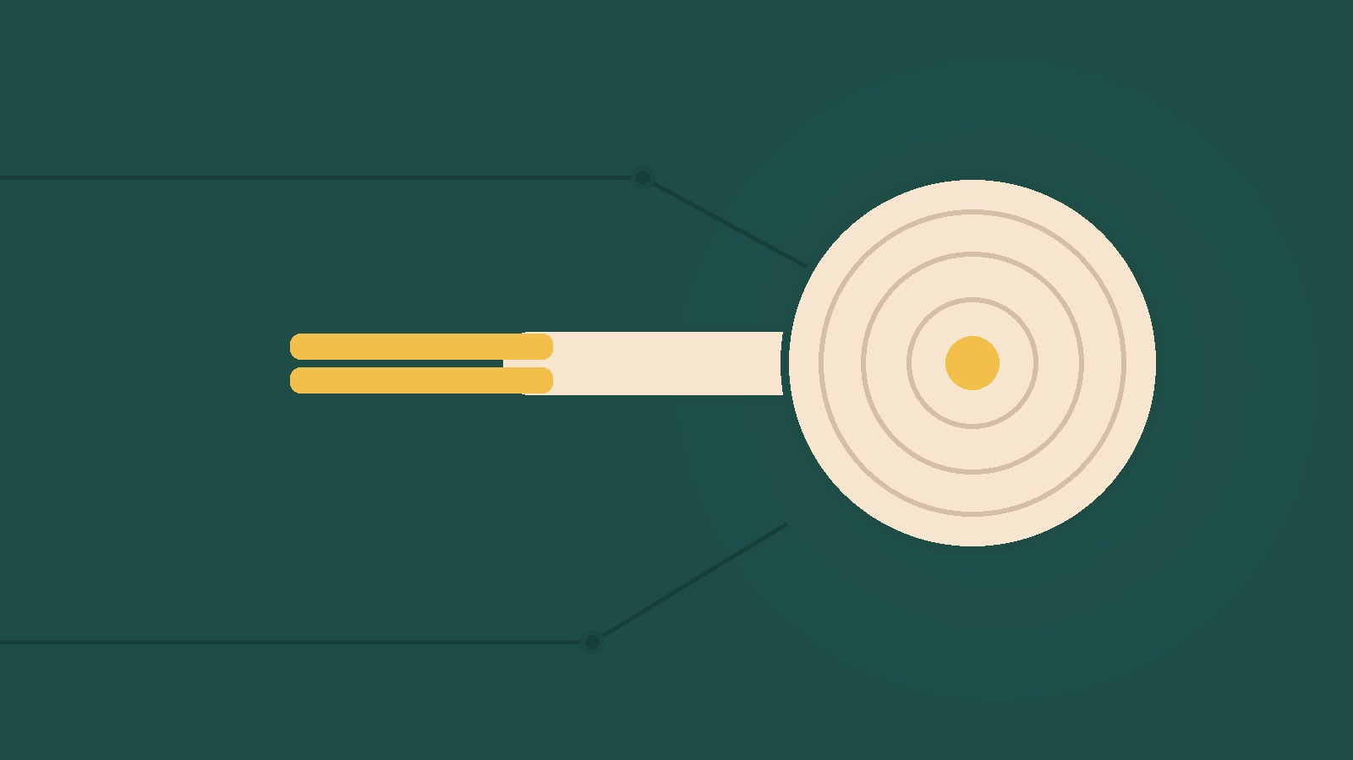
YEAR 8 · ELECTRONICS · LESSON 6
Measuring a Push
A pad that turns a press into a number
Notes:
The last lesson of Year 8. Every sensor so far answered a
question with one number. This one answers a question with a curve.

Slide 2



A doorbell, a kitchen scale and a game controller. Which one knows how hard?
Doorbell. Pressed, or not pressed.
Kitchen scale. Grams, to the nearest one.
Controller. Soft press, hard press.
Two of them only know on and off.
A force sensor reads the press, not just the touch.
Notes:
The button from Year 7 is one of these, and it is the one that
cannot tell. That contrast is the way in.

Slide 3
A force-sensing resistor
Hard press, low resistance
Same divider trick
Over 1 MΩ untouched. A few hundred ohms pressed.
The resistor turns that into a voltage A0 can read.
Press
Divide
Read
Resistance falls.
The voltage rises.
A0 gives a number.
Twice the force is not twice the reading. It curves.
Notes:
The divider is the same circuit as the light sensor. Say that
out loud - the sensor changed, the trick did not.

Slide 4

The pad and its two leads
Two leads, one resistor, and a springy surface between them.
Notes:
SLIDE 4 · PICTURE. Point at the two leads. There is nothing else
on the part to wire, which surprises them after the RGB LED.

Slide 5
Wire the force pad
Four-minute challenge
1
One lead to 5V. The other lead to A0.
2
A 10 kΩ resistor from A0 to GND.
3
Open the Serial Monitor.
4
Press with one finger, then with your thumb.
Notes:
Without the resistor the reading floats and the numbers jump
about. If a student sees noise, that is the first thing to check.

Slide 6
Decode the code
int lowest = 40; // light press
int highest = 900; // hard press
void setup() {
Serial.begin(9600);
}
void loop() {
int press = analogRead(A0);
int amount = map(press, lowest, highest, 0, 100);
Serial.println(amount);
delay(100);
}
lowest and highest
Measure both yourself. Nothing else fits your pad.
map() = rescale
It turns the raw numbers into 0 to 100.
It is not linear
The first gram moves the number more than the last.
Notes:
Same map() as the plant. The new idea is that the two ends are
measurements, not constants someone handed them.

Slide 7
Mission 1: Find Your Ends
1
Note the reading with nothing touching it.
WATCH CLOSELY
Which press changes the number most?
2
Press as lightly as you can. Note it.
3
Press as hard as you dare. Note it.
The light one. The response flattens as you press harder.
4
Put those two numbers into the sketch.
Notes:
They will expect the hard press to move it most. Watching the
opposite happen is the memorable part of this lesson.

Slide 8
Mission 2: A Soft Alarm
1
Print a bar of # marks, one per 5%.
THINK FIRST
Why does a second press add less?
2
Press lightly, then hard, and watch the bar.
3
Now ring: a buzzer above 70%.
The pad is already squashed. There is less left to compress.
EXTENSION · ONE PAD, TWO JOBS
Smooth the reading for a dial, and ring an alarm on the peak. One sensor, two uses.
Notes:
A bar of # marks is a graph they made themselves, and it makes
the curve visible without any maths.

Slide 9
QUICK CHECK
ANSWER
Quick check: the curve
Curve
Press twice as hard and the reading does not double.
So why calibrate the ends and not the middle?
The response is not a straight line, so two measured ends and a map are close enough.
Think first. Then raise your hand.
Notes:
This is the honest answer to a real engineering problem: we
approximate, on purpose, and we know why.

Slide 10
BEFORE YOU LOG OFF
Wrap-up and exit ticket
A sensor with a personality needs calibrating, not trusting.
Name something that knows how hard you press.
Write your answer on a slip or in the chat.
Two leads, one number.
EXIT TICKET
Pressed hard, my pad reads ________ . Lightly, ________ .
Notes:
Good answers: a stylus, a drum pad, a brake pedal, a bathroom
scale. Anything where the amount matters, not just the touch.

