Slide 1
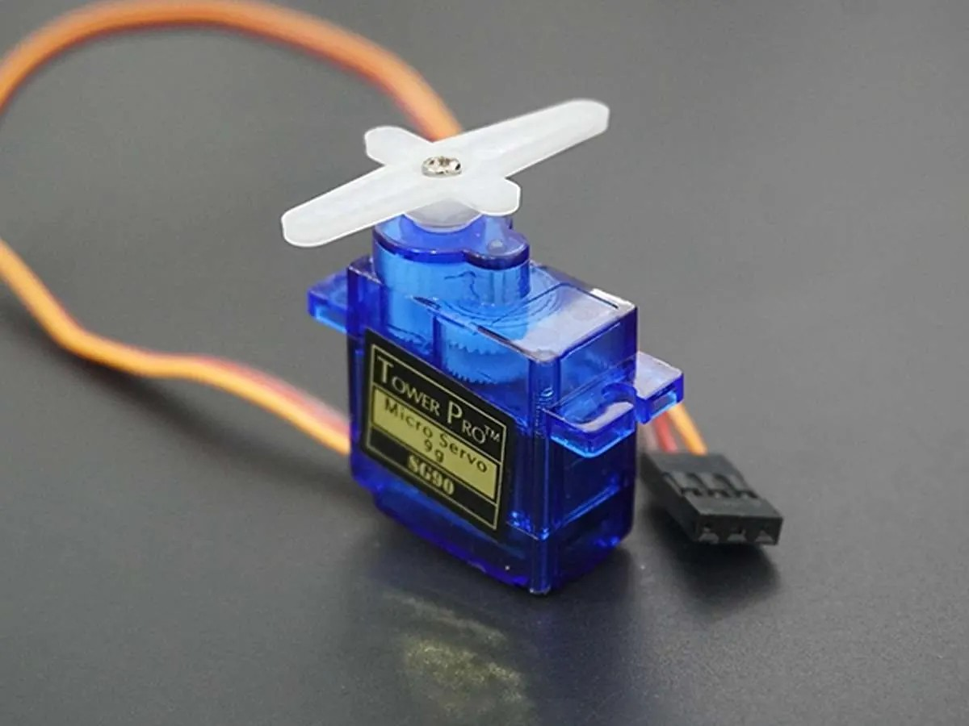
YEAR 9 · ELECTRONICS · LESSON 3
Motors That Know Their Place
You ask for an angle, not a speed.
Notes:
Last lesson's motor spins and cannot stop anywhere in
particular. This one can. Ask which of the two they would want on a robot arm.

Slide 2



A crane, a robot arm and a camera gimbal. What do they all do the same way?
Crane. Stops where the load needs it.
Robot arm. Every joint has an angle.
Camera gimbal. Holds a line while you walk.
None of them spins freely.
They hold a position, not a speed.
Notes:
The gimbal is the one to dwell on: it holds an angle while
everything around it moves, and it does that by measuring, not by guessing.

Slide 3
A motor with a position sensor inside
0 to 180 degrees
Closed loop
Ask for 90 and it drives there and stays, even against a small push.
It compares where it is with where it was told to be, and corrects.
Attach
Write
Hold
Servo.h, one pin.
write(90) means 90 degrees.
It pushes back.
An SG90 gives about 1.8 kg·cm of torque. That is a small arm, not a door.
Notes:
Two ideas, and the second is the important one: it knows where
it is. That is why it can hold a position and last lesson's motor cannot.

Slide 4
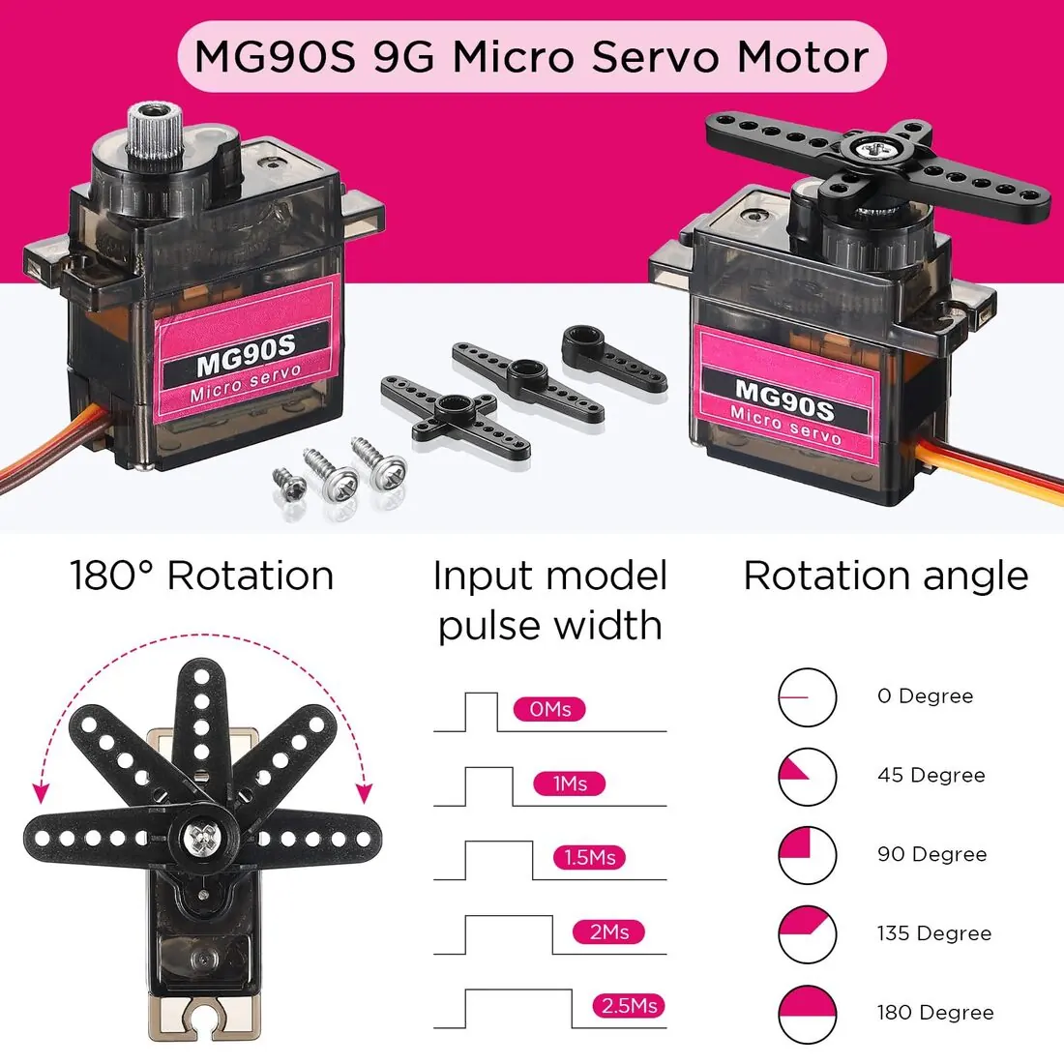
The servo and its arm
Three wires: power, ground, signal. The arm is the output.
Notes:
SLIDE 4 · PICTURE. Three wires, not two. That is the difference
they can see, and it is worth pointing at before the code arrives.

Slide 5

Sweep the arm in Tinkercad
Four-minute build
1
Drag a micro servo onto the canvas.
2
Signal to pin 9, power to 5V, ground to GND.
3
First line: #include <Servo.h>
4
Start the simulation and watch the arm.
Illustrative interface. Use the live Tinkercad menus.
Notes:
The library line goes at the very top, before anything else.
A sketch without it fails with an error that means nothing to a beginner.

Slide 6
Decode the code
#include <Servo.h>
Servo arm;
int from = 0; // degrees
int to = 180;
int stepDelay = 15; // ms per degree
void setup() {
arm.attach(9);
}
void loop() {
for (int a = from; a <= to; a++) {
arm.write(a);
delay(stepDelay);
}
for (int a = to; a >= from; a--) {
arm.write(a);
delay(stepDelay);
}
}
attach(9) = which pin
Once, in setup(). The library sends the pulses from there.
from and to = the ends
The arm visits every degree between them, in order.
stepDelay = the pace
Milliseconds per degree. Bigger is slower, and it still gets there.
Notes:
The two loops are the same loop backwards. Say that, and the
second one stops looking like new code.

Slide 7
Mission 1: Set the Ends
1
Run it from 0 to 180. Watch the whole sweep.
WATCH CLOSELY
Which way does the arm move first?
2
Change to to 90. Run it.
3
Change from to 45. Run it.
Up from from, towards to. Then back again.
4
Say out loud where the arm starts and which way it goes.
Notes:
Ask them to predict before running. Two of the four answers are
wrong in useful ways - the arm does not jump, and it does not stop at To and wait.

Slide 8
Mission 2: Slow It Down
1
Set stepDelay to 15 and run it.
THINK FIRST
Why does a bigger stepDelay move it more slowly?
2
Set it to 40. Run it. Then set it to 2.
3
Which one moves the arm slowest?
A longer pause between one degree and the next, so the sweep takes longer.
4
Find the setting where it twitches instead of sweeping.
EXTENSION · A WAVE
Two servos, opposite sweeps, one starting a little late.
Notes:
Below about 3 ms the writes pile up and the servo jitters. That
is a timing limit, not a fault, and it is fine to say so.

Slide 9
QUICK CHECK
ANSWER
Quick check: the pulse
A pulse
You write 90 and the arm stops at 90 degrees.
What does the board actually send down the wire?
About fifty pulses a second, each about 1.5 ms long. The width is the angle.
Think first. Then raise your hand.
Notes:
The servo never receives the number 90. It receives a pulse
width, fifty times a second, and the library worked out the width for them.

Slide 10
BEFORE YOU LOG OFF
Wrap-up and exit ticket
A servo trades speed for knowing where it is.
Name something that has to stop at an exact angle.
Write your answer on a slip or in the chat.
Three wires. One angle.
EXIT TICKET
At 90 degrees the pulse is about ________ ms wide.
Notes:
Car mirrors, a robot gripper, a camera gimbal, a rudder. The
exit ticket answer is 1.5 ms, and it is in the notes above if they ask.

