Slide 1
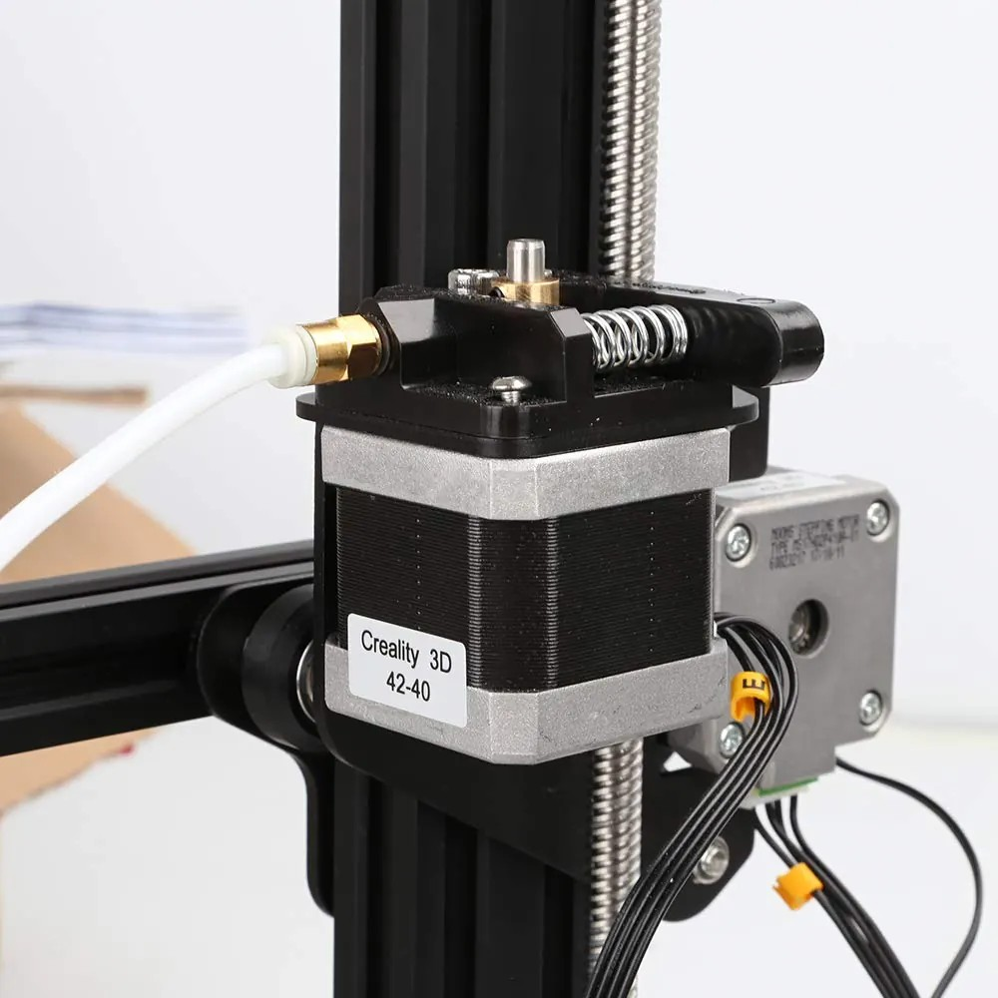
YEAR 9 · ELECTRONICS · LESSON 4
Counting Instead of Measuring
No sensor. The board counts what it has sent.
Notes:
The servo measured. This one counts. That is the whole lesson,
and it is the difference between a robot that returns to the same spot and one
that drifts.

Slide 2



A 3D printer, a clock and a lift. How do they stop in exactly the same place?
3D printer. Layer after layer, same spot.
Clock. The second hand lands on the mark.
Lift. The floor lines up every time.
None of them looks to check.
They count the steps and trust the count.
Notes:
A lift does have a sensor, and a printer has end stops - do not
pretend otherwise. The honest version: it counts between the marks, and it looks
once, at the start.

Slide 3
A stepper moves in fixed steps
2048 steps a turn
No sensor, no guessing
32 steps through a 64:1 gearbox. Half a turn is 1024.
The board counts what it has sent, so it always knows the angle.
Step
Count
Driver
One small turn.
The board keeps the total.
The ULN2003 feeds the coils.
The pins cannot drive four coils. The driver board does that.
Notes:
Every other motor in the course reports nothing. This one is
told and remembers. Say the 2048 number several times - it is the unit of the
whole lesson.

Slide 4
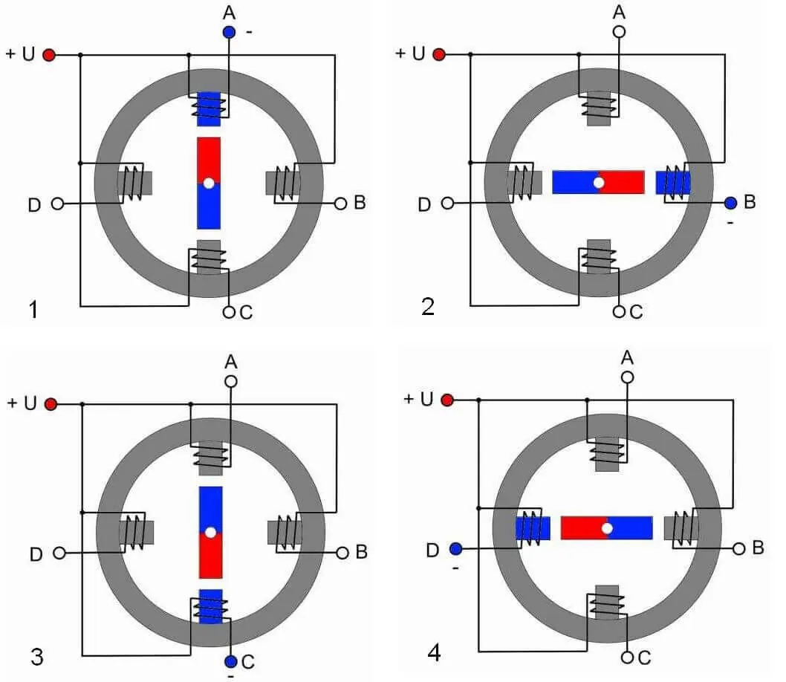
The motor and the driver
Four coils, one white connector, one driver board.
Notes:
SLIDE 4 · PICTURE. The motor is not wired to the Arduino. It is
wired to the little board, and the board is wired to the Arduino.

Slide 5
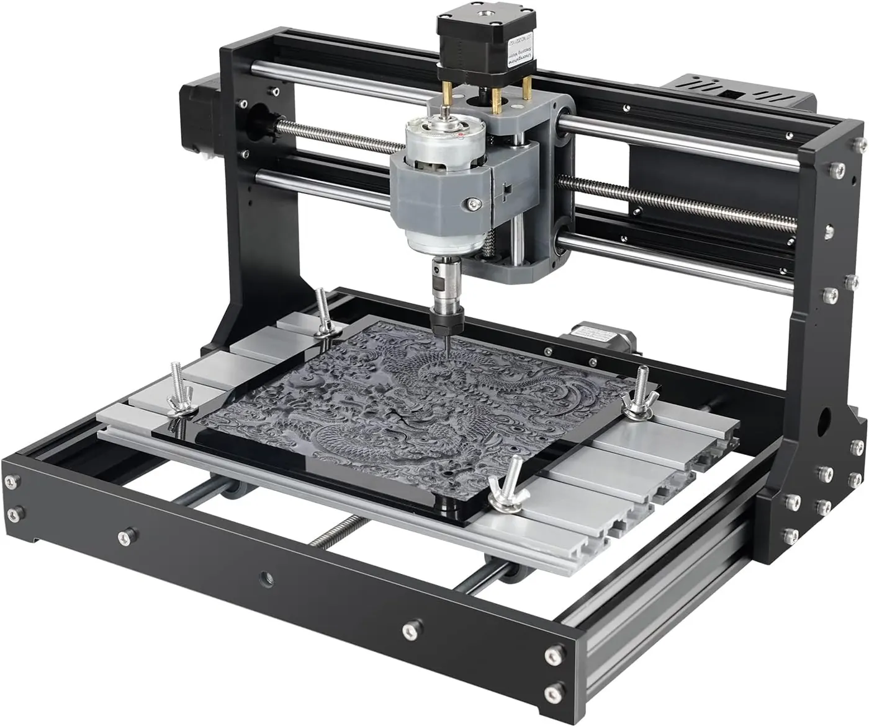
Wire the stepper
Five-minute build
1
Plug the motor's white connector into the driver.
2
IN1 to IN4 go to pins 8, 9, 10, 11.
3
5V and GND to the driver, in that order.
4
First line: #include <Stepper.h>
The white connector is the driver board.
Notes:
The connector only fits one way. If the motor buzzes and does
not turn, two wires are swapped - that is the standard symptom and it is worth
telling them before they meet it.

Slide 6
Decode the code
#include <Stepper.h>
Stepper wheel(2048, 8, 10, 9, 11);
int topSpeed = 9; // rpm
int rampSteps = 40; // steps spent speeding up
void setup() {
wheel.setSpeed(1);
}
void loop() {
for (int i = 0; i < 2048; i++) {
if (i < rampSteps) {
wheel.setSpeed(1 + topSpeed * i / rampSteps);
}
wheel.step(1);
}
wheel.setSpeed(1);
delay(800);
}
2048 = one whole turn
The number in the brackets. Everything is measured in steps.
rampSteps = the slow start
Forty steps of speeding up, then it cruises.
step(1) = one step
Nothing else happens. No measuring, only counting.
Notes:
The pins in the brackets are out of numeric order on purpose -
it is 8, 10, 9, 11 for this wiring, and the library is fussy about it.

Slide 7
Mission 1: One Whole Turn
1
Run it and watch the shaft.
WATCH CLOSELY
How does the board know it is back at the top?
2
Change 2048 to 512 and run it.
3
What angle is 512 steps?
It counted. Nothing measured anything.
4
Put it back to 2048 and run it twice.
Notes:
512 is a quarter turn. The question to press on is how it knows
- the answer is that it never checked, and it is still right, which is the point.

Slide 8
Mission 2: A Gentle Start
1
Set rampSteps to 40 and run it.
THINK FIRST
A gentler start still reaches the same top speed. Why?
2
Set it to 0 and run it. Listen.
3
Which start buzzes and misses steps?
The ramp changes how it gets there, not where it ends up.
4
Find the smallest rampSteps that starts cleanly.
EXTENSION · FOUR POSITIONS
Stop every 512 steps and hold. A wheel that lands on four marks.
Notes:
With rampSteps at 0 the motor is asked for nine rpm from a
standstill and skips. Missing steps is silent - the count is now wrong and the
board does not know. That is the failure worth showing.

Slide 9
QUICK CHECK
ANSWER
Quick check: the count
It skips
Ask for 1000 steps a second from a standstill and the motor buzzes.
Why does it not simply go fast?
The rotor cannot keep up, so it misses steps - and the count drifts without anyone noticing.
Think first. Then raise your hand.
Notes:
Buzzing with no movement is the sound of a stepper being asked
for more than it can do. Name the sound; they will hear it again.

Slide 10
BEFORE YOU LOG OFF
Wrap-up and exit ticket
A stepper is precise because it counts, not because it looks.
Name something that must return to the same spot every time.
Write your answer on a slip or in the chat.
2048 steps, one turn.
EXIT TICKET
Half a turn is ________ steps.
Notes:
A printer head, a camera slider, a telescope mount, a valve.
The exit ticket answer is 1024.

