Slide 1
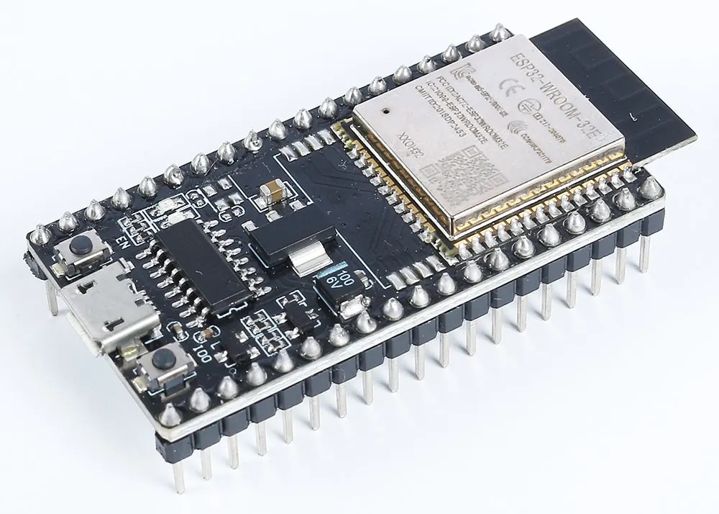
YEAR 9 · ELECTRONICS · LESSON 6
A Device That Talks
The same loop, with a radio inside.
Notes:
The last lesson of the year, and the one that leaves the desk.
Run it as a demonstration on a shared board - there is no ESP32 in Tinkercad.

Slide 2

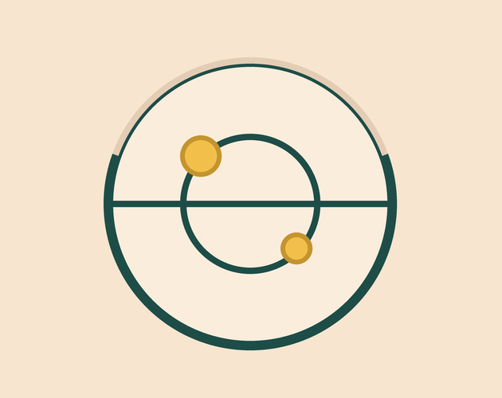

A connected device needs three things a blinking LED does not. What are they?
A radio. Something to carry the message.
An address. A place to be found.
A message. A reading, going somewhere.
The board is the same size either way.
A reading has to leave the board to be useful.
Notes:
Accept anything sensible. The three you want are a radio, an
address and something to say - and the third is the one they forget, because a
device that says nothing is still just a blinking LED.

Slide 3
A micro-controller with a radio inside
Same setup() and loop()
3.3 V, not 5 V
What is extra is a radio, more memory, and a network stack.
A 5 V signal on a 3.3 V pin can damage it. The sensors have to match.
Input
Process
Send
The sensor, as always.
The sketch decides.
The reading travels.
Input, process, output - and the output now leaves the board.
Notes:
They have used a 5 V board all year. The voltage change is the
practical warning: a sensor that worked on the Uno may need a divider here.

Slide 4
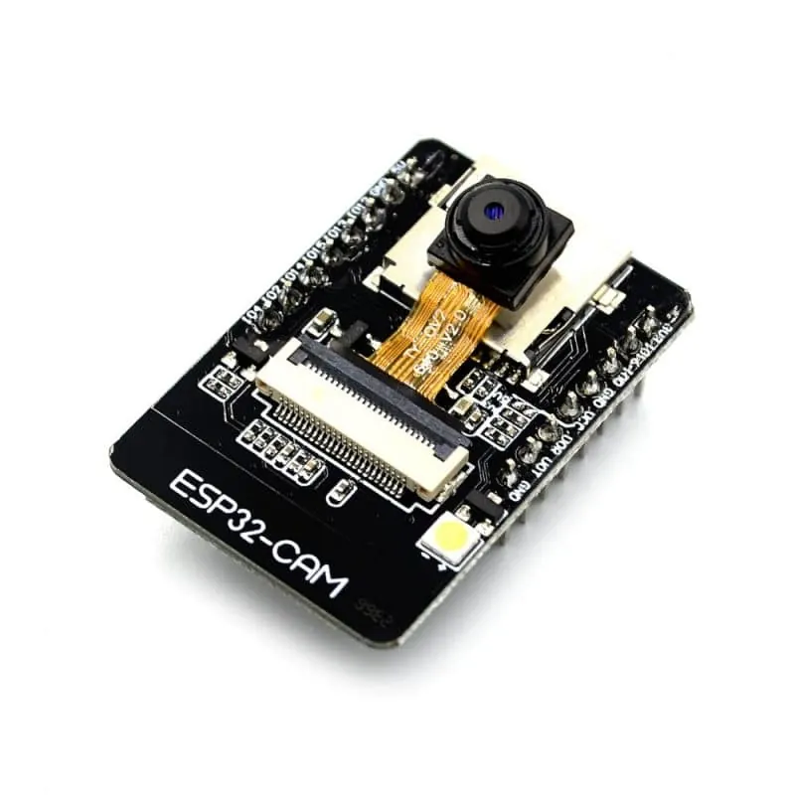
The ESP32 on a breadboard
Same pins, same sketch, plus an aerial.
Notes:
SLIDE 4 · PICTURE. Point at the aerial - the wiggly copper trace
or the metal can. That is the whole difference, and it is smaller than they
expect.

Slide 5
Load a sketch onto the ESP32
One-time setup
1
Add the ESP32 board package in the Arduino IDE.
2
Choose ESP32 Dev Module, then the right port.
3
Paste the sketch and press upload.
4
Open the Serial Monitor and read the address.
Notes:
This is a teacher job on a shared board. The board package
download is the step that fails on a school network, so do it before the lesson.

Slide 6
Decode the code
#include <WiFi.h>
#include <WebServer.h>
WebServer page(80);
void setup() {
Serial.begin(115200);
WiFi.begin("classroom", "password");
page.on("/", []() {
page.send(200, "text/plain", "21 degrees");
});
page.begin();
}
void loop() {
page.handleClient();
}
WiFi.begin = join
The name and the password of the network.
page.on = what to answer
Someone asks for /, and the board sends back the reading.
handleClient = listen
Called in every loop, forever. That is the whole job.
Notes:
Two new lines do the work: on() says what to reply, and
handleClient() keeps listening. Everything else is setup they already know.

Slide 7
Mission 1: Watch the Page
1
Watch the address appear in the Serial Monitor.
WATCH CLOSELY
Where is the page coming from?
2
Open that address on your phone.
3
Ask the teacher to breathe on the sensor.
The board. No website is involved.
4
Refresh the page and read the new number.
Notes:
Everyone should see the page on their own phone. That moment -
a page that exists nowhere but on a board on the desk - is the lesson.

Slide 8
Mission 2: Send It Back
1
Press the button on the page.
THINK FIRST
Why test the sensor before you add the network?
2
Watch the LED on the board change.
3
Say which half of the system acted.
A fault could be in either half, and that decides where you look.
4
Now find one thing that could break each half.
EXTENSION · THE SCHOOL NETWORK
One board, one address, and thirty phones asking at once. Does it keep up?
Notes:
The message goes both ways. That is what makes it a device
rather than a display, and it is the sentence to end the year on.

Slide 9
QUICK CHECK
ANSWER
Quick check: the message
A message
A reading is on the board and nobody can see it.
What has to happen before it is useful?
It has to leave the board - to a page, a phone, or another board.
Think first. Then raise your hand.
Notes:
A sensor alone is a fact nobody knows. The network is what turns
it into information, and that is the final idea of the course.

Slide 10
BEFORE YOU LOG OFF
Wrap-up and exit ticket
A connected device is the same system plus a message.
Name a device you own that could do this.
Write your answer on a slip or in the chat.
3.3 V, and a radio.
EXIT TICKET
The page is served by the ________ , not a website.
Notes:
A doorbell, a thermostat, a plant monitor, a cat flap. The exit
ticket answer is the board. End the year on that: nothing about this was magic.

