Slide 1

YEAR 7 · ELECTRONICS · LESSON 4 OF 5
The board remembers
By the end you will keep a count that survives, and recognise the bug that resets it every second.
BUILD: A PRESS COUNTER
Notes:
Cover. Say what they will be able to do by the end: By the end you will keep a count that survives, and recognise the bug that resets it every second.

Slide 2
STARTER · 2 MINUTES
What do you remember?
1
When is an AND condition true?
When both sides are true.
ANSWER
click to reveal
2
What does else do?
Runs when the if condition was false.
ANSWER
click to reveal
Answer it in your head before I click.
Y7.4 · THE BOARD REMEMBERS
Notes:
Quick recall. If || and && are still shaky,
spend the two minutes on one example each before moving on.

Slide 3


How does a turnstile know how many people came in today?
A count of entries.
A number kept on a display.
A total, printed at the end.
Something has to remember the number between one person and the next.
That is a variable: a named box in the board's memory.
Y7.4 · THE BOARD REMEMBERS
Notes:
The turnstile is the clearest example: a number has
to survive between one person and the next. Ask what would happen if it forgot
every time — the door would never know anyone had come in.

Slide 4
PREDICT · EVERYONE COMMITS
Before I show you
This loop runs with int count = 0; on its first line. You press the button three times. What prints?
A
B
C
1, 2, 3
1, then 0, then 1, then 0…
3, 3, 3
THE ANSWER
THE ANSWER
click to reveal
1, then 0, then 1, then 0…
count is built fresh at the top of every pass. It is not remembering, it is being rebuilt. Move the line outside loop() and it survives.
Hands up for the one you chose — then we find out.
Y7.4 · THE BOARD REMEMBERS
Notes:
Put the four lines on the board, not on the
slide, and let them trace it. The answer surprises almost everyone: it is not a
counting bug, it is a where-the-line-is bug.

Slide 5
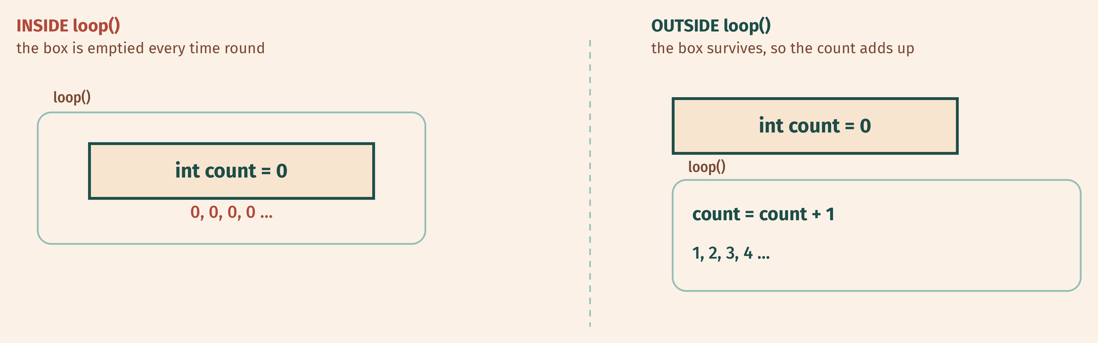
THE IDEA
A variable lives where you put it
Declared outside loop(), the box survives. Declared inside, it is emptied every time round.
Where you write the line matters as much as what the line says.
Notes:
Where the line sits is the whole lesson. Draw the two
boxes on the board if the diagram is not enough: one inside the loop, one
outside it.

Slide 6

BUILD · 15 MINUTES
Keep the button, add a counter
1
Keep the button and pull-down from Y7.2 on pin 2.
2
Add an LED and 220 Ω on pin 13.
3
Open the Serial Monitor and set it to 9600 baud.
4
Write int count = 0; above setup().
Illustrative interface. Use the live Tinkercad menus.
Y7.4 · THE BOARD REMEMBERS
Notes:
They are reusing the button from lesson 2, which
is deliberate: the new thing is the counting, not the wiring.

Slide 7
DECODE THE CODE
One line that keeps a number
int count = 0;
void setup() {
pinMode(2, INPUT);
Serial.begin(9600);
}
void loop() {
if (digitalRead(2) == HIGH) {
count = count + 1;
Serial.println(count);
delay(250);
}
}
INT COUNT = 0;
Made once, before setup runs. The value stays until you change it or unplug the board.
COUNT = COUNT + 1;
Read the old value, add one, put it back. The right-hand side is worked out first.
DELAY(250);
A crude debounce. Without it, one press is counted many times.
Try it with and without delay(250).
Y7.4 · THE BOARD REMEMBERS
Notes:
count = count + 1 deserves a pause: the right-hand
side is worked out first, then stored. Ask what count = count + 1 would do if the
right-hand side were skipped.

Slide 8
TEST IT · 5 MINUTES
What success looks like
✓
Three presses give 1, then 2, then 3.
1 2 3
✓
Holding the button counts slowly, not in a blur.
250 ms
✓
Press the board's reset button: it starts again at 0.
0
WATCH FOR
A blur of numbers means the debounce delay is missing. One press must give one number.
Y7.4 · THE BOARD REMEMBERS
Notes:
The third check is the important one: a reset proves
the number was in memory, not on the screen.

Slide 9
DEBUG · 5 MINUTES
It does not work. Find the fault.
WHAT YOU SEE
A
The button is broken
The count is always 0 or always 1, however many times you press.
B
count is declared inside loop()
C
Serial.begin is missing
THE FAULT
THE FAULT
click to reveal
int count = 0; is inside loop().
Move it above setup(). A variable declared inside a function is thrown away when that function ends, so every pass starts from zero.
Y7.4 · THE BOARD REMEMBERS
Notes:
This is the same bug as the prediction, now in
their own code. Do not point at the line; ask where the variable is declared.

Slide 10
CHECK · ONE QUESTION
Where must a counter be declared so it survives from one loop() to the next?
A
B
C
Inside loop()
Outside both functions, at the top
Inside setup()
THE ANSWER
ANSWER — B
click to reveal
Outside both functions, at the top of the file.
A variable made inside a function lives only while that function runs. At the top of the file it lives for as long as the program.
If you chose another one, say why. That is the useful bit.
Y7.4 · THE BOARD REMEMBERS
Notes:
B. "Lives as long as the program" is the phrase to
use. Ask what happens to a variable inside setup() — it disappears the moment
setup finishes, which is why counters never go there.

Slide 11
STRETCH · IF YOU FINISHED EARLY
If that was easy
COUNT DOWN
Add a second button that subtracts one. Use && to stop it going below zero, and print EMPTY when the count is 0.
FIX THE DOUBLE COUNT PROPERLY
Remove delay(250). Store millis() each time you count, and only count again if 300 ms have passed. That is debouncing, and every real button needs it.
delay() stops the whole program. millis() lets it keep running. That difference matters in Year 9.
Y7.4 · THE BOARD REMEMBERS
Notes:
Both are real. The second one is how debouncing
actually works; if a pupil gets it, they have outgrown delay().

Slide 12
EXIT TICKET · BEFORE YOU LOG OFF
Two questions, then close the laptop.
What happens to a variable declared inside loop()?
FINISH THE SENTENCE
1
A variable is a named ________ in memory.
Which line adds one to count?
2
One word for today
NEXT LESSON
Y7.5 — Design a crossing
Four lessons of pieces. Now a whole machine.
Notes:
The sentence frame is the rule they need to carry
into every later lesson.

