Slide 1
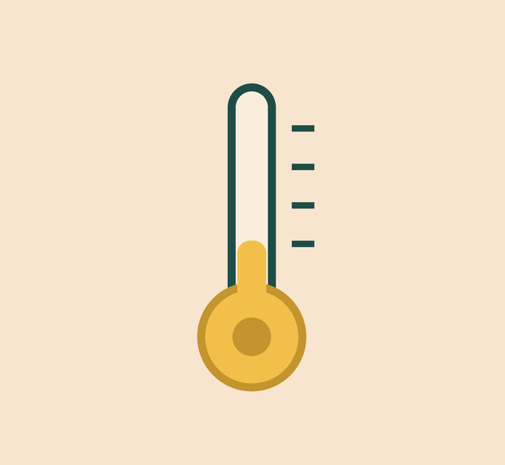
YEAR 8 · ELECTRONICS · LESSON 4 OF 5
A number that means degrees
By the end you will turn a raw reading into degrees Celsius, and know why the formula has a 0.5 in it.
BUILD: A THERMOMETER
Notes:
Cover. Say what they will be able to do by the end: By the end you will turn a raw reading into degrees Celsius, and know why the formula has a 0.5 in it.

Slide 2
STARTER · 2 MINUTES
What do you remember?
1
analogWrite(6, 64): what fraction of the time is the pin on?
About one quarter.
ANSWER
click to reveal
2
What is the average voltage?
About 1.25 V.
ANSWER
click to reveal
Answer it in your head before I click.
Y8.4 · A NUMBER THAT MEANS DEGREES
Notes:
Duty cycle recall. If they cannot do 64/255,
do it on the board: it is about a quarter.

Slide 3


An oven dial says 1 to 9. A thermometer says 180 °C. Why is one more useful?
A unit you can trust.
A scale with no unit.
A probe that reads the real thing.
A number means nothing until you know what it is counting.
Calibration is the line between a reading and a real quantity.
Y8.4 · A NUMBER THAT MEANS DEGREES
Notes:
An oven dial of 1–9 is a real example of an
uncalibrated scale. Ask what 5 means. Nobody knows, and that is the point.

Slide 4
PREDICT · EVERYONE COMMITS
Before I show you
A TMP36 outputs 0.75 V at 25 °C. What will analogRead show?
A
B
C
750
153
1023
THE ANSWER
THE ANSWER
click to reveal
About 153.
0.75 V is 15% of 5 V. analogRead reports 1024 steps across 5 V, so 0.15 × 1024 ≈ 154. The reading is a share of the supply, not millivolts.
Hands up for the one you chose — then we find out.
Y8.4 · A NUMBER THAT MEANS DEGREES
Notes:
Do the arithmetic on the board: 0.75/5 = 0.15,
and 0.15 × 1024 ≈ 154. The answer 750 is the millivolt value, and it is the
trap.

Slide 5
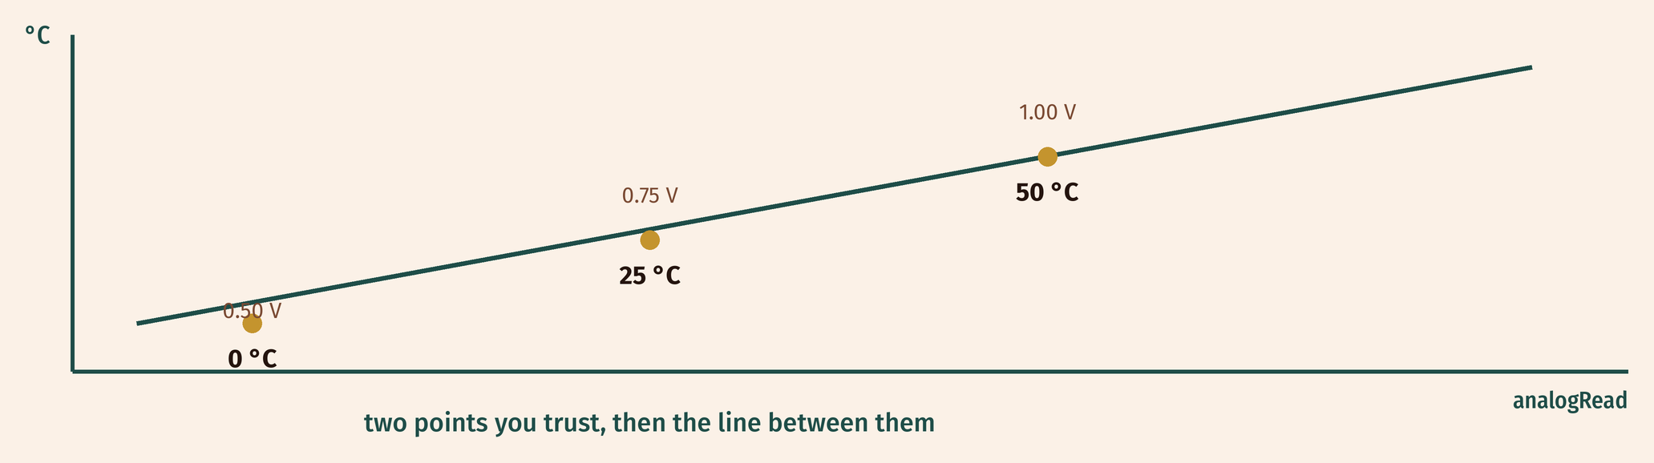
THE IDEA
Two points you trust are enough
Find two readings you know, draw the line between them, and every other reading has a value.
The TMP36 is pre-calibrated: 0.5 V at 0 °C, and 10 mV for every degree.
Notes:
Two points define a line. That is all
calibration is. The TMP36 is convenient because the manufacturer already did
it: 0.5 V at 0 °C, 10 mV per degree.

Slide 6

BUILD · 15 MINUTES
Wire the thermometer
1
Hold the TMP36 with the flat face towards you.
2
Left leg to 5 V, right leg to GND.
3
Middle leg to A0.
4
Open the Serial Monitor at 9600.
Illustrative interface. Use the live Tinkercad menus.
Y8.4 · A NUMBER THAT MEANS DEGREES
Notes:
The TMP36 has a flat face. With the flat face
towards you, the legs are 5 V, A0, GND from left to right. Getting this
backwards is the most common error and it gets hot — check it yourself.

Slide 7
DECODE THE CODE
Three lines from a reading to a temperature
void setup() {
Serial.begin(9600);
}
void loop() {
int raw = analogRead(A0);
float volts = raw * 5.0 / 1024.0;
float celsius = (volts - 0.5) * 100.0;
Serial.print(celsius);
Serial.println(" C");
delay(500);
}
RAW * 5.0 / 1024.0
The reading as a voltage. The .0 matters: 5/1024 in whole numbers is 0.
(VOLTS - 0.5)
The sensor puts out 0.5 V at 0 °C. Subtract it so the scale starts at zero.
* 100.0
10 mV per degree is 0.01 V, so multiply by 100.
Print volts too while you debug.
Y8.4 · A NUMBER THAT MEANS DEGREES
Notes:
The two decimal points in 5.0 and 1024.0 and
100.0 are the lesson. In C++, 5/1024 is 0. Write the integer division on the
board and let them see it fail.

Slide 8
TEST IT · 5 MINUTES
What success looks like
✓
Room temperature reads about 18–24 °C.
≈20 °C
✓
Breathe on it: it rises a few degrees, then falls.
+2–4 °C
✓
A real thermometer agrees within a degree or two.
±2 °C
WATCH FOR
A reading of −50 °C every time means integer division: 5/1024 is 0, so volts is 0.
Y8.4 · A NUMBER THAT MEANS DEGREES
Notes:
Comparing with a real thermometer is the point of
calibration. If you have one, pass it round. Breathing on the sensor is the
quickest proof that it is live.

Slide 9
DEBUG · 5 MINUTES
It does not work. Find the fault.
WHAT YOU SEE
A
The sensor is broken
The temperature reads −50.00 C, every single time.
B
The division used whole numbers
C
Serial.begin is too slow
THE FAULT
THE FAULT
click to reveal
raw * 5 / 1024 is done in whole numbers, so it is always 0.
Write 5.0 and 1024.0 so the maths happens in decimals. Then volts is a real number, and (0 - 0.5) * 100 stops happening.
Y8.4 · A NUMBER THAT MEANS DEGREES
Notes:
This is a genuine C++ trap and it will happen.
Show the integer division on the board: 5 divided by 1024 is 0 with a
remainder of 5.

Slide 10
CHECK · ONE QUESTION
Why does the formula subtract 0.5?
A
B
C
To correct for room temperature
The sensor outputs 0.5 V at 0 °C
To convert volts to millivolts
THE ANSWER
ANSWER — B
click to reveal
Because the sensor outputs 0.5 V at 0 °C.
The output is offset by half a volt so the sensor can report temperatures below zero. Without subtracting it, 0 °C would read as 50 °C.
If you chose another one, say why. That is the useful bit.
Y8.4 · A NUMBER THAT MEANS DEGREES
Notes:
B. This is the one piece of the formula pupils
memorise without understanding. The offset is in the datasheet, and it is why
the sensor can read below 0 °C.

Slide 11
STRETCH · IF YOU FINISHED EARLY
If that was easy
ADD FAHRENHEIT
F = C × 9 / 5 + 32. Print both. Check a known value: 100 °C must be 212 °F.
CALIBRATE IT YOURSELF
Take a reading in ice water (0 °C) and one in your own mouth (about 37 °C). Work out your own two-point formula. Compare it with the datasheet one.
Two points, one line, any unit. That is calibration.
Y8.4 · A NUMBER THAT MEANS DEGREES
Notes:
Fahrenheit is a second calibration, and it makes
the idea transfer. The ice-water task is real lab work if you have a kettle and
a cup.

Slide 12
EXIT TICKET · BEFORE YOU LOG OFF
Two questions, then close the laptop.
What are the two reference points for the TMP36?
FINISH THE SENTENCE
1
Calibration turns a reading into a ________.
Why write 5.0 instead of 5?
2
One word for today
NEXT LESSON
Y8.5 — A device that decides
Two thresholds, one buzzer, and no chattering.
Notes:
The frame should be "unit" or "quantity". Both
are acceptable; ask for one example.

