Slide 1
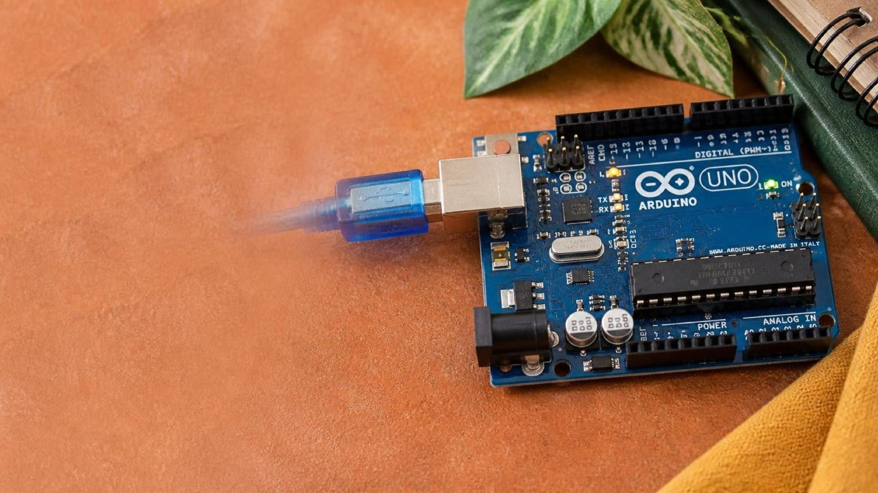
ELECTRONICS
Meet the board
By the end you will blink an LED, and say what setup() and loop() do.
Notes:
Point at the USB socket, the digital pins, and the power pins.

Slide 2
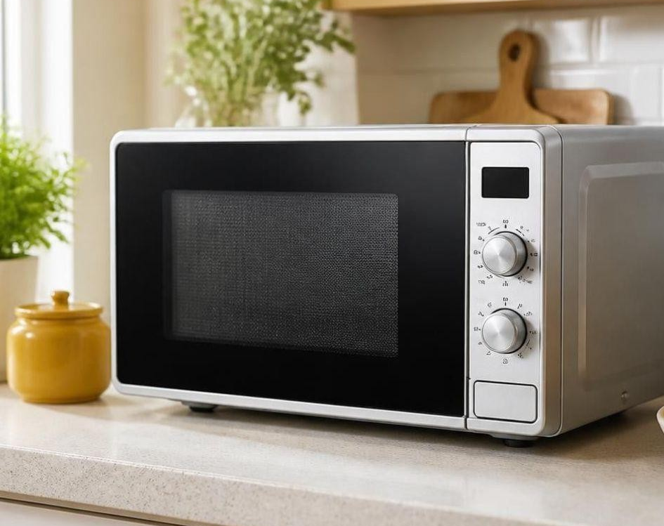

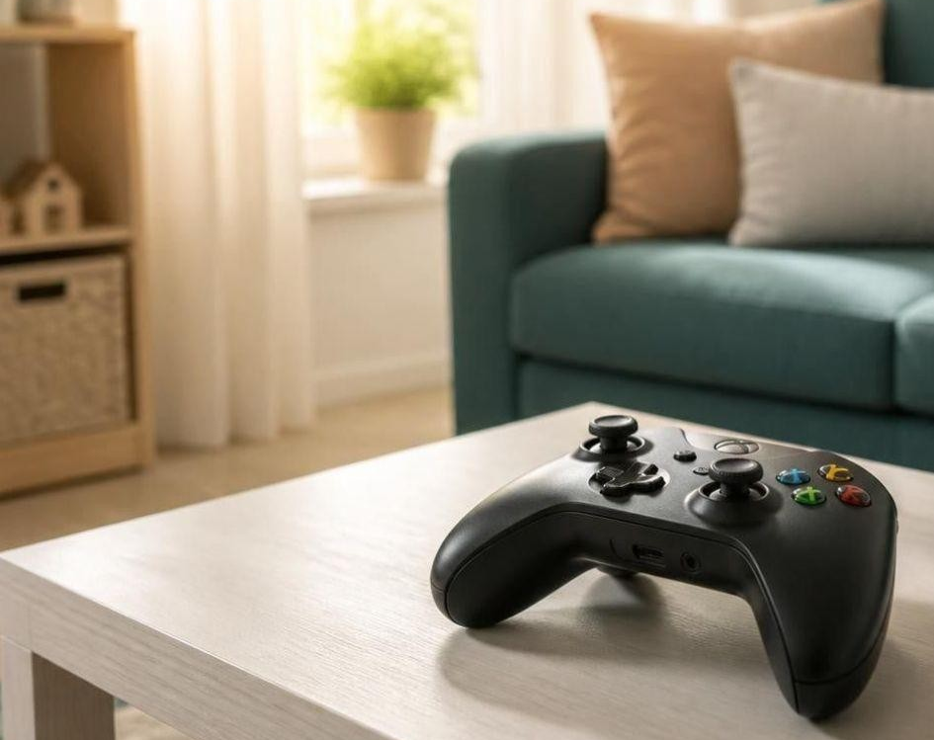
What can this board do?
A microwave follows one set of steps.
A door opens when someone is there.
A controller reads buttons and moves a game.
Each one reads something, decides, then does something.
This board runs one program, again and again.
Notes:
Collect one example from the room before the gold line.

Slide 3
One program, two parts
setup()
loop()
Runs once, when the board starts. Use it to get pins ready.
Runs again and again, for as long as the board has power.
Input
Process
Output
A pin reads a signal.
The program decides.
A pin turns something on.
Notes:
Write the two words on the board before the wiring.

Slide 4
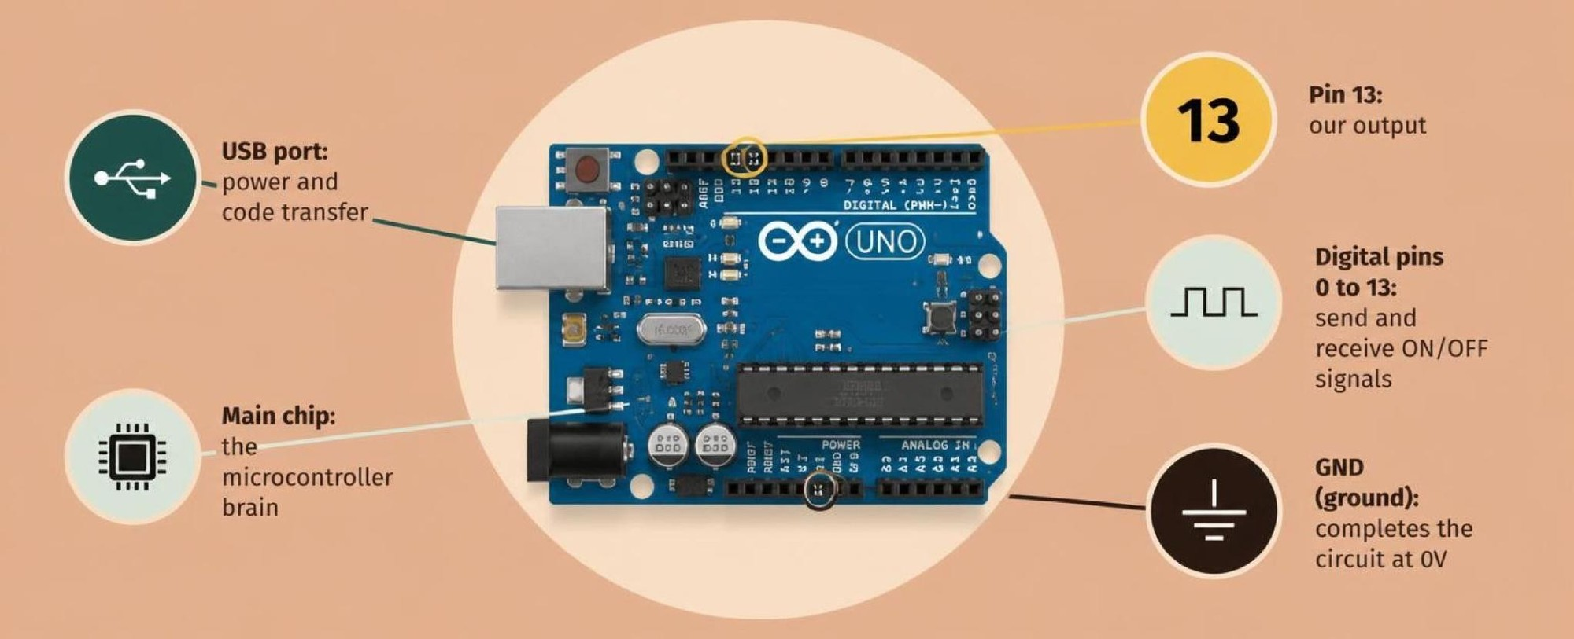
The pins you will use
Digital pins are on or off. Analog pins read a range. 5 V and GND supply the parts.
Notes:
Point at pin 13, 5 V, and GND.

Slide 5

Open the blink circuit
The build
1
Open Tinkercad, then Circuits, then Create.
2
In Components, choose Starters, then Arduino.
3
Drag the Blink starter onto the canvas.
4
The LED is already on pin 13, with a resistor.
Use the live Tinkercad menus.
Notes:
Walk the room and check everyone has the Blink starter.

Slide 6
The blink program
void setup() {
pinMode(13, OUTPUT);
}
void loop() {
digitalWrite(13, HIGH);
delay(1000);
digitalWrite(13, LOW);
delay(1000);
}
pinMode(13, OUTPUT)
Pin 13 will send a voltage out. It will not read anything.
HIGH and LOW
HIGH is 5 V, so the LED is on. LOW is 0 V, so the LED is off.
delay(1000)
Wait 1000 milliseconds. That is 1 second.
Notes:
Read HIGH and LOW as voltages, not as the words on and off only.

Slide 7
Change the speed
1
Start the simulation and watch the 1 second blink.
CHECK
Is the blink faster or slower?
2
Open the code.
3
Change both delay(1000) lines to delay(200).
Faster. 200 ms is a shorter wait than 1000 ms.
4
Start the simulation again.
Notes:
They should change both delays, or the on and off times will not match.

Slide 8
CHECK
ANSWER
What does loop() do?
It repeats.
setup() has already finished.
loop() runs the same code again and again, while the board has power.
Notes:
If they say 'it runs once', send them back to the two-part slide.

