Slide 1
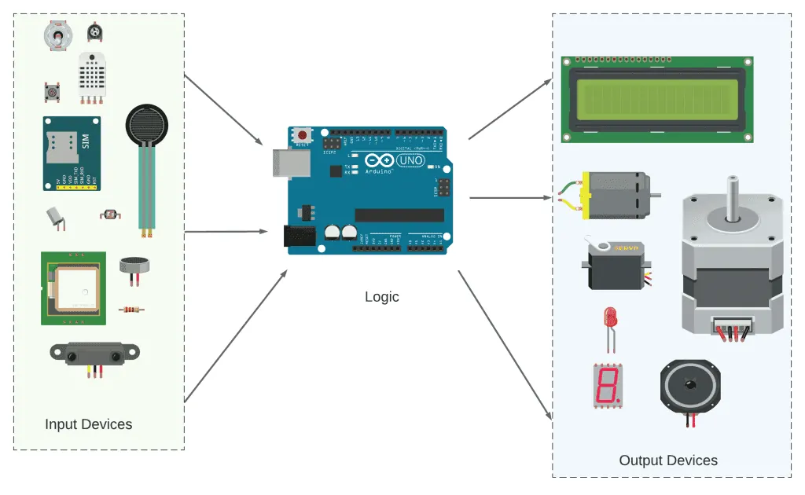
ELECTRONICS
A button and an LED
By the end you will turn an LED on while a button is held.
Notes:
The new idea is digitalRead. HIGH and LOW are already known.

Slide 2
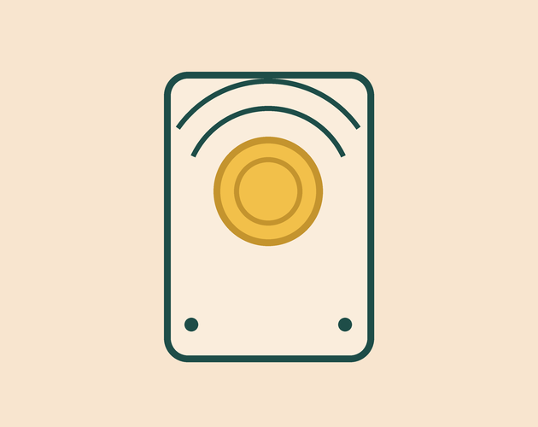
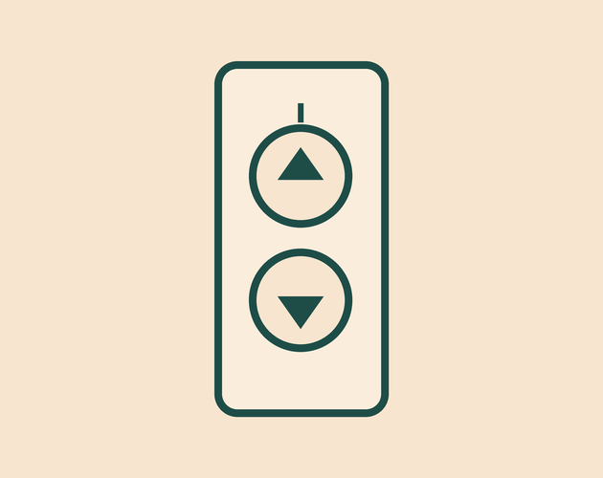

How does the board know a button is pressed?
A doorbell waits for a press.
A lift reads a button.
Each key is a switch.
A button connects two wires, or it leaves them apart.
Pressed is 5 V. Not pressed must be a clear 0 V.
Notes:
Ask what the pin should read when nobody is touching the button.

Slide 3
HIGH is 5 V. LOW is 0 V.
Button pressed
Button open
The button connects the pin to 5 V. digitalRead returns HIGH.
A resistor to 0 V holds the pin LOW, so the reading stays steady.
digitalWrite sends a voltage out. digitalRead reads the voltage that is already there.
Notes:
Without the resistor the reading jumps about. Say that before they wire.

Slide 4

Wire the button and the LED
The build
1
Push the button so it crosses the gap in the breadboard.
2
One side of the button to 5 V. The other side to pin 2.
3
A 10 kΩ resistor from pin 2 to GND.
4
LED and 220 Ω from pin 13 to GND.
Use the live Tinkercad menus.
Notes:
The button must cross the centre gap, or it is always on.

Slide 5
Read the button, light the LED
void setup() {
pinMode(2, INPUT);
pinMode(13, OUTPUT);
}
void loop() {
int pressed = digitalRead(2);
if (pressed == HIGH) {
digitalWrite(13, HIGH);
} else {
digitalWrite(13, LOW);
}
}
int pressed
A variable stores the reading. int means a whole number.
== means 'is it equal?'
One = stores a value. Two == compare two values.
if and else
if runs when the test is true. else runs when it is not.
Notes:
Stay on the difference between = and ==. It is the mistake they will make.

Slide 6
Swap the rule
1
Hold the button. The LED should be on.
CHECK
When is the LED on now?
2
Let go. The LED should be off.
3
Swap HIGH and LOW in the if and the else.
When you let go of the button.
4
Run it again.
Notes:
They have reversed the test. That is the point of the mission.

Slide 7
CHECK
ANSWER
Why is the 10 kΩ resistor there?
It holds 0 V.
The button is not pressed.
The resistor keeps the pin at 0 V until the button connects it to 5 V.
Notes:
The wrong answer is 'to protect the LED'. That is the 220 Ω's job.

