Slide 1
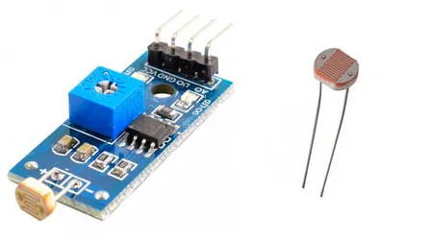
ELECTRONICS
A number from a sensor
By the end you will read a light sensor as a number from 0 to 1023.
Notes:
Digital was only HIGH or LOW. Today the pin can be anywhere in between.

Slide 2


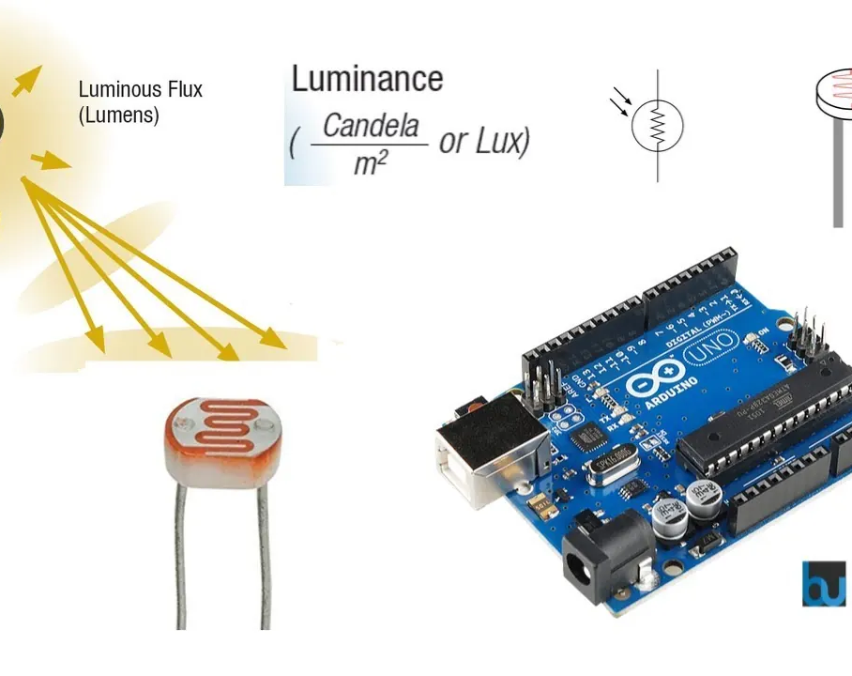
A button is only on or off. How can a sensor say how bright it is?
A lamp can be dim or bright.
A dial can sit anywhere in between.
This sensor changes with the light.
The board can only measure a voltage.
analogRead turns that voltage into a number.
Notes:
They should say a number, not HIGH or LOW.

Slide 3
0 to 1023, not just on or off
analogRead(A0)
An LDR
Gives a whole number from 0 to 1023. 0 is 0 V. 1023 is 5 V.
In bright light its resistance falls. In the dark its resistance rises.
map() can turn 0–1023 into another range, such as 0–100.
Notes:
The second resistor with the LDR makes a voltage the pin can read.

Slide 4
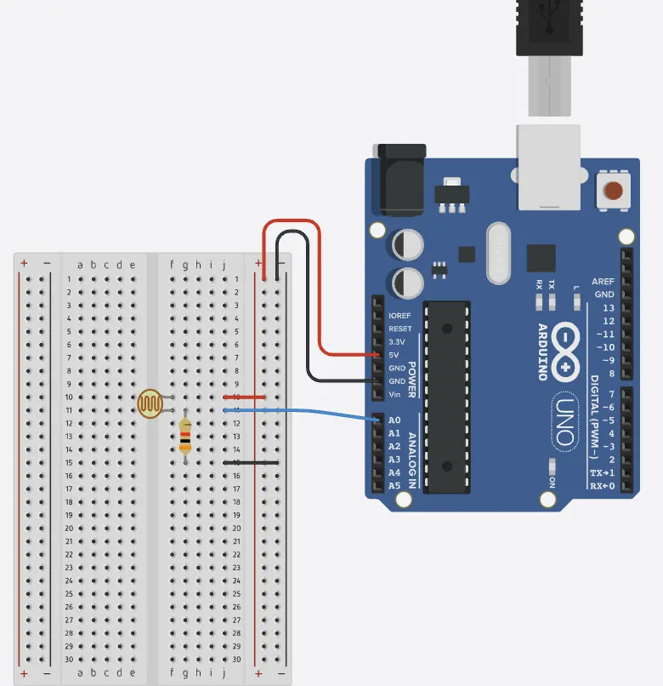
Wire the light sensor
The build
1
LDR from 5 V to pin A0.
2
10 kΩ from A0 to GND.
3
Open the Serial Monitor in Tinkercad.
4
Cover the LDR, then shine a light on it.
Use the live Tinkercad menus.
Notes:
If the number never changes, A0 is not on the join of the LDR and the resistor.

Slide 5
Print the reading
void setup() {
Serial.begin(9600);
}
void loop() {
int light = analogRead(A0);
int percent = map(light, 0, 1023, 0, 100);
Serial.println(percent);
delay(200);
}
Serial.begin(9600)
Starts the Serial Monitor. 9600 is the speed they both use.
map(...)
Turns a number from one range into another. 0–1023 becomes 0–100.
Serial.println
Sends the number, then starts a new line, so each reading is separate.
Notes:
Show the Monitor button. A reading you cannot see is no use yet.

Slide 6
Watch the number move
1
Start the simulation.
CHECK
Which way did the number move?
2
Read the number in ordinary light.
3
Cover the sensor.
It changed with the light.
4
Shine a torch, or the Tinkercad light, on it.
Notes:
Do not insist on a direction until they have seen their own wiring. The divider sets which way it goes.

Slide 7
CHECK
ANSWER
What does analogRead return?
0 to 1023.
The sensor is on pin A0.
A whole number from 0 to 1023. It stands for a voltage from 0 V to 5 V.
Notes:
Not volts, and not HIGH or LOW.

