Slide 1
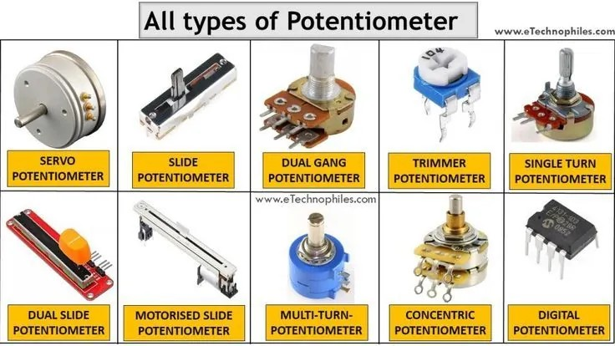
ELECTRONICS
A knob and brightness
By the end you will use a knob to change how bright an LED looks.
Notes:
They can already read 0–1023. Today that number sets an output.

Slide 2
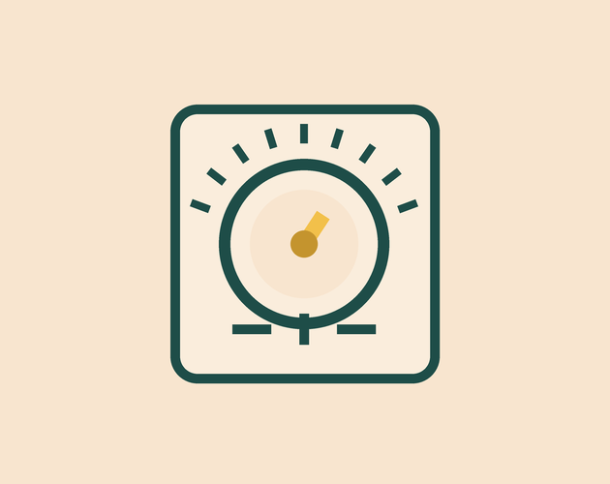
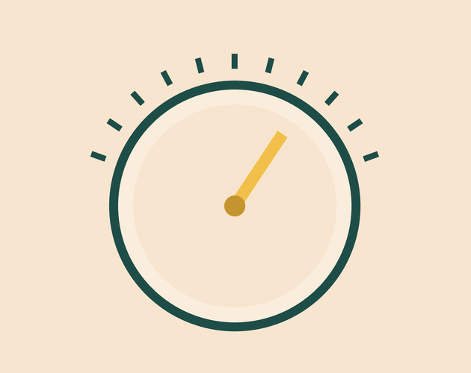
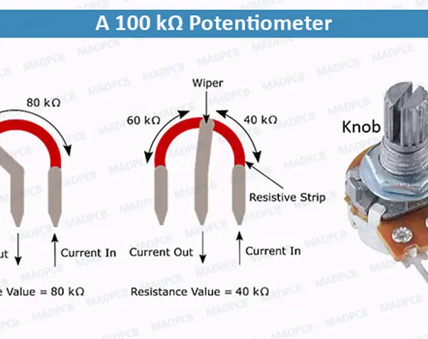
The pin is only fully on or fully off. How can an LED look dim?
A dimmer makes a lamp look dim.
A knob turns a little or a lot.
Three pins. The middle one moves.
A pin cannot sit at 2.5 V.
It switches on and off, faster than you can see.
Notes:
Listen for 'on and off quickly', not 'a lower voltage'.

Slide 3
The middle pin shows how far you turned it
The knob
analogWrite
Outer pins go to 5 V and 0 V. The middle pin's voltage moves as you turn.
A number from 0 to 255. 0 is off. 255 is on all the time. 128 is on about half the time.
The LED looks dim because it is on for only part of the time.
Notes:
Only pins marked with ~ can do this. Pin 9 is one of them.

Slide 4
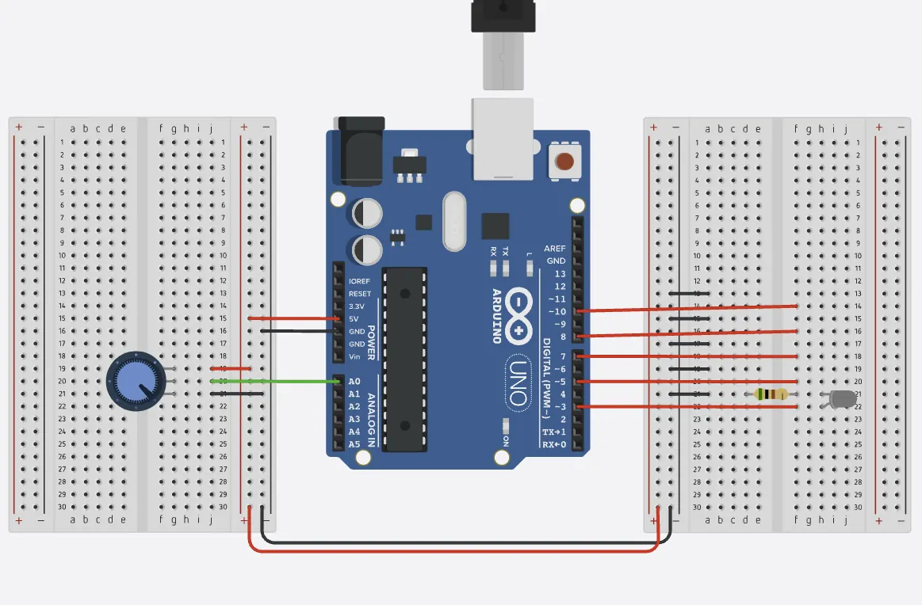
Wire the knob and the LED
The build
1
Outer pins of the knob to 5 V and GND.
2
Middle pin of the knob to A0.
3
LED and 220 Ω from pin 9 to GND.
4
Pin 9 must be a pin marked with ~.
Use the live Tinkercad menus.
Notes:
The usual mistake is putting an outer pin on A0. Then the number jumps between 0 and 1023.

Slide 5
Knob in, brightness out
void setup() {
pinMode(9, OUTPUT);
}
void loop() {
int knob = analogRead(A0);
int brightness = map(knob, 0, 1023, 0, 255);
analogWrite(9, brightness);
}
map to 0–255
The knob is read as 0–1023. analogWrite only accepts 0–255.
analogWrite(9, ...)
Switches pin 9 fully on and fully off. A higher number means on for more of the time.
Not a voltage in between
The pin is never at 2.5 V. Your eye blends the flashes, so the LED looks dim.
Notes:
If someone says the pin is at half voltage, stop and correct it.

Slide 6
Reverse the knob
1
Turn the knob and watch the LED.
CHECK
What changed?
2
In map(), swap the last two numbers: 255, 0.
3
Run it again.
The brightness now goes the other way.
4
Turn the knob the same way as before.
Notes:
map(knob, 0, 1023, 255, 0) flips the ends of the range.

Slide 7
CHECK
ANSWER
Is the pin ever at a voltage in between?
No.
The LED looks about half as bright.
The pin is fully on or fully off. It is on for only part of the time.
Notes:
The name analogWrite is misleading. Say so.

