Slide 1
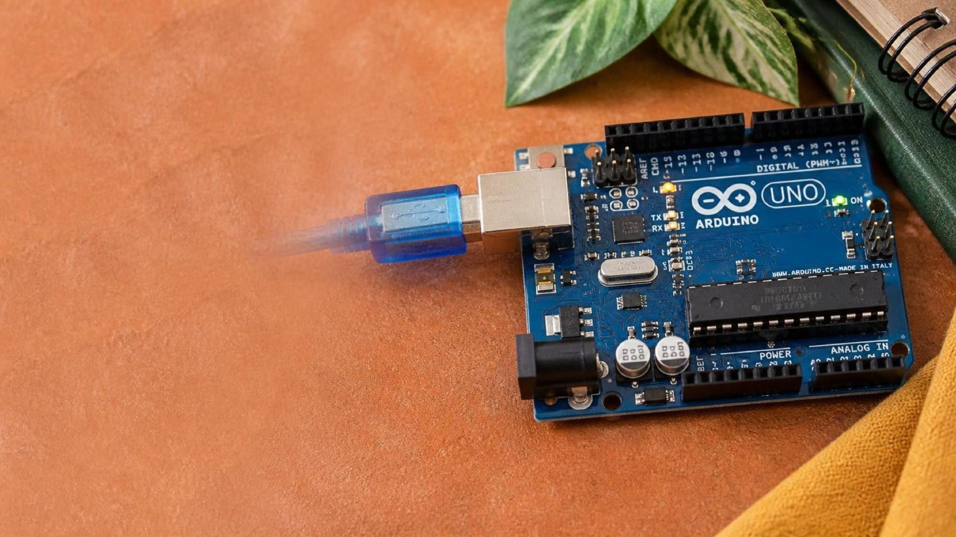
ELECTRONICS
Loops and functions
By the end you will put a repeated job in a function, and call it.
Notes:
They already have setup and loop. Today they write a function of their own.

Slide 2



You need the same blink in three places. Do you copy it three times?
The same pattern, again and again.
A machine repeats a cycle.
The same note, different lengths.
Copying the same lines makes a later change harder.
Write it once, then call it by name.
Notes:
Get them to say 'once' before you show the function.

Slide 3
A function is a named block of code
void blinkLED()
A parameter
void means this function does not send a number back. The name says what it does.
A value you pass in, such as how many milliseconds to wait. The same function can then blink fast or slowly.
The names in the brackets only exist inside the function.
Notes:
Call it with blinkLED(200); from inside loop().

Slide 4
A loop repeats a block
for
while
Use for when you know how many times. It counts for you.
Use while when you do not know how many times. It keeps going while a test is true.
Notes:
loop() is itself a loop. for and while are loops you write inside it.

Slide 5
One function, two speeds
void blinkLED(int waitMs) {
digitalWrite(13, HIGH);
delay(waitMs);
digitalWrite(13, LOW);
delay(waitMs);
}
void setup() {
pinMode(13, OUTPUT);
}
void loop() {
blinkLED(200);
blinkLED(800);
}
int waitMs
The caller passes the wait. Inside the function that number is called waitMs.
blinkLED(200)
This call runs the function with a short wait. Then the next line calls it again.
void
The function does a job. It does not hand a number back to loop().
Notes:
Trace one call on the board: 200 goes in, the LED blinks, control returns to loop().

Slide 6
Blink three times, then pause
1
Add a for loop around blinkLED(200).
CHECK
How many times does blinkLED run before the pause?
2
Make the loop run 3 times.
3
After the loop, delay(1000).
Three times.
4
Run it. You should see three blinks, then a pause.
Notes:
for (int i = 0; i < 3; i++) is enough. Do not require a perfect first draft.

Slide 7
CHECK
ANSWER
What is a parameter?
A value passed in.
Look at blinkLED(200).
It is the value you give the function when you call it. Here, 200 is the wait.
Notes:
A parameter is not the same as a variable you create for the whole program.

