Slide 1
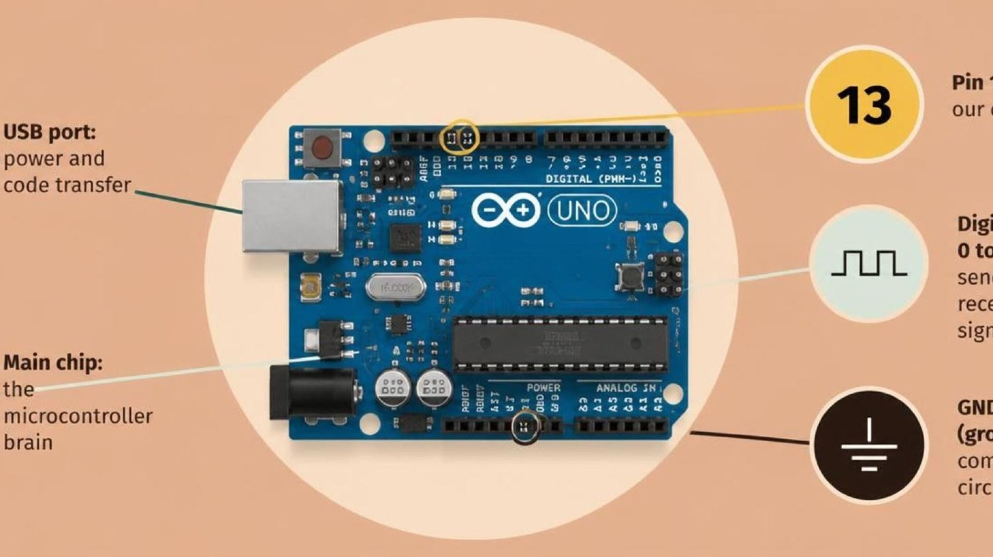
ELECTRONICS
Voltage, current, resistance
By the end you will use V = I × R, and compare series with parallel.
Notes:
No new code today. This is the circuit idea the sensors sit on.

Slide 2


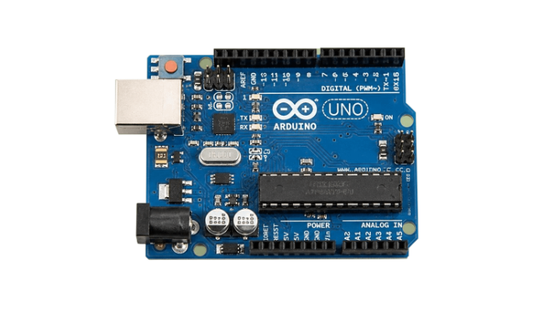
A resistor is in the way of the current. What changes?
More resistance, a dimmer lamp.
The lamp needs a current.
The board supplies 5 V.
Three words come up every time a circuit is built.
Voltage pushes. Current flows. Resistance slows it.
Notes:
Get the three words on the board before the formula.

Slide 3
V = I × R
The three quantities
The rule
Voltage, V, is in volts. Current, I, is in amps. Resistance, R, is in ohms.
Voltage = current × resistance. If you know two, you can find the third.
V = I × R
I = V / R
R = V / I
Find the voltage.
Find the current.
Find the resistance.
Notes:
A 220 Ω resistor on a 5 V LED keeps the current small enough.

Slide 4
Series shares the path. Parallel splits it.
Series
Parallel
One path. The same current goes through each resistor. The resistances add.
More than one path. The voltage across each is the same. Total resistance is less than the smallest.
The voltage at the join depends on the two resistances.
Notes:
A voltage divider is two resistors in series. They share the 5 V.

Slide 5
Read a resistor, then do one sum
Try this
1
A four-band resistor: two digits, a multiplier, then the tolerance.
2
Brown, black, red, gold is 1, 0, ×100, and ±5%. That is 1000 Ω.
3
Put 5 V across 1000 Ω. Current = 5 / 1000.
4
That is 0.005 A, which is 5 mA.
Use the live Tinkercad menus.
Notes:
Do the sum on the board. 5 mA is a safe LED-sized current.

Slide 6
Share 5 V
1
Two equal resistors in series, across 5 V and 0 V.
CHECK
What is the voltage at the join?
2
The join in the middle is the output.
3
Each resistor drops the same voltage.
2.5 V.
4
Work out the voltage at the join.
Notes:
Equal resistors share the voltage in half. Unequal ones do not.

Slide 7
CHECK
ANSWER
Two resistors in series. What happens to the total resistance?
They add.
The same current goes through both.
Series resistances add, because there is only one path.
Notes:
Parallel is the other way: the total is smaller than either one.

