Slide 1
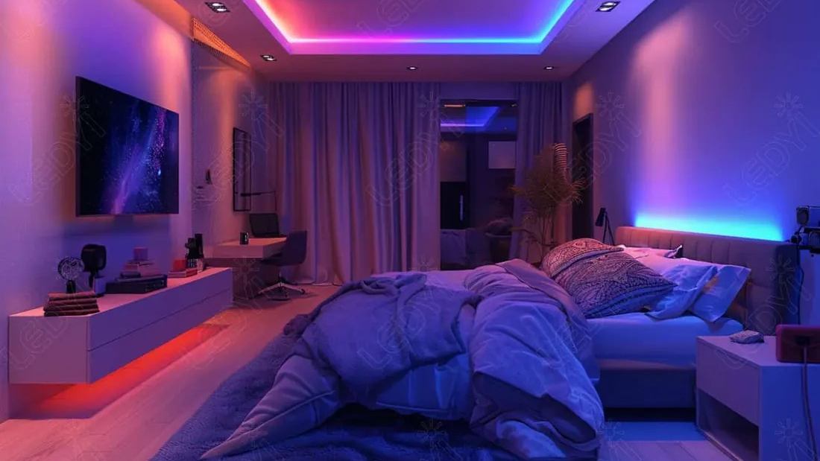
ELECTRONICS
Mix three colours
By the end you will mix red, green and blue to make another colour.
Notes:
They already know analogWrite. Today three LEDs share one package.

Slide 2
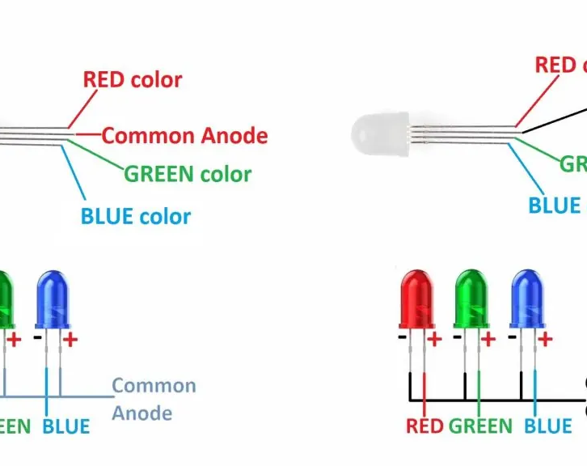


Red light and green light shine on the same spot. What colour do you see?
Three LEDs in one package.
The colours add.
Stage lights mix the same way.
This is mixing light, not mixing paint.
Red and green light make yellow.
Notes:
All three at full brightness make white. Ask that as the follow-up.

Slide 3
Three LEDs, one shared pin to 0 V
Common cathode
A resistor each
The long shared leg goes to GND. Red, green and blue each have their own leg.
Each colour goes through its own resistor to a PWM pin, so you can set each brightness.
Red + green = yellow. All three = white. All off = dark.
Notes:
analogWrite from 0 to 255 sets how much of the time that colour is on.

Slide 4
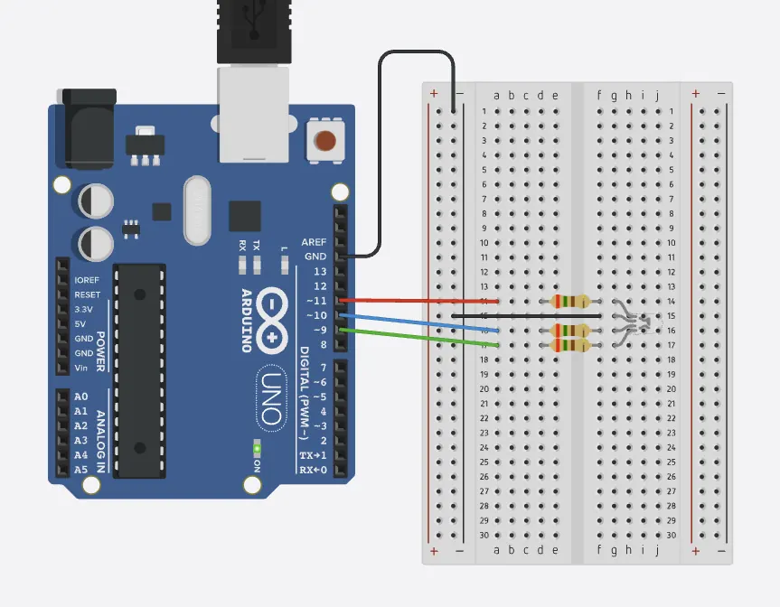
Wire the RGB LED
The build
1
Shared leg (cathode) to GND.
2
Red through 220 Ω to pin 9.
3
Green through 220 Ω to pin 10.
4
Blue through 220 Ω to pin 11. All three pins need a ~.
Use the live Tinkercad menus.
Notes:
If one colour never lights, that leg is in the wrong row or on a pin without ~.

Slide 5
Set a colour
void setup() {
pinMode(9, OUTPUT);
pinMode(10, OUTPUT);
pinMode(11, OUTPUT);
}
void loop() {
analogWrite(9, 255);
analogWrite(10, 80);
analogWrite(11, 0);
delay(1000);
}
255, 80, 0
Red is fully on, green is partly on, blue is off. That mix looks orange.
Three writes
Each analogWrite sets one colour. Change the three numbers to change the mix.
delay(1000)
Holds the colour for one second, so you can see it.
Notes:
Have them predict the colour before they run it.

Slide 6
Make yellow, then white
1
Set red and green to 255, and blue to 0.
CHECK
What colour is all three fully on?
2
Run it. You should see yellow.
3
Then set all three to 255.
White.
4
Run it again.
Notes:
If it looks tinted, one resistor or one pin is not matching the others.

Slide 7
CHECK
ANSWER
Why does each colour need a PWM pin?
To set brightness.
You want orange, not only red or only green.
analogWrite needs a pin marked ~. That is how you set each colour somewhere between off and full on.
Notes:
A normal digital pin can only be fully on or fully off.

