Slide 1
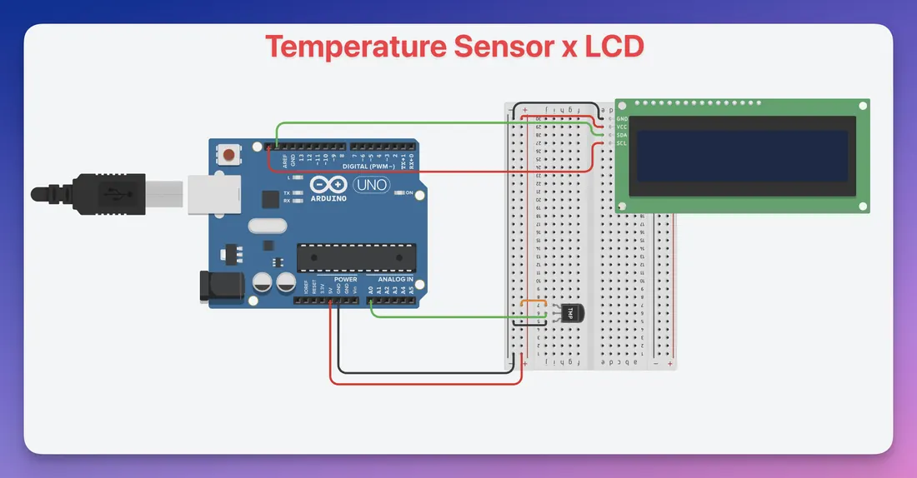
ELECTRONICS
Write on a screen
By the end you will print a word on a 16 by 2 screen.
Notes:
16 characters on each of 2 rows. I2C means four wires, not a ribbon.

Slide 2


The Serial Monitor is on the computer. How can the project show a message on its own?
A small screen on the device.
Two rows of letters.
It only needs the letters you send.
A 16×2 screen shows two lines, with 16 characters on each.
Four wires: power, ground, and two for the data.
Notes:
Name I2C after they have the idea of two data wires.

Slide 3
Two wires carry the message
I2C
The library
One wire for data (SDA), one wire for the clock (SCL), plus 5 V and GND.
LiquidCrystal_I2C knows the commands. You include it, then name the screen's address, columns and rows.
setCursor(column, row) picks the place. print sends the letters. clear wipes the screen.
Notes:
A common address is 0x27. If the screen stays blank, the address is the first thing to check.

Slide 4
Connect the screen
The build
1
GND to GND, VCC to 5 V.
2
SDA to the board's SDA pin.
3
SCL to the board's SCL pin.
4
Install LiquidCrystal_I2C, then upload.
Use the live Tinkercad menus.
Notes:
Four wires only. If they are wiring more than that, they have skipped the I2C board on the back.

Slide 5
Print two lines
#include <LiquidCrystal_I2C.h>
LiquidCrystal_I2C lcd(0x27, 16, 2);
void setup() {
lcd.init();
lcd.backlight();
lcd.setCursor(0, 0);
lcd.print("Hello");
lcd.setCursor(0, 1);
lcd.print("Year 8");
}
void loop() {
}
0x27, 16, 2
Address, then 16 columns, then 2 rows.
setCursor(0, 0)
Column 0, row 0. That is the first character of the top line. Counting starts at 0.
print
Writes the letters from the cursor. clear() wipes both lines before a new reading.
Notes:
Counting from 0 catches people out. Column 0 is the first space, not the second.

Slide 6
Show a changing number
1
Read a sensor into a variable.
CHECK
Why call clear() each time?
2
lcd.clear() at the start of loop().
3
Print a label, then the number, on row 0.
So the old number does not stay on screen.
4
Wait half a second, then loop again.
Notes:
Without clear, a shorter new number leaves the tail of the old one behind.

Slide 7
CHECK
ANSWER
What does setCursor(0, 1) do?
Start of row 2.
The screen has two rows.
Column 0, row 1. That is the first character on the second line.
Notes:
Row 0 is the top line. Row 1 is the bottom line.

