Slide 1
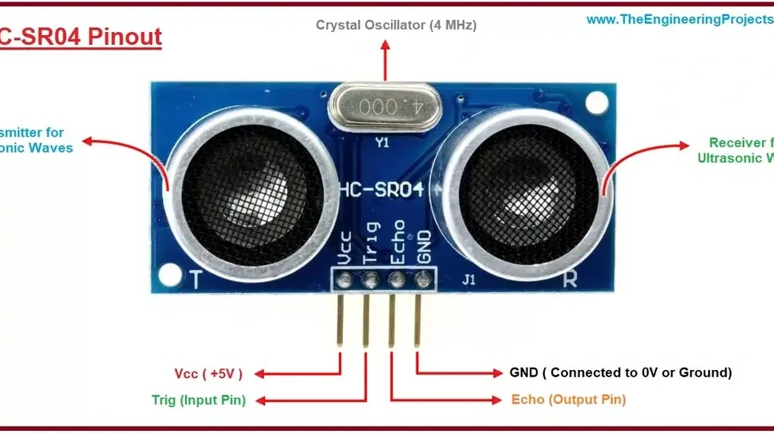
ELECTRONICS
Measure a distance
By the end you will turn an echo time into centimetres.
Notes:
The sensor sends a click of sound and times the echo.

Slide 2
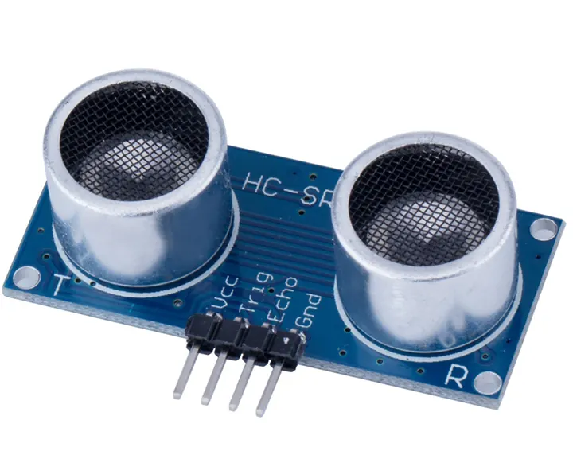


You cannot reach the wall with a ruler. How can the board still measure it?
One side sends, one side listens.
Ships time an echo too.
A bat does this with sound.
Sound travels at a known speed.
Time the echo, then halve it.
Notes:
The halving is the part they forget. The sound goes there and back.

Slide 3
There and back
Trigger
Echo
A short HIGH pulse on the trigger pin sends a burst of sound you cannot hear.
The echo pin stays HIGH until the sound comes back. That time is the whole trip.
0.034 cm per microsecond is the speed of sound. Divide by 2 because of the return journey.
Notes:
Distance in cm is time in microseconds × 0.034 ÷ 2.

Slide 4
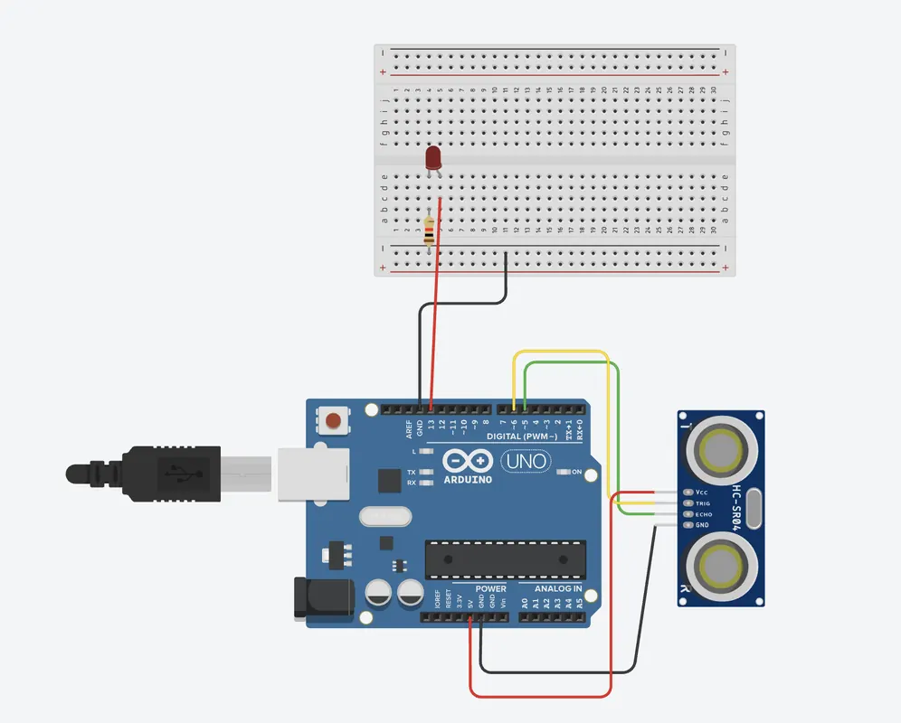
Wire the HC-SR04
The build
1
VCC to 5 V, GND to GND.
2
Trig to pin 9, set as an output.
3
Echo to pin 10, set as an input.
4
Point it at a book, not at the ceiling.
Use the live Tinkercad menus.
Notes:
Trig and Echo swapped is the usual fault. The reading stays at 0.

Slide 5
Centimetres from the echo
int trig = 9;
int echo = 10;
void setup() {
pinMode(trig, OUTPUT);
pinMode(echo, INPUT);
Serial.begin(9600);
}
void loop() {
digitalWrite(trig, LOW);
delayMicroseconds(2);
digitalWrite(trig, HIGH);
delayMicroseconds(10);
digitalWrite(trig, LOW);
long time = pulseIn(echo, HIGH);
int cm = time * 0.034 / 2;
Serial.println(cm);
delay(200);
}
10 microseconds
That short HIGH on trig is the 'go' signal. Then trig goes LOW again.
pulseIn
Measures how long echo stays HIGH, in microseconds.
÷ 2
The sound went to the object and back. Half of that time is one way.
Notes:
long is used for the time because the number can be bigger than an int likes.

Slide 6
Check it with a ruler
1
Put a book 20 cm in front of the sensor.
CHECK
Did the number about double?
2
Read the Serial Monitor.
3
Move the book to 40 cm.
It should be close.
4
Read it again.
Notes:
A few centimetres of error is normal. A number that never changes means trig and echo are mixed up.

Slide 7
CHECK
ANSWER
Why do we divide the time by 2?
The sound returns.
The echo has just come back.
The measured time is the trip to the object and back. Half of it is the distance once.
Notes:
Forgetting the ÷ 2 makes every distance twice as big.

