Slide 1

ELECTRONICS
Make a sound
By the end you will tell the two buzzers apart, and play a note.
Notes:
Active: the tone is inside. Passive: you have to send the frequency.

Slide 2
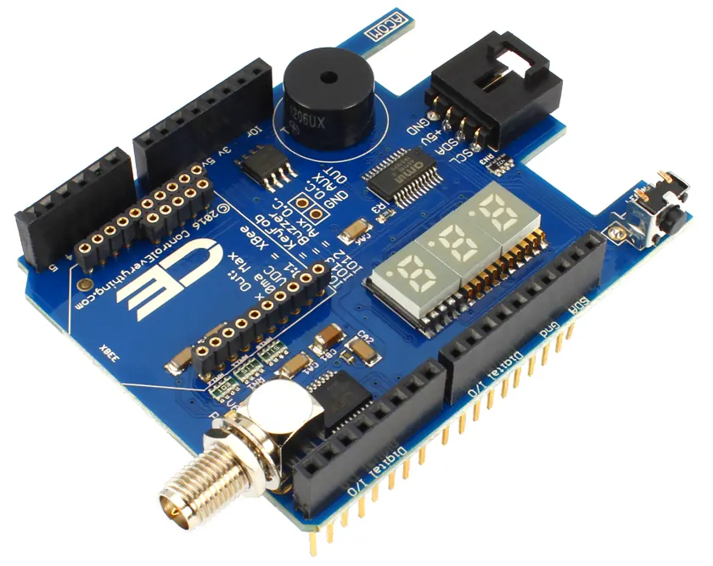


One buzzer beeps as soon as you give it 5 V. The other only clicks. Why?
A small speaker made of a disc.
An alarm wants a beep.
A tune needs different notes.
They are not the same part.
One makes its own tone. The other needs you to send it.
Notes:
Hold up both types if you have them. The + mark is on the active one more often.

Slide 3
Active makes the tone. Passive does not.
Active
Passive
It has its own oscillator. digitalWrite HIGH turns on a fixed beep. LOW stops it.
It needs a changing signal. tone(pin, frequency) plays a note. noTone(pin) stops it.
Notes:
A passive buzzer on plain 5 V only clicks. That is how you tell.

Slide 4
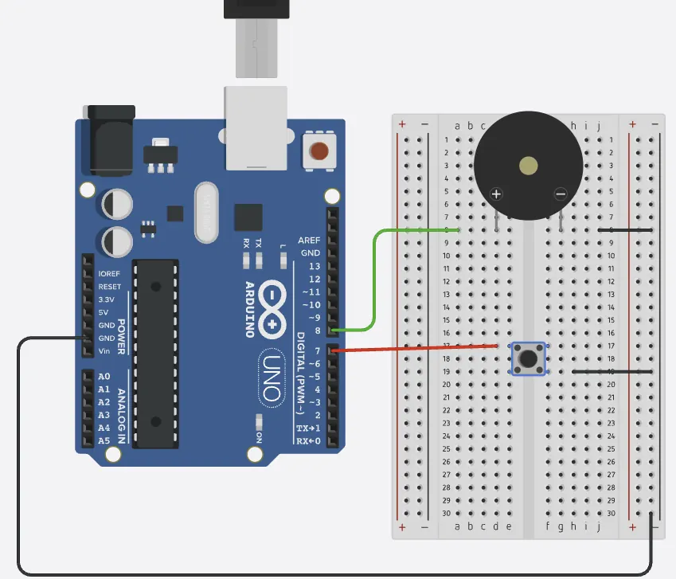
Wire a passive buzzer
The build
1
Positive leg to pin 8.
2
Other leg to GND.
3
A button from pin 2 to GND, with INPUT_PULLUP.
4
You will use the button to change the note.
Use the live Tinkercad menus.
Notes:
If they only ever hear one pitch, they have an active buzzer. tone() will not give them a scale.

Slide 5
Play a note
void setup() {
pinMode(8, OUTPUT);
}
void loop() {
tone(8, 440);
delay(400);
noTone(8);
delay(200);
tone(8, 523);
delay(400);
noTone(8);
delay(200);
}
tone(8, 440)
Pin 8, 440 times a second. 440 Hz is the note A.
noTone(8)
Stops the pin. Without a gap, the notes run into each other.
523
A higher frequency is a higher note. 523 Hz is the C above that A.
Notes:
An active buzzer ignores the frequency and keeps its own beep. Say that when it happens.

Slide 6
Add a third note
1
Pick a third frequency, such as 659.
CHECK
What does a bigger number in tone() do?
2
Add another tone, delay, noTone, delay.
3
Run it.
It plays a higher note.
4
You should hear three notes, then it repeats.
Notes:
Frequency is how many vibrations a second. More vibrations, higher pitch.

Slide 7
CHECK
ANSWER
You connect a buzzer to 5 V and it beeps steadily. Which type is it?
Active.
You have not used tone().
An active buzzer has its own oscillator, so 5 V is enough. A passive one would only click.
Notes:
The passive one is the one you write frequencies for.

