Slide 1
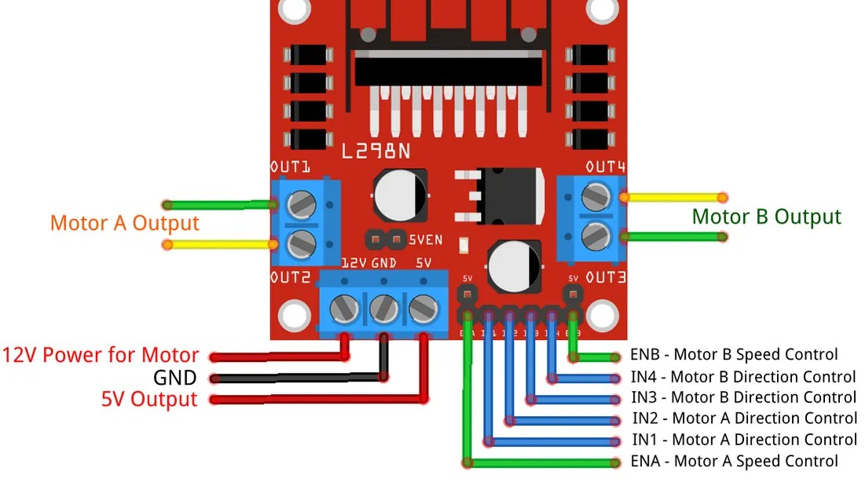
ELECTRONICS
Turn a motor
By the end you will set a motor's speed and direction.
Notes:
The pin cannot supply the current. The H-bridge does.

Slide 2

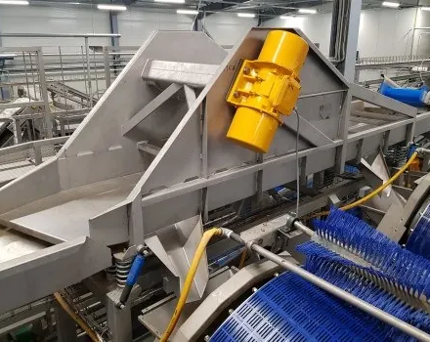

Why can't a pin power a motor the way it powers an LED?
A motor needs a real current.
The board's pin is small.
The car has its own supply.
An LED is about 20 mA. A motor wants much more.
The pin sends the signal. A driver carries the current.
Notes:
Connecting a motor straight to a pin can damage the pin.

Slide 3
An H-bridge can reverse the current
One pair of switches
The other pair
Current flows through the motor one way, so it spins forwards.
Current flows the other way, so the motor reverses.
The motor's power comes from a battery pack, not from the Arduino pin. The grounds must be joined.
Notes:
The L298N module is that circuit, ready wired.

Slide 4
Speed and direction are separate
Direction
Speed
IN1 HIGH and IN2 LOW is one way. Swap them for the other way. Both LOW is off.
analogWrite on the enable pin. A higher number means the motor is powered for more of the time.
Notes:
Half the time on is not exactly half the speed. The motor also has to overcome friction.

Slide 5

Wire the driver
The build
1
Motor wires to the driver's output screws.
2
Battery pack to the driver's power input. Grounds joined.
3
IN1 to pin 7, IN2 to pin 8.
4
ENA to pin 9, a PWM pin.
Use the live Tinkercad menus.
Notes:
If the motor is silent, the battery is not connected, or ENA is LOW.

Slide 6
On, then reverse
void setup() {
pinMode(7, OUTPUT);
pinMode(8, OUTPUT);
pinMode(9, OUTPUT);
}
void loop() {
digitalWrite(7, HIGH);
digitalWrite(8, LOW);
analogWrite(9, 180);
delay(2000);
digitalWrite(7, LOW);
digitalWrite(8, HIGH);
delay(2000);
}
IN1 and IN2
These two pins choose the direction. They must not be the same if you want it to spin.
analogWrite(9, 180)
Enable pin. 180 out of 255 is on for most of the time, so the motor spins quickly.
The swap
After 2 seconds the two direction pins swap, so the motor reverses.
Notes:
Keep hands clear of the shaft before they upload.

Slide 7
Find a slow speed
1
Set the enable pin to 80.
CHECK
Why might 80 not turn it?
2
Watch whether the motor actually turns.
3
Raise the number until it turns steadily.
Friction. Not enough power yet.
4
Write that number down.
Notes:
That gap at the bottom is normal. The motor needs a minimum before it moves.

Slide 8
CHECK
ANSWER
What job does the pin do?
It sends the signal.
The motor is spinning.
The pin tells the driver what to do. The driver, fed by the battery, carries the motor's current.
Notes:
A pin is about 20 to 40 mA. A motor needs more than that.

